Slide 1
Operating Systems Lecture No. 6

Slide 2
Summary
Process creation and termination
Process management in UNIX/Linux— system calls: fork, exec, wait, exit
Sample codes

Slide 3
Operations on Processes
The processes in the system execute concurrently and
they must be created and deleted dynamically
thus the operating system must provide the mechanism for the creation and deletion of processes.

Slide 4
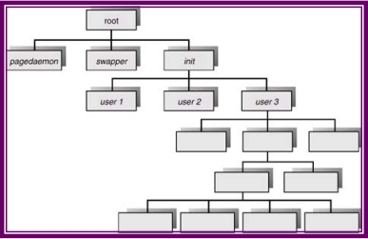
Process Creation
A process may create several new processes via a create-process system call during the course of its execution.
The creating process is called a parent process while the new processes are called the children of that process.
Each of these new processes may in turn create other processes, forming a tree of processes.
Figure 6.1 shows partially the process tree in a UNIX/Linux system
In general, a process will need certain resources (such as CPU time, memory files, I/O devices) to accomplish its task.

Slide 5
Process Creation (Continue..)
When a process creates a new process, two possibilities exist in terms of execution:
The parent continues to execute concurrently with its children
The parent waits until some or all of its children have terminated.
There are also two possibilities in terms of the address space of the new process:
The child process is a duplicate of the parent process
The child process has a program loaded into it.

Slide 6
Process in UNIX (continue.. From previous slide)
In order to consider these different implementations let us consider the UNIX operating system.
In UNIX its process identifier identifies a process, which is a unique integer.
A new process is created by the fork system call.
The new process consists of a copy of the address space of the parent
This mechanism allows the parent process to communicate easily with the child process
Both processes continue execution at the instruction after the fork call, with one difference, the return code for the fork system call is zero for the child process, while the process identifier of the child is returned to the parent process

Slide 7
Process termination (continue..from previous slide)
A process terminates when it finishes executing its final statement and asks the operating system to delete it by calling the exit system call
At that point, the process may return data to its parent process (via the wait system call)
All the resources of the process including physical and virtual memory, open the files and I/O buffers – are de allocated by the operating system
Termination occurs under additional circumstances. A process can cause the termination of another via an appropriate system call (such as abort).
Usually only the parent of the process that is to be terminated can invoke this system call.
Therefore parents need to know the identities of its children, and thus when one process creates another process, the identity of the newly created process is passed to the parent

Slide 8
UNIX Example for Process Termination
we can terminate a process by using the exit system call
its parent process may wait for the termination of a child process by using the wait system call
The wait system call returns the process identifier of a terminated child, so that the parent can tell which of its possibly many children has terminated.
If the parent terminates however all its children have assigned as their new parent, the init process.
Thus the children still have a parent to collect their status and execution statistics.

Slide 9
The fork() system call
When the fork system call is executed, a new process is created
The original process is called the parent process whereas the process is called the child process
The new process consists of a copy of the address space of the parent
This mechanism allows the parent process to communicate easily with the child process
On success, both processes continue execution at the instruction after the fork call, with one difference, the return code for the fork system call is zero for the child process, while the process identifier of the child is returned to the parent process.
On failure, a -1 will be returned in the parent's context, no child process will be created, and an error number will be set appropriately.

Slide 10
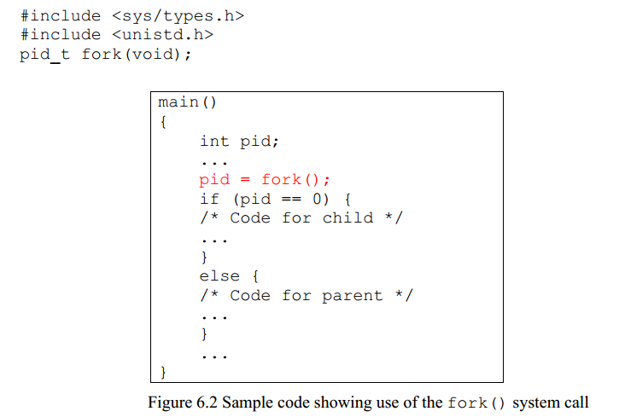

Slide 11
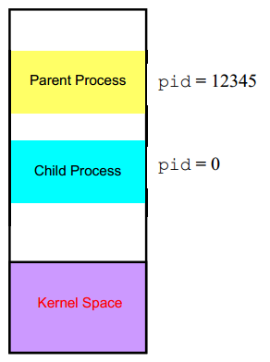
Fork() continue..
Figure 6.2 shows sample code, showing the use of the fork() system call and Figure 6.3 shows the semantics of the fork system call. As shown in Figure 6.3, fork() creates an exact memory image of the parent process and returns 0 to the child process and the process ID of the child process to the parent process.
After the fork() system call the parent and the child share the following:
 Environment
 Open file descriptor table
 Signal handling settings 
Nice value
Current working directory 
Root directory 
File mode creation mask (umask)

Slide 12
The following things are different in the parent and the child: 
Different process ID (PID)
 Different parent process ID (PPID)
 Child has its own copy of parent’s file descriptors
The fork() system may fail due to a number of reasons. One reason maybe that the maximum number of processes allowed to execute under one user has exceeded, another could be that the maximum number of processes allowed on the system has exceeded. Yet another reason could be that there is not enough swap space.

