Slide 1
Operating Systems Lecture - 8

Slide 2
Summary
Shortest-Job-First Scheduling
Priority Scheduling

Slide 3
Shortest-Job-First Scheduling
This algorithm associates with each process the length of the latter’s next CPU burst.
When the CPU is available, it is assigned to the process that has the smallest next CPU burst.
If two processes have the same length next CPU burst, FCFS scheduling is used to break the tie.
The real difficulty with the SJF algorithm is in knowing the length of the next CPU request.
The SJF algorithm may either be preemptive or non-preemptive.
The choice arises when a new process arrives at the ready queue while a previous process is executing.
The new process may have a shorter next CPU burst than what is left of the currently executing process.
A preemptive SJF algorithm preempts the currently executing process, whereas a non-preemptive SJF algorithm will allow the currently running process to finish its CPU burst.

Slide 4
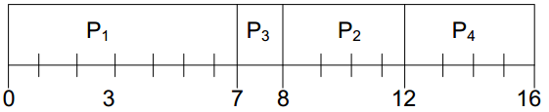
Shortest-Job-First Scheduling (continue…)
Preemptive SJF scheduling is sometimes called shortest remaining-time-first scheduling
We illustrate the working of the SJF algorithm by using the following system state
PROCESS | ARRIVAL TIME | BURST TIME
P1 | 0.0 | 7
P2 | 2.0 | 4
P3 | 4.0 | 1
P4 | 5.0 | 4
The Gantt chart for the execution of the four processes using SJF is shown in Figure 8.1

Slide 5
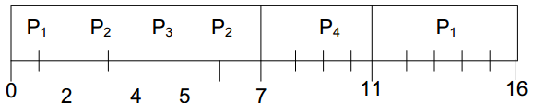
Shortest-Job-First Scheduling (continue…)
Here is the average waiting time per process
Average waiting time = (0 + 6 + 3 + 7)/4 = 4 time units
We illustrate the working of the SRTF algorithm by using the system state shown above. The Gantt chart for the execution of the four processes using SRTF is shown in Figure 8.2
Here is the average waiting time per process
Average waiting time = (9 + 1 + 0 +2)/4 = 3 time units

Slide 6
Priority Scheduling
SJF is a special case of the general priority-scheduling algorithm. A priority is associated with each process, and the CPU is allocated to the process with the highest priority (smallest integer ≡ highest priority).
Equal priority processes are scheduled in FCFS order. The SJF algorithm is simply a priority algorithm where the priority (p) is the inverse of the (predicted) next CPU burst.
The larger the CPU burst of a process, the lower its priority, and vice versa.
Priority scheduling can either be preemptive or non-preemptive.
When a process arrives at the ready queue, its priority is compared with the priority of the currently running process. A preemptive priority-scheduling algorithm will preempt the CPU if the priority of the newly arrived process is higher than the priority of the currently running process.
A non-preemptive priority- scheduling algorithm will simply put the new process at the head of ready queue

Slide 7
Priority Scheduling (Continue..)
A major problem with priority- scheduling algorithms is indefinite blocking (or starvation).
A process that is ready to run but lacking the CPU can be considered blocked-waiting for the CPU.
A priority-scheduling algorithm can leave some low priority processes waiting indefinitely for the CPU.
Legend has it that when they were phasing out IBM 7094 at MIT in 1973, they found a process stuck in the ready queue since 1967!
Aging is solution to the problem of indefinite blockage of low-priority processes.
It involves gradually increasing the priority of processes that wait in the system for a long time.
For example, if priority numbers range from 0 (high priority) to 127 (high priority), we could decrement priority of every process periodically (say every 10 minutes).
This would result in every process in the system eventually getting the highest priority in a reasonably short amount of time and scheduled to use the CPU.

Slide 8
Priority Scheduling (Continue..) non-preemptive approach
First input the processes with their arrival time, burst time and priority.
First process will schedule, which have the lowest arrival time, if two or more processes will have lowest arrival time, then whoever has higher priority will schedule first.
Now further processes will be schedule according to the arrival time and priority of the process. (Here we are assuming that lower the priority number having higher priority). If two process priority are same then sort according to process number. Note: In the question, They will clearly mention, which number will have higher priority and which number will have lower priority.
Once all the processes have been arrived, we can schedule them based on their priority.

Slide 9
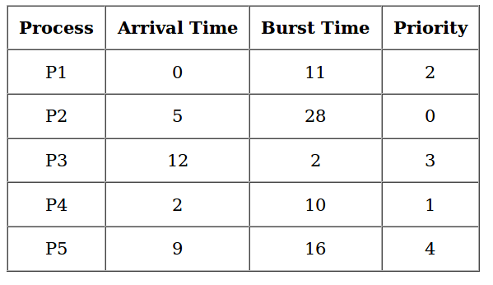
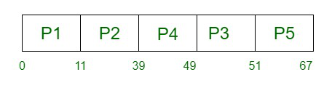
Priority Scheduling (Continue..) non-preemptive approach
Gantt Chart

Slide 10
Priority Scheduling (Continue..) Preemptive approach
Process | Arrival time | Burst time | Priority
P1 | 0 | 4 | 1
P2 | 0 | 3 | 2
P3 | 6 | 7 | 1
P4 | 11 | 4 | 3
P5 | 12 | 2 | 2
Step 0) At time=0, Process P1 and P2 arrive. P1 has higher priority than P2. The execution begins with process P1, which has burst time 4.
Step 1) At time=1, no new process arrive. Execution continues with P1.
Step 2) At time 2, no new process arrives, so you can continue with P1. P2 is in the waiting queue.
Step 3) At time 3, no new process arrives so you can continue with P1. P2 process still in the waiting queue.
Step 4) At time 4, P1 has finished its execution. P2 starts execution.
Step 5) At time= 5, no new process arrives, so we continue with P2.
Step 6) At time=6, P3 arrives. P3 is at higher priority (1) compared to P2 having priority (2). P2 is preempted, and P3 begins its execution.
Step 7) At time 7, no-new process arrives, so we continue with P3. P2 is in the waiting queue.
Step 8) At time= 8, no new process arrives, so we can continue with P3.
Step 9) At time= 9, no new process comes so we can continue with P3.
Step 10) At time interval 10, no new process comes, so we continue with P3
Step 11) At time=11, P4 arrives with priority 4. P3 has higher priority, so it continues its execution.
Step 12) At time=12, P5 arrives. P3 has higher priority, so it continues execution.
Step 13) At time=13, P3 completes execution. We have P2,P4,P5 in ready queue. P2 and P5 have equal priority. Arrival time of P2 is before P5. So P2 starts execution.

Slide 11
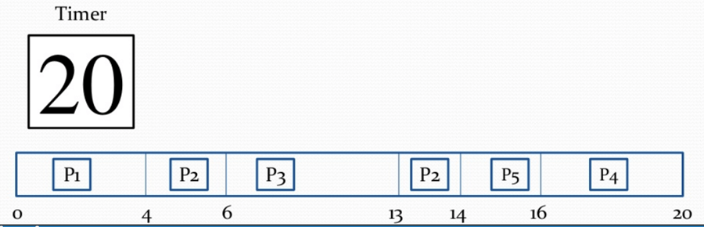
Priority Scheduling (Continue..) Preemptive approach
Process | Arrival time | Burst time | Priority
P1 | 0 | 4 | 1
P2 | 0 | 3 | 2
P3 | 6 | 7 | 1
P4 | 11 | 4 | 3
P5 | 12 | 2 | 2
Step 14) At time =14, the P2 process has finished its execution. P4 and P5 are in the waiting state. P5 has the highest priority and starts execution.
Step 15) At time =15, P5 continues execution.
Step 16) At time= 16, P5 is finished with its execution. P4 is the only process left. It starts execution.
Step 17) At time =20, P5 has completed execution and no process is left.
Step 18) Let’s calculate the average waiting time for the above example.
Waiting Time = start time – arrival time + wait time for next burst
P1 = 0 - 0 = 0
P2 =4 - 0 + 7 =11
P3= 6-6=0
P4= 16-11=5
Average Waiting time = (0+11+0+5+2)/5 = 18/5= 3.6

Slide 12
P2 | P3 | P1
0
3
6
30

