Slide 1
Operating Systems Lecture - 9

Slide 2
Summary
Scheduling algorithms

Slide 3
Why is SJF optimal?
SJF is an optimal algorithm because it decreases the wait times for short processes much more than it increases the wait times for long processes.
Let’s consider the example
shown in Figure 9.1, in which the next CPU bursts of P1, P2, and P3 are 5, 3, and 2, respectively.
The first Gantt chart shows execution of processes according to the longest job-first algorithm, resulting in the waiting times for P1, P2, and P3 to be 0, 5, and 8 times units.
P1 | P2 | P3
0
5
8
10
Figure 9.1 : Gantt Chart: longest job-first

Slide 4
Why is SJF optimal? (continue..)
The second Gantt chart shows execution of processes according to the shortest-job-first algorithm, resulting in the waiting times for P1, P2, and P3 to be 0, 2, and 5.
Note that the waiting time for P2 has decreased from 5 to 2 and that of P3 has decreased from 8 to 0. The increase in the wait time for P1 is from 0 to 5, which is much smaller than the decrease in the wait times for P2 and P3.
P3 | P2 | P1
0
2
5
10
Figure 9.1 : Gantt Chart: shortest-job-first

Slide 5
Round-Robin Scheduling
The round-robin (RR) scheduling algorithm is designed especially for time-sharing systems.
It is similar to FCFS scheduling but preemption is added to switch between processes. A small unit of time, called a time quantum (or time slice) is defined.
The ready queue is treated as a circular queue.
The CPU scheduler goes around the ready queue, allocating the CPU to each process for a time interval of up to 1 time quantum.
To implement RR scheduling, we keep ready queue as a FIFO queue of processes.
New processes are added to the tail of the ready queue. The CPU scheduler picks the first process from the ready queue, sets a timer to interrupt after 1 time quantum, and then dispatches the process.
One of the two things will then happen. The process may have a CPU burst of less than 1 time quantum, in which case the process itself will release the CPU voluntarily.
The scheduler will then proceed to the next process in the ready queue.

Slide 6
Round-Robin Scheduling (Continue..)
Otherwise, if the CPU burst of currently running process is longer than one time quantum, the timer will go off and will cause an interrupt to the operating system.
A context switch will happen, the current process will be put at the tail of the ready queue, and the newly scheduled process will be given the CPU.
The average waiting time under the RR policy however is often quite long.
It is a preemptive scheduling algorithm.
The performance of RR algorithm depends heavily on the size of the time quantum. If the time quantum is very large (infinite), the RR policy remains the same as the FCFS policy.
If the time quantum is very small, the RR approach is called the processor sharing and appears to the users as though each of n processes has its own processor running at 1/n the speed of real processor (q must be large with respect to context switch, otherwise the overhead is too high).

Slide 7
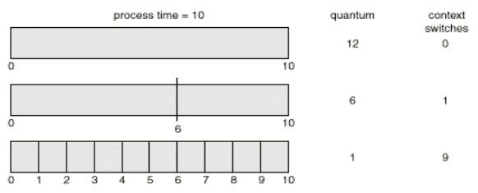
Round-Robin Scheduling (Continue..)
The drawback of small quantum is more frequent context switches.
Since context switching is the cost of the algorithm and no useful work is done for any user process during context switching, the number of context switches should be minimized and the quantum should be chosen such that the ratio of a quantum to context switching is not less than 10:1 (i.e., context switching overhead should not be more than 10% of the time spent on doing useful work for a user process).
Figure 9.2 shows an increase in the number of context switches with a decrease in quantum size.
Figure 9.2 Quantum size versus number of context switches

Slide 8
Round-Robin Scheduling (Continue..)
The turnaround time of a process under round robin is also depends on the size of the time quantum.
In Figure 9.3 we show a workload of four processes P1, P2, P3, and P4 with their next CPU bursts as 6, 3, 1, and 7 time units.
The graph in the figure shows that best (smallest) turnaround time is achieved when quantum size is 6 or greater.
Note that most of the given processes finish their next CPU bursts with quantum of 6 or greater.
We can make a general statement that the round-robin algorithm gives smallest average turnaround time when quantum value is chosen such that most of the processes finish their next CPU bursts within the quantum.

Slide 9
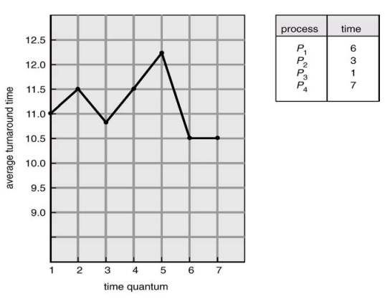
Round-Robin Scheduling (Continue..)
Figure 9.3 Turnaround time versus quantum size

Slide 10
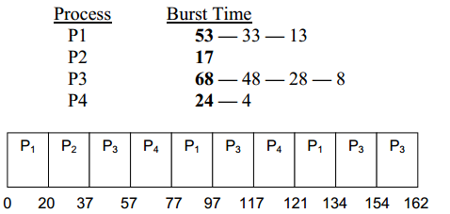
Round-Robin Scheduling (Continue..)
We now consider the following system workload to illustrate working of the roundrobin algorithm.
Execution of P1 though P4 with quantum 20 is shown in Figure 9.4.
In the table, original CPU bursts are shown in bold and remaining CPU bursts (after a process has used the CPU for one quantum) are shown in non-bold font.
Figure 9.4 Gantt chart showing execution of P1, P2, P3, and P4 with quantum 20 time units

Slide 11
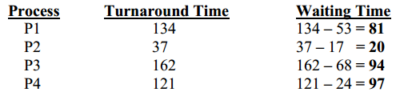
Round-Robin Scheduling (Continue..)
Figure 9.5 shows wait and turnaround times for the four processes.
The average wait time for a process comes out to be 73 time units for round robin and 38 for SJF.
Typically, RR has a higher average turnaround than SJF, but better response.
In timesharing systems, shorter response time for a process is more important than shorter turnaround time for the process.
Thus, round-robin scheduler matches the requirements of time-sharing systems better than the SJF algorithm. SJF scheduler is better suited for batch systems, in which minimizing the turnaround time is the main criterion.
Figure 9.5 Wait and turnaround times for processes

Slide 12
Round-Robin Scheduling (Continue..)
Average waiting time = 73
Average waiting time for SJF = 38
Typically, higher average turnaround than SJF, but better response.

Slide 13
Round-Robin Scheduling (Continue..)
Process | Burst Time | Arrival Time
P1 | 5 ms | 0 ms
P2 | 4 ms | 1 ms
P3 | 2 ms | 2 ms
P4 | 1 ms | 4 ms
Here, every process executes for 2 milliseconds (Time Quantum Period)
READY QUEUE
P2
P3
At time = 0,
Time Instance | Process | Arrival Time | Ready Queue | Running Queue | Execution Time | Initial Burst Time | Remaining Burst Time
0-2ms | P1 | 0ms | P2, P3 | P1 | 2ms | 5ms | 3ms

Slide 14
Round-Robin Scheduling (Continue..)
Process | Burst Time | Arrival Time
P1 | 5 ms | 0 ms
P2 | 4 ms | 1 ms
P3 | 2 ms | 2 ms
P4 | 1 ms | 4 ms
Here, every process executes for 2 milliseconds (Time Quantum Period)
READY QUEUE
P3
P1
At time = 2,
Time Instance | Process | Arrival Time | Ready Queue | Running Queue | Execution Time | Initial Burst Time | Remaining Burst Time
0-2ms | P1 | 0ms | P2, P3 | P1 | 0ms | 5ms | 3ms
2-4ms | P2 | 1ms | P3, P1 | P2 | 2ms | 4ms | 2ms

Slide 15
Round-Robin Scheduling (Continue..)
Here, every process executes for 2 milliseconds (Time Quantum Period)
READY QUEUE
P1
P4
P2
Process | Burst Time | Arrival Time
P1 | 5 ms | 0 ms
P2 | 4 ms | 1 ms
P3 | 2 ms | 2 ms
P4 | 1 ms | 4 ms
Time Instance | Process | Arrival Time | Ready Queue | Running Queue | Execution Time | Initial Burst Time | Remaining Burst Time
0-2ms | P1 | 0ms | P2, P3 | P1 | 0ms | 5ms | 3ms
2-4ms | P2 | 1ms | P3, P1 | P2 | 0ms | 4ms | 2ms
4-6ms | P3 | 2ms | P1,P4,P2 | P3 | 2ms | 2ms | 0ms
At time = 4,

Slide 16
Round-Robin Scheduling (Continue..)
Here, every process executes for 2 milliseconds (Time Quantum Period)
READY QUEUE
P4
P2
Process | Burst Time | Arrival Time
P1 | 5 ms | 0 ms
P2 | 4 ms | 1 ms
P3 | 2 ms | 2 ms
P4 | 1 ms | 4 ms
Time Instance | Process | Arrival Time | Ready Queue | Running Queue | Execution Time | Initial Burst Time | Remaining Burst Time
0-2ms | P1 | 0ms | P2, P3 | P1 | 0ms | 5ms | 3ms
2-4ms | P2 | 1ms | P3, P1 | P2 | 0ms | 4ms | 2ms
4-6ms | P3 | 2ms | P1,P4,P2 | P3 | 2ms | 2ms | 0ms
6-8ms | P1 | 0ms | P4,P2 | P1 | 2ms | 3ms | 1ms
At time = 6,

Slide 17
Round-Robin Scheduling (Continue..)
Process | Burst Time | Arrival Time
P1 | 5 ms | 0 ms
P2 | 4 ms | 1 ms
P3 | 2 ms | 2 ms
P4 | 1 ms | 4 ms
Here, every process executes for 2 milliseconds (Time Quantum Period)
READY QUEUE
P2
P1
Time Instance | Process | Arrival Time | Ready Queue | Running Queue | Execution Time | Initial Burst Time | Remaining Burst Time
0-2ms | P1 | 0ms | P2, P3 | P1 | 0ms | 5ms | 3ms
2-4ms | P2 | 1ms | P3, P1 | P2 | 0ms | 4ms | 2ms
4-6ms | P3 | 2ms | P1,P4,P2 | P3 | 2ms | 2ms | 0ms
6-8ms | P1 | 0ms | P4,P2 | P1 | 2ms | 3ms | 1ms
8-9ms | P4 | 4ms | P2,P1 | P4 | 1ms | 1ms | 0ms
At time = 8,

Slide 18
Round-Robin Scheduling (Continue..)
Process | Burst Time | Arrival Time
P1 | 5 ms | 0 ms
P2 | 4 ms | 1 ms
P3 | 2 ms | 2 ms
P4 | 1 ms | 4 ms
Here, every process executes for 2 milliseconds (Time Quantum Period)
READY QUEUE
P1
Time Instance | Process | Arrival Time | Ready Queue | Running Queue | Execution Time | Initial Burst Time | Remaining Burst Time
0-2ms | P1 | 0ms | P2, P3 | P1 | 0ms | 5ms | 3ms
2-4ms | P2 | 1ms | P3, P1 | P2 | 0ms | 4ms | 2ms
4-6ms | P3 | 2ms | P1,P4,P2 | P3 | 2ms | 2ms | 0ms
6-8ms | P1 | 0ms | P4,P2 | P1 | 2ms | 3ms | 1ms
8-9ms | P4 | 4ms | P2,P1 | P4 | 1ms | 1ms | 0ms
9-11ms | P2 | 4ms | P1 | P2 | 2ms | 2ms | 0ms
At time = 9,

Slide 19
Round-Robin Scheduling (Continue..)
Process | Burst Time | Arrival Time
P1 | 5 ms | 0 ms
P2 | 4 ms | 1 ms
P3 | 2 ms | 2 ms
P4 | 1 ms | 4 ms
Here, every process executes for 2 milliseconds (Time Quantum Period)
READY QUEUE
Time Instance | Process | Arrival Time | Ready Queue | Running Queue | Execution Time | Initial Burst Time | Remaining Burst Time
0-2ms | P1 | 0ms | P2, P3 | P1 | 0ms | 5ms | 3ms
2-4ms | P2 | 1ms | P3, P1 | P2 | 0ms | 4ms | 2ms
4-6ms | P3 | 2ms | P1,P4,P2 | P3 | 2ms | 2ms | 0ms
6-8ms | P1 | 0ms | P4,P2 | P1 | 2ms | 3ms | 1ms
8-9ms | P4 | 4ms | P2,P1 | P4 | 1ms | 1ms | 0ms
9-11ms | P2 | 4ms | P1 | P2 | 2ms | 2ms | 0ms
11-12ms | P1 | 0ms | - | P1 | 1ms | 1ms | 0ms
At time = 11,

Slide 20
Round-Robin Scheduling (Continue..)
Time Instance | Process | Arrival Time | Ready Queue | Running Queue | Execution Time | Initial Burst Time | Remaining Burst Time
0-2ms | P1 | 0ms | P2, P3 | P1 | 0ms | 5ms | 3ms
2-4ms | P2 | 1ms | P3, P1 | P2 | 0ms | 4ms | 2ms
4-6ms | P3 | 2ms | P1,P4,P2 | P3 | 2ms | 2ms | 0ms
6-8ms | P1 | 0ms | P4,P2 | P1 | 2ms | 3ms | 1ms
8-9ms | P4 | 4ms | P2,P1 | P4 | 1ms | 1ms | 0ms
9-11ms | P2 | 4ms | P1 | P2 | 2ms | 2ms | 0ms
11-12ms | P1 | 0ms | - | P1 | 1ms | 1ms | 0ms
P1
P2
P3
P1
P4
P2
P1
Gantt chart
0
2
4
6
8
9
11
12

Slide 21
Round-Robin Scheduling (Continue..)
How to compute below times in Round Robin using a program?
Completion Time: Time at which process completes its execution.
Turn Around Time: Time Difference between completion time and arrival time.
Turn Around Time = Completion Time – Arrival Time
Waiting Time(W.T): Time Difference between turn around time and burst time. Waiting Time = Turn Around Time – Burst Time
Now,
Average Turn around time =
(12 + 10 + 4 + 5)/4 = 31/4 = 7.7
Average waiting time =
(7 + 6 + 2 + 4)/4 = 19/4 = 4.7
Processes | AT | BT | CT | TAT | WT
P1 | 0 | 5 | 12 | 12-0 = 12 | 12-5 = 7
P2 | 1 | 4 | 11 | 11-1 = 10 | 10-4 = 6
P3 | 2 | 2 | 6 | 6-2 = 4 | 4-2 = 2
P4 | 4 | 1 | 9 | 9-4 = 5 | 5-1 = 4

Slide 22
Multilevel Queue Scheduling
Another class of scheduling algorithms has been created for situations in which processes are easily classified into different groups.
For example, a common division is made between foreground (or interactive) processes and background (or batch) processes.
These two types of processes have different response time requirements and so might have different scheduling needs.
In addition, foreground processes may have priority over background processes.
A multilevel queue-scheduling algorithm partitions the ready queue into several separate queues, as shown in Figure 9.6. Each queue has its own priority and scheduling algorithm.

Slide 23
Multilevel Queue Scheduling
Processes are permanently assigned to one queue, generally based of some property of the process, such as memory size, process priority or process type.
In addition, there must be scheduling among the queues, which is commonly implemented as fixed-priority preemptive scheduling i.e., serve all from foreground then from background.
Another possibility is to time slice between queues. Each queue gets a certain portion of the CPU time, which it can then schedule among the various processes in its queue, e.g., 80% to foreground in RR and 20% to background in FCFS.
Scheduling across queues prevents the starvation of processes in lower-priority queues.

Slide 24
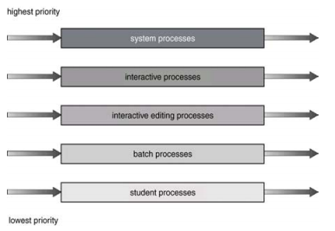
Multilevel Queue Scheduling (Continue..)
Figure 9.6 Wait and turnaround times for processes

Slide 25
P3 | P2 | P1
0
2
5
10

