Slide 1
Operating Systems Lecture No. 5

Slide 2
Summary
Process concept
Process scheduling concepts
Process creation and termination

Slide 3
Process Concept
A process can be thought of as a program in execution.
A process will need certain resources – such as CPU time, memory, files, and I/O devices – to accompany its task.
These resources are allocated to the process either when it is created or while it is executing
A process is the unit of work in most systems.
Such a system consists of a collection of processes: operating system processes execute system code and user processes execute user code.
All these processes may execute concurrently

Slide 4
Process Concept (Continue..)
Processes may be of two types
IO bound processes: spend more time doing IO than computations, have many short CPU bursts. Word processors and text editors are good examples of such processes
CPU bound processes: spend more time doing computations, few very long CPU bursts.

Slide 5
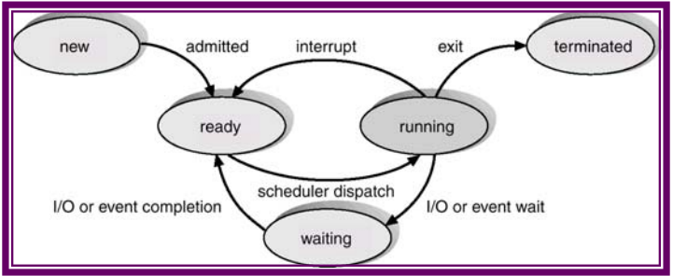
Process States
As a process executes, it changes states. The state of a process is defined in part by the current activity of that process.
Each process may be in either of the following states, as shown in Figure 5.2:
New: The process is being created.
Running: Instructions are being executed.
Waiting: The process is waiting for some event to occur (such as an I/O completion or reception of a signal.
Ready: The process is waiting to be assigned to a processor.
Terminated: The process has finished execution.

Slide 6
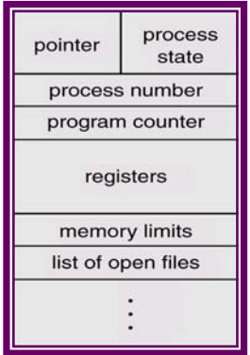
Process Control Block
Each process is represented in the operating system by a process control block (PCB) – also called a task control block, as shown in Figure 5.3.
A PCB contains many pieces of information associated with a specific process, including these:
Process state: The state may be new, ready, running, waiting, halted, and so on.
Program counter: The counter indicates the address of the next instruction to be executed for this process.
CPU registers: The registers vary in number and type, depending on the computer architecture. They include accumulators, index registers, stack pointers and general-purpose registers, plus any condition code information. Along with the program counter, this state information must be saved when an interrupt occurs, to allow the process to be continued correctly afterward

Slide 7
Process Control Block (Continue..)
CPU Scheduling information: This information includes a process priority, pointers to scheduling queues, and any other scheduling parameters.
Memory-management information: This information may include such information such as the value of the base and limit registers, the page tables, or the segment tables, depending on the memory system used by the operating system.
Accounting information: This information includes the amount of CPU and real time used, time limits, account numbers, job or process numbers, and so on.
I/O status information: The information includes the list of I/O devices allocated to the process, a list of open files, and so on

Slide 8
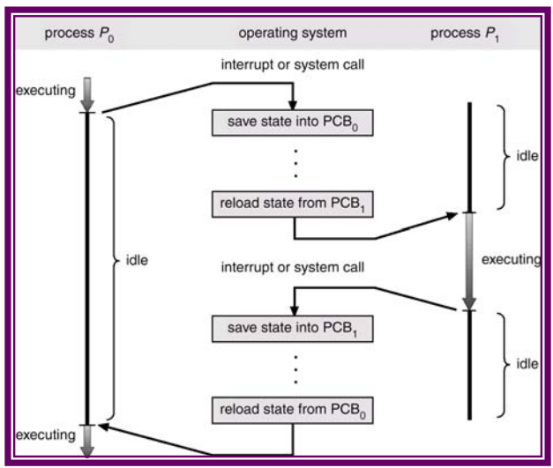
Process Scheduling
The objective of multiprogramming is to have some process running all the time so as to maximize CPU utilization.
The objective of time-sharing is to switch the CPU among processors so frequently that users can interact with each program while it is running.
A uniprocessor system can have only one running process at a given time.
If more processes exist, the rest must wait until the CPU is free and can be rescheduled.
Switching the CPU from one process to another requires saving of the context of the current process and loading the state of the new process, as shown in Figure 5.4.
This is called context switching

Slide 9
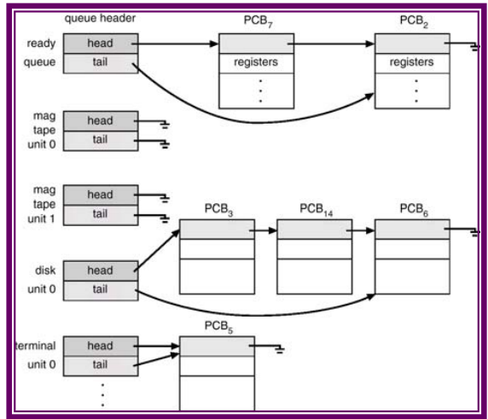
Scheduling Queues
As shown in Figure 5.5, a contemporary computer system maintains many scheduling queues.
Here is a brief description of some of these queues
Job Queue: As processes enter the system, they are put into a job queue. This queue consists of all processes in the system
Ready Queue: The processes that are residing in main memory and are ready and waiting to execute are kept on a list called the ready queue. This queue is generally stored as a linked list. A ready-queue header contains pointers to the first and final PCBs in the list. Each PCB is extended to include a pointer field that points to the next PCB in the ready queue.

Slide 10
Scheduling Queues (Continue..)
Device Queue: When a process is allocated the CPU, it executes for a while, and eventually quits, is interrupted or waits for a particular event, such as completion of an I/O request. In the case of an I/O request, the device may be busy with the I/O request of some other process, hence the list of processes waiting for a particular I/O device is called a device queue. Each device has its own device queue.

Slide 11
Scheduling Queues (Continue..)
In the queuing diagram shown in Figure 5.6,
each rectangle box represents a queue, and two such queues are present, the ready queue and an I/O queue.
A new process is initially put in the ready queue until it is dispatched. Once the process is executing: the ready and I/O queues, one of several events could occur:
The process could issue an I/O request, and then be placed in an I/O queue.
The process could create a new sub process and wait for its termination.
The process could be removed forcibly from the CPU, as a result of an interrupt, and be put back in the ready queue.

Slide 12
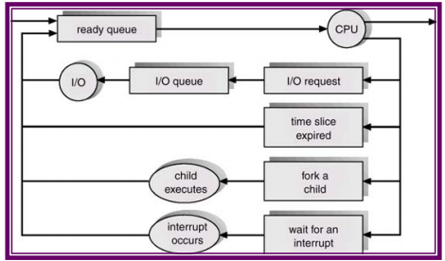

Slide 13
Schedulers
A process migrates between the various scheduling queues throughout its lifetime.
The operating system must select, for scheduling purposes, processes from these queues in some fashion.
The appropriate scheduler carries out this selection process.
The Long-term scheduler (or job scheduler) selects which processes should be brought into the ready queue, from the job pool that is the list of all jobs in the system.
The Short-term scheduler (or CPU scheduler) selects which process should be executed next and allocates CPU.
The primary distinction between the two schedulers is the frequency of execution.

Slide 14
Schedulers (Continue..)
Short-term Scheduler
The short-term scheduler must select a new process for the CPU frequently.
A process may execute for only a few milliseconds before waiting for an I/O request.
Often the short-term scheduler executes at least once every 100 milliseconds.
Because of the brief time between executions, the short-term scheduler must be fast.
If it takes 10 milliseconds to decide to execute a process for 100 milliseconds, then 10/(100+10)=9 % of the CPU is being used for scheduling only.

Slide 15
Schedulers (Continue..)
Long-term Scheduler
The long-term scheduler, on the other hand, executes much less frequently.
There may be minutes between the creation of new processes in the system.
The long-term scheduler controls the degree of multiprogramming – the number of processes in memory.
If the degree of multiprogramming is stable, then the average rate of process creation must be equal to the average department rate of processes leaving the system.
Because of the longer interval between executions, the long-term scheduler can afford to take more time to select a process for execution.

Slide 16
