Slide 1
Disk Scheduling
Lecture - 17

Slide 2
Things to know before algorithms
Seek Time:
Its are time to locate the disk arm to a specific track, where the data is to be read or write.
e.g. if the disk head position is 50 and disk head need to move to 176 storing index to read/write, then the seek time for that would be
seek time = 176-50 = 126
Note: minimum average seek time is better
Rotational Latency:
Is the time taken by desired sector of disk to rotate into a position so that it can access the read/write heads.
Note: minimum rotational latency is better

Slide 3
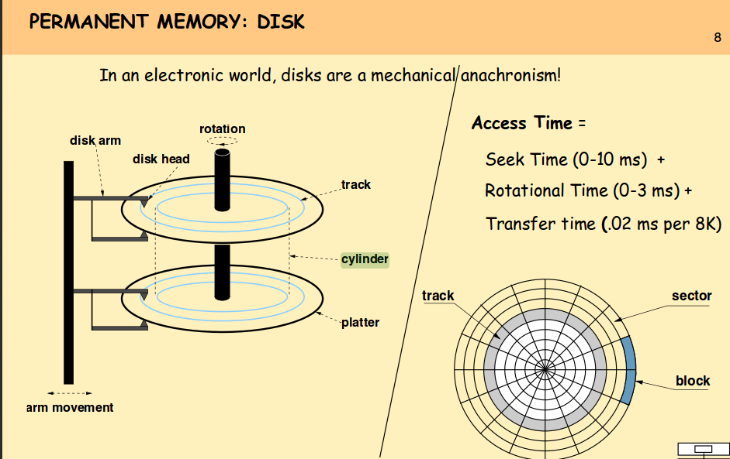

Slide 4
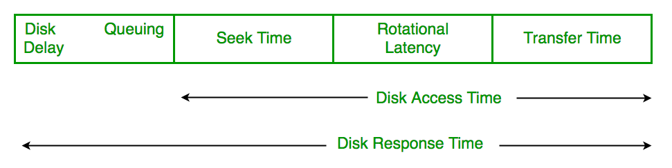
Things to know before algorithms
Transfer Time:
is a time to transfer the data. It depends on the rotating speed of the disk and number of bytes to be transferred
Disk Access Time:
Disk Access Time = Seek Time + Rotational Latency + Transfer Time
Response Time is the average of time spent by a request waiting to perform its I/O operation

Slide 5
FCFS (First Come First Serve) Algorithm
As the name suggest, this algorithm entertains requests in the order they arrive in the disk queue
For example:
Request sequence = [176, 79, 34, 60, 92, 11, 41, 114]
Initial disk head position = 50
_{Continue…}

Slide 6
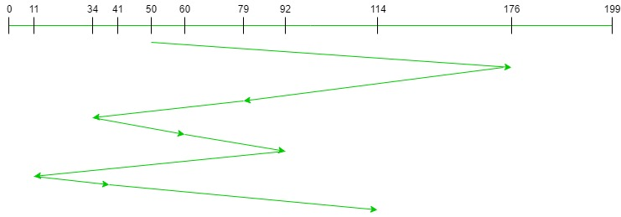
FCFS (First Come First Serve) Algorithm
Look at the graph ([176, 79, 34, 60, 92, 11, 41, 114])
6
3
7
start
4
2
5
8
1

Slide 7
FCFS (First Come First Serve) Algorithm
Look at the graph ([176, 79, 34, 60, 92, 11, 41, 114])
Seek Time= 176-50=126
Head Position=176
Seek Time= 176-79=97
Head Position=79
Seek Time= 79-34=45
Head Position=34
Seek Time= 60-34=26
Head Position=60
Seek Time= 92-60=32
Head Position=92
Seek Time=126+97+45+26+32+81+30+73 = 510
Seek Time= 92-11=81
Head Position=11
Advantages:
Every request gets a fair chance
No indefinite postponement
Disadvantages:
Does not try to optimize seek time
May not provide the best possible service
Seek Time= 41-11=30
Head Position=41
Seek Time= 114-41=73
Head Position=114

Slide 8
SSTF (Shortest Seek Time First) Algorithm
Basic idea is the tracks which are closer to current disk head position should be server first in order to minimize the seek operation
For example:
Request sequence = [176, 79, 34, 60, 92, 11, 41, 114]
Initial disk head position = 50
First calculate the nearest seek time from the initial disk head position
_{Continue…}

Slide 9
SSTF (Shortest Seek Time First) Algorithm
Head=11
176-11=165
79-11=68
60-11=49
92-11=81
114-11=103
Head=60
176-60=116
79-60=19
92-60=32
114-60=54
Head=50
176-50=126
79-50=29
50-34=16
60-50=10
92-50=42
50-11=39
50-41=9
114-50=64
Head=41
176-41=135
79-41=38
41-34=7
60-41=19
92-41=51
41-11=30
114-41=73
Head=34
176-34=142
79-34=45
60-34=26
92-34=58
34-11=23
114-34=80
Head=79
176-79=116
92-79=32
114-79=54
Head=92
176-92=84
114-92=22
A=[41,]
_{Continue…}
A=[41,34,]
A=[41,34,11]
A=[41,34,11,60]
A=[41,34,11,60,79]
A=[41,34,11,60,79,92,114,176]
A=[41,34,11,60,79,92]

Slide 10
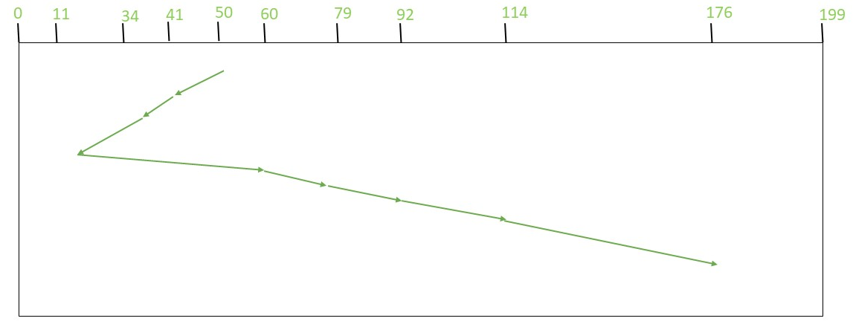
SSTF (Shortest Seek Time First) Algorithm
Look at the graph ([41,34,11,60,79,92,114,176])
3
2
1
start
4
5
6
7
8

Slide 11
SSTF (Shortest Seek Time First) Algorithm
Look at the graph ([41,34,11,60,79,92,114,176])
Seek Time=9+7+23+49+19+13+22+62 = 204
Seek Time= 41-34=7
Head Position=34
Seek Time= 50-41=9
Head Position=41
Advantages:
Average Response Time decreases
Throughput increases
Disadvantages:
Overhead to calculate seek time in advance
Can cause Starvation for a request if it has higher seek time as compared to incoming requests
High variance of response time as SSTF favors only some requests
Seek Time= 79-60=19
Head Position=79
Seek Time= 34-11=23
Head Position=11
Seek Time= 60-11=49
Head Position=60
Seek Time= 114-92=22
Head Position=114
Seek Time= 92-79=13
Head Position=92
Seek Time= 176-114=62
Head Position=176

Slide 12
SCAN (Elevator) Algorithm
Head starts from one end of the disk and moves towards the other end, servicing request in between one by one and reach the other end, then the direction of the head is reversed and the process continues as head continuously scan back and forth to access the disk.
For example:
Request sequence = [176, 79, 34, 60, 92, 11, 41, 114]
Initial disk head position = 50
Direction = Left (we moving from right to left)
First sort the array in ascending order: lower storing index on the left side of initial disk head and higher storing index on the right side of initial disk head
_{Continue…}

Slide 13
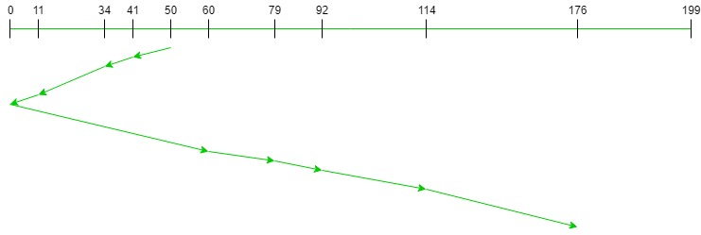
SCAN (Elevator) Algorithm
Look at the graph ([11,34, 41,60, 79, 92, 114,176])
Direction : Left (moving right to left)
4
3
2
1
start
5
6
7
8
9

Slide 14
SCAN (Elevator) Algorithm
Look at the graph ([11,34, 41,60, 79, 92, 114,176])
Direction : Left (moving right to left)
Seek Time= 41-34=7
Head Position=34
Seek Time= 50-41=9
Head Position=41
Seek Time=9+7+23+11+60+19+13+22+62 = 226
Seek Time= 34-11=23
Head Position=11
Advantages:
High throughput
Low variance of response time
Average response time
Disadvantages:
Long waiting time for requests for locations just visited by disk arm
Seek Time= 11-0=11
Head Position=0
Seek Time= 79-60=19
Head Position=79
Seek Time= 60-0=60
Head Position=60
Seek Time= 114-92=22
Head Position=114
Seek Time= 92-79=13
Head Position=92
Seek Time= 176-114=62
Head Position=176

Slide 15
C-SCAN (Circular Elevator) Algorithm modify SCAN
C-SCAN moves the head from one end servicing all the requests to the other end. However, as soon as the head reaches the other end, it immediately returns to the beginning of the disk without servicing any requests on the return trip and starts servicing again once reaches the beginning.
For example:
Request sequence = [176, 79, 34, 60, 92, 11, 41, 114]
Initial disk head position = 50
_{Continue…}

Slide 16
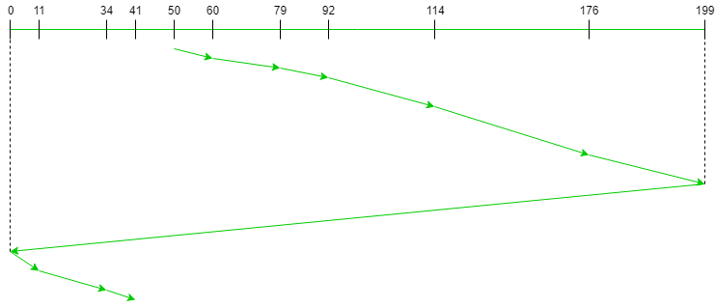
C-SCAN (Circular Elevator) Algorithm
Look at the graph ([11,34, 41,60, 79, 92, 114,176])
Advantages-
The waiting time for the cylinders just visited by the head is reduced as compared to the SCAN Algorithm.
It provides uniform waiting time.
It provides better response time.
Disadvantages-
It causes more seek movements as compared to SCAN Algorithm.
It causes the head to move till the end of the disk even if there are no requests to be serviced.
Seek Time= 79-60=19
Head Position=79
Seek Time= 60-50=10
Head Position=60
Seek Time= 114-92=22
Head Position=114
Seek Time=10+19+13+22+62+23+199+11+23+7 = 386
Seek Time= 92-79=13
Head Position=92
Seek Time= 176-114=62
Head Position=176
Seek Time= 199-176=23
Head Position=199
Seek Time= 199-0=199
Head Position=0
Seek Time= 11-0=11
Head Position=11
Seek Time= 34-11=23
Head Position=34
Seek Time= 41-34=7
Head Position=41

Slide 17
LOOK Disk Scheduling Algorithm
LOOK is the advanced version of SCAN (elevator) disk scheduling algorithm which gives slightly better seek time than any other algorithm
The main reason behind the better performance of LOOK algorithm in comparison to SCAN is because in this algorithm the head is not allowed to move till the end of the disk.
For example:
Request sequence = [176, 79, 34, 60, 92, 11, 41, 114]
Initial disk head position = 50
Direction = right (we are moving from left to right)
_{Continue…}

Slide 18
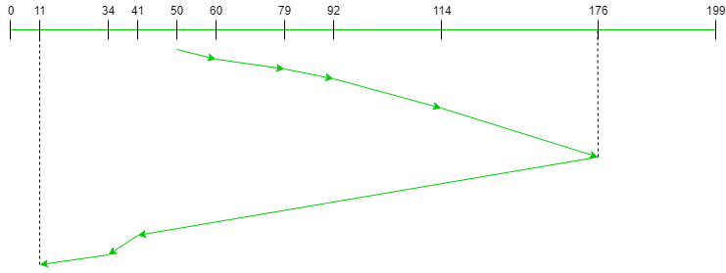
LOOK Disk Scheduling Algorithm
Advantages-
It does not causes the head to move till the ends of the disk when there are no requests to be serviced.
It provides better performance as compared to SCAN Algorithm.
It does not lead to starvation.
It provides low variance in response time and waiting time.
Disadvantages-
There is an overhead of finding the end requests.
It causes long waiting time for the cylinders just visited by the head.
Look at the graph ([11,34, 41,60, 79, 92, 114,176])
Direction : Right (moving left to right)
Seek Time=10+19+13+22+62+135+7+23 = 291
Seek Time= 79-60=19
Head Position=79
Seek Time= 60-50=10
Head Position=60
Seek Time= 114-92=22
Head Position=114
Seek Time= 92-79=13
Head Position=92
Seek Time= 176-114=62
Head Position=176
Seek Time= 176-41=135
Head Position=41
Seek Time= 34-11=23
Head Position=11
Seek Time= 41-34=7
Head Position=34

Slide 19
C-LOOK (Circular LOOK) Disk Scheduling Algorithm
C-LOOK is an enhanced version of both SCAN as well as LOOK disk scheduling algorithms.
seek time is better than C-SCAN algorithm
the head services requests only in one direction(either left or right) until all the requests in this direction are not serviced and then jumps back to the farthest request on the other direction and service the remaining requests which gives a better uniform servicing as well as avoids wasting seek time for going till the end of the disk.
For example:
Request sequence = [176, 79, 34, 60, 92, 11, 41, 114]
Initial disk head position = 50
Direction = right (we are moving from left to right)
_{Continue…}

Slide 20
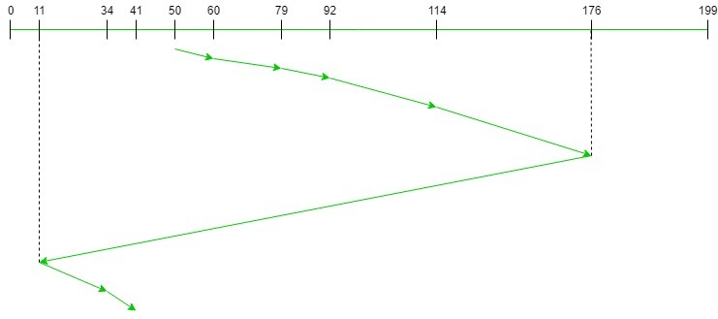
C-LOOK (Circular LOOK) Disk Scheduling
Advantages-
It does not causes the head to move till the ends of the disk when there are no requests to be serviced.
It reduces the waiting time for the cylinders just visited by the head.
It provides better performance as compared to LOOK Algorithm.
It does not lead to starvation.
It provides low variance in response time and waiting time.
Disadvantages-
There is an overhead of finding the end requests.
Look at the graph ([11,34, 41,60, 79, 92, 114,176])
Direction : Right (moving left to right)
Seek Time=10+19+13+22+62+165+23+7= 321
Seek Time= 79-60=19
Head Position=79
Seek Time= 60-50=10
Head Position=60
Seek Time= 114-92=22
Head Position=114
Seek Time= 92-79=13
Head Position=92
Seek Time= 176-114=62
Head Position=176
Seek Time= 176-11=165
Head Position=11
Seek Time= 34-11=23
Head Position=34
Seek Time= 41-34=7
Head Position=41

