Slide 1
Operating Systems Lecture - 11

Slide 2
Process Synchronization
Concurrent processes or threads often need access to shared data and shared resources.
If there is no controlled access to shared data, it is often possible to obtain an inconsistent state of this data.
Maintaining data consistency requires mechanisms to ensure the orderly execution of cooperating processes, and hence various process synchronization methods are used.
In the producer-consumer problem, the version only allows one item less than the buffer size to be stored, to provide a solution for the buffer to use its entire capacity of N items is not simple.

Slide 3
Process Synchronization (Continue..)
#define BUFFER_SIZE 10 typedef struct { ... } item; item buffer[BUFFER_SIZE]; int in=0; int out=0;
The producer and consumer share a data structure ‘buffer’ and use other variables shown below:
while(1) { /*Produce an item in nextProduced*/ while(counter == BUFFER_SIZE); /*do nothing*/ buffer[in]=nextProduced; in=(in+1)%BUFFER_SIZE; counter++; }
The code for the producer process is:

Slide 4
Process Synchronization (Continue..)
while(1)
{
while(counter==0); //do nothing
nextConsumed=buffer[out];
out=(out+1)%BUFFER_SIZE;
counter--;
/*Consume the item in nextConsumed*/
}
The code for the consumer process is:
Both producer and consumer routines may not execute properly if executed concurrently
Suppose that the value of the counter is 5, and that both the producer and the consumer execute the statement counter++ and counter- - concurrently.

Slide 5
Process Synchronization (Continue..)
Following the execution of these statements the value of the counter may be 4,5,or 6!
The only correct result of these statements should be counter= =5, which is generated if the consumer and the producer execute separately.
Suppose counter++ is implemented in machine code as the following instructions:
MOV R1, counter INC R1 MOV counter, R1
MOV R2, counter DEC R2 MOV counter, R2
whereas counter- - may be implemented as:
Producer
Customer

Slide 6
Process Synchronization (Continue..)
If both the producer and consumer attempt to update the buffer concurrently, the machine language statements may get interleaved.
Interleaving depends upon how the producer and consumer processes are scheduled.
Assume the counter is initially 5. One interleaving of statements is:
producer: MOV R1, counter (R1 = 5) INC R1 (R1 = 6)
consumer: MOV R2, counter (R2 = 5) DEC R2 (R2 = 4)
producer: MOV counter, R1 (counter = 6) consumer: MOV counter, R2 (counter = 4)

Slide 7
Process Synchronization (Continue..)
The value of count will be 4, where the correct result should be 5.
The value of count could also be 6 if producer executes MOV counter, R1 at the end.
The reason for this state is that we allowed both processes to manipulate the variable counter concurrently.
A situation like this, where several processes access and manipulate the same data concurrently and the outcome of the manipulation depends on the particular order in which the access takes place, is called a race condition.
To guard against such race conditions, we require synchronization of processes.
Concurrent transactions in a bank or in an airline reservation (or travel agent) office are a couple of other examples that illustrates the critical section problem.

Slide 8
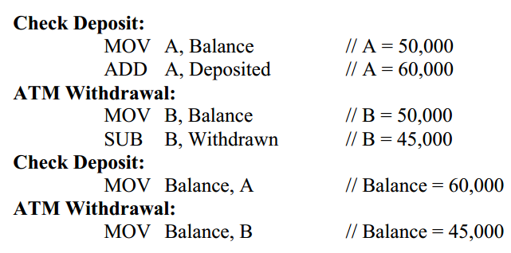
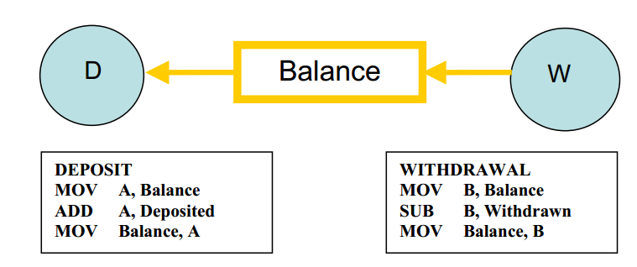
Process Synchronization (Continue..)
We show interleaving of two bank transactions, a deposit and a withdrawal. Here are the details of the transactions:
Current balance = Rs. 50,000
Check deposited = Rs. 10,000
ATM withdrawn = Rs. 5,000
Here is what may happen if the two transactions are allowed to execute concurrently, i.e., the transactions are allowed to interleave.
Note that in this case the final balance will be Rs. 45,000, i.e., a loss of Rs. 5,000. If MOV Balance,A executes at the end, the result will be a gain of Rs. 5,000.
In both cases, the final result is wrong.

Slide 9
The Critical Section Problem
Critical Section: A piece of code in a cooperating process in which the process may update shared data (variable, file, database, etc.).
Critical Section Problem: Serialize executions of critical sections in cooperating processes.
When a process executes code that manipulates shared data (or resources), we say that the process is in its critical section (for that shared data).
The execution of critical sections must be mutually exclusive: at any time, only one process is allowed to execute in its critical section (even with multiple processors).
So each process must first request permission to enter its critical section.

Slide 10
The Critical Section Problem (Continue..)
The section of code implementing this request is called the entry section.
The remaining code is the remainder section.
The critical section problem is to design a protocol that the processes can use so that their action will not depend on the order in which their execution is interleaved (possibly on many processors).
There can be three kinds of solutions to the critical section problem:
Software based solutions
Hardware based solutions
Operating system based solution
We discuss the software solutions first. Regardless of the type of solution, the structure of the solution should be as follows

Slide 11
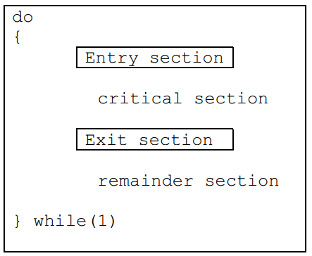
The Critical Section Problem (Continue..)
The Entry and Exist sections comprise solution for the problem.

Slide 12
Solution to the Critical Section Problem
A solution to the critical section problem must satisfy the following three requirements:
Mutual Exclusion
If process Pi is executing in its critical section, then no other process can be executed in its critical section.
Progress
If no process is executing in its critical section and some processes wish to enter their critical sections, then only those processes that are not executing in their remainder section can participate in the decision on which will enter its critical section next, and this selection cannot be postponed indefinitely.
Bounded Waiting
There exists a bound on the number of times that other processes are allowed to enter their critical sections after a process have made a request to enter its critical section and before that request is granted.

Slide 13
Solution to the Critical Section Problem (Continue..)
Assumptions
While formulating a solution, we must keep the following assumptions in mind:
Assume that each process executes at a nonzero speed
No assumption can be made regarding the relative speeds of the N processes

Slide 14
2-Process Solutions to the Critical Section Problem
In this section algorithms that are applicable to two processes will be discussed.
The processes are P0 and P1. When presenting Pi, we use Pj to denote the other process.
An assumption is that the basic machine language instructions such as load and store are executed atomically, that is an operation that completes in its entirety without interruption

Slide 15
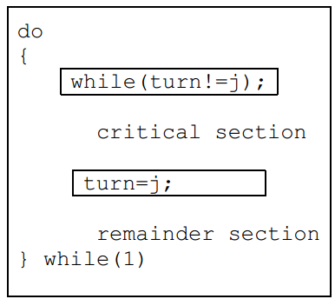
Algorithm 1
The first approach is to let the processes share a common integer variable turn initialized to 0 or 1.
If turn = = i, then process Pi is allowed to execute in its critical section.
The structure of the process Pi is as follows:

Slide 16
Algorithm 1 (Continue..)
This solution ensures mutual exclusion, that is only one process at a time can be in its critical section.
However, it does not satisfy the progress requirement, since it requires strict alternation of processes in the execution of the critical section. For example, if turn= =0 and P1 is ready to enter its critical section, P1 cannot do so, even though P0 may be in its remainder section.
The bounded wait condition is satisfied though, because there is an alternation between the turns of the two processes.

Slide 17
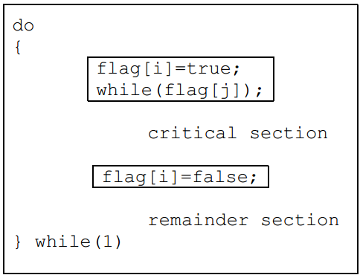
Algorithm 2
In algorithm two, the variable turn is replaced with an array boolean flag[2] whose elements are initialized to false.
If flag is true for a process that indicates that the process is ready to enter its critical section.
The structure of process Pi is shown:

Slide 18
Algorithm 2 (Continue..)
In this algorithm Pi sets flag[i]= true signaling that it is ready to enter its critical section.
Then Pi checks to verify that process Pj is not also ready to enter its critical section.
If Pj were ready, then Pi would wait until Pj had indicated that it no longer needed to be in the critical section (that is until flag[j]=false).
At this point Pi would enter the critical section. On exiting the critical section, Pi would set flag[i]=false allowing the other process to enter its critical section.
In this solution, the mutual exclusion requirement is satisfied.
Unfortunately the progress condition is not met; consider the following execution sequence:
T0: P0 sets flag[0]= true
T1: P1 sets flag[1]= true
Now both the processes are looping forever in their respective while statements.

