Slide 1
Operating Systems Lecture - 12

Slide 2
2-Process Critical Section Problem (continued)
We discussed two solutions for the 2-process critical section problem in lecture 11 but both were not acceptable because they did not satisfy the progress condition.
Here is a good solution for the critical section problem that satisfies all three requirements of a good solution.

Slide 3

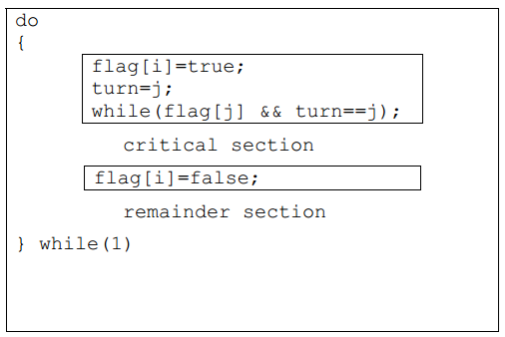
Algorithm 3 (Continue..)
The processes share two variables:
The boolean array of ‘flag’ is initialized to false, whereas ‘turn’ maybe 0 or 1.
The structure of the process is as follows:
To enter its critical section, Pi sets flag[i] to true, and sets ‘turn’ to j, asserting that if the other process wishes to enter its critical section, it may do so.
If both try to enter at the same time, they will attempt to set ‘turn’ to i and j
However, only one of these assignments will last, the other will occur but be overwritten instantly
Hence, the eventual value of ‘turn’ will decide which process gets to enter its critical section.

Slide 4
Algorithm 3 (Continue..)
prove mutual exclusion
note that Pi enters its critical section only if either flag[j]=false or turn=i.
Also, if both processes were executing in their critical sections at the same time, then flag[0]= = flag[1]= = true
These two observations suggest that P0 and P1 could not have found both conditions in the while statement true at the same time, since the value of ‘turn’ can either be 0 or 1.
Hence only one process say P0 must have successfully exited the while statement.
Hence mutual exclusion is preserved.

Slide 5
Algorithm 3 (Continue..)
prove bounded wait and progress requirements
we note that a process Pi can be prevented the critical section only if it is stuck in the while loop with the condition flag[j]= =true and turn=j.
If Pj is not ready to enter the critical section, then flag[j]=flase and Pi can enter its critical section.
If Pj has set flag[j]=true and is also executing its while statement then either turn=i or turn=j.
If turn=i then Pi enters its critical section, otherwise Pj. However, whenever a process finishes executing in its critical section, lets assume Pj, it resets flag[j] to false allowing Pi to enter its critical section.
If Pj resets flag[j]=true, then it must also set ‘turn’ to i, and since Pi does not change the value of ‘turn’ while executing in its while statement, Pi will enter its critical section (progress) after at most one entry by Pj (bounded waiting)

Slide 6
N-Process Critical Section Problem
In this section we extend the critical section problem of two processes to include n processes. Consider a system of n processes (P0, P1 …… Pn-1).
Each process has a segment of code called a critical section in which the process may be changing common variables, updating a table, writing a file and so on.
The important feature of the system in that, when one process enters its critical section, no other process is allowed to execute in its critical section.
Thus the execution of critical sections by the processes is mutually exclusive in time.
The critical section problem is to design a protocol to serialize executions of critical sections.
Each process must request permission to enter its critical section. Many solutions are available in the literature to solve the N-process critical section problem.
We will discuss a simple and elegant solution, known as the Bakery algorithm.

Slide 7
The Bakery Algorithm
The bakery algorithm is due to Leslie Lamport and is based on a scheduling algorithm commonly used in bakeries, ice-cream stores, and other locations where order must be made out of chaos.
On entering the store, each customer receives a number. The customer with the lowest number is served next.
Before entering its critical section, process receives a ticket number.
Holder of the smallest ticket number enters its critical section.
Unfortunately, the bakery algorithm cannot guarantee that two processes (customers) will not receive the same number.
In the case of a tie, the process with the lowest ID is served first. If processes Pi and Pj receive the same number, if i < j, then Pi is served first; else Pj is served first.
The ticket numbering scheme always generates numbers in the increasing order of enumeration; i.e., 1, 2, 3, 4, 5 ...

Slide 8
The Bakery Algorithm (Continue..)
Since process names are unique and totally ordered, our algorithm is completely deterministic. The common data structures are:
boolean choosing [n];
int number[n];
Initially, these data structures are initialized to false and 0, respectively. The following notation is defined for convenience:
(ticket #, process id #)
(a,b) < (c,d) if a<c or if a= =c and b<d.
max(a0, …an-1 ) is a number, k, such that k>= ai for i=0,…n-1
The structure of process Pi used in the bakery algorithm is as follows:

Slide 9
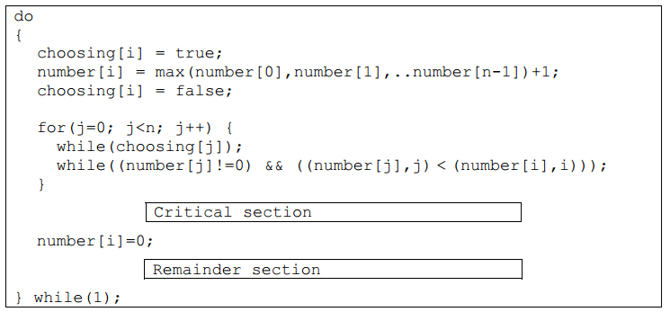
The Bakery Algorithm (Continue..)
To prove that the bakery algorithm is correct, we need to first show that if Pi is in its critical section and Pk has already chosen its number k!=0, then ((number [i],i) < (number[k],k)).

Slide 10
The Bakery Algorithm (Continue..)
Consider Pi in its critical section and Pk trying to enter its critical section.
When process Pk executes the second while statement for j==i it finds that,
number[i] != 0
(number[i],i) < (number[k],k)
Thus it keeps looping in the while statement until Pi leaves the Pi critical section.
Hence mutual exclusion is preserved. For progress and bounded wait we observe that the processes enter their critical section on a first come first serve basis.

Slide 11
The Bakery Algorithm (Continue..)
Following is an example of how the Bakery algorithm works.
In the first table, we show that there are five processes, P0 through P4.
P1’s number is 0 because it is not interested in getting into its critical section at this time.
All other processes are interested in entering their critical sections and have chosen non-zero numbers by using the max()function in their entry sections.

Slide 12
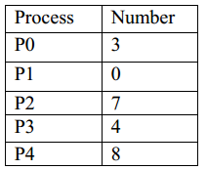
The Bakery Algorithm (Continue..)
The following table shows the status of all the processes as they execute the ‘for’ loops in their entry sections.
The gray cells show processes waiting in the second while loops in their entry sections.
The table shows that P0 never waits for any process and is, therefore, the first process to enter its critical section, while all other processes wait in their second while loops for j = = 0, indicating that they are waiting for P0 to get out of its critical section and then they would make progress (i.e., they will get out the while loop, increment j by one, and continue their execution).

Slide 13
The Bakery Algorithm (Continue..)
You can make the following observations by following the Bakery algorithm closely with the help of this table:
P1 not interested to get into its critical section ⇒ number[1] is 0
P2, P3, and P4 wait for P0
P0 gets into its CS, get out, and sets its number to 0
P3 get into its CS and P2 and P4 wait for it to get out of its CS
P2 gets into its CS and P4 waits for it to get out
P4 gets into its CS
Sequence of execution of processes: <P0, P3, P2, P4>

Slide 14
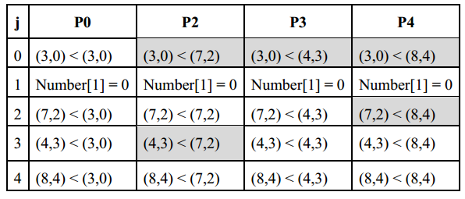
The Bakery Algorithm (Continue..)

Slide 15
Hardware Solutions for the Critical Section Problem
In this section, we discuss some simple hardware (CPU) instructions that can be used to provide synchronization between processes and are available on many systems.
The critical section problem can be solved simply in a uniprocessor environment if we could forbid interrupts to occur while a shared variable is being modified. In this manner, we could be sure that the current sequence of instructions would be run, so no unexpected modifications could be made to the shared variable.
Unfortunately, this solution is not feasible in a multiprocessing environment, as disabling interrupts can be time-consuming as the message is passed to all processors.
This message passing delays entry into each critical section, and system efficiency decreases

Slide 16
Hardware Solutions for the Critical Section Problem (Continue..)
Normally, access to a memory location excludes other accesses to that same location.
Designers have proposed machine instructions that perform two operations atomically (indivisibly) on the same memory location (e.g., reading and writing).
The execution of such an instruction is also mutually exclusive (even on Multiprocessors).
They can be used to provide mutual exclusion but other mechanisms are needed to satisfy the other two requirements of a good solution to the critical section problem.

Slide 17
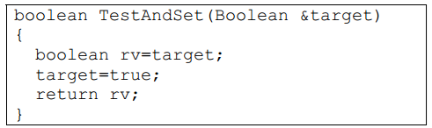
Hardware Solutions for the Critical Section Problem (Continue..)
We can use these special instructions to solve the critical section problem. These instructions are TestAndSet (also known as TestAndSetLock; TSL) and Swap. The semantics of the TestAndSet instruction are as follows:
The semantics simply say that the instruction saves the current value of ‘target’, set it to true, and returns the saved value.
The important characteristic is that this instruction is executed atomically.
Thus if two TestAndSet instructions are executed simultaneously, they will be executed sequentially in some arbitrary order.

Slide 18
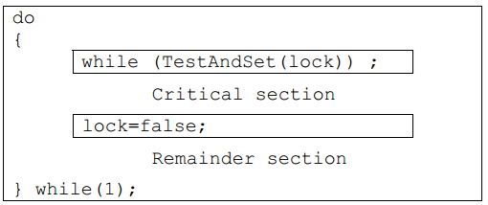
Hardware Solutions for the Critical Section Problem (Continue..)
If the machine supports TestAndSet instruction, then we can implement mutual exclusion by declaring a Boolean variable lock, initialized to false. The structure of process Pi becomes:
The above TSL-based solution is no good because even though mutual exclusion and progress are satisfied, bounded waiting is not.
The semantics of the Swap instruction, another atomic instruction, are, as expected, as follows:

Slide 19
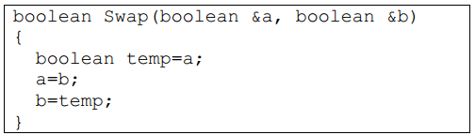
Hardware Solutions for the Critical Section Problem (Continue..)
The semantics of the Swap instruction, another atomic instruction, are, as expected, as follows:
If the machine supports the Swap instruction, mutual exclusion can be implemented as follows.
A global Boolean variable lock is declared and is initialized to false.
In addition each process also has a local Boolean variable key.

Slide 20
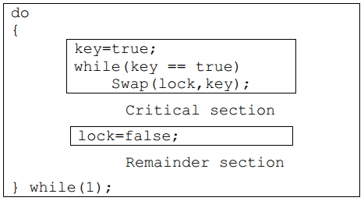
Hardware Solutions for the Critical Section Problem (Continue..)
The structure of process Pi is:
Just like the TSL-based solution shown in this section, the above Swap-based solution is not good because even though mutual exclusion and progress are satisfied, bounded waiting is not.
In the next lecture, we will discuss a good solution for the critical section problem by using the hardware instructions.

Slide 21
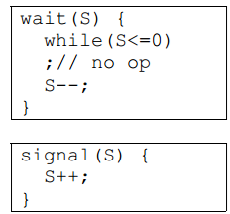
Semaphores
Hardware solutions to synchronization problems are not easy to generalize to more complex problems.
To overcome this difficulty we can use a synchronization tool called a semaphore.
A semaphore S is an integer variable that, apart from initialization is accessible only through two standard atomic operations: wait and signal.
These operations were originally termed P (for wait) and V (for signal).
The classical definitions of wait and signal are:

Slide 22
Semaphores (continue…)
Modifications to the integer value of the semaphore in the wait and signal operations must be executed indivisibly.
That is, when one process is updating the value of a semaphore, other processes cannot simultaneously modify that same semaphore value.
In addition, in the case of the wait(S), the testing of the integer value of S (S<=0) and its possible modification (S--) must also be executed without interruption.

Slide 23
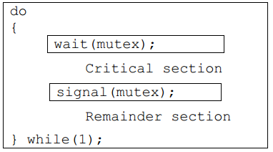
Semaphores (continue…)
We can use semaphores to deal with the n-process critical section problem.
The n processes share a semaphore, mutex (standing for mutual exclusion) initialized to 1.
Each process Pi is organized as follows:

Slide 24
Semaphores (continue…)
As was the case with the hardware-based solutions, this is not a good solution because even though it satisfies mutual exclusion and progress, it does not satisfy bounded wait
In a uni-processor environment, to ensure atomic execution, while executing wait and signal, interrupts can be disabled. In case of a multi-processor environment, to ensure atomic execution is one can lock the data bus, or use a soft solution such as the Bakery algorithm
The main disadvantage of the semaphore discussed in the previous section is that it requires busy waiting.
While a process is in its critical section, any other process that tries to enter its critical section must loop continuously in the entry code.

Slide 25
Semaphores (continue…)
This continual looping is clearly a problem in a real multiprogramming system, where a single CPU is shared among many processes.
Busy waiting wastes CPU cycles that some other process may be able to use productively.
This type of semaphore is also called a spinlock (because the process spins while waiting for the lock).
Spinlocks are useful in multiprocessor systems.
The advantage of a spinlock is that no context switch is required when a process must wait on a lock, and a context switch may take considerable time.
This is, spinlocks are useful when they are expected to be held for short times.
The definition of semaphore should be modified to eliminate busy waiting. We will discuss the modified definition of semaphore in the next lecture.

