Slide 1
Introduction to Programming
Lecture No. 1

Slide 2
Program
“A precise sequence of steps to
solve a particular problem”

Slide 3
Alan Perlis – Yale University:
“It goes against the grain of modern
education to teach children to program.
What fun is there in making plans,
acquiring discipline in organizing
thoughts, devoting attention to detail
and learning to be self-critical? “

Slide 4
Critical Skills
  Analysis
  Critical Thinking
  Attention to Detail

Slide 5
Design Recipe
To design a program properly, we must:
  Analyze a problem statement, typically
  expressed as a word problem
  Express its essence, abstractly and with
  examples
  Formulate statements and comments in a
  precise language
  Evaluate and revise the activities in light of
  checks and tests

Slide 6
  PAY ATTENTION TO DETAIL
  These skills are useful for
  anybody
  All assignments in this course
  should follow the these
  guidelines

Slide 7
Computers are STUPID

Slide 8
Humans are even more…….

Slide 9
Think Reuse

Slide 10
Area of the Ring
Inner Circle
Outer Circle
Area of Outer Circle
Area of Inner Circle
____
= Area of the Ring

Slide 11
Think Reuse
Think User Interface
Comments liberally

Slide 12
What is the probability that she gets
exactly three letter right i.e. three
Letters into their correct envelopes.

Slide 13
Logical Error
Lewis Carol: “Through the Looking Glass”
“Twas brillig, and the slithy toves
Did gyre and gimble in the wabe “

Slide 14
Course Policy
Policy for the distribution of marks and
examination is as follows
Quizzes, Class Participation/Attendance, Assignments etc. 30%
Midterm 20 % (2 Hours)
Final 50 % (3 Hours & 75% Attendance Required)

Slide 15
Books
1. Starting out with Python, 4th Edition, Tony Gaddis.
2. Starting out with Programming Logic & Degins, 4th Edition, Tony Gaddis,
3. The C Programming Language, 2nd Edition by Brian W. Kernighan, Dennis M. Ritchie
4. Object Oriented Programming in C++ by Robert Lafore
5. Introduction to Computation and Programming Using Python: With Application to Understanding Data, 2nd Edition by Guttag, John
6. Practice of Computing Using Python, 3rd Edition by William Punch & Richard Enbody

Slide 16
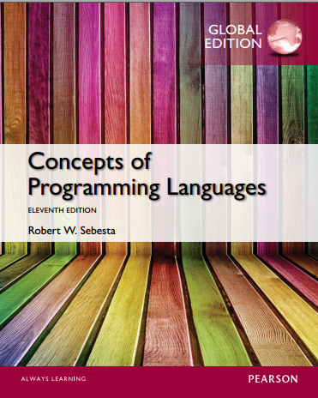

Slide 17
Course Objectives
Objectives of this course are three fold
  To appreciate the need for a programming language
  To introduce the concept and usability of the structured programming methodology
  To develop proficiency in making useful software using the C++ language

Slide 18
Course Contents
Introduction to problem solving
A brief review of Von-Neumann architecture
Introduction to programming
Role of compiler and linker, introduction to algorithms
Basic data types and variables, input/output constructs
Arithmetic, comparison and logical operators
Conditional statements and execution flow for conditional statements

Slide 19
Course Contents
AFTER Mid Term
Lists and their memory organization, multi-dimensional lists
Introduction to modular programming
Function definition and calling
Stack rolling and unrolling, string and string operations
Pointers/references
Static and dynamic memory allocation
Static and dynamic memory allocation

