Slide 1
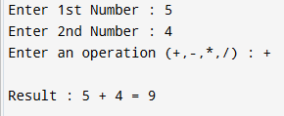
Continuation of last lecture - 6 Write a program that takes two numbers from the user and an operation (such as +, −, /,* ) and displays the result.
Expected output :

Slide 2
Loop – Repetition structure
For Loop
While loop
Do while loop

Slide 3
Example
int sum ;
sum = 1+2+3+4+5+……..+10 ;
cout << sum ;

Slide 4
Find the Sum of the first 100 Integer starting from 1
?

Slide 5
for Loop

Slide 6
For loop
for ( initialization condition ; termination condition ; increment condition )
{
statement ( s ) ;
}

Slide 7
Example
int counter ;
for( counter = 0 ; counter < 10 ; counter = counter + 1 )
cout << counter;
Output
0123456789

Slide 8
Table for 2
2 x 1 = 2
2 x 2 = 4
2 x 3 = 6
:
:
2 x 10 = 20

Slide 9
Output
2 x1 = 2
2 x 2 = 4
2 x 3 = 6
:
:
2 x 10 = 20

Slide 10
Always think re-use
Don’t use explicit constants

Slide 11
Create a flowchart of the program which calculating the Table of 2

Slide 12
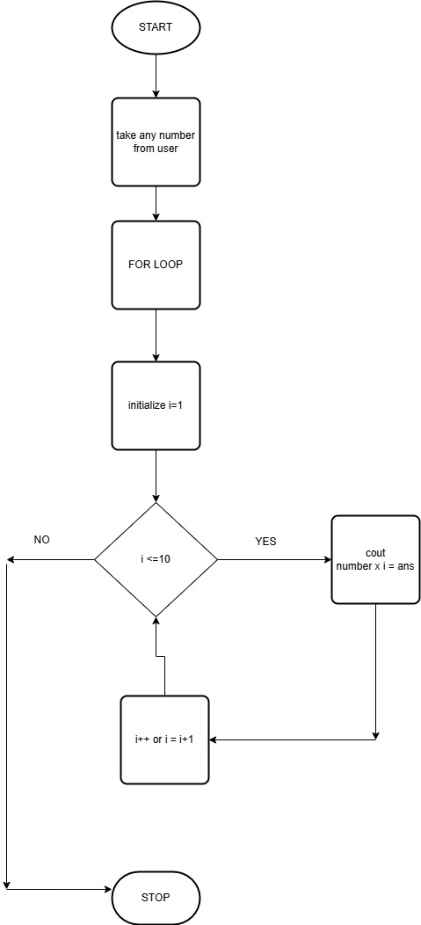

Slide 13
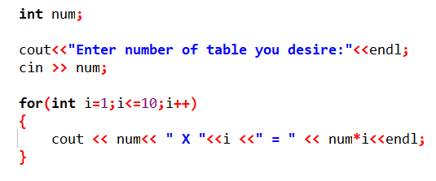
Code

Slide 14
while

Slide 15
while ( Logical Expression )
{
statements; :
}

Slide 16
Find the Sum of the first 1000 Integer starting from 1
?

Slide 17
Example
int sum , number ;
sum = 0 ;
number = 1 ;
while ( number <= 1000 )
{
sum = sum + number ;
number = number + 1 ;
}
cout << “ The sum of the first 1000 integer starting from 1 is ” << sum ;

Slide 18
Property of While Statement
It executes zero or more times

Slide 19
do-while

Slide 20
Do while loop execute on
or more times

Slide 21
Syntax of do-while loop
do
{
statements ;
}
while ( condition ) ;

Slide 22
Create a simple character guessing game where the player has to guess a secret character within a limited number of attempts (i.e. 5).

Slide 23
Example-Guessing game
char c ;
int tryNum = 1 ;
do
{
cout << "Please enter your guess by pressing a character key from a to z “ ;
cin >> c ;
if ( c == 'z‘ )
{
cout << "Congratulations! you guessed the right answer“ ;
tryNum = 6 ;
}
else
tryNum = tryNum + 1 ;
} while ( tryNum <= 5 ) ;

Slide 24
LAB-3

