Slide 1
Basic Data Types and Variables

Slide 2
Data types
in programming languages define the type of data that a variable can hold.
These types determine what kind of operations can be performed on the data and
how much memory will be allocated for it.
Here are the basic data types commonly found in most programming languages (like C++, Java, Python, etc.):
Integer (int):
Used to store whole numbers (both positive and negative).
e.g. int age = 25;
range: Typically from -2,147,483,648 to 2,147,483,647 (varies by system).

Slide 3
Data types (Cont.…)
Floating-point (float, double):
Used to store real numbers with decimal points.
float: Less precision (usually up to 7 decimal places).
e.g. float height = 5.9;
double: More precision (up to 15 decimal places).
e.g. double weight = 72.56789;
Character (char):
Used to store a single character (letters, digits, symbols).
e.g. char grade = 'A';
Typically 1 byte, stores the ASCII value of the character.

Slide 4
Data types (Cont.…)
Boolean (bool):
Used to store truth values true or false.
e.g. bool isStudent = true;
String:
Used to store sequences of characters (a collection of char).
e.g. string name = “John";

Slide 5
Variables
A variable is a container that stores data. You can assign a value to a variable and later use or modify it.
Declaring a Variable
syntax: <data_type> variable_name = value;
my suggestion:
Use names that explain the purpose of the variable;
e.g. Instead of declaring the variable as int x (which holds the age), we can declare it as int age.

Slide 6
Variables
Follow Naming Conventions
in most of the programming languages, camelCase is common for variable names (start with a lowercase letter, and subsequent words are capitalized)
e.g.
int totalMarks;
float averageHeight;
bool isLoggedIn;
Avoid Single Letter Names
Except for variables with very small scopes (like in loops), avoid single-letter names like a, b, or x, as they don’t convey meaning
e.g. int p; instead you may use int producPrice;

Slide 7
Variables
Avoid Abbreviations
Abbreviations can be confusing. Instead, use complete words for better clarity.
e.g. instead of int numStd;
use int numberOfStudents;
Avoid Keywords as Variable Name
Don’t use keywords or reserved words
e.g. instead of int return;
use int returnValue;
Use Boolean Names that Suggest True/False Meaning
When defining boolean variables, choose names that clearly indicate a true or false condition.
e.g. bool isComplete;
bool hasError;
bool isStudent;

Slide 8
Variables
Use Boolean Names that Suggest True/False Meaning
When defining boolean variables, choose names that clearly indicate a true or false condition.
e.g. bool isComplete;
bool hasError;
bool isStudent;
Assigning Operator
is used in programming to assign values to variables
E.g.
int a = 5;
Left side
Name of Variable
Right side
Value / expression

Slide 9

Arithmetic
Solve this expression
Where a=4, b=25, and c=5
Manually = <Calculate yourself>
Try in c++
float returnValue = b*b - 4*a*c /2 *a
Do we get the correct answer?

Slide 10
Decision

Slide 11
If/else Condition
If condition is true
statements
If Ali’s height is greater then 6 feet
Then
Ali can become a member of the Basket Ball team

Slide 12
If statement in C++
If (condition)
statement ;
If (condition)
{
statement 1;
statement 2;
}
if (age1 > age2)
cout<<“Student 1 is older than student 2” ;

Slide 13
Relational Operators
< less than
<= less than or equal to
== equal to
>= greater than or equal to
> greater than
!= not equal to

Slide 14
Relational Operators
a != b;
X = 0;
X == 0;

Slide 15
Example
If the student age is greater than 18 or his height is greater than five feet then put him on the foot balll team
Else
Put him on the chess team

Slide 16
Logical Operators
AND &&
OR ||

Slide 17
Logical Operators
If a is greater than b
AND c is greater than d
In C++
if(a > b && c> d)
if(age > 18 || height > 5)

Slide 18
Make a small flow chart of this
program and see the one to one
correspondence of the chart
and the code

Slide 19
Example
Code
if AmirAge > AmaraAge)
{
cout<< “Amir is older than Amara” ;
}
else
{
cout<<“Amir is younger than or of the same age as Amara” ;
}

Slide 20
Flow Chart Symbols
Start or stop
Process
Flow line
Continuation mark
Decision

Slide 21
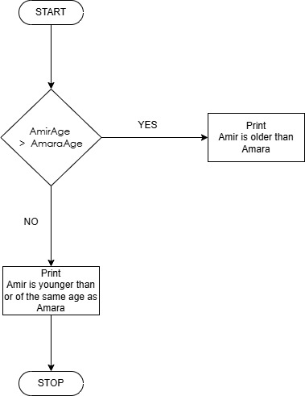

Slide 22
Unary Not operator !
!true = false
!false = true

Slide 23
Example
if ((interMarks > 45) && (testMarks >= passMarks))
{
cout << “ Welcome to Newport Institute”;
}

Slide 24
Example
If(!((interMarks > 45) && (testMarks >= passMarks)))
?

Slide 25
Unary Increment operator ++
count++
is same as count=count + 1

Slide 26
Unary Decrement operator --
count--
is same as count=count - 1

Slide 27
Nested if
If (age > 18)
{
If(height > 5)
{
cout << “you are in Foot Ball Team”<<endl;
}
}
Make a flowchart of this nested if structure…

