Slide 1


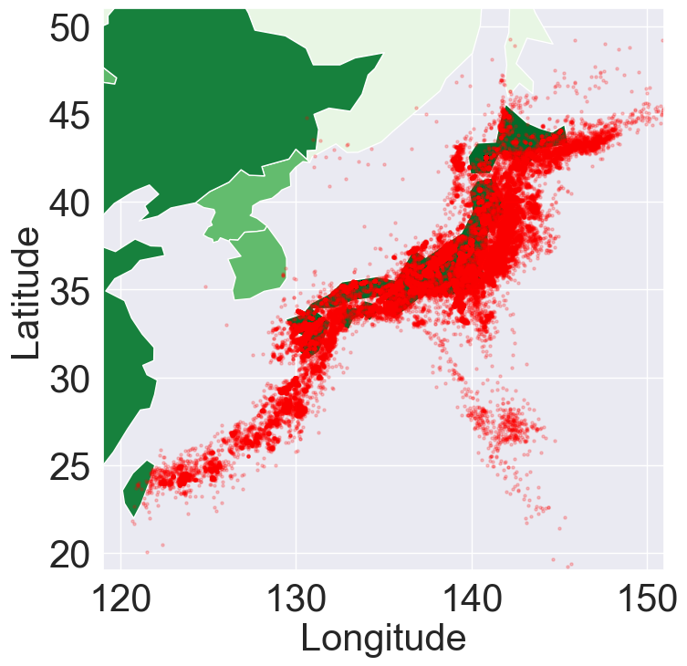
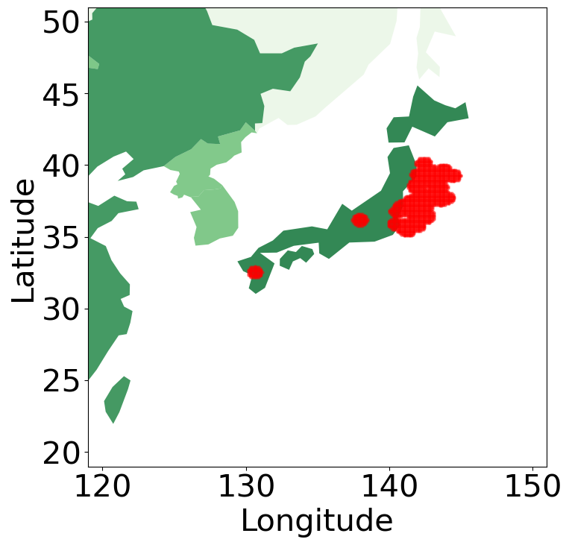
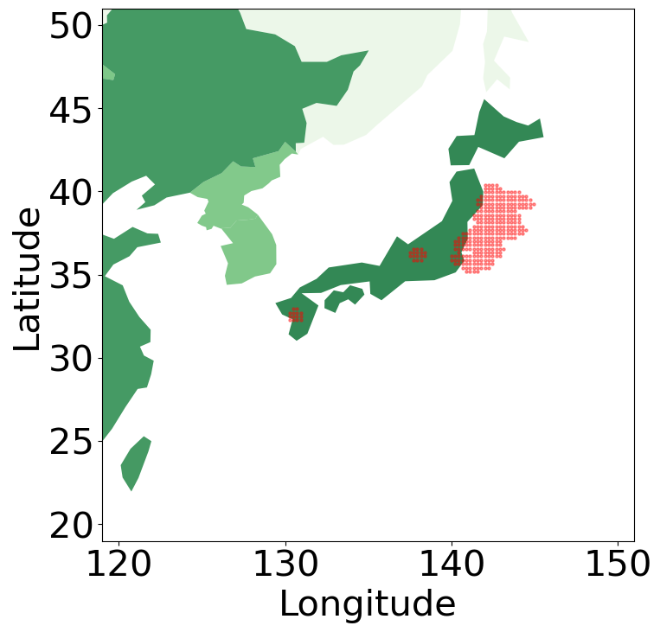
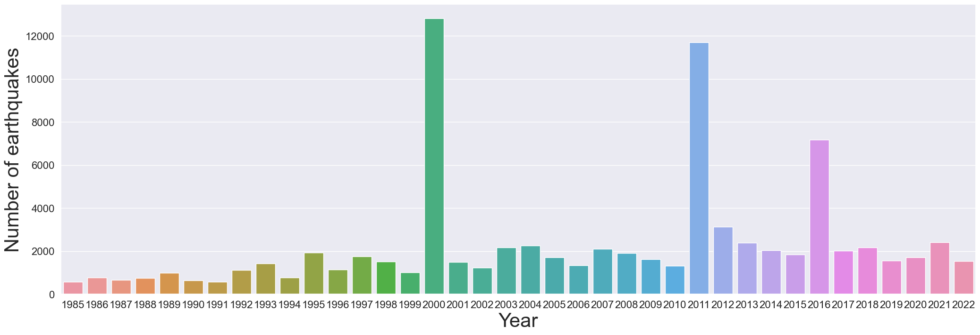
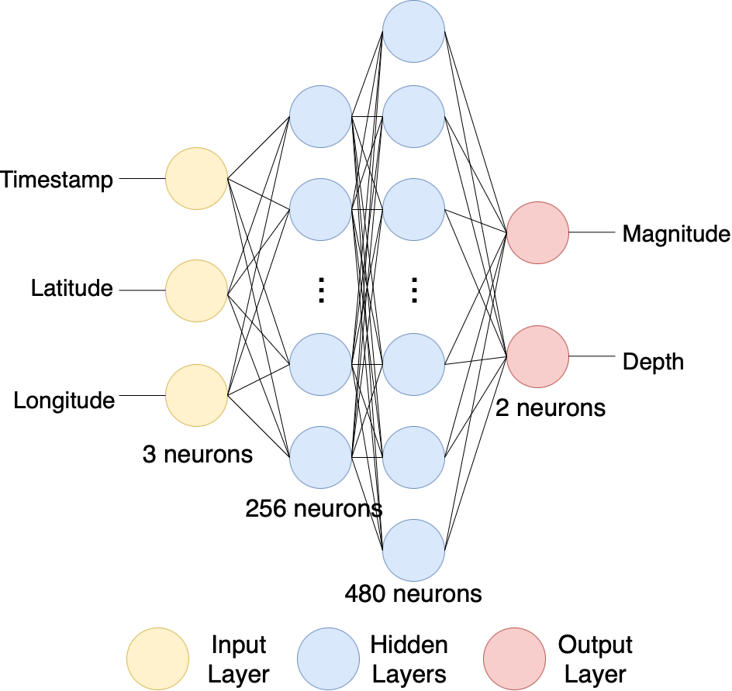
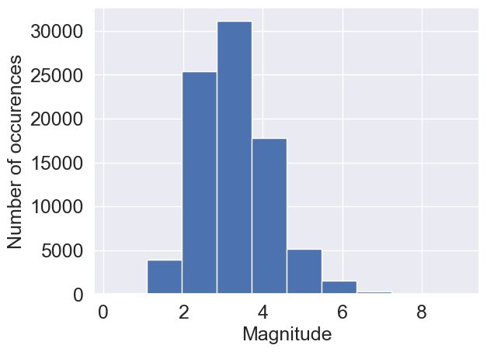
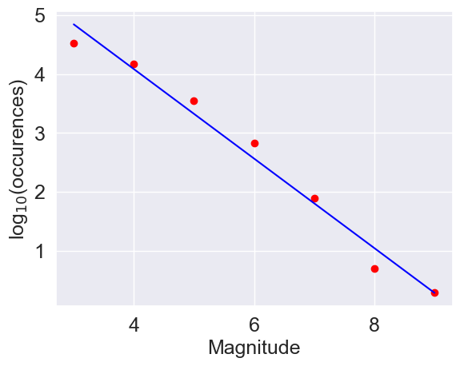
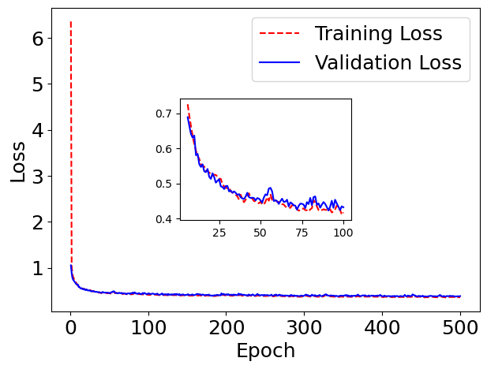


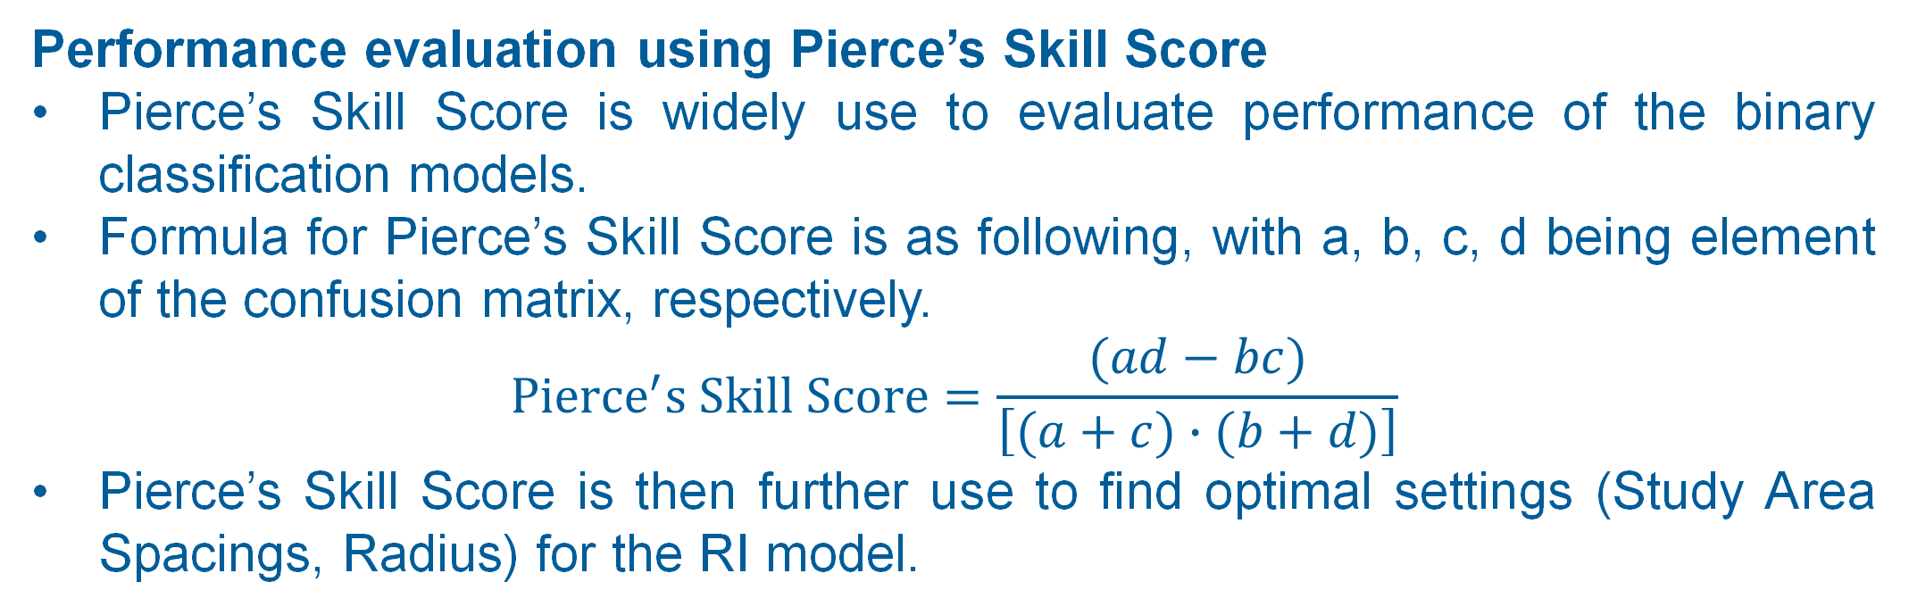

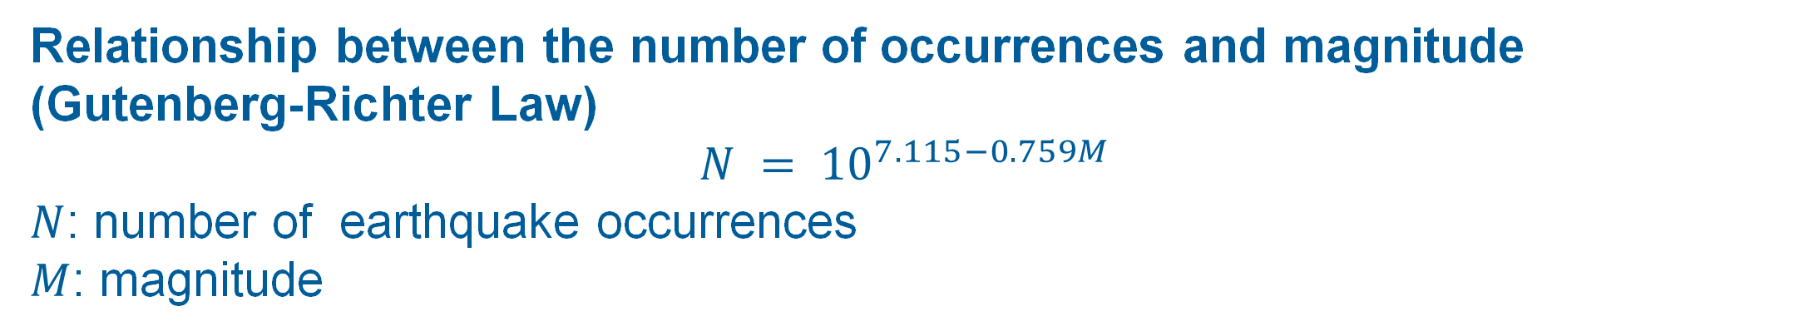
Machine Learning-Based Method
for Earthquake Analysis in Japan: A Preliminary Study
Phongwit SRIKOKCHAROEN, Shota SUZUKI, Kantapisit LIMSUPAPUTTIKUN
Supervisor: Lin ZHU
National Institute of Technology (KOSEN), Sendai College
Earthquake Occurences in Japan
Purpose
Relative Intensity (Conventional)
In Japan, earthquakes frequently occur. Each time causes devastating damages to human lives and infrastructure. The purpose of this preliminary study is to utilize machine learning-based method to analyze the earthquake data in Japan.
RI Score Calculation
Study area is defined as point with even spacing ranges from 30°E 128°N to 46°E 146°N
RI Score is min-max normalization of Cumulative Benioff Strain of a point in study area.
Cumulative Benioff Strain of a point is the sum of square root of seismic energy from M5.0 or larger earthquake around the point, which can be written mathematically as following.
$$B_{xy}\left(t\right)=\sum_{i=1}^{N_{xy}(t)}{\sqrt{E_{xy}^{(i)}}}$$
Seismic energy is estimated by magnitude using the following formula.
$${E_{xy}^{(i)}=e}^{5.24+1.44M}$$
Data Format and Data Visualization
We use earthquake data during 1985 to 2022 from Japan Meteorological Agency.
Data contains time, locations, magnitude and depth.
Performance evaluation using Pierce’s Skill Score
Pierce’s Skill Score is widely use to evaluate performance of the binary classification models.
Formula for Pierce’s Skill Score is as following, with a, b, c, d being element of the confusion matrix, respectively.
$$Pierce^{′}s Skill Score=\frac{(ad−bc)}{\left[(a+c)∙(b+d)\right]}$$
Pierce’s Skill Score is then further use to find optimal settings (Study Area Spacings, Radius) for the RI model.
Locations of earthquake occurrences
In Japan, earthquakes are more frequent on the Pacific side because it is in the Ring of Fire.
Results
Study Area Spacing | Radius | RI value Threshold | Pierce’s Skill Score
10 km. | 50 km. | 0.101 | 0.694
25 km. | 50 km. | 0.107 | 0.688
2000 Tottori earthquake
2011 Tohoku earthquake
2016 Kumamoto and Fukushima earthquakes
Study Area Spacing 10km (left) and 25km (right)
Machine Learning-Based Model (Proposed)
Relationship between the number of occurrences and time
Every earthquake accumulates energy before occurring. From the graph above, it can be concluded that in the past, the year with high rate of earthquakes was in 2000, 2011, and 2016.
Architecture
We built the neural network with the architecture in the left side.
We used Rectified Linear Unit (ReLU) as the activation function in hidden layers and linear as the activation function in output layer.
Training
We trained this model with
Optimizer: Adam (learning rate=0.05)
Loss: Mean Squared Error (MSE)
Batch size: 10,000
Epochs: 2,000
We plotted loss function of train set and validation set as graph below.
Relationship between the number of occurrences and magnitude
(Gutenberg-Richter Law)
$$N = {10}^{7.115−0.759M}$$
$N$: number of earthquake occurrences
$M$: magnitude
Testing and Evaluation
We used test set to evaluate this model, we got MSE=0.394 as the result.
From training, we got MSE=0.349 for train set and MSE=0.377 for validation set.
Train-Test Split
For relative intensity model, we divided 70% of data to train set and 30% of data to test set.
For machine learning, we normalized data. Then, we separated data to X(timestamp, latitude, longitude) and Y(magnitude, depth). After that, we divided 80% of data to train set, 10% of data to test set, and 10% of data to validation set.
Conclusion
From the above results from both models, we can conclude that earthquake in Japan has pattern. From this preliminary study, we can use relative intensity to find the areas that have high risk of earthquake. For machine learning-based model, we can find the relationship between time, locations, magnitude, and depth.
References
Acknowledgement
References
We would like to express our greatest appreciation to Japan Meteorological Agency, National Research Institute for Earth Science, and Disaster Resilience for providing the earthquake data in Japan.
We also would like to express our greatest appreciation to Dr. ZHANG Xiaoyong from Sendai KOSEN for giving us valuable advices about machine learning (neural networks).
Bruce A. Bolt. 2022. Earthquake Geology. www.britannica.com/science/earthquake-geology. [9/23/2022]
Japan Meteorological Agency. 2022. Earthquake Database in Japan. www.data.jma.go.jp/svd/eqdb/data/shindo/index.html. [9/23/2022]
Kristy French Tiampo and Robert Shcherbakov. 2012. Seismicity-based earthquake forecasting techniques: Ten years of progress. www.researchgate.net/publication/251496912_Seismicity -
based_earthquake_forecasting_techniques_Ten_years_of_progress. [9/23/2022]
United States Geological Survey (USGS). 2022. Can you predict earthquakes? www.usgs.gov/faqs/can-you-predict-
earthquakes. [9/23/2022]

