Slide 1

Reinforcement Learning: Fitting models to bandit tasks
BAMB! Summer School Tutorial 3A

Slide 2
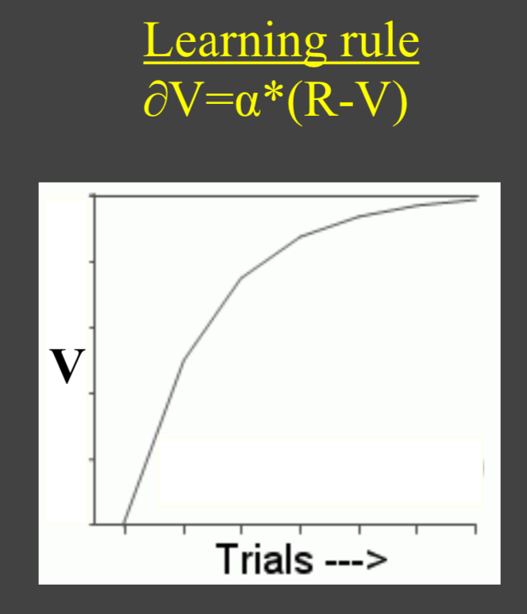
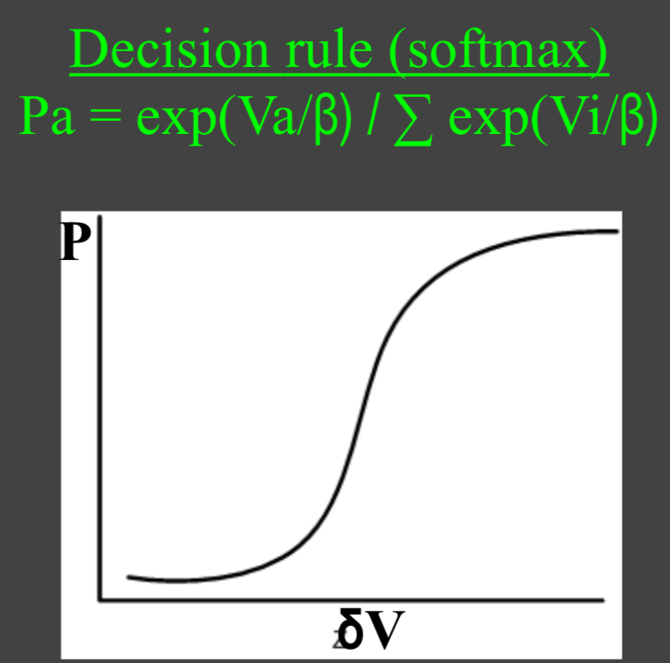

Reinforcement learning
Learning rule based on PREDICTION ERROR
α
Decision rule based on SOFTMAX function (other policies exist)
β

Slide 3
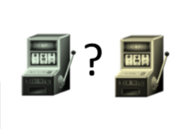

Today example: 2-armed bandit task
Fixed reward probabilities

Slide 4


Today example: 2-armed bandit task
Fixed reward probabilities
Binary rewards 0/1

Slide 5

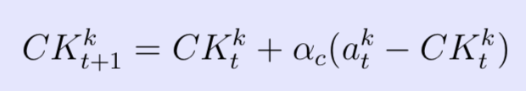
Our candidate models
Model 2. Noisy win-stay-lose-shift
Model 3. Rescorla-Wagner
Model 4. Choice kernel (captures tendency to repeat previous action)
Get familiar with models and data structure
Notes:
Choice kernel. This model tries to capture the tendency for people to repeat their previous actions.
In particular, we assume that participants compute a ‘choice kernel,’ CKtk, for each action, which keeps track of how frequently they have chosen that option in the recent past.
This choice kernel updates in much the same way as the values in the Rescorla-Wagner rule (ACTIONS instead of REWARDS).
where akt = 1 if option k is played on trial t, otherwise akt = 0, and αc is the choice- kernel learning rate.

Slide 6
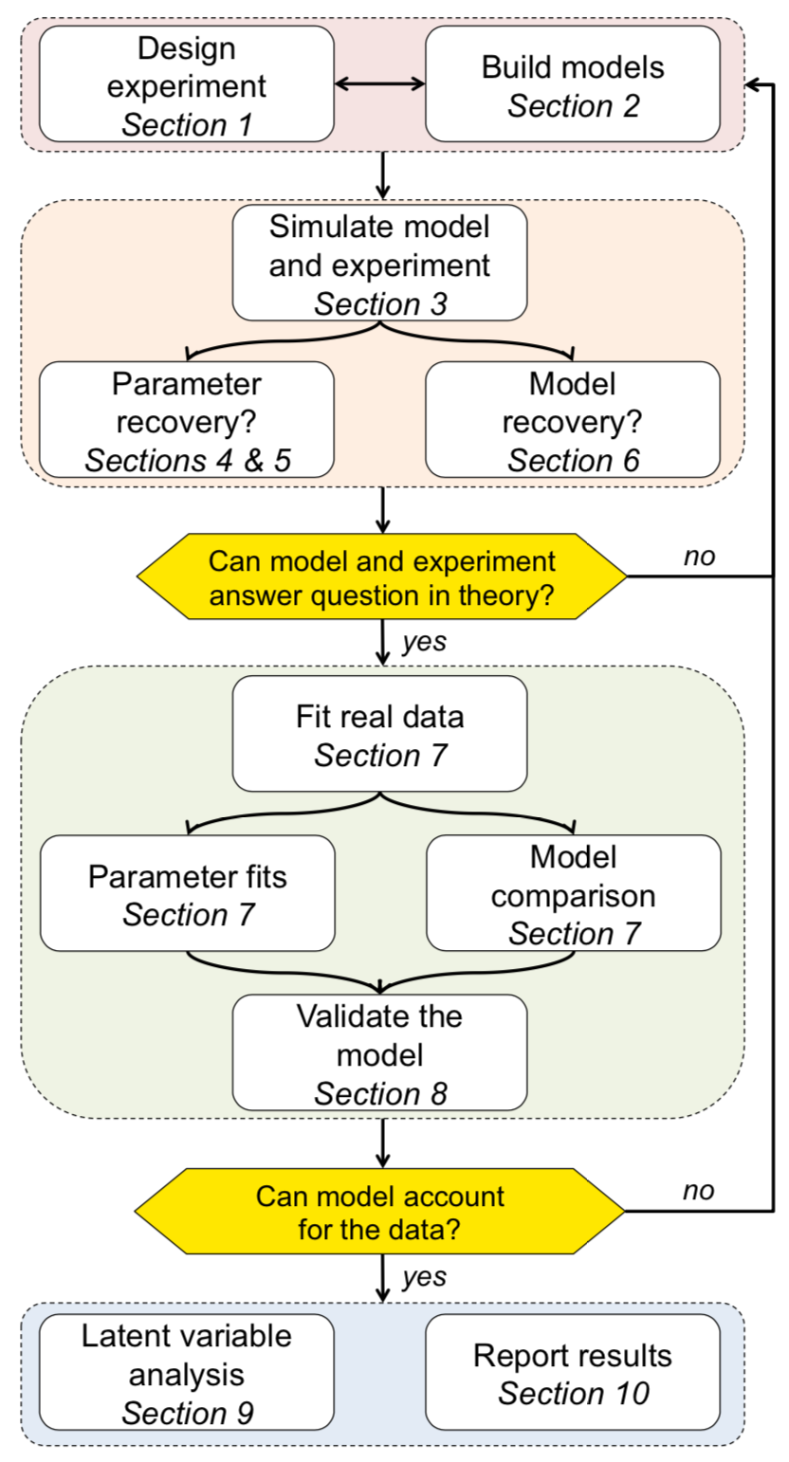
Wilson & Collins, 2019 eLife

Slide 7
Today’s focus
Model simulations
Parameter recovery
Model recovery
Wilson & Collins, 2019 eLife

Slide 8
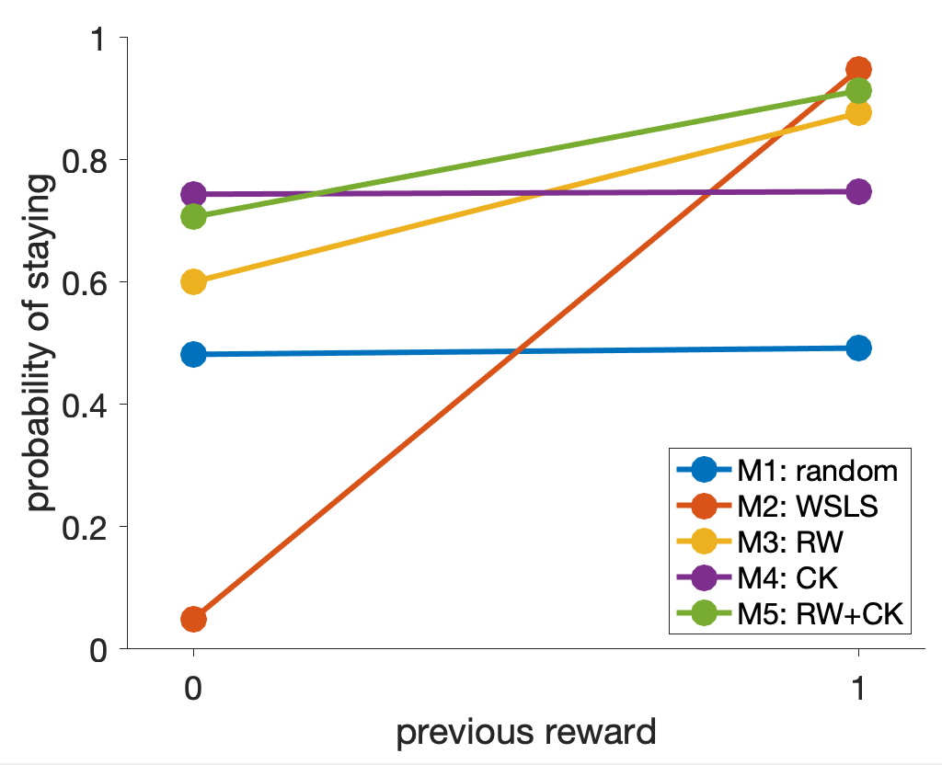
Model simulations
Examples of relevant diagnostic behavioural features:
probability of repeating an action, p(stay) = WSLS analysis
probability of choosing the correct option, p(correct), for early and late trials
Add simulations for Model 3 using arbitrary params and perform behavioral analyses;
If you vary the parameters, what is the effect on the behavior of the model?
Take home messages
Define model-independent measures that capture key aspects of the processes you are trying to model.
Simulate the model across the range of parameter values.
Visualize the simulated behavior of different models.

Slide 9
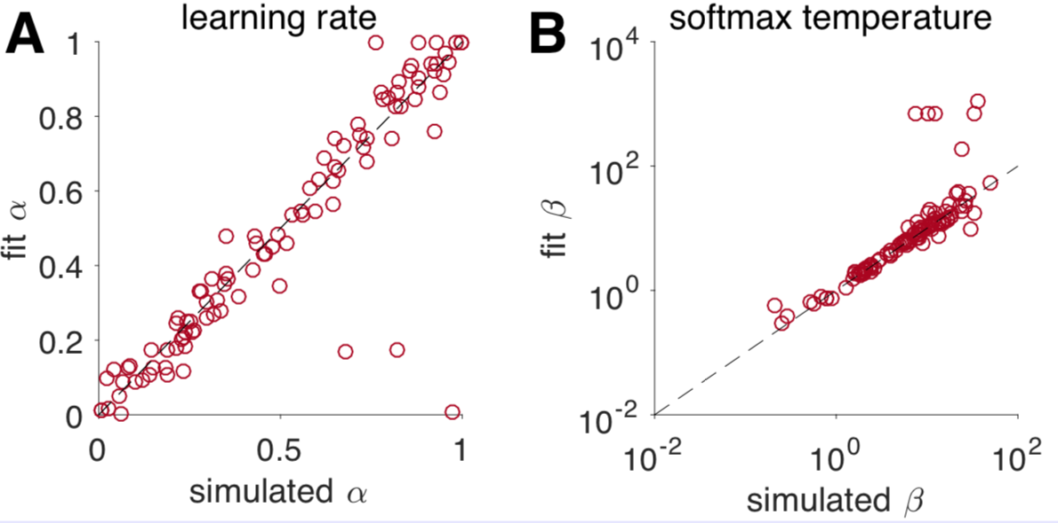
Parameter recovery
Focus on Model 3 Rescorla-Wagner: parameters alpha and beta
Take home messages
Make sure your simulation parameters are in the right range.
Plot the correlations between simulated and recovered parameters.
Make sure the recovery process does not introduce correlations between parameters.
IMPORTANT for examining parameter differences between different populations or conditions.
Remember that even successful parameter recovery represents a best-case scenario.

Slide 10
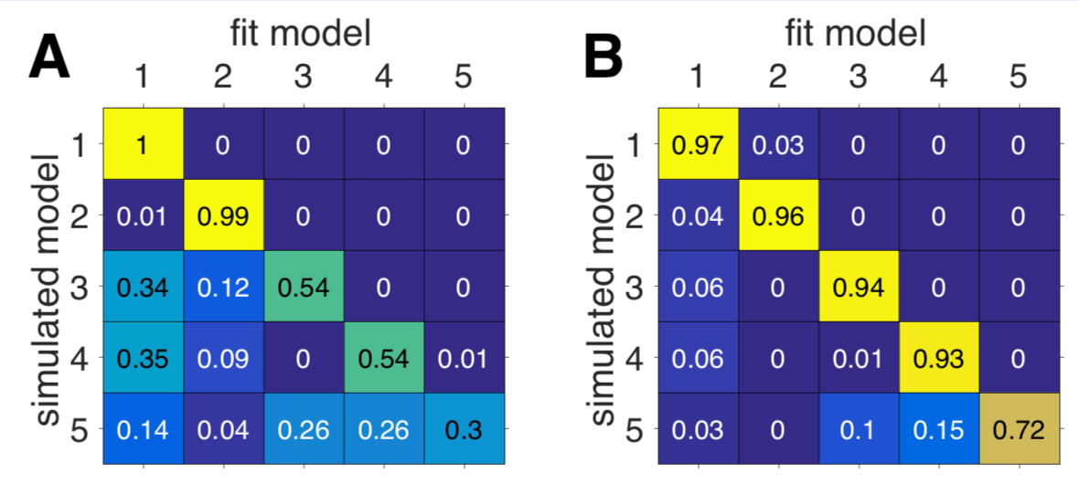
Model recovery
Among the set of models, which fits best?
Winning model corresponds to the lowest BIC = −2 log LL + k_{m} log(T)
Take home messages
Validate model comparison with simulated data.
Compare different methods of model comparison.
Remember that your best-fitting models is best only relative to the set of models you considered.

