Slide 1

Introduction to modelling of behavioral data
BAMB! Summer School Lecture I
Notes:
ADD SLIDE. HOW TO FIND ML: analytical (line reg, GLM), grid search, gradient descent (fmincon, tensorflow).

Slide 2
Life cycle of a modelling project
Our goal for today: cover all the steps involved in a modelling project using a toy model example
Defining a model
Simulating a model
Fitting a model to behavioral data
Validating the model against the data
Comparing various models on a dataset
Checking the validity of the model selection process

Slide 3
Part I Defining your model (a 5-step guide)
BAMB! Summer School Lecture I
Notes:
Add slide about ML being heavily biased by outliers

Slide 4


1. Start from a question
(about the brain)

Slide 5

2. Define your modelling objectives
“All models are wrong, some are useful.” George Box, 1976
Is a good model of ?

Slide 6
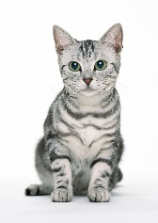
Predictive power vs. interpretability
the same cat
Artificial Neural Networks Support Vector Machines…
Regression analyses
Number of parameters
predictive power
Drift-Diffusion Model Reinforcement Learning models
How much the model tells you about the structure of data, i.e. cognitive processes at work
How precisely the model predicts actual behaviour
interpretability

Slide 7

A dual perspective on model evaluation
Outperforming other models on quantitative measures for how well the model explains the data (~ null hypothesis testing)
Capturing some qualitative properties of the data revealed by model-free analysis (e.g. psychometric curve)
Relative criterion
Absolute criterion
We want our model to pass both tests

Slide 8
Setting your modelling on firm experimental ground
Modelling does not spare looking for an experimental paradigm where models generate different conceptual predictions. Otherwise it is unlikely modelling can be of any help.
Modelling as support to standard analyses rather instead of standard analyses.
A good modelling won’t save a bad paradigm!

Slide 9
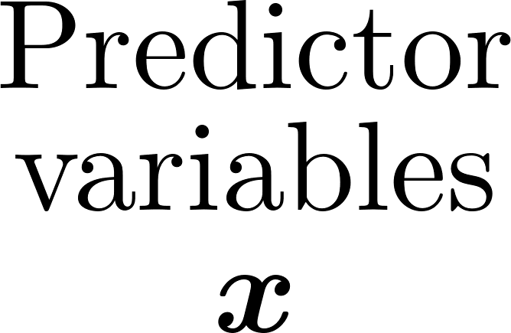
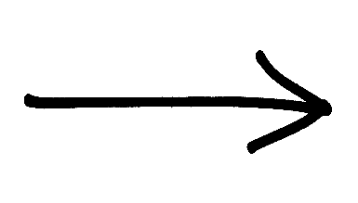
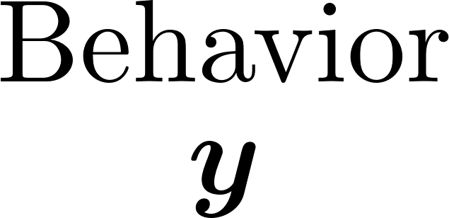

3. Define your input and output variables
Called independent variable, regressors, covariates, explanatory variables …:
Stimuli
Experimental conditions
History of stimuli, choices, outcomes, …
Peripheral marker (SCR, ECG, pupil dilation, …)
Neural marker (alpha power, ROI activity,…)
…
Called dependent variable, target variable …:
Choices
Reaction times
Confidence report
Movement time
Saccadic movements
Spatial trajectories
….
Notes:
Add slide illustration with detectino task (toy example to walk through) Generative only of behavior, not of covariates. So should be called ‘discriminative’ instead of ‘generative’ in pure stats terms.

Slide 10

Selecting output variables
The output variables should be sensitive to the process under study (sure)
Include more than one variable if they offer complimentary views on the process under study (e.g choice & RT in speeded perceptual tasks)
Day 2

Slide 11
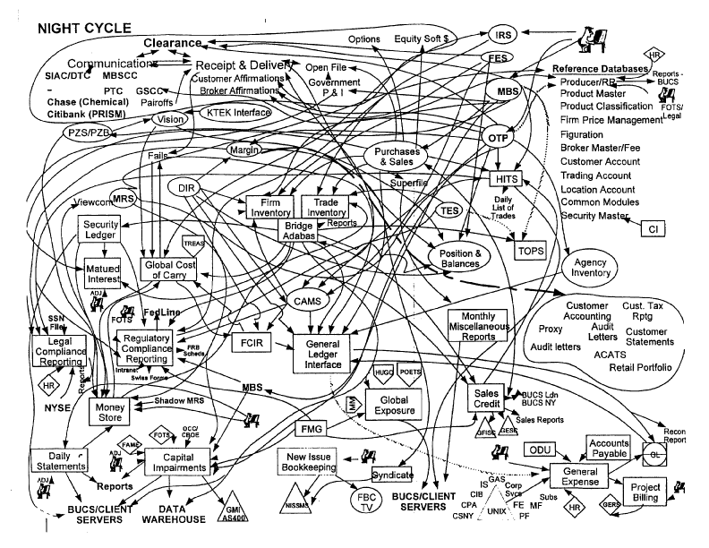
input variables = variables of interest + control variables
Should I include this control variable?
always when the control variable is correlated with the variable of interest -> regressing out the effect of control regressors
If it is not correlated with the variable of interest, adding the regressor can have two opposite effects:
if it has a strong influence on behavior, more variance is explained so the parameter for the variable of interest will be more precisely evaluated
If the influence is weak and the number of trials is low, more regressors may lead to more regressor correlation and so more estimation errors (overfitting)

Slide 12
4. Define your model as a box diagram
The diagram isolates cognitive processes at play in our behavior
Latent (or unobserved) variable
previous choice
action values
choice
reward
Day 3

Slide 13
5. Convert the diagram into a statistical model
We need to formalize our model by moving from a conceptual description to a computational level
Formalization allows:
Model estimation: compare parameters in different conditions, populations; infer latent variable to look for their neural substrate (e.g. model-based fMRI)
Model validation and comparison: can one model account for subject behavior? Better than others?
Model predictions: formalization allows to make specific predictions (both qualitative and quantitative) that often are difficult to formulate directly from a conceptual description.

Slide 14
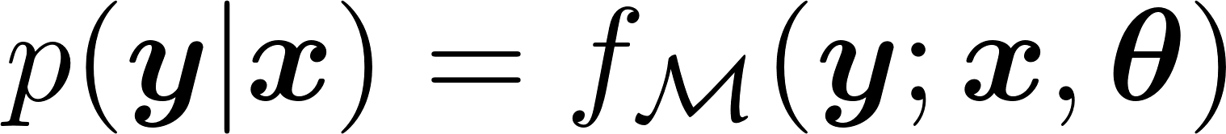


A statistical description of behavior
Parameters (properties of neural system), e.g. learning rate, sensitivity to motion, etc.
previous choice
action values
choice
reward
Turning arrows into (deterministic/stochastic) equations
action values:
choice:

Slide 15
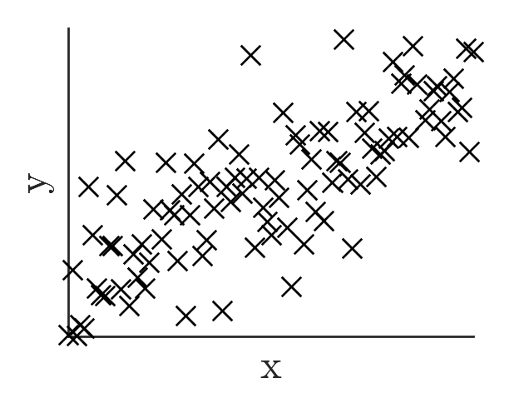
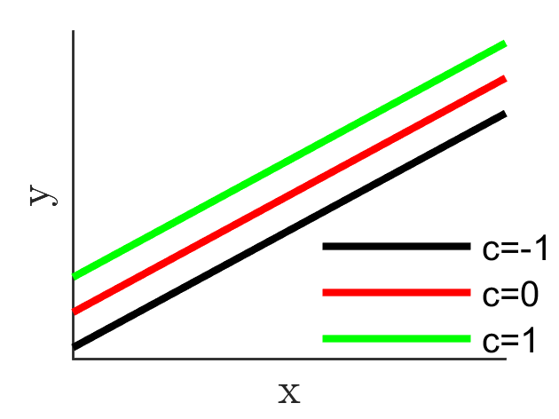
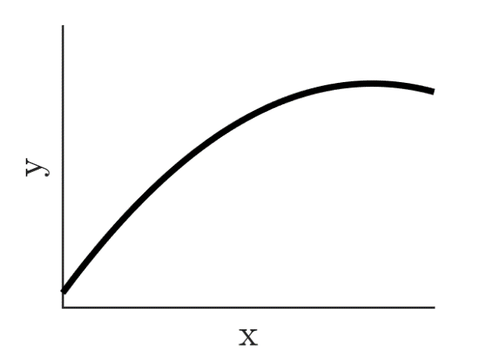
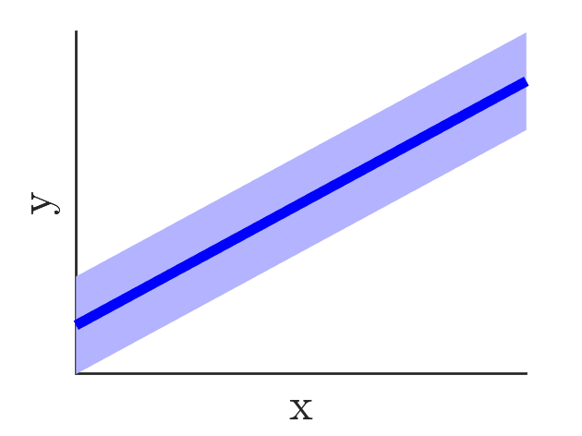
What’s that noise (in the model)?
‘Noise’ = all that cannot be accounted for by the deterministic part of the model:
Neural noise: low level variability in neural circuits / behavior (sensory, decision, motor…)
Factors not taken into account in the model (fluctuation in response bias, attention …)
Model imperfections: any systematic bias between the model predicted response and subject behavior that the model cannot accomodate
DATA
For different models accounting for the same data, the model that uses less noise explains the most structure in the data
MODEL
Notes:
See Yu&Huang 2014: matching law could instead be due to close to deterministic policy that evolves over time. We can play on 2nd and 3rd: Reducing estimated noise means we have a better predictive model.

Slide 16
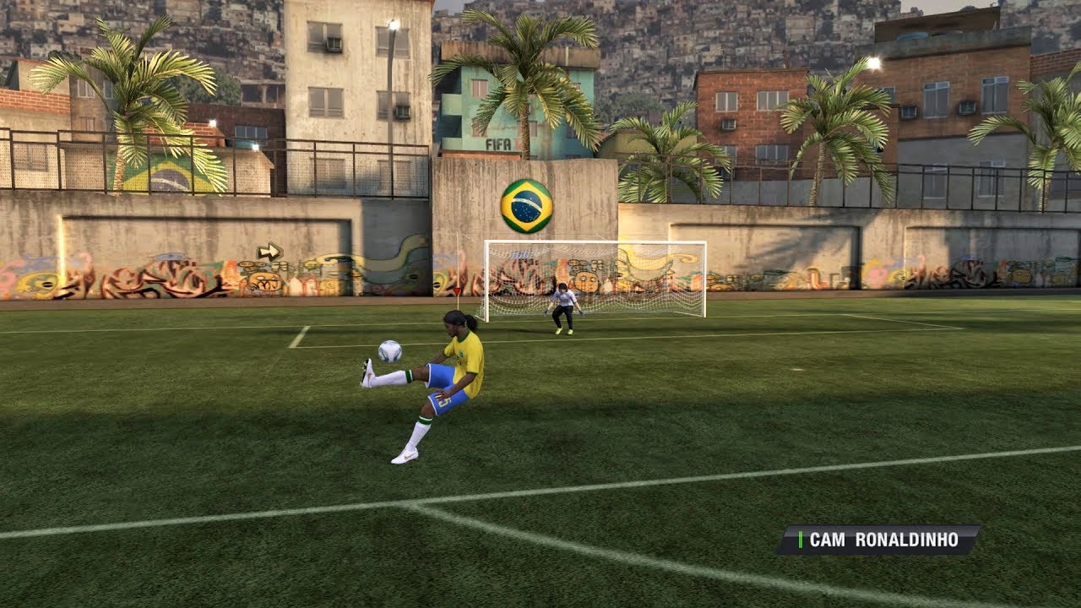
On the importance of simulating your model
Before fitting your model to data, it is important to simulate it (with various parameter sets) to develop intuitions about its behavior and understand how it is affected by the choice of parameters.

Slide 17
Preparing for tutorial part 1
Standard 2AFC motion discrimination task (left vs right)
Stimulus evidence is varied across 9 levels
In half trials, brain area X is experimentally deactivated
A reduction in performance is observed in those trials
Is it due to deteriorated sensory processing or to sensory unrelated effects (lapses)?

Slide 18
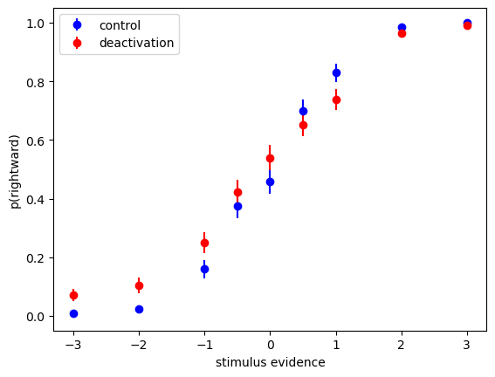
Defining the models
Scientific question: “Does deactivating brain area X deteriorate sensory processing or provokes sensory-unrelated effects (lapses)?”
2. Modelling objectives:
- which of two models representing each hypothesis better accounts for the data? (relative criterion) - does the favored model reproduces the change in the psychometric curve during deactivation?

Slide 19
Defining the models (cont’d)
Defining input and output variables: - output variable: choice (binary) - input variables: stimulus evidence (continuous), manipulation (binary)
Defining the models as box diagram:
Model A
Model B
stimulus
percept
choice
stimulus
percept
choice
manipulation
manipulation

Slide 20

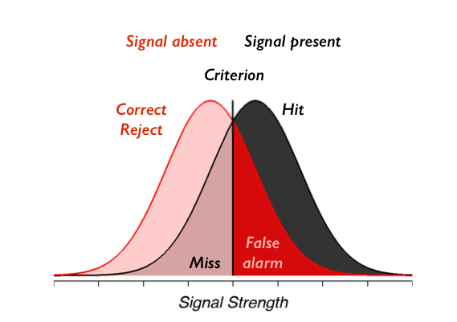
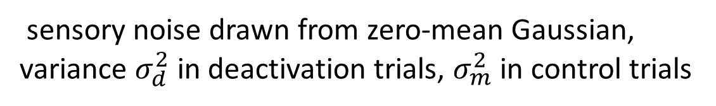
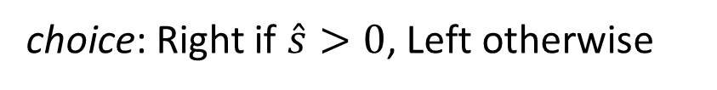
Defining the models (cont’d)
Convert model A to statistical model:
Signal detection theory
percept:
sensory noise drawn from zero-mean Gaussian, variance $σ_{d}^{2}$ in deactivation trials, $σ_{m}^{2}$ in control trials
choice: Right if $\hat{s}>0$, Left otherwise
Model A
stimulus
percept
choice
(image from Gardner lab)
manipulation

Slide 21
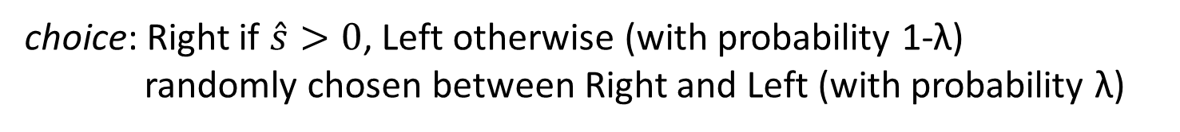
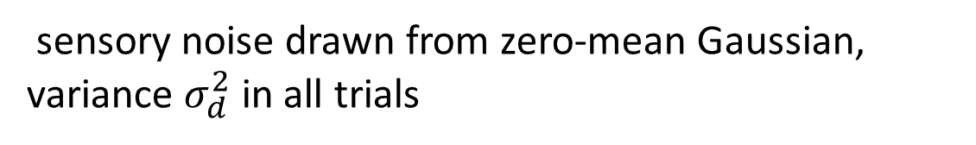
Defining the models (cont’d)
Convert model A to statistical model:
percept:
sensory noise drawn from zero-mean Gaussian, variance $σ_{d}^{2}$ in all trials
choice: Right if $\hat{s}>0$, Left otherwise (with probability 1-λ) randomly chosen between Right and Left (with probability λ)
Model B
stimulus
percept
choice
manipulation

Slide 22
Part II Fitting your model to data
BAMB! Summer School Lecture I
Notes:
Add slide about ML being heavily biased by outliers

Slide 23

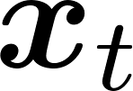
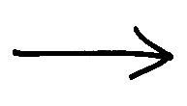
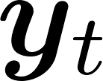

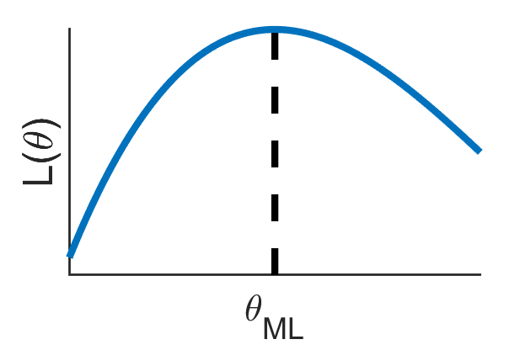
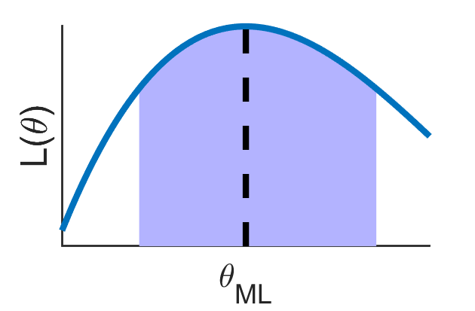
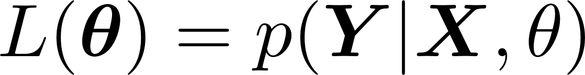
Parameter estimation (aka inference)
Generation:
Inference:
We want the parameters with better match between model behavior and observed behavior.
-> Optimize measure of how plausible would the experimental data be if the model were to be true, i.e. maximize likelihood:
confidence interval
That’s the frequentist approach
Notes:
Method-of-moments -> e.g. fit the psychometric curve.

Slide 24
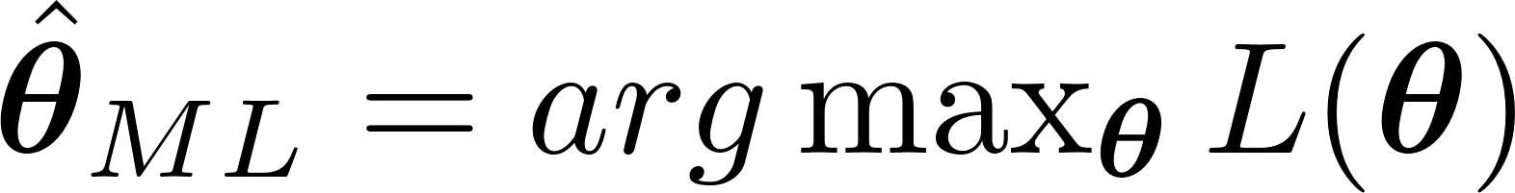
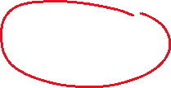
Maximum likelihood estimation
log-likelihood (LLH)
If behavior is independent across trials, LLH turns into sum of terms:
The sum is more practical to deal with for analytical and numerical reasons
Notes:
Add l_t(theta) (likelihood for one trial).

Slide 25
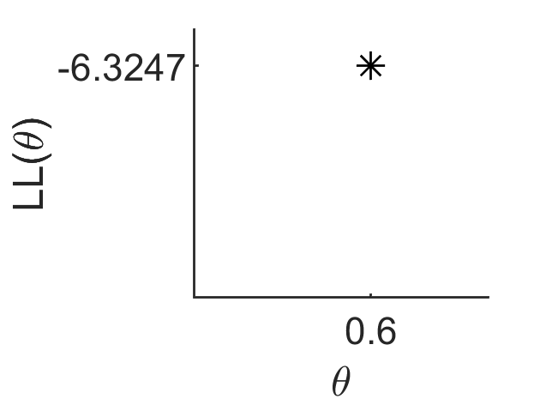
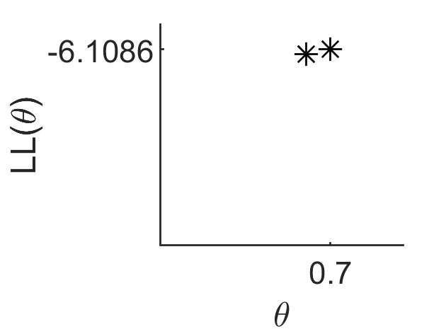
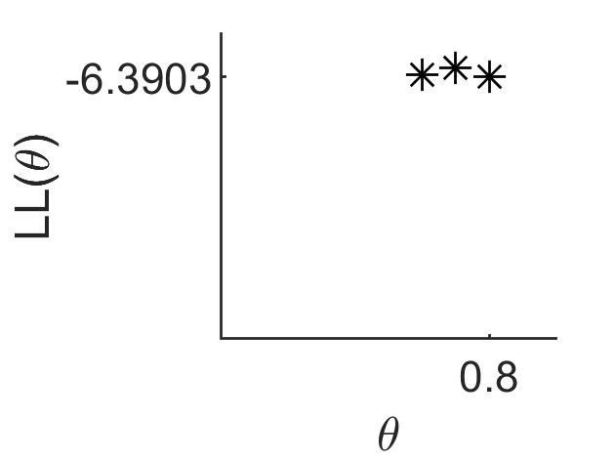
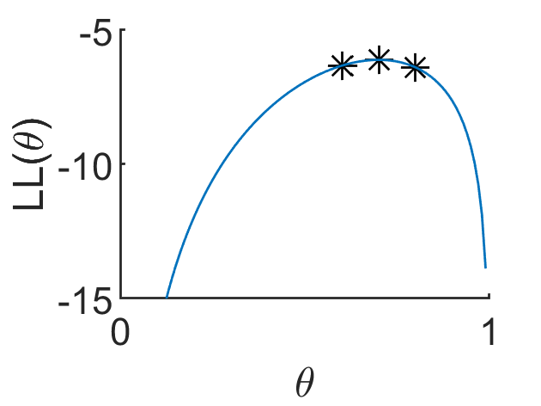
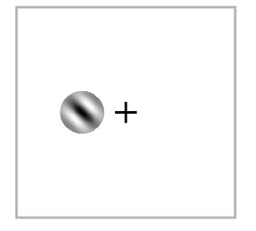
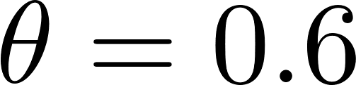

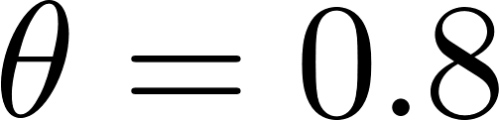
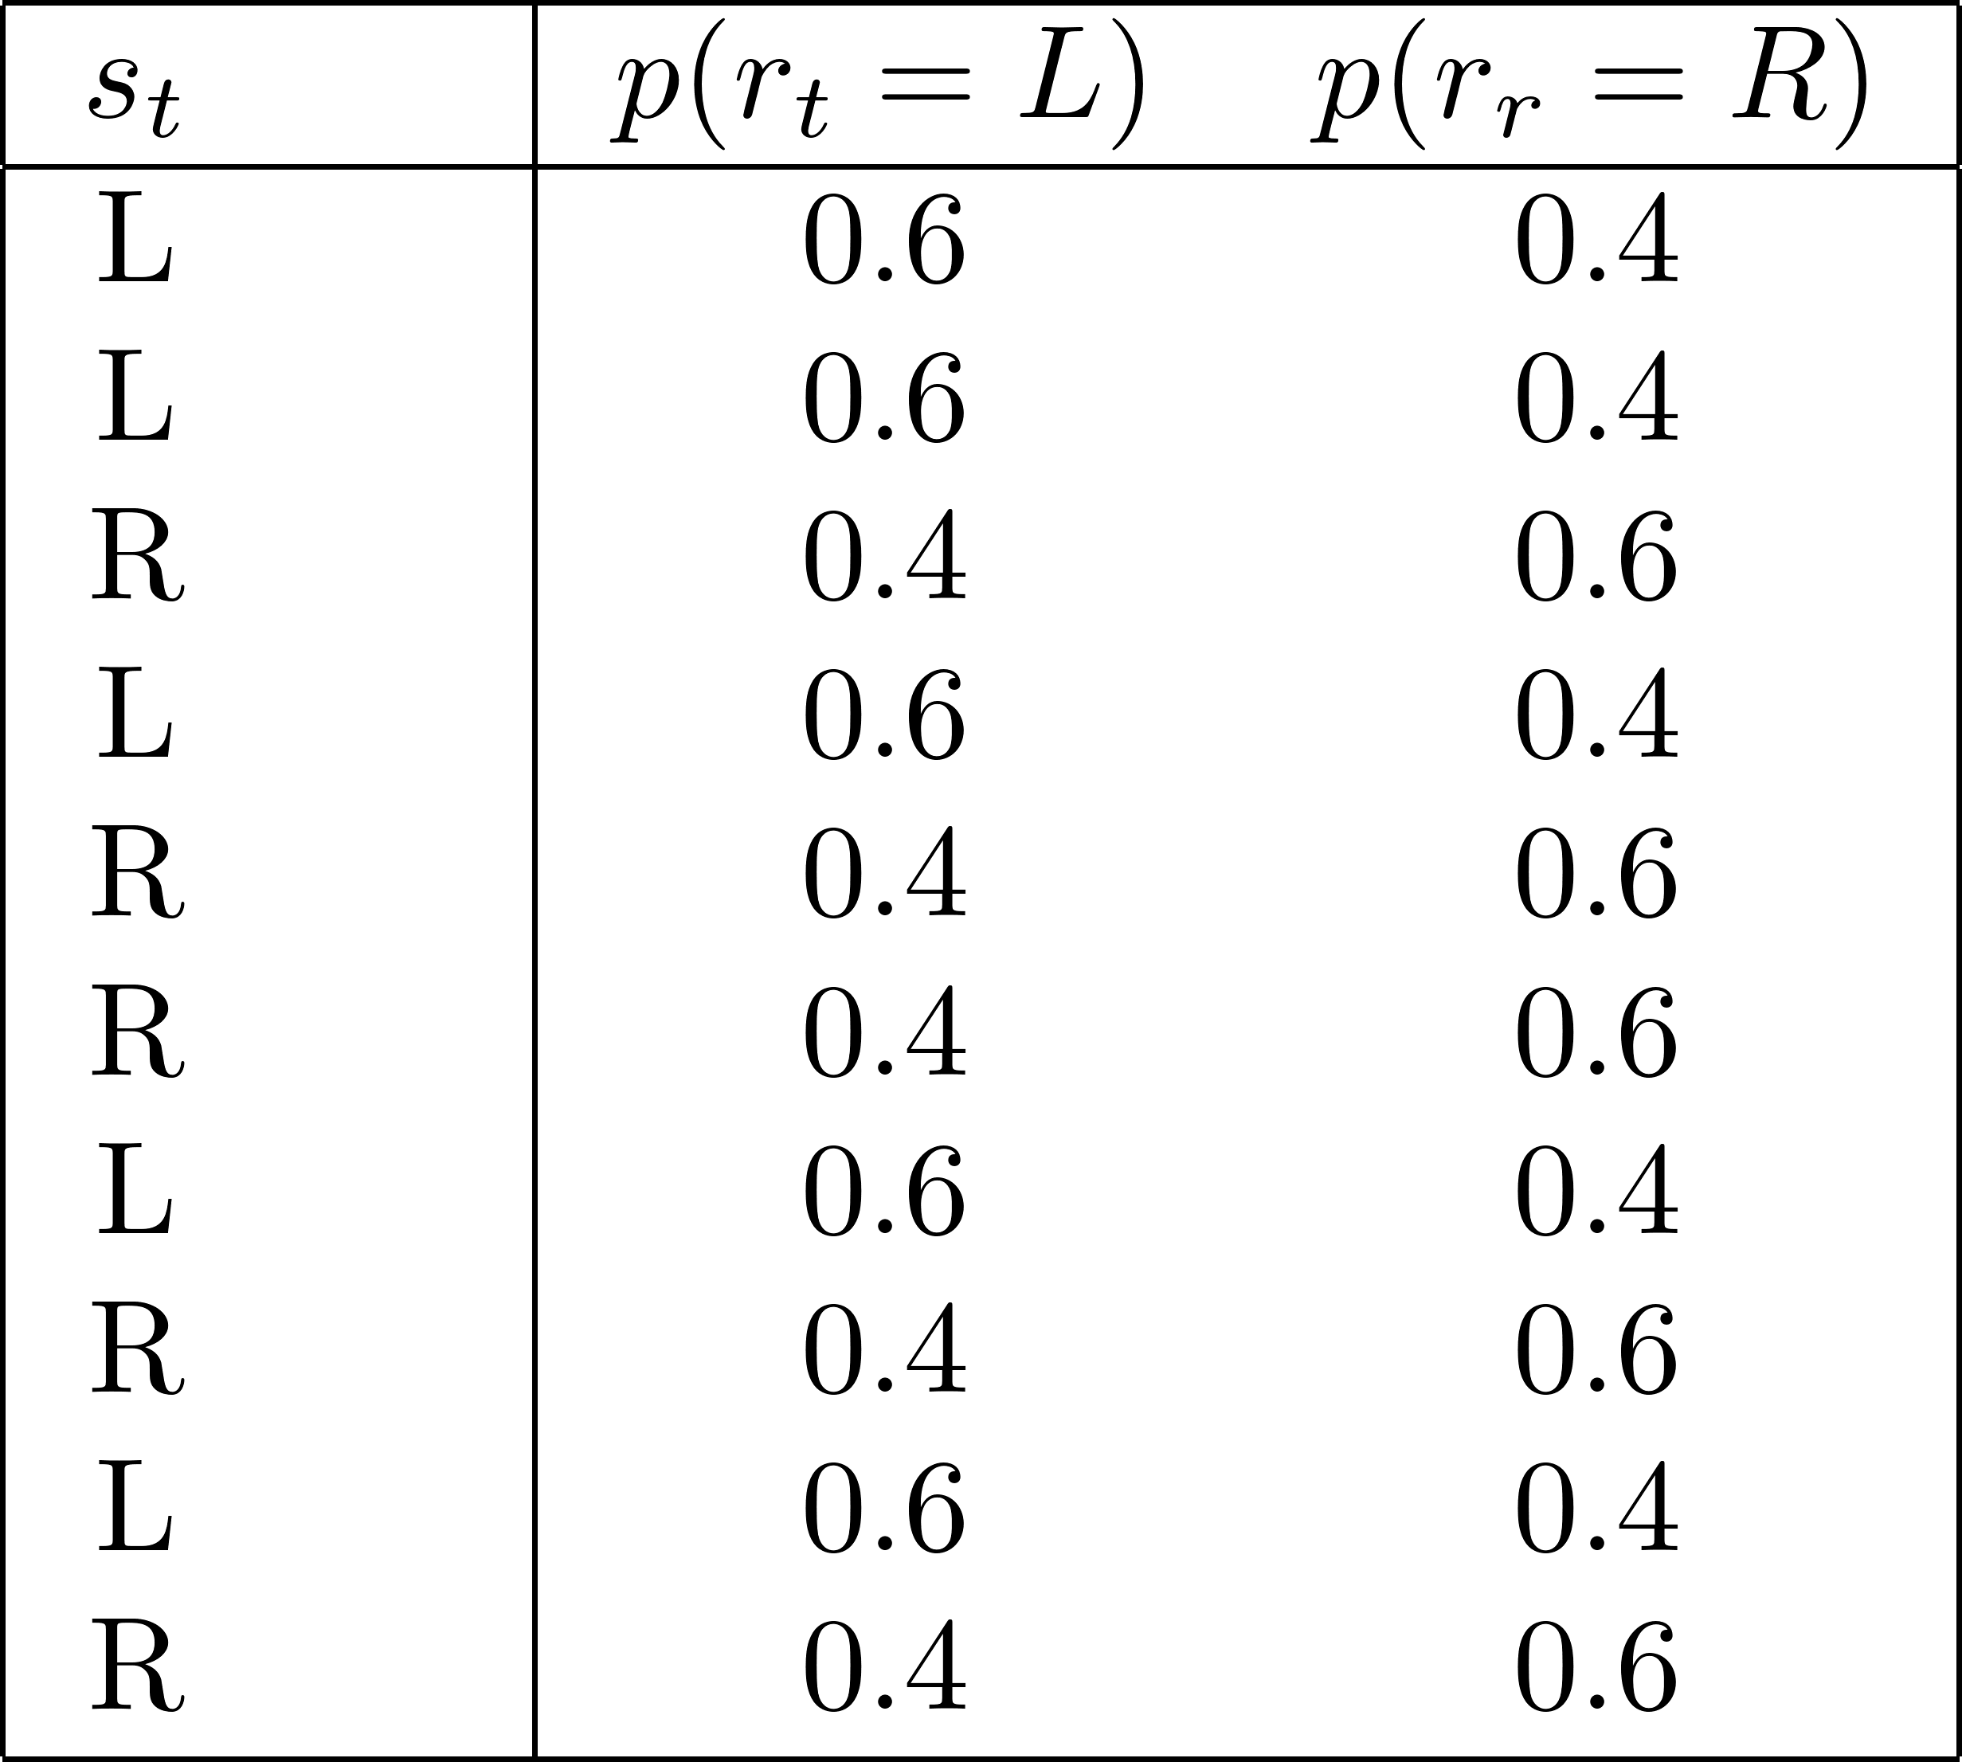
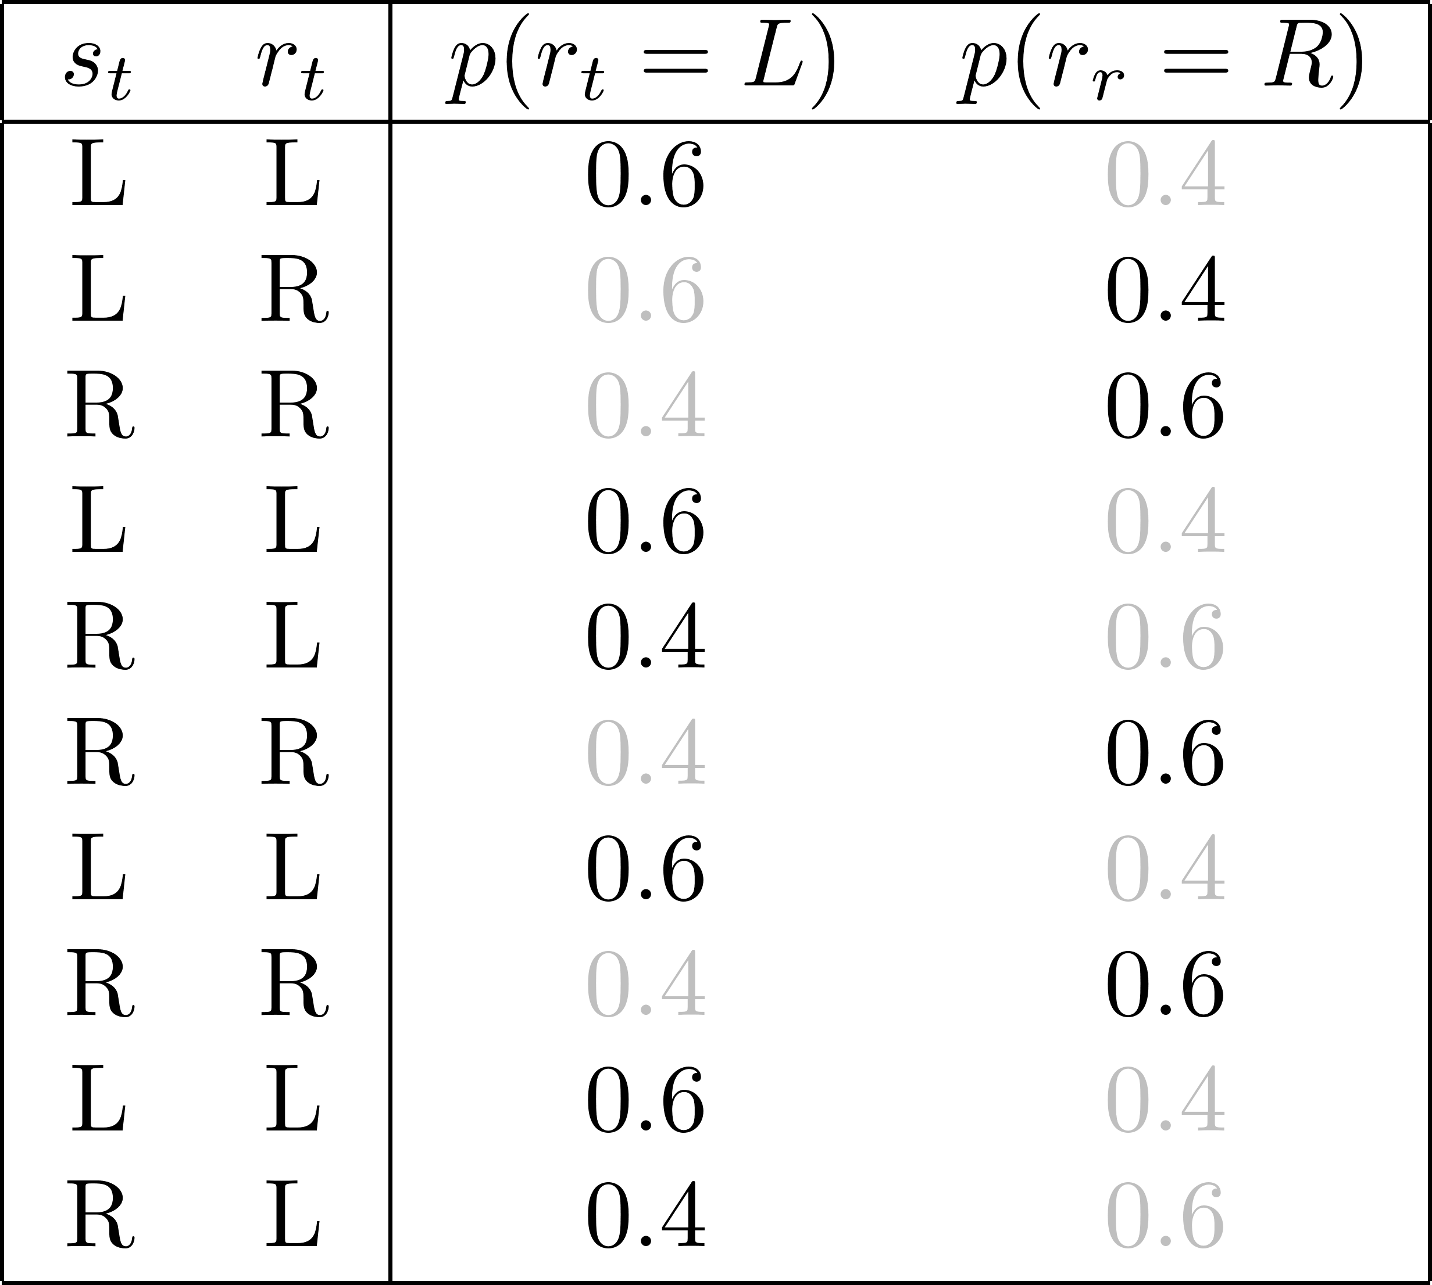
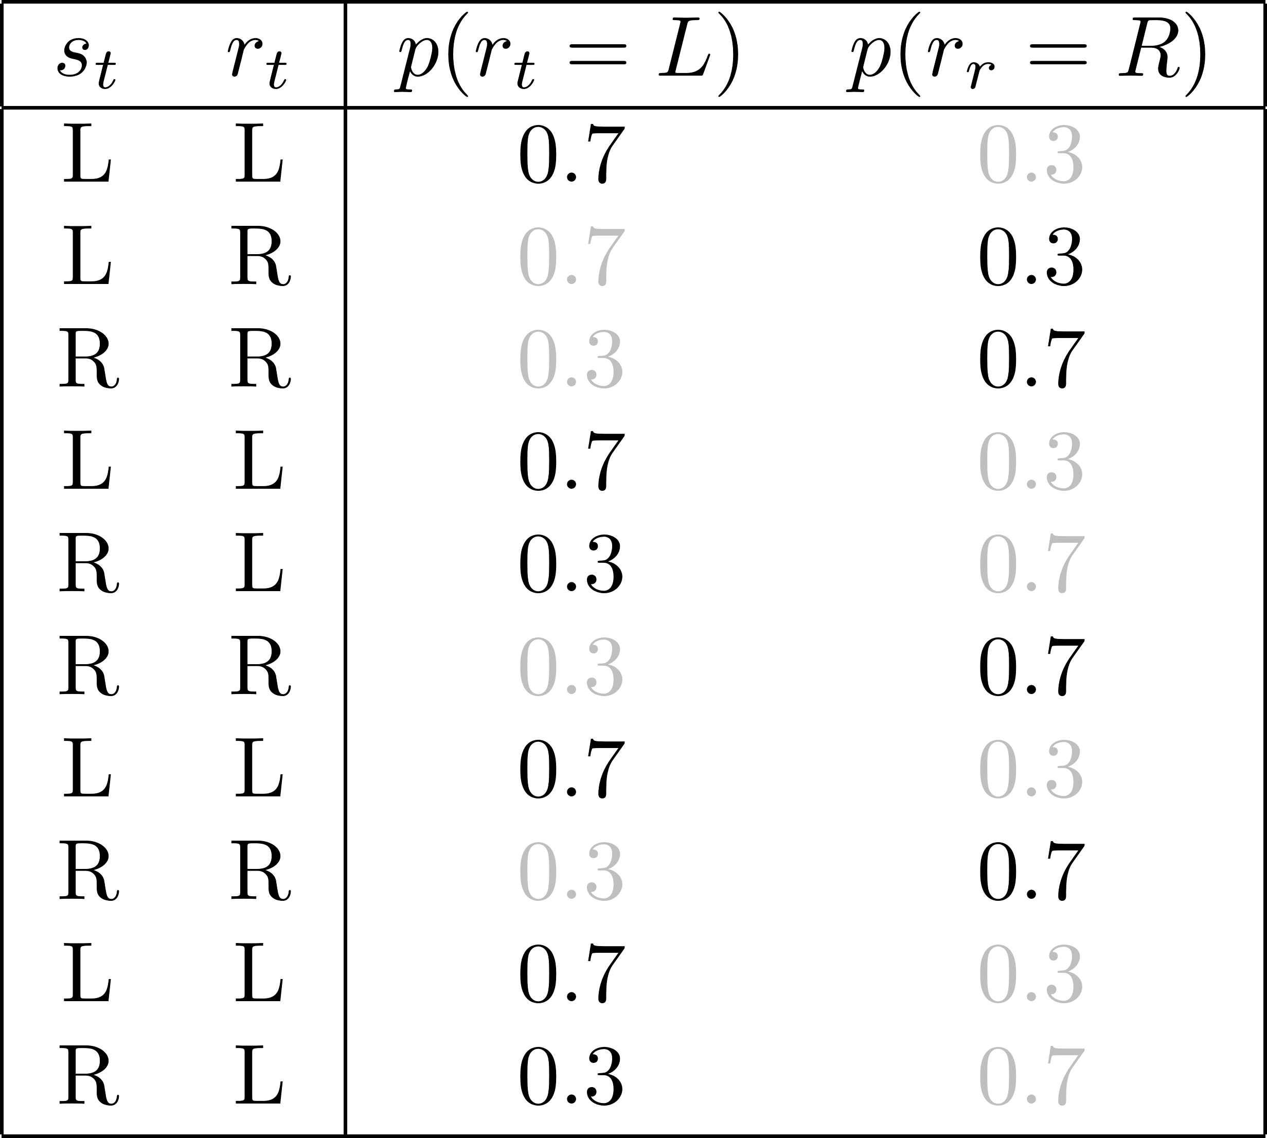
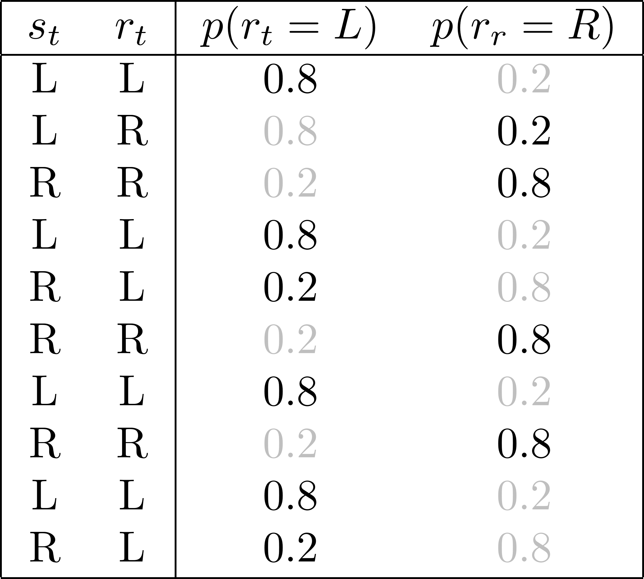
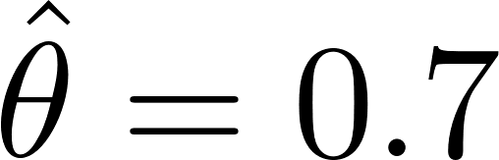

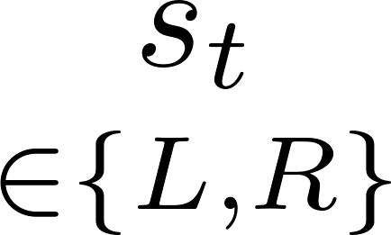
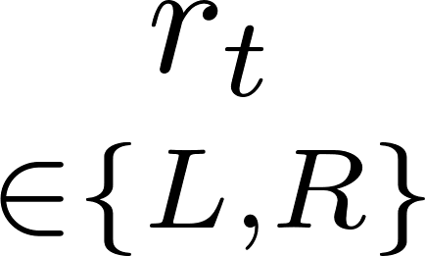
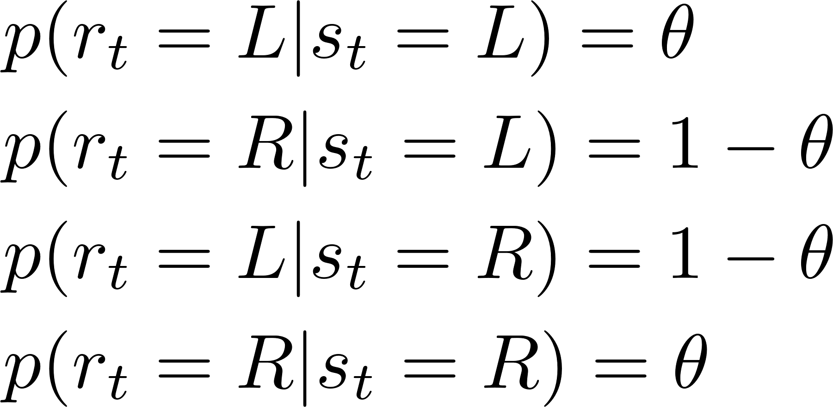
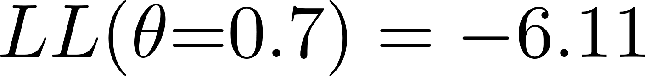
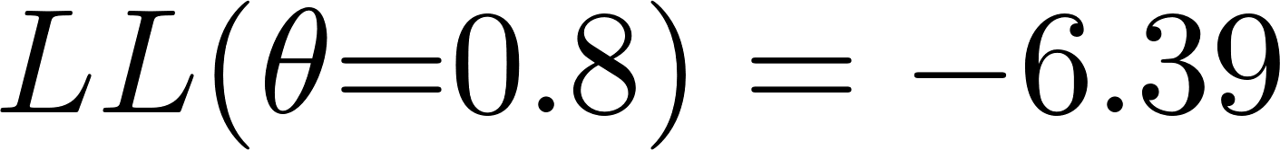
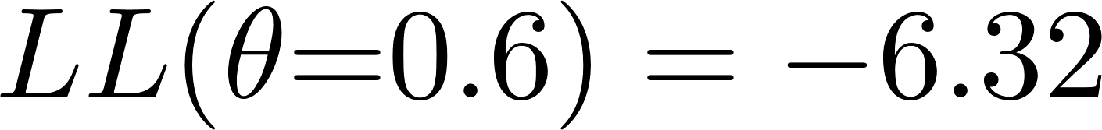
Toy example: 2 AFC detection task
Probability of selecting the side where the stimulus appeared
Notes:
Add slide: methods to find LLH

Slide 26
References
Palminteri, S., Wyart, V., & Koechlin, E. (2017, June 1). The Importance of Falsification in Computational Cognitive Modeling. Trends in Cognitive Sciences, Vol. 21, pp. 425–433. https://doi.org/10.1016/j.tics.2017.03.011
Wilson, R., & Collins, A. G. E. (n.d.). Ten simple rules for the computational modeling of behavioral data. https://doi.org/10.31234/OSF.IO/46MBN
Nassar, M. R., & Frank, M. J. (2016). Taming the beast: Extracting generalizable knowledge from computational models of cognition. Current Opinion in Behavioral Sciences, Vol. 11, pp. 49–54. https://doi.org/10.1016/j.cobeha.2016.04.003
Bishop, C. M. (2006). Pattern Recognition and Machine Learning, Chapter 3. In Vasa. Retrieved from http://medcontent.metapress.com/index/A65RM03P4874243N.pdf

Slide 27
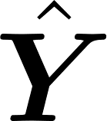
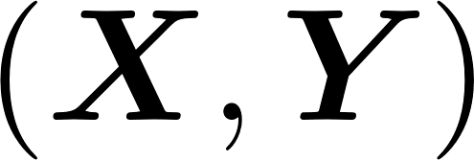


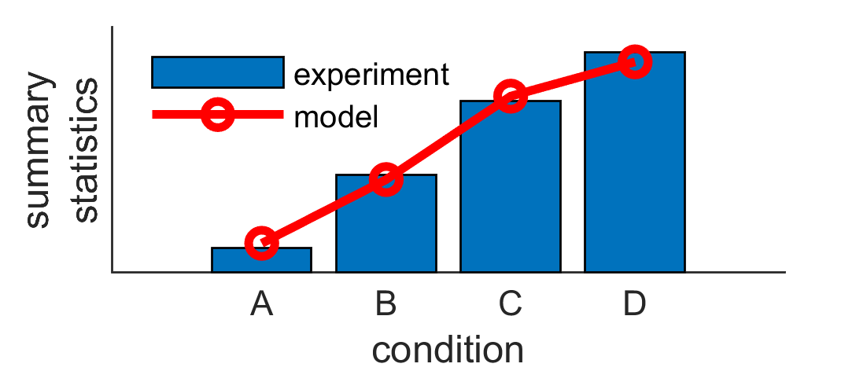



Model validation
Tutorial 7
Also called Posterior Predictive Checks
Similar to tests of goodness-of-fit
2) Simulate model with same predictors as subjects
1) Estimate model parameters
3) Compare simulated data with experimental data on descriptive statistics
Caution! CIRCULAR ANALYSIS
Notes:
e.g. plot average value of detection in bins of 20, should be constant… change ylabel to descriptive stats

Slide 28
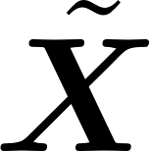
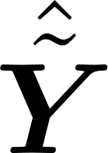
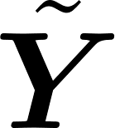
Model prediction
Tutorial 7
2) Simulate model on different data set
1) Estimate model parameters
3) Compare simulated data with experimental data on descriptive statistics
Same dependent variable Different dataset
We avoid the circularity of model validation
Notes:
Refer to cross-validation

Slide 29
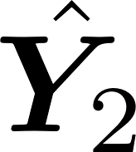



Model prediction (alternative)
Tutorial 7
2) Simulate different dependent variable
1) Estimate model parameters
3) Compare simulated data with experimental data on descriptive statistics
Different dependent variable Same dataset
e.g. reaction time
e.g. choice

Slide 30












Population-level analyses
Lecture 8
We want to infer from a sample of subjects conclusions about general population(s)
Subject 1:
Subject 2:
Summary statistics
approach
….
Subject m:
Mixed models
Notes:
Add mixed models

Slide 31



The interpretability of parameters is bounded by parameter assumption
A T-test is only valid if data is (approximately) normally distributed.
I collect RTs and choices from two experimental conditions and fit a Drift-Diffusion Model to it, allowing different drift rates between the conditions:
But maybe….
(Nassar & Frank 2016)
Notes:
Change with detection example: incorrect conclusions from theta if there is a lapse asymmetry, or if learning…

