Slide 1

1C - Model comparison
Marion Rouault
CNRS & Paris Brain Institute
marion.rouault@gmail.com
BAMB! 2023 Summer School

Slide 2
The plan for the next 120 minutes
Model selection
Goodness of fit: what makes a good model?
Quantitative criteria (AIC, BIC, Bayes factor, elbo)
Cross-validation
  For model comparison and generalization
Model recovery (with confusion matrix)

Slide 3
The plan for the next 120 minutes
Model selection
Goodness of fit: what makes a good model?
Quantitative criteria (AIC, BIC, Bayes factor, elbo)
Cross-validation
  For model comparison and generalization
Model recovery (with confusion matrix)

Slide 4
Quantitative criteria
Usually, there are several candidate models that potentially describe the behaviour and/or cognitive process you are interested in
The goal of model selection is to choose one of these models based on your data
In brief, the idea is:
• You define a minimum contrast estimator (e.g., log likelihood, least squares, ...) for each model
• Then you choose the model with the lowest estimator
The main problem: same data are used for training the algorithms and for choosing one

Slide 5
Quantitative criteria
The number of models of even simple experiments grows very quickly
Suppose that you have two experimental design factors, A and B
Possible (linear) models include:
single estimated value (constant)
a main effect of A or B
both main effects and their interaction
Hence 2^{f} models to select from (f being the number of factors)
Plus, if you allow m types of model parameter this freedom, you get 2^{f*m}
number of variants
Heathcote, Brown, Wagenmakers (2015)

Slide 6
Goodness of fit
We can just take how good models are fitting and correct for the number of free parameters
We can fit on one part of the data and see how good the model is at predicting data that we have not used for fitting (Cross-validation)
Measures of model evidence
  – Akaike Information Criterion (AIC)
  – Bayesian Information Criterion (BIC)
  – Variational Bayes (VB)
  negative free energy as lower bound approximation to the log
  evidence (“evidence lower bound” (ELBO), cf. Luigi Acerbi)
  – Sampling-based methods
Notes:
Lower bound on the log model evidence (the ELBO

Slide 7
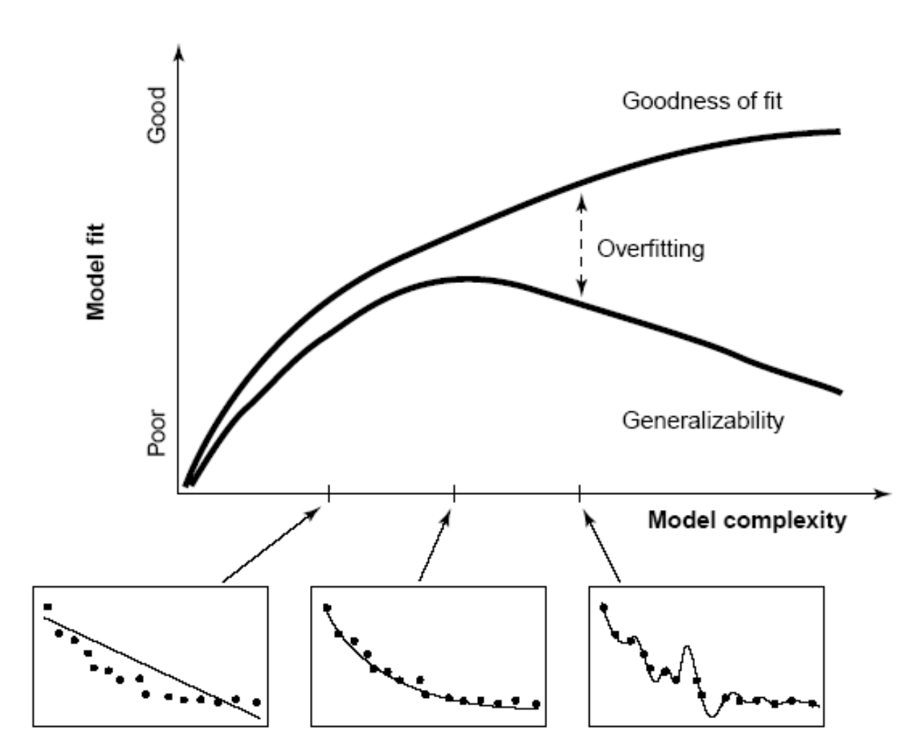
Goodness of fit
Which model represents the best trade-off between model fit and model complexity? Pitt & Miyung (2002) TICS

Slide 8
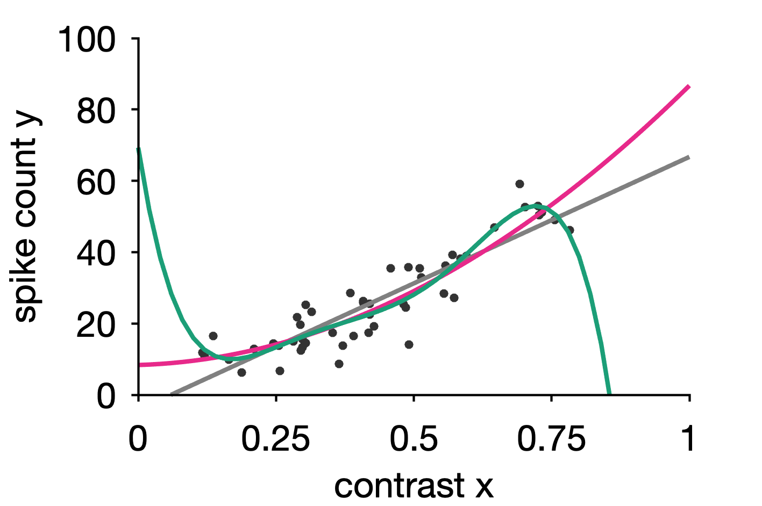
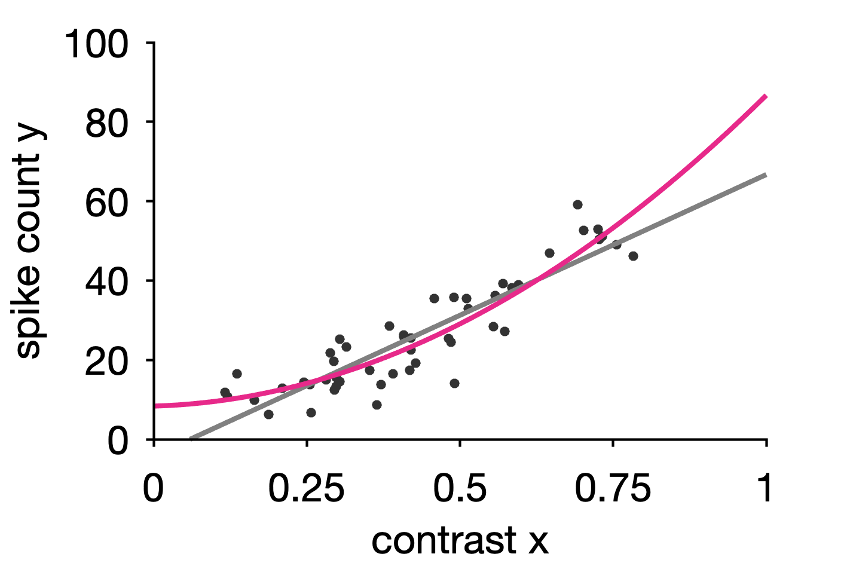
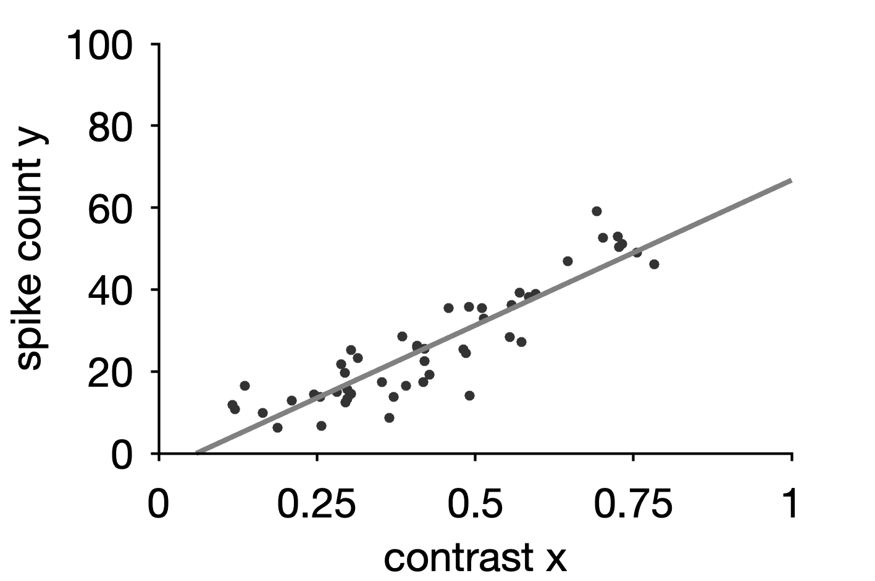
Comparing models
2nd order polynomial
line
5th order
polynomial
Notes:
for these polynomial fits, the reason that MSE keeps dropping as we increase the order is because, as the model complexity increases, the bias decreases.
Thus the bias curve should be aligned with MSE.
We also say that usually the model under fits the data which means missing a lot of data points thus the bias is high.
On the contrary, the variance increases as the model complexities increases.
And we say the model over fits the data which means trying to fit all the data, thus the variance is high.
We define the total error to be the sum of bias and variance which has a valley in the middle.
The best model is chosen when the total error is small.

Slide 9
Bias-variance trade-off
Bias
Low model complexity: systematic deviation from structure underlying data (underfitting)
best
model
model error
total
Variance
High model complexity: capturing variability beyond the structure underlying data (i.e., noise; overfitting)
bias
variance
model complexity
model complexity
underfitting
overfitting
Total error = bias + variance
Best model 🏆
balances bias and variance
Notes:
Bias is the difference between the prediction of the model and the corresponding true output variables you are trying to predict.
Models with high bias will not fit the training data well since the predictions are quite different from the true data.
These high bias models are overly simplified - they do not have enough parameters and complexity to accurately capture the patterns in the data and are thus underfitting.
Variance refers to the variability of model predictions for a given input.
Essentially, do the model predictions change a lot with changes in the exact training data used?
Models with high variance are highly dependent on the exact training data used - they will not generalize well to test data.
These high variance models are overfitting the data.

Slide 10
Quantitative criteria
popular: Information criteria : AIC & BIC
simple and transparent in how they quantify the trade-off between parsimony and goodness of fit
trade-off: criterion = goodness of fit - model complexity
small = good
relatively easy to compute assuming known estimates of parameters
each criterion is correct for certain assumptions ONLY and they are widely employed (despite assumptions not always met in practice..)
Vandekerckhove et al. (2015)

Slide 11
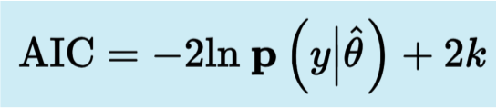
Comparing models while correcting for model complexity
When we do a regular ML fit of a model we get the likelihood
But if we have more parameters this always gets better (e.g. quadratic describes more variance as linear etc).
There is a first order way of correcting for this: Akaike Information Criterion (AIC) (k=number of parameters)
We prefer models with lower AIC - every parameter costs something
Likelihood of best fit

Slide 12
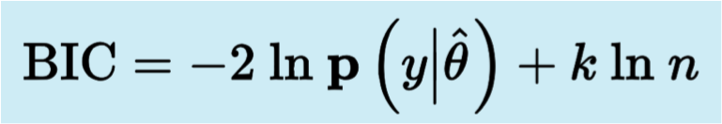
Quantitative criteria
Bayesian Information Criterion (BIC) penalizes model complexity more severely (k=number of parameters, n=number of data points)
Everything else being equal, BIC tends to select models less complex than those selected via AIC
In cognitive and behavioral science, often our data points are trials or decisions or responses 🧠
BIC and AIC weigh equally all data points ...
... But not all responses matter equally ⚖️
e.g. at reversal, differences, but at plateau, all models perform well

Slide 13
Model selection
Goodness of fit: what makes a good model?
Quantitative criteria (AIC, BIC, Bayes factor, elbo)
Cross-validation
  For model comparison and generalization
Model recovery (with confusion matrix)

Slide 14
Cross validation – general principles
• The preferred model class is the one whose (weighted) parameterized models best predict unseen data from the same source
• Validation methods divide the observed data in a training set and a test set, there are many ways in which this can be done
• We fit on one part of the data and see how good the model is at predicting data that we have not used for fitting
👍 minimal assumptions required about your data
👎 computationally expensive

Slide 15
Cross validation
Person presents at ER with a headache
Your goal is to predict whether person needs urgent further examination
Fever | Neck stiffness | Abrupt onset | Age | Urgent further exam
38 | Yes | No | 42 | No
38 | No | Yes | 51 | Yes
... | ... | ... | ... | ...
Then we see a new patient 🥴
?

Slide 16
Cross validation
Person presents at ER with a headache
Your goal is to predict whether person needs urgent further examination
Fever | Neck stiffness | Abrupt onset | Age | Urgent further exam
38 | Yes | No | 42 | No
38 | No | Yes | 51 | Yes
... | ... | ... | ... | ...
Then we see a new patient 🥴
?
We want to use the variables: fever, etc to predict Y = urgent exam needed or not

Slide 17
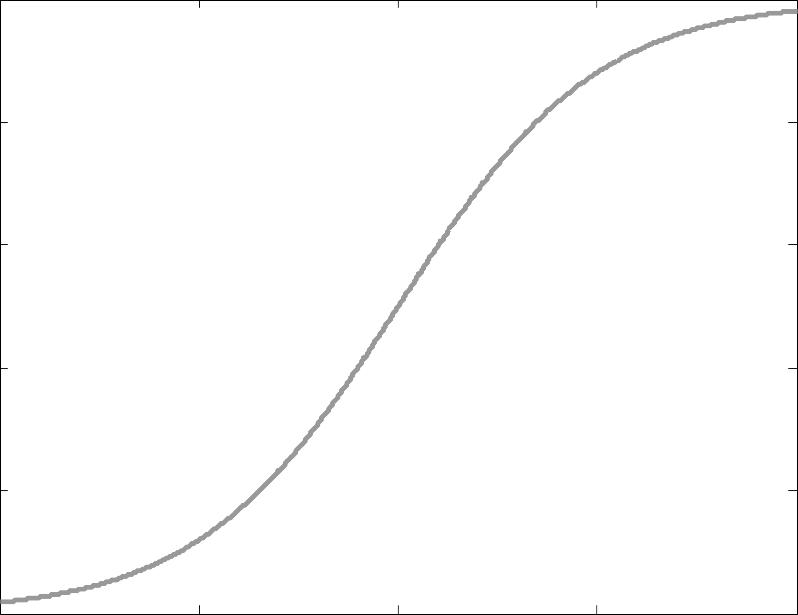
Cross validation
We seek a model to relate to
e.g. a logistic regression Y = Fever + Age + ...
Y = need for urgent exam

Slide 18
Cross validation
We seek a model to relate to
e.g. a logistic regression Y = Fever + Age + ...
Cross-validation allows us to compare different models/methods and get a sense
of how well they work in practice
Y = need for urgent exam

Slide 19
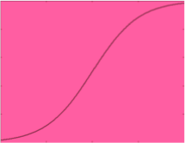
Cross validation
This is all your data collected
about people who needed or not
needed urgent further exam
With your data you have to:
Estimate model parameters (weights) of variables Fever, Age, etc. for the regression
i. e. TRAINING
Evaluate how well your model (regression) works
i. e. TESTING
Does the obtained curve do a good job in categorizing new data?

Slide 20
Cross validation
With your data you have to:
Estimate model parameters (weights) of variables Fever, Age, etc. for the regression
i. e. TRAINING
Evaluate how well your model (regression) works
i. e. TESTING
Notes:
So we need our two steps training and testing

Slide 21
Cross validation
⛔ A bad approach would be to use ALL our data to achieve this
and estimate the
parameters (slope):
Y = need for urgent exam
With your data you have to:
Estimate model parameters (weights) of variables Fever, Age, etc. for the regression
i. e. TRAINING
Evaluate how well your model (regression) works
i. e. TESTING

Slide 22
Cross validation
⛔ A bad approach would be to use ALL our data to achieve this
and estimate the
parameters (slope):
Y = need for urgent exam
With your data you have to:
Estimate model parameters (weights) of variables Fever, Age, etc. for the regression
i. e. TRAINING
Evaluate how well your model (regression) works
i. e. TESTING
Then you would have no data left to test your model 😥

Slide 23
Cross validation
💡 A slightly better approach would be to use 75% of your data to achieve the training
and estimate the
parameters (slope):
Y = need for urgent exam

Slide 24
Cross validation
💡 A slightly better approach would be to use 75% of your data to achieve the training
and estimate the
parameters (slope):
Y = need for urgent exam
💡 And the last 25% for testing:

Slide 25
Cross validation
💡 A slightly better approach would be to use 75% of your data to achieve the training
and estimate the
parameters (slope):
Y = need for urgent exam
💡 And the last 25% for testing:
✅ We can then compare models by examining how well each one categorises the test data

Slide 26
Cross validation
But how do you know that this is the best way to split your data into 75% for training and 25% for testing?

Slide 27
Cross validation
But how do you know that this is the best way to split your data into 75% for training and 25% for testing?

Slide 28
Cross validation
But how do you know that this is the best way to split your data into 75% for training and 25% for testing?
Cross-validation uses of all these blocks, one at a time, and summarizes the results at the end
Notes:
Rather than worrying about which of these blocks would be best for testing, cross validation uses all of them, one at a time, and summarizes the results at the end

Slide 29
Cross validation
You keep track of how well
the model does:
Y = need for urgent exam
Test data categorization
Correct✔️ Incorrect❌
3 1

Slide 30
Cross validation
You keep track of how well
the model does:
Y = need for urgent exam
Test data categorization
Correct✔️ Incorrect❌
4 0

Slide 31
Cross validation
You keep track of how well
the model does:
Y = need for urgent exam
Test data categorization
Correct✔️ Incorrect❌
2 2

Slide 32
Cross validation
You keep track of how well
the model does:
Y = need for urgent exam
Test data categorization
Correct✔️ Incorrect❌
3 1

Slide 33
Cross validation
In the end, every block of data has been used for testing
Hence you know how well
the model does OVERALL:
Y = need for urgent exam
Test data categorization
Correct✔️ Incorrect❌
12 4

Slide 34
Cross validation
Hence you know how well
the model does OVERALL:
ModelA
Y = need for urgent exam
Test data categorization
Correct✔️ Incorrect❌
12 4

Slide 35
Cross validation
Hence you know how well
the model does OVERALL:
ModelA
Y = need for urgent exam
Test data categorization
Correct✔️ Incorrect❌
12 4
Test data categorization
Correct✔️ Incorrect❌
10 6
ModelB

Slide 36
Cross validation
Hence you know how well
the model does OVERALL:
ModelA
Y = need for urgent exam
Test data categorization
Correct✔️ Incorrect❌
12 4
Test data categorization
Correct✔️ Incorrect❌
10 6
ModelB
ModelC
ModelD
ModelE
Notes:
And we can compare models or methods by comparing how well they performed

Slide 37
Cross validation
“Four-fold” cross-validation
Number of divisions is arbitrary
Ten-fold cross-validation is common

Slide 38
Cross validation
“Four-fold” cross-validation
Number of divisions is arbitrary
Ten-fold cross-validation is common

Slide 39
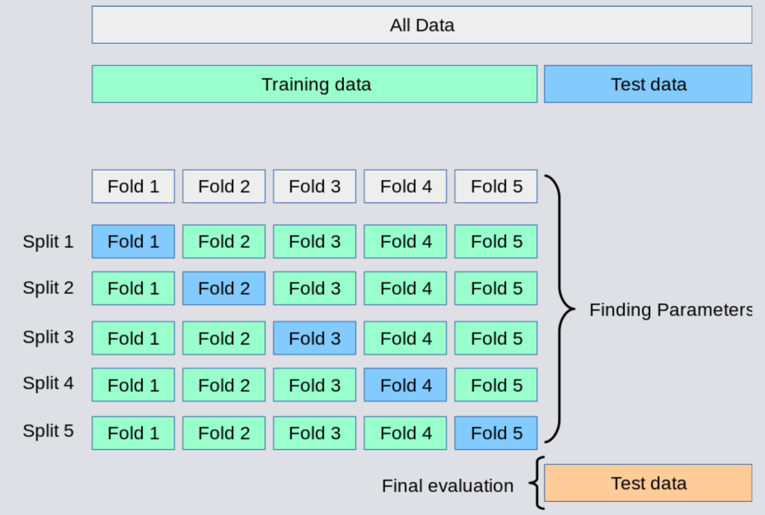
Nested cross-validation
Evaluation of the parameters by 10-fold cross validation (“outer folds”)
The parameters themselves were tuned by 10-fold cross validation (“inner folds”)
Rotate through inner and outer folds: a lot of work 💪
Notes:
Inner folds/outer folds
Sometimes we hold out data completely separately
And we adjust the parameters using cross validation on so-called inner folds: internal cross-validation INSIDE the training set for tuning the model parameters
As we will see with regularized regression

Slide 40
Cross validation
Extreme case of cross-validation: leave-one-out cross-validation
Instead of 10-fold or 10 blocks division of your data, each division is one participant
Popular in fMRI
• Remove one data point
• Train on all but R-1 data points, where R is the total number of data points
• Test on remaining data point and record error
• Repeat for all R data points
• Report mean error
• Computationally expensive 🤑

Slide 41
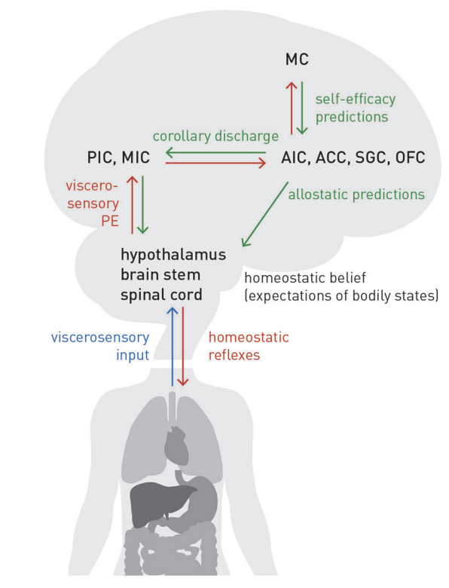
Cross validation example
Theorical argument
Linking fatigue, interoception and metacognition
Empirical work
71 participants with multiple sclerosis
Y = degree of fatigue experienced
14 measurements: neuropsychological assessments, physiological assessments including interoceptive awareness and interoceptive beliefs, (meta)cognitive task assessments
Stephan et al. (2016) Frontiers; Rouault et al. (2023) European J of Neurosci

Slide 42
Model selection
Goodness of fit: what makes a good model?
Quantitative criteria (AIC, BIC, Bayes factor, elbo)
Cross-validation
  For model comparison and generalization
Model recovery (with confusion matrix)

Slide 43
Model recovery
Simulate data for your model space: only a limited number of models can be tested, carefully consider your choice
Fit each model to all simulated data sets based on each model

Slide 44
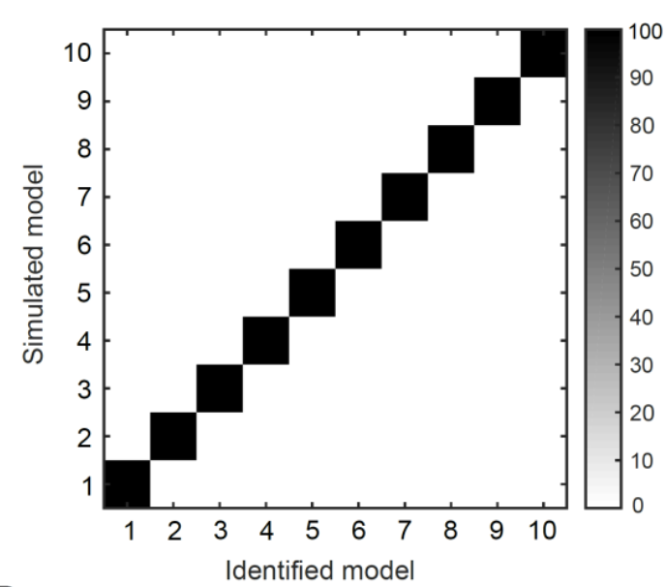
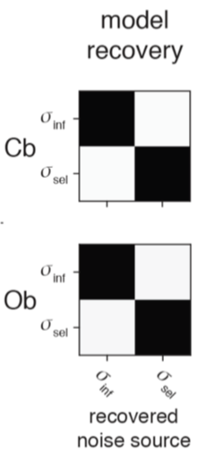
Model recovery
Simulate data for your model space: only a limited number of models can be tested, carefully consider your choice
Fit each model to all simulated data sets based on each model
Estimate how often true generative model is identified and plot confusion matrix: we want each model to be identifiable
Salem-Garcia et al. (2021) BioRxiv
Weiss et al. (2021) ncomms
Notes:
RECAP PROCEDURE
It quantifies the probability that each model is the best fit to data generated from the other models.
Left: 10 RL models based on exceedance probability from 90 synthetic participants

Slide 45
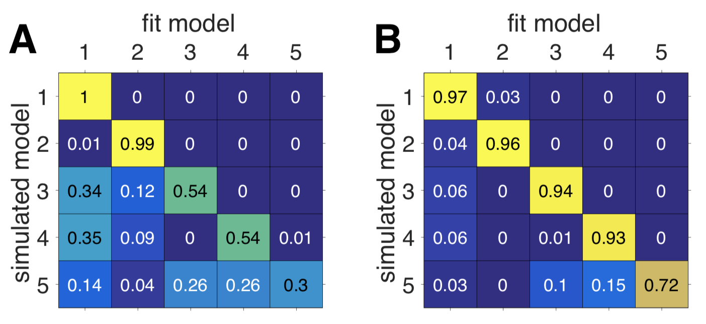
Model recovery
Simulate data for your model space: only a limited number of models can be tested, carefully consider your choice
Fit each model to all simulated data sets based on each model
Estimate how often true generative model is identified and plot confusion matrix: we want each model to be identifiable
See also tutorial 3A-RL based on Wilson & Collins (2019) eLife
Notes:
RECAP PROCEDURE
If your matrix has large off-diagonal components, it indicates a problem with your model recovery
Left:less good
Right: good

Slide 46
Model recovery
😈 There are a number of choices to be made and the devil is in the details
Under what parameter regime do you perform the model recovery?
  Sample randomly between parameter bounds
  Sample randomly between reasonable parameter bounds
  Re-use best-fitting parameters for each model from participants
  At the boundaries, recovery may fail, but what matters most is that you can recover under the parameter space of relevance for your data
  Criterion on which to select: e.g., BIC
🚀 What space of models do you choose to explore?
  Strawman models will be easily set aside
  Models are never true in an absolute sense: identify the best model among the set of models you have selected to compare
  Parsimony applies to the model space ➡️ carefully examine your hypotheses, keep the number of alternative models small without ignoring any potential hypotheses ⚖️
  If two or more models unidentifiable, you might need a new/better experimental design

Slide 47
Model selection conclusions
Popular quantitative information criteria: AIC & BIC
Examine qualitative signatures of behaviour: model validation exercise (tutorial 1B) is key! Can you validate your best-fitting model AND unvalidate your alternative models?
Cross-validation
    Evaluate our models’ performance
    Evaluate a machine learning method
    Make predictions for new data as accurately as possible
Notes:
recap

Slide 48
Acknowledgements
🙏
A. Wu, J. Drugowitsch, A. Hyafil: neuromatch academy
K. Preuschoff (BAMB 2019)
Statquest

Slide 49
Tutorial 1C
        Model selection
        Cross validation
        Model recovery

Slide 50
Brief summary Tutorial 1C
Model selection compares quantitative criteria
such as AIC BIC model evidence etc
Each metric has pros and cons, no perfect recipe
Keep in mind that comparison is relative:
To the space of models that you have defined in the first place
Notes:
[CAN BE SKIPPED]

Slide 51
Brief summary Tutorial 1C
Cross validation asks how well the model predicts new data that it hasn’t seen yet.
This approach is to use held-out data which we call testing data or validation data:
we do not fit the model with this data, but we use it to select our best model.
We often have a limited amount of data though (especially in neuroscience), so we do not want to further reduce our potential training data by reassigning some as validation.
So we can use k-fold cross-validation!
      we divide up the training data into k subsets (called folds)
      train our model on the first k-1 folds
      then compute error on the last held-out fold
Notes:
[CAN BE SKIPPED]

Slide 52
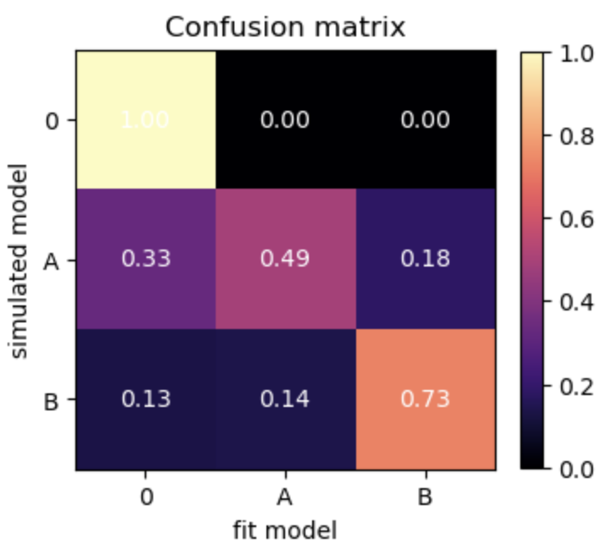
Brief summary Tutorial 1C
Model recovery analysis verifies that your model is identifiable from others.
The aim is to build an experimental paradigm that will allow you to identify a model distinctly from alternative accounts
Notes:
[CAN BE SKIPPED]

Slide 53
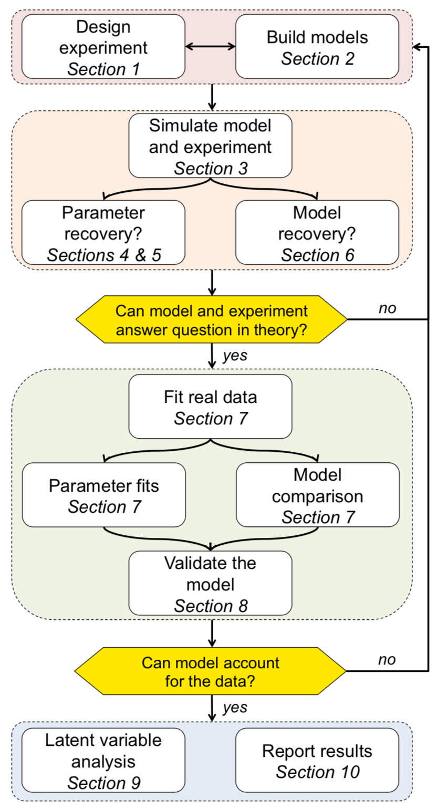
Wrap-up Day 1
Wilson & Collins, 2019 eLife

Slide 54
Take home messages
🏠
Model-free analysis: check your raw data
Run model-independent data analysis first: what behavioral patterns/signatures do you expect?
Experimental design: no amount of modeling can make up for a bad design! Does your design allow you to isolate the behavioral signatures you expect to see in the behavior?
✅
😬
Palminteri, Wyart & Koechlin (2017) TICS; Wilson & Collins (2019) eLife

Slide 55
Take home messages
🏠
Model-free analysis: check your raw data
Run model-independent data analysis first: what behavioral patterns/signatures do you expect?
Experimental design: no amount of modeling can make up for a bad design! Does your design allow you to isolate the behavioral signatures you expect to see in the behavior?
Parameter estimates: do the parameters take reasonable values? How are they related to each other (structure of the variance)? Are they in the range of what you expected?
Consider “sponge parameters” that will wash away unimportant variance: example: a leftward bias in choice. If not modelled, it may compromise the reliability of your other parameters of importance!
✅
😬
🤔
🧽
Palminteri, Wyart & Koechlin (2017) TICS; Wilson & Collins (2019) eLife

Slide 56
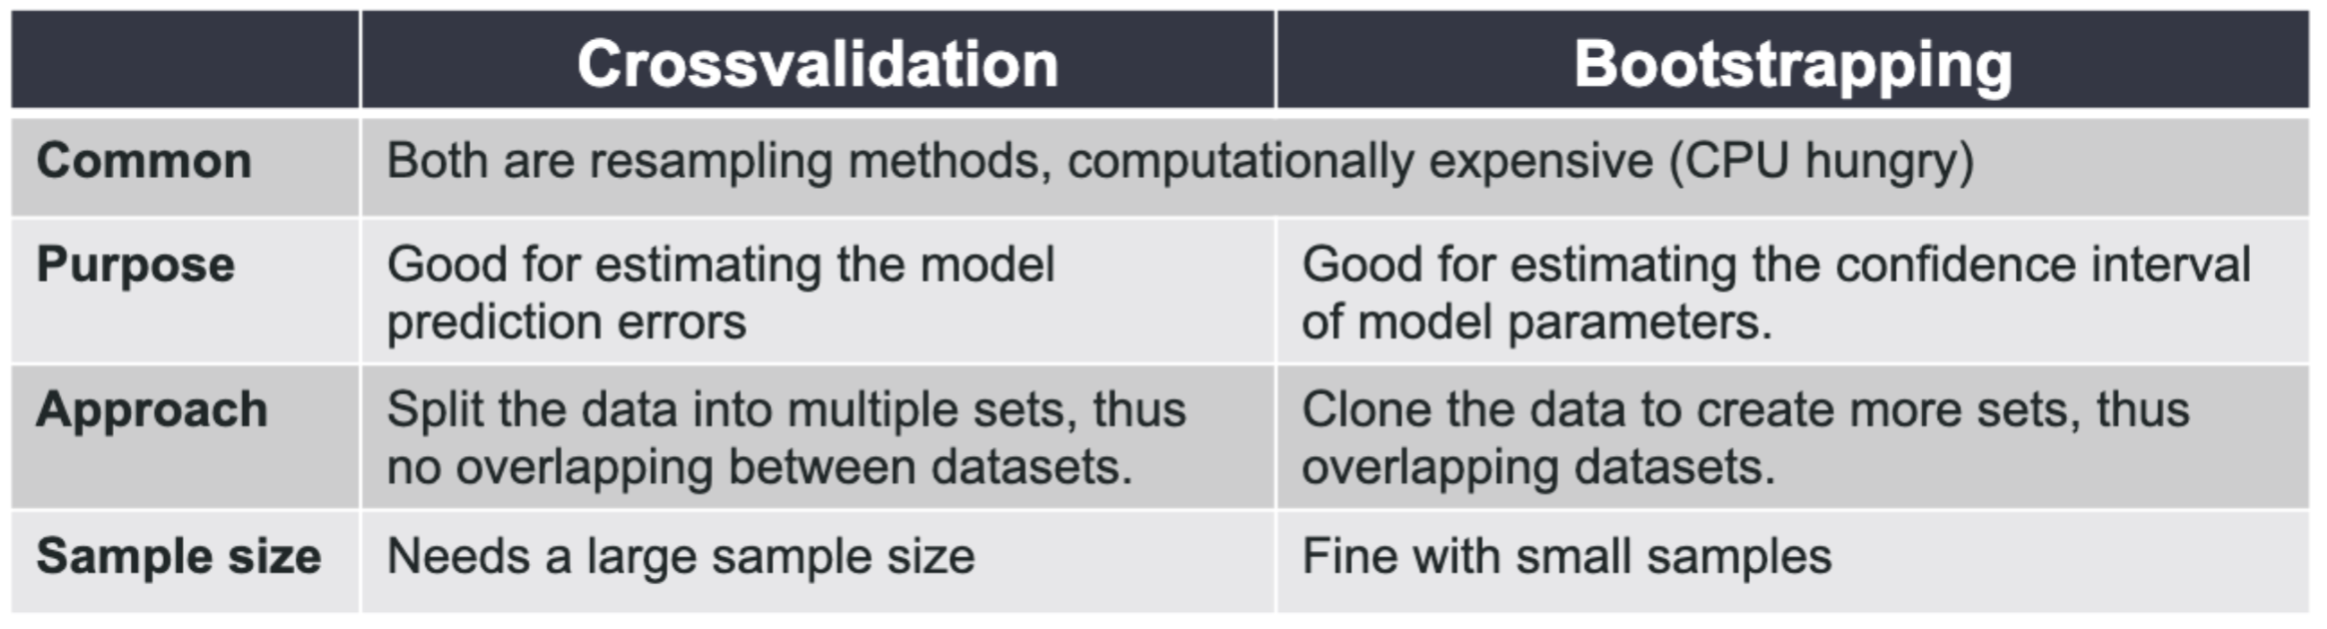
Cross-validation vs. bootstrapping
Kunlin Wei

Slide 57
Questions?

