Slide 1
BAMB! RL tutorial
Model-free reinforcement learning
in a grid world

Slide 2

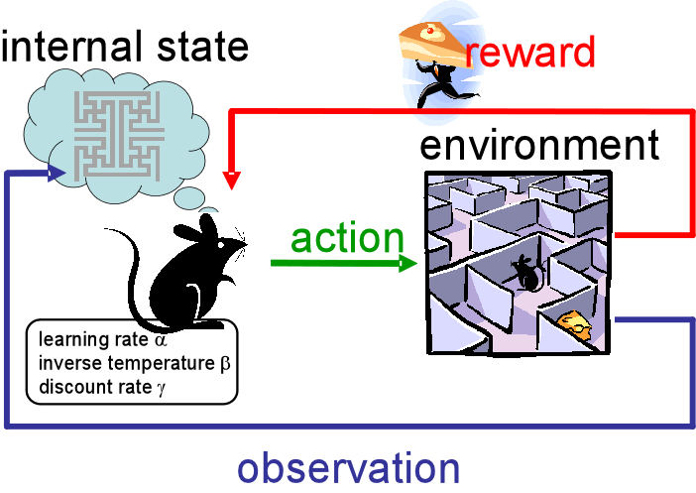
Reinforcement learning
Rewards are assumed to be “emitted” by the environment
The framework of reinforcement learning describes how a system learns to select actions on the basis of observations and rewards
Sutton & Barto, 1998

Slide 3

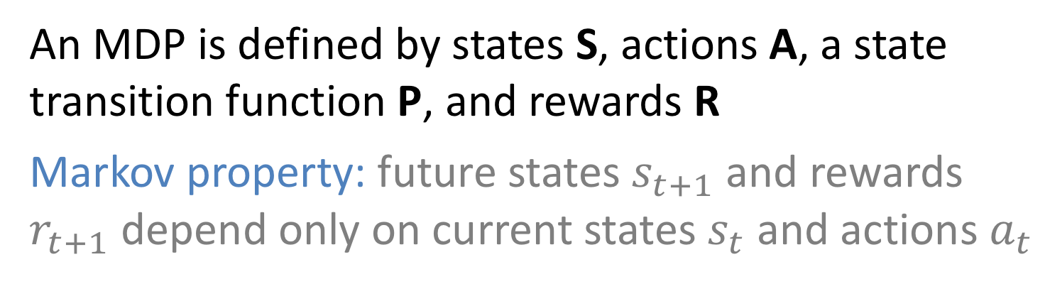
Markov decision process (MDP)
Goal
How can the agent (yellow) learn to reach the white?
Agent
Empty
Wall
An MDP is defined by states S, actions A, a state transition function P, and rewards R
Markov property: future states $s_{t+1}$ and rewards $r_{t+1}$ depend only on current states $s_{t}$ and actions $a_{t}$
Sutton & Barto, 1998

Slide 4
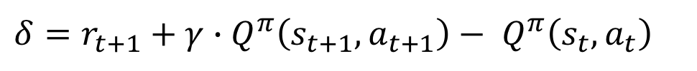


TD learning (on-policy) a.k.a. SARSA
We can approximate the optimal solution using temporal difference (TD) learning:
learning rate
$Q^{π}\left(s_{t},a_{t}\right)←$ $Q^{π}\left(s_{t},a_{t}\right)+α∙δ$
The Q-value (of the current state and action) under the policy $π$
prediction error
$$δ=r_{t+1}+γ∙Q^{π}\left(s_{t+1},a_{t+1}\right)− Q^{π}\left(s_{t},a_{t}\right)$$
reward for next state
Q-value for the next state/action
Q-value for current state/action
Note that the only addition to the delta rule is the new term for discounted reward of future action
Sutton & Barto, 1998

Slide 5


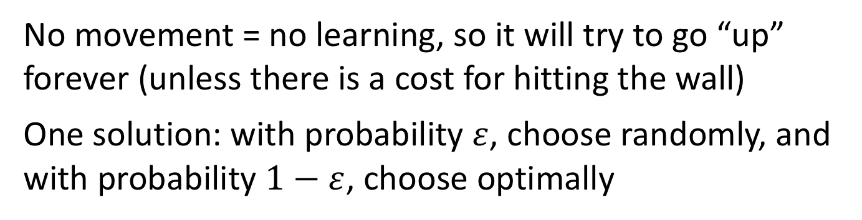
Epsilon-greedy action selection
If the agent always chooses the most valuable action(“greedy” choice) then it risks getting “stuck”
Imagine our agent had learned the following Q-values:
up down left right
0.9 0.8 0.2 0.1
$argmax\left(Q\left(s_{t},a\right)\right)$ is 0.9, i.e. “up”
No movement = no learning, so it will try to go “up” forever (unless there is a cost for hitting the wall)
One solution: with probability $ε$, choose randomly, and with probability $1−ε$, choose optimally

Slide 6
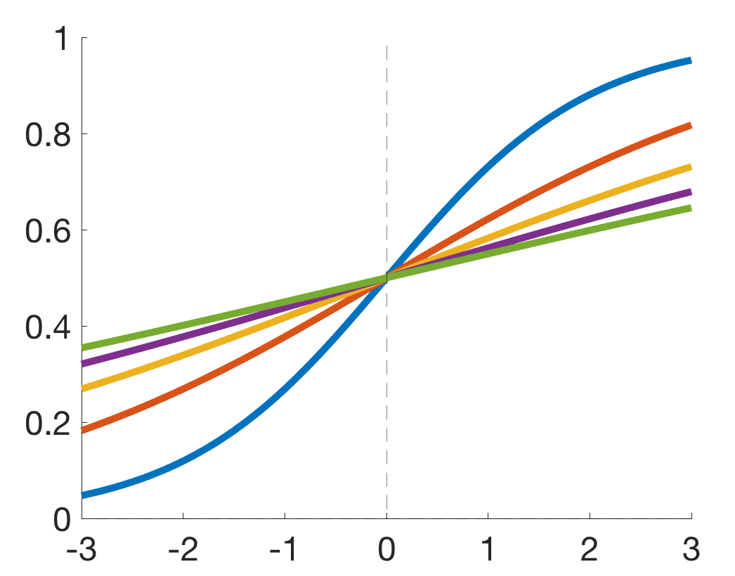





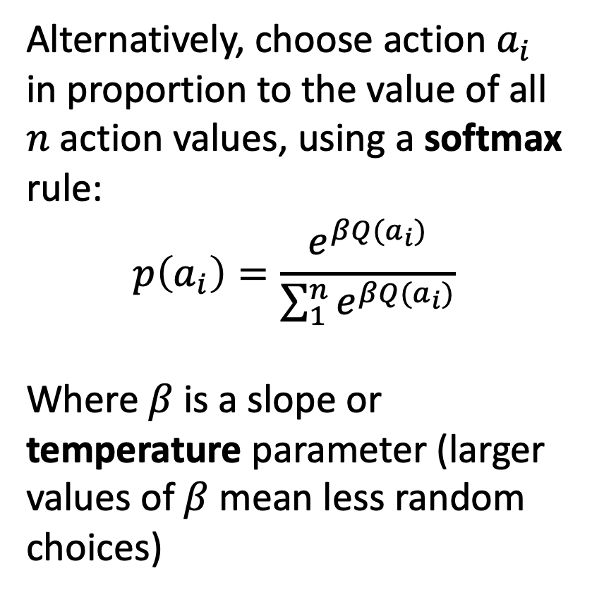
softmax action selection
$$p\left(Right\right)=f(A,s)$$
Alternatively, choose action $a_{i}$ in proportion to the value of all $n$ action values, using a softmax rule:
$$p\left(a_{i}\right)=\frac{e^{βQ(a_{i})}}{\sum_{1}^{n}{e^{βQ(a_{i})}}}$$
Where $β$is a slope or temperature parameter (larger values of$β$mean less random choices)
$$p(resp=“Right”)$$
s = 1
s = 2
s = 3
s = 4
s = 5
$$grating angle A$$
Decisions made by animals are subject to intrinsic variability

Slide 7

Q learning (off-policy)
A similar method updates according to the value of the best possible (future) action, not that dictated by the current policy:
learning rate
$Q\left(s_{t},a_{t}\right)←$ $Q\left(s_{t},a_{t}\right)+α∙δ$
The Q-value (of the current state and action)
prediction error
$$δ=r_{t+1}+γ∙Q^{max}\left(s_{t+1},a_{t+1}\right)− Q\left(s_{t},a_{t}\right)$$
reward for next state
Best Q-value for the next state
Q-value for current state/action
Note that the only addition to the delta rule is the new term for discounted reward of future action
Watkins, 1990

Slide 8


Reinforcement learning
At first, the agent behaves randomly
By the end of training, it behaves optimally (makes a beeline for the goal, irrespective of the start location).
Sutton & Barto, 1998

Slide 9
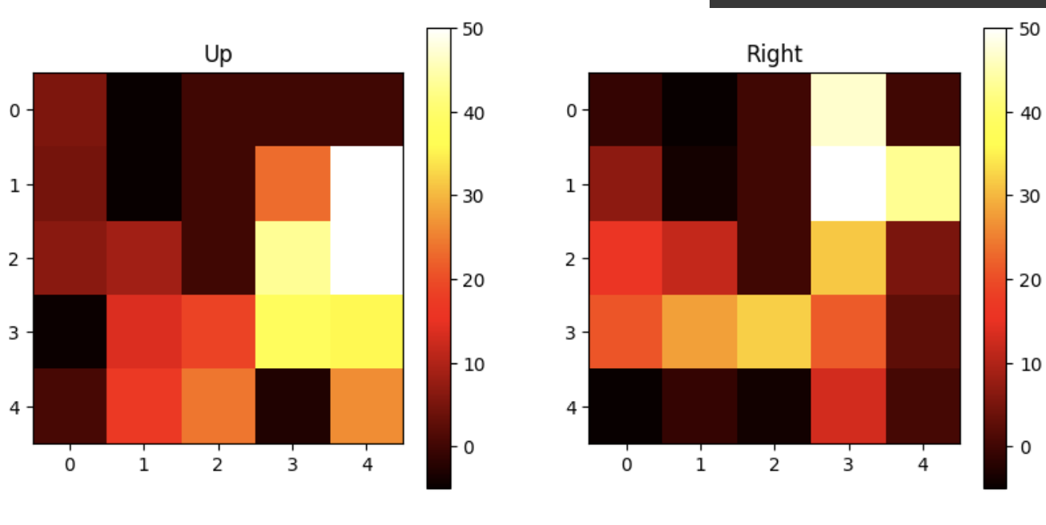
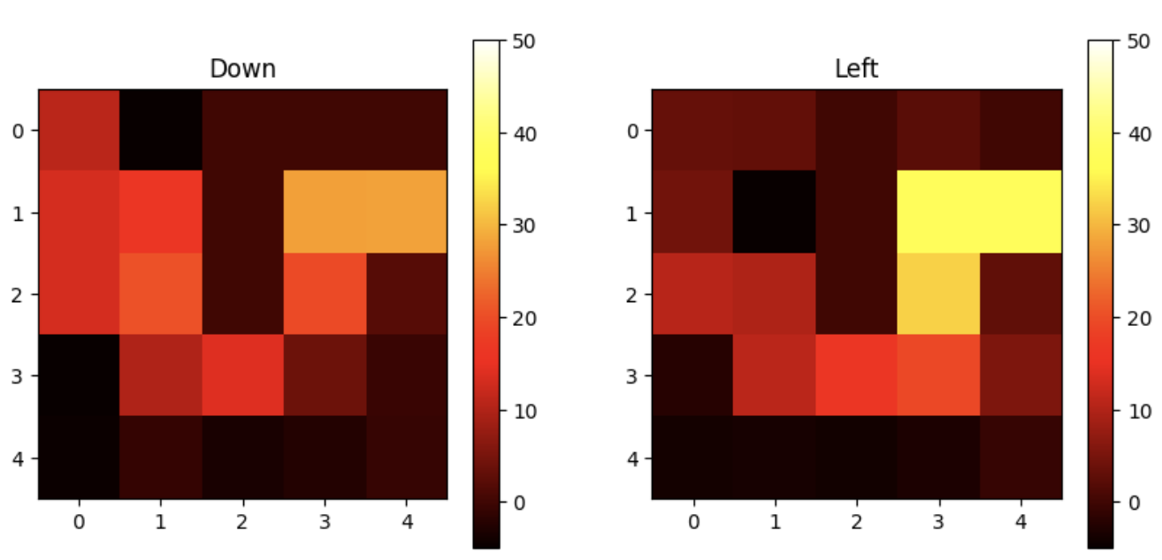
Q-values (E-greedy agent)
Visualisation of the Q-values reveals the policy the agent has learned. The rewards are “backed up” from the goal to adjacent states.
Sutton & Barto, 1998

Slide 10
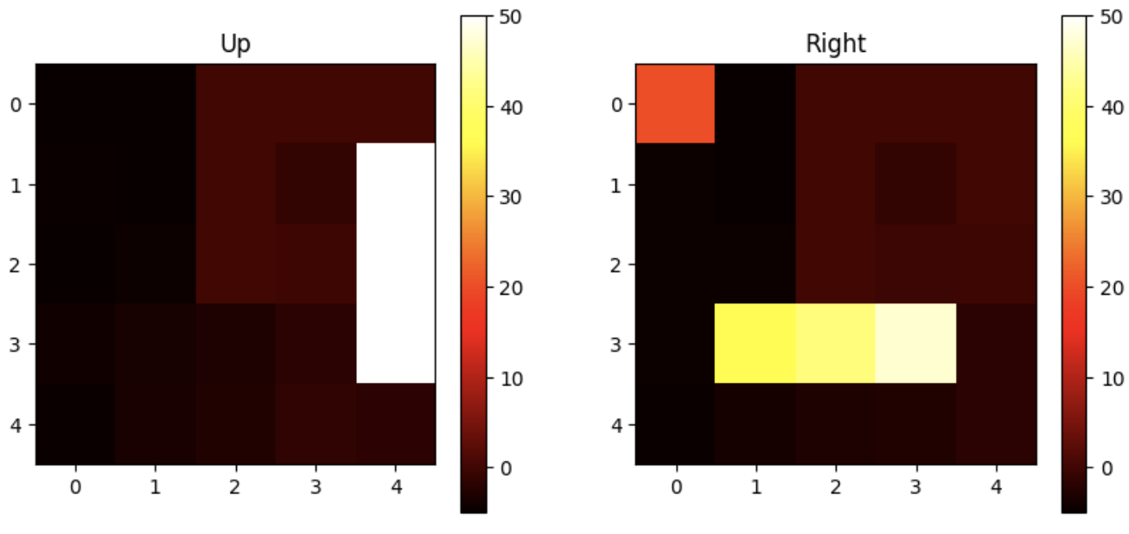
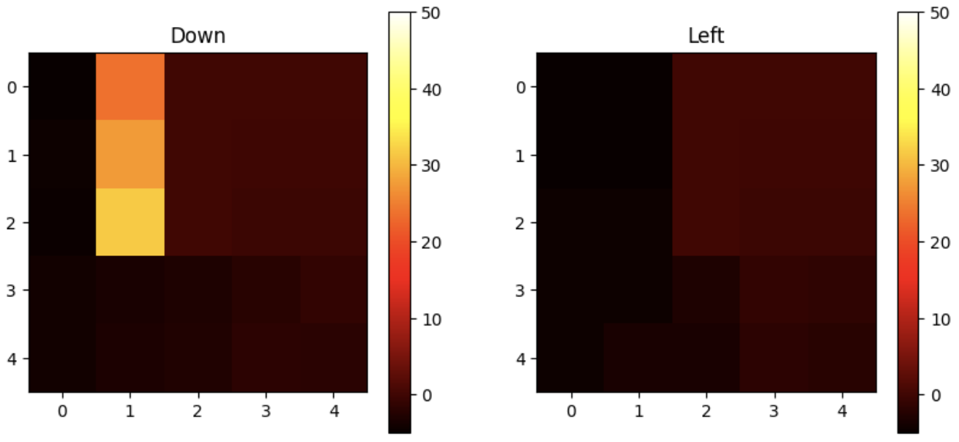
Q-values (softmax agent)
Visualisation of the Q-values reveals the policy the agent has learned. The rewards are “backed up” from the goal to adjacent states.
Sutton & Barto, 1998

Slide 11
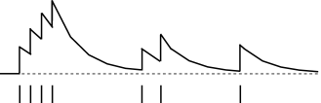
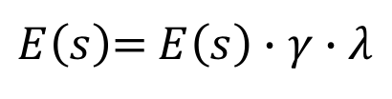
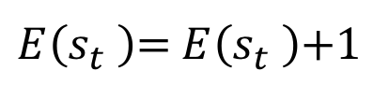

Eligibility trace
An eligibility trace allows the reward to be backed up faster through recently visited (or “eligible”) states, rather than just the current state
$Q\left(s_{t},a_{t}\right)←$ $Q\left(s_{t},a_{t}\right)+α∙δ∙E$
eligibility trace
$E\left(s\right)$= $E\left(s\right)∙γ∙λ$
decay eligibility trace by lamba + discount (gamma)
$E\left(s_{t} \right)$= $E\left(s_{t} \right)$+1
update current state by 1
eligibility trace for one state
visits
Sutton & Barto, 1998

Slide 12
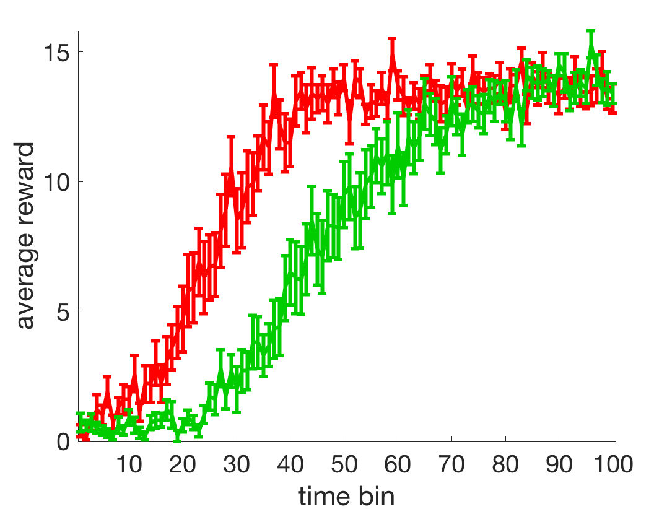
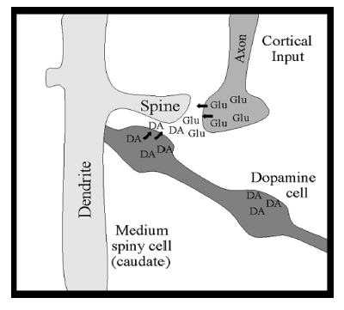
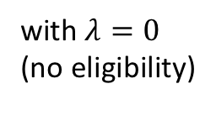

Eligibility trace
The agent learns faster with an eligibility trace, because rewards are backed up more rapidly
with $λ=0.2$
with $λ=0$
(no eligibility)
Neurally, eligibility traces may be mediated by slow timescales of learning or synaptic “tagging” at the synapse
See Gerstner (2018)

Slide 13
Limitations of RL
1. What is a “state”? The world is noisy and high-dimensional. How does RL work for complex problems?
2. RL performs poorly where rewards are sparse. To remedy this, we can use temporal abstraction (coming later)
3. Some functions just clearly require model-based methods. We can simulate counterfactuals, plan towards imagined goals, and reason using inductive logic. RL can’t explain this!
To explain these phenomena, we need model-based approaches. But in the next lecture, we will first consider a more fundamental question…how do we learn about “states” in the first place?
Notes:
Let’s begin with a question. What is really special about human intelligence? What makes us distinctive from that of other highly intelligent species, such as monkeys and birds?
Well, there are lots of anwers to this question, but in this talk I’d like to focus on one of them.

Slide 14
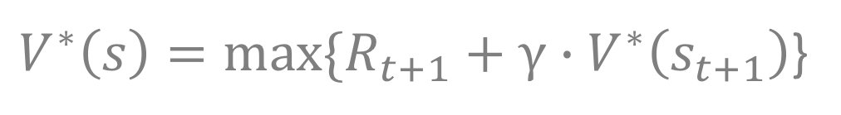
Bellman equation
What is the best policy in an MDP?
A policy is a definition of the action you should take in each state to maximise reward
Optimal solution is given by the Bellman Equation:
discount function
$V^{∗}\left(s\right)=max⁡\{R_{t+1}+$ $γ∙V^{∗}\left(s_{t+1}\right)$}
The discount function that determines how much you prefer rewards now vs. later
reward just coming
value of next state
compute recursively (expensive)
Sutton & Barto, 1998

Slide 15
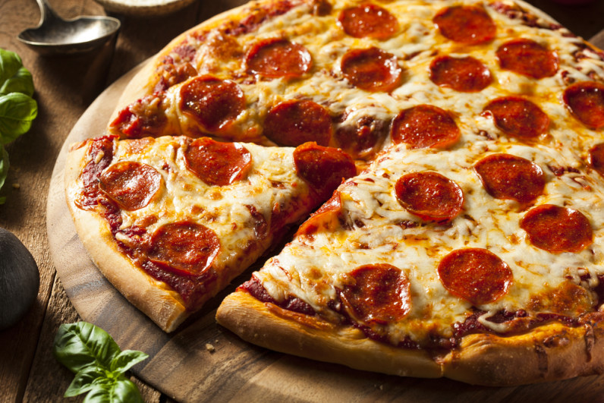

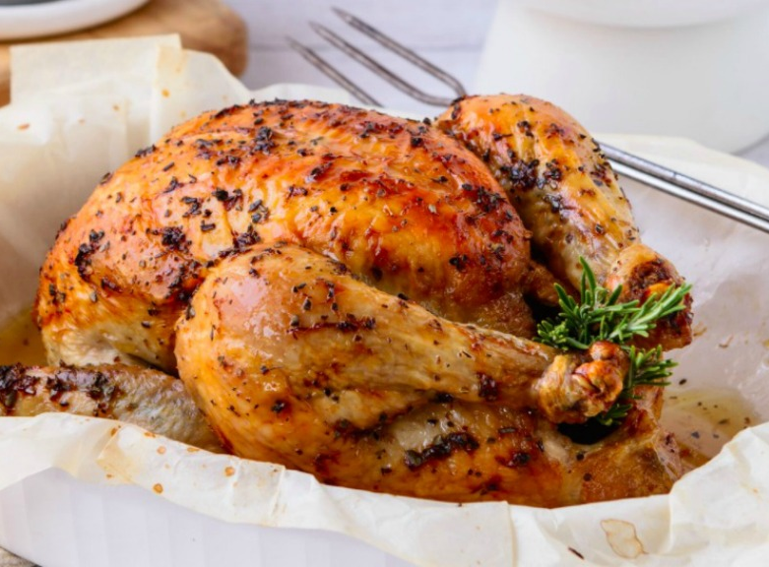
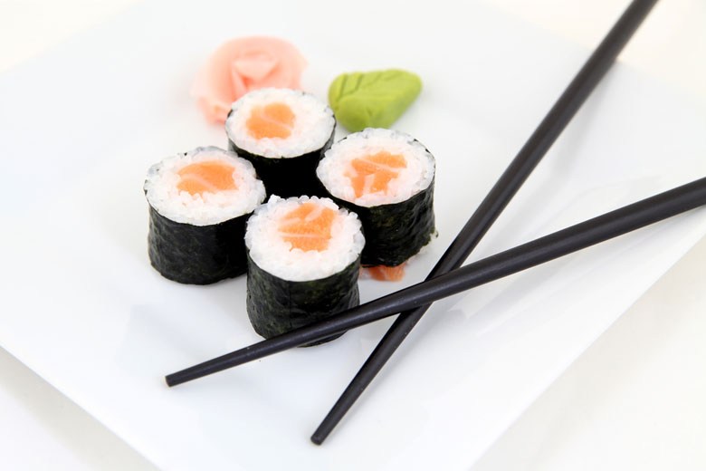
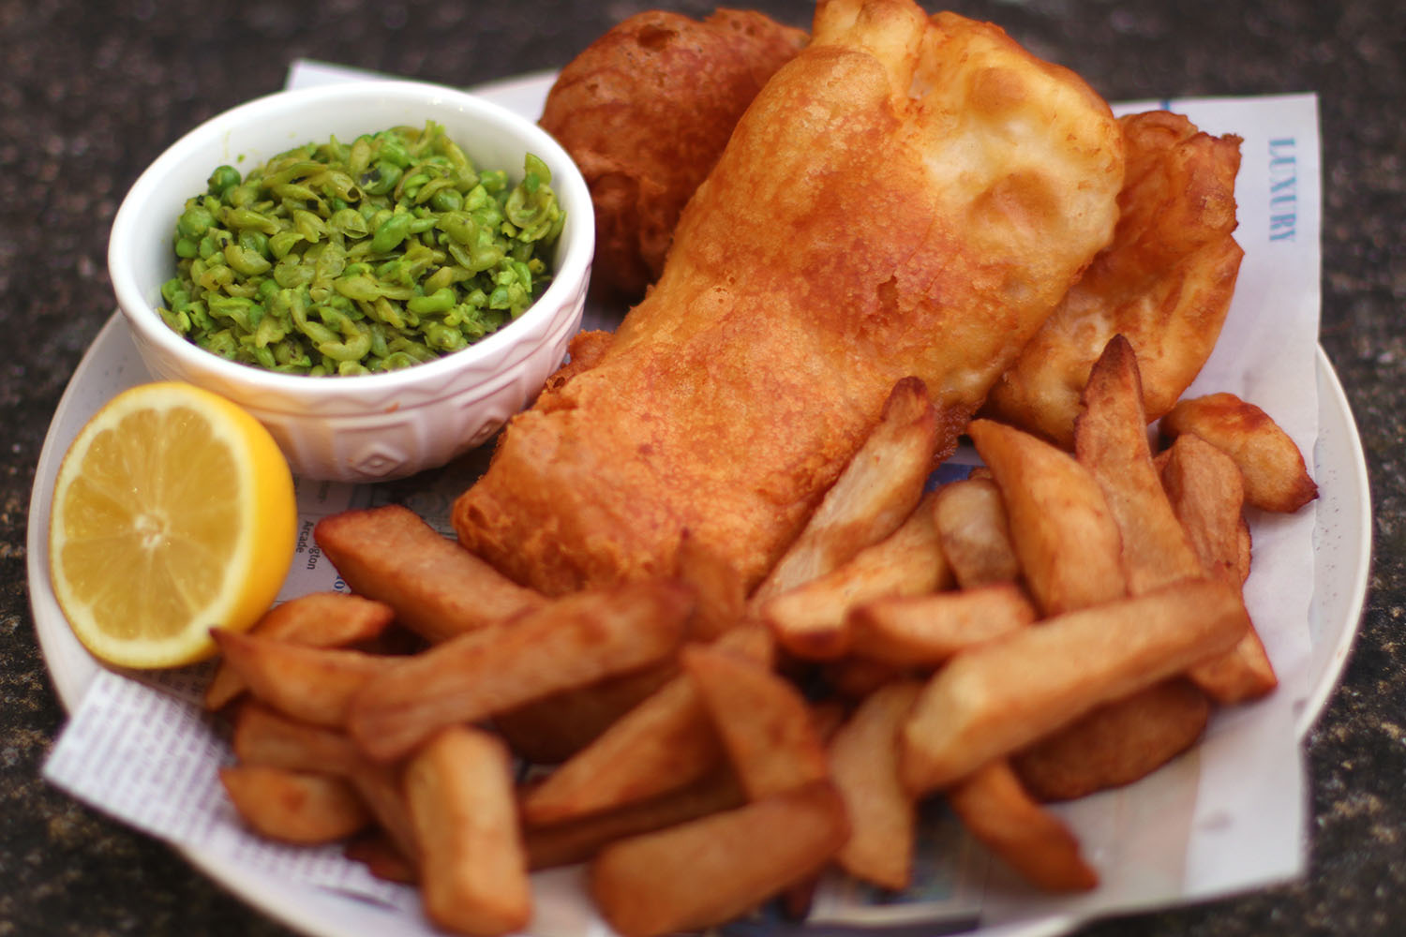
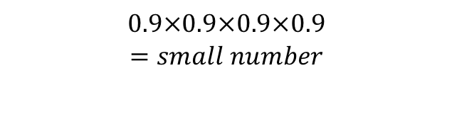
Bellman equation
Monday
Tuesday
Wednesday
Thursday
Friday
pizza = 0.7
salad = 0.3
chicken = 0.6
sushi = 0.5
fish = 0.9
It is Monday. What is the value of the menu this week?
discounted future reward
$V^{∗}\left(mon\right)=R\left(pizza\right)+γ∙R(salad)+γ^{2}∙R(chicken)$ $+γ^{3}∙R(sushi)$ $+γ^{4}∙R(fish)$
today’s reward
$$0.9×0.9×0.9×0.9$$
$$=small number$$
Sutton & Barto, 1998

Slide 16

Bellman equation
Monday
Tuesday
Wednesday
Thursday
Friday
R = 0
R = 0
R = 0
R = 0
R = 1
What about this week? Monday is boring, but on the other hand, your birthday is coming up.
discounted future reward
$V^{∗}\left(mon\right)=R\left(mon\right) + γ∙R(tues)+γ^{2}∙R(wed)$ $+γ^{3}∙R(thurs)$ $+γ^{4}∙R(friday)$
today’s reward
not zero! (but not 1, because discounted multiple times)

