Slide 1

Tutorial 2: Drift-diffusion models
BAMB! Summer School Tutorial 2

Slide 2

Tutorial overview
Hour 1: Simulating the DDM by hand
Construct a DDM from first principles
Hour 2: Simulating the DDM using PyDDM
Use efficient and higher-accuracy methods to perform simulations
Hour 3: Fitting the DDM to data
Use PyDDM to fit the DDM to monkey random dot motion data
Hour 4: Generalized drift diffusion models (GDDMs)
Create variants of the DDM which are specialized to specific tasks or encapsulate distinct strategies

Slide 3
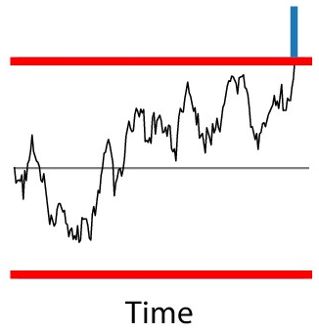
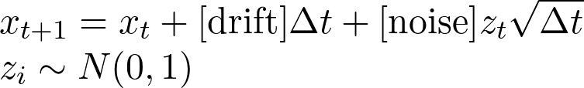
Hour 1: Simulating the DDM by hand
Basic algorithm
1. Set x to starting point
2. Set:
3. Check if x crosses a boundary. If so, you are done
4. Otherwise, go to (2)

Slide 4
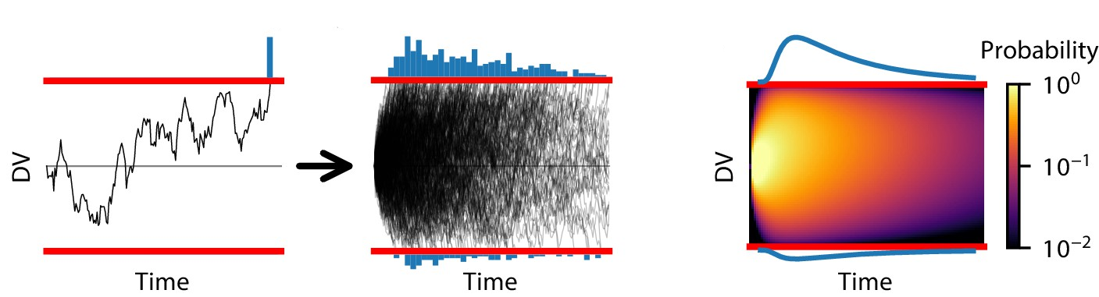
Hour 2: Simulating the DDM using PyDDM
Use more efficient methods to simulate the probability distribution of a trajectory’s position instead of one trial at a time

Slide 5
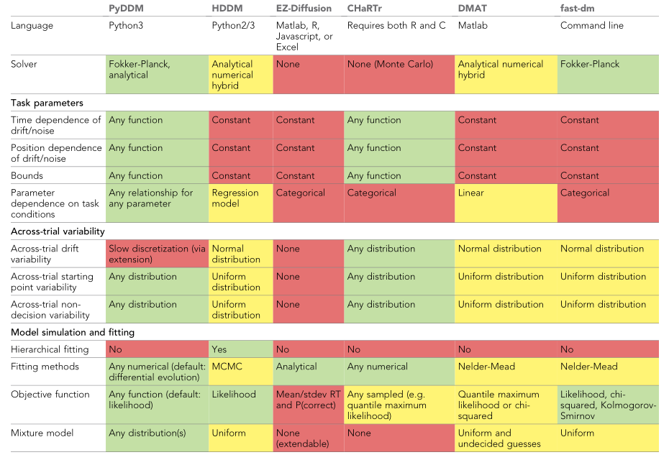
DDM libraries

Slide 6
How PyDDM works:
Construct a Model from its components
Model components:
Drift rate
Noise
Bound
Initial Condition
“Overlay” (diffusion-independent processes, e.g., non-decision time)

Slide 7
Many model components are built-in:
For a simple DDM:
Drift rate = DriftConstant
Noise = NoiseConstant
Bound = BoundConstant
Initial Condition = ICPointSourceCenter
“Overlay” = OverlayNonDecision

Slide 8
Parameters and conditions
Parameters: Have the same value for the entire dataset
E.g. bound height
Conditions: May change from trial to trial
E.g. strength of motion coherence

Slide 9
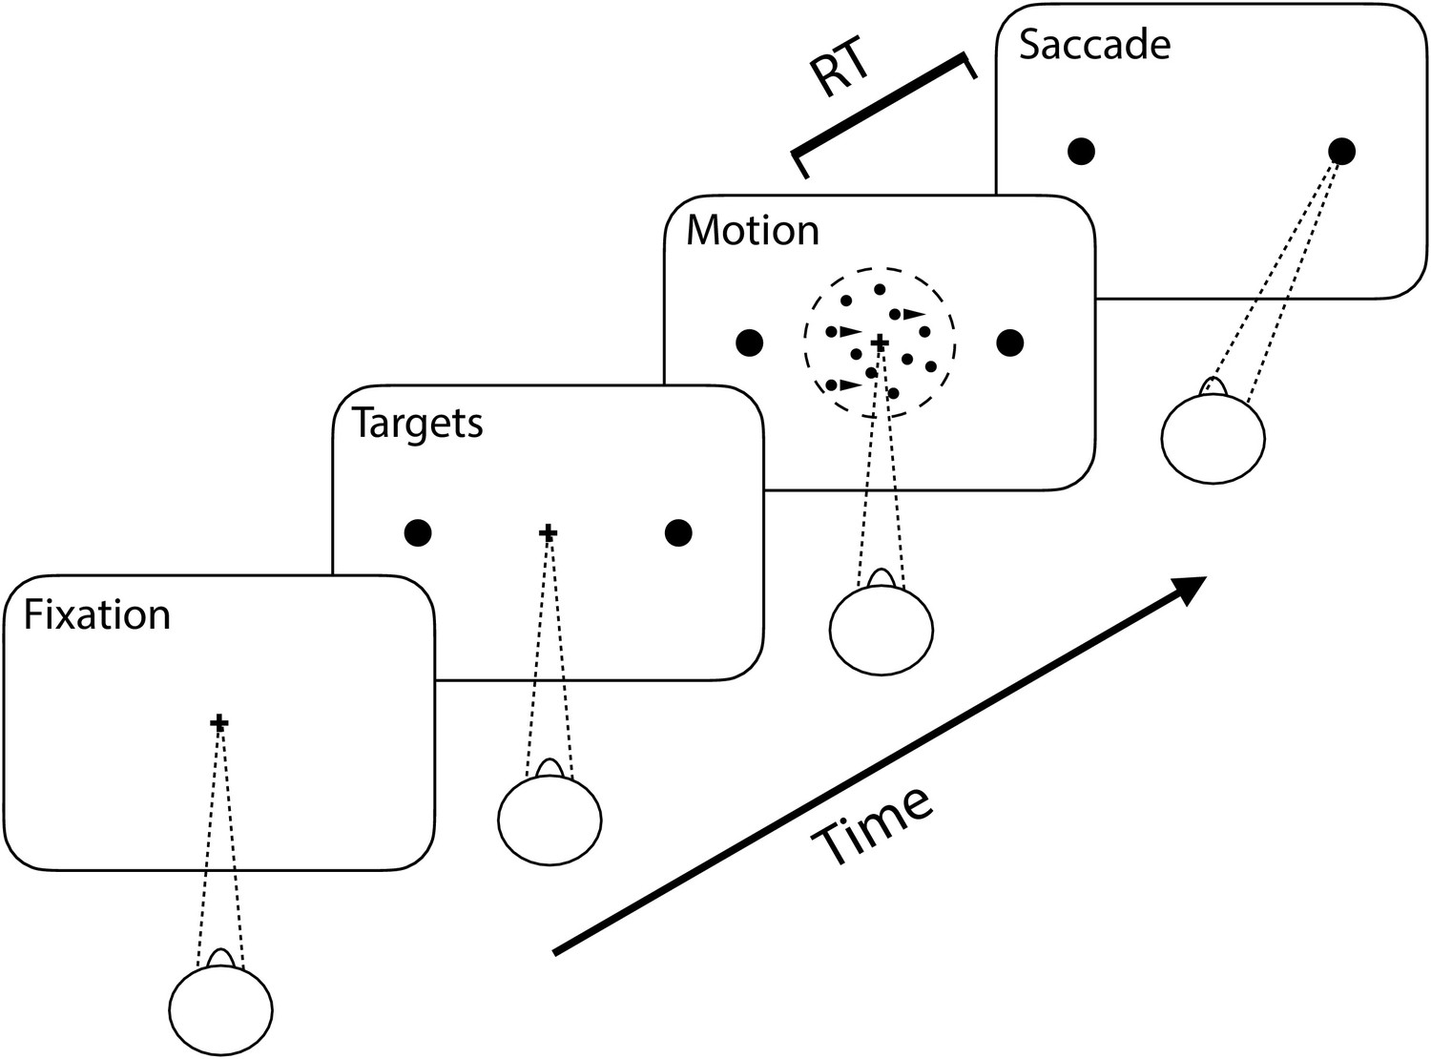
Hour 3: Fitting the DDM to data
Dataset: Monkeys performing the random dot motion task (Roitman and Shadlen, 2002)
Several levels of motion coherence
https://shadlenlab.columbia.edu/resources/RoitmanDataCode.html

Slide 10
Multiple motion coherences in PyDDM
How to make drift rate depend on the “coherence” condition?
Create a new type of drift rate by creating a subclass of Drift
See PyDDM quickstart guide or PyDDM cookbook for an example
class DriftThatDependsOnSomething(pyddm.Drift):
name = “drift that depends on something”
required_conditions = [“the_thing_it_depends_on”]
required_parameters = [“param”]
def get_drift(self, x, t, conditions, **_):
return conditions[“the_thing_it_depends_on”] * self.param

Slide 11
Hour 4: Generalized DDMs (GDDMs)
Construct a Model from its components – all components can depend on conditions
Model components:
Drift rate can also depend on position (x) and time
Noise can also depend on position and time
Bound can also change over time
Initial Condition can be any probability distribution
“Overlay” can be anything which modifies the RT distributions
Some are built-in so you don’t have to make them yourself!

Slide 12
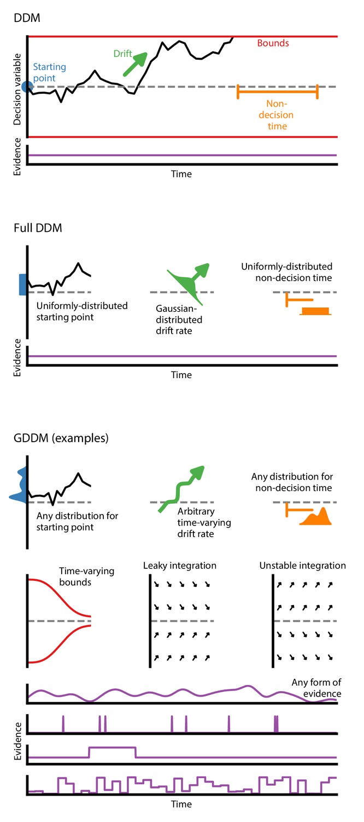
Example GDDMs

