Slide 1



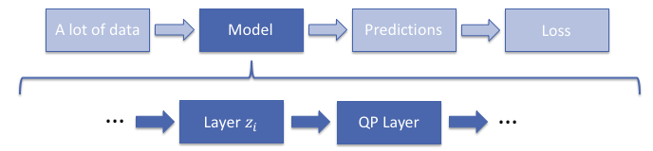
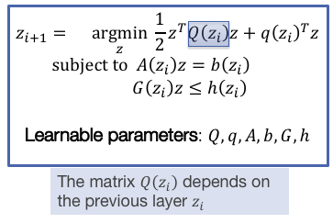

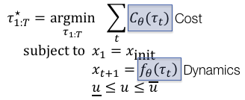
PyTorch libraries for linear algebra, optimization, and control
Brandon Amos
Carnegie Mellon University
http://bamos.github.io
brandondamos
block: Convenience functions for linear algebra
http://github.com/bamos/block
Let’s try to construct the KKT matrix in numpy and PyTorch.
Without block, there is no way to infer the appropriate sizes of the zero and identity matrix blocks. It is an inconvenience to think about what size these matrices should be.
qpth: A differentiable QP layer
http://locuslab.github.io/qpth
OptNet: Differentiable Optimization as a Layer in Neural Networks B. Amos and J. Z. Kolter ICML 2017
mpc: A model predictive control layer
http://github.com/locuslab/mpc.pytorch
Differentiable MPC for End-to-end Planning and Control B. Amos, I. Rodriguez, J. Sacks, B. Boots, and J. Z. Kolter NIPS 2018
Bonus
setGPU: Auto-set CUDA_VISIBLE_DEVICES
http://github.com/bamos/setGPU
A DenseNet implementation
http://github.com/bamos/densenet.pytorch

