Slide 1


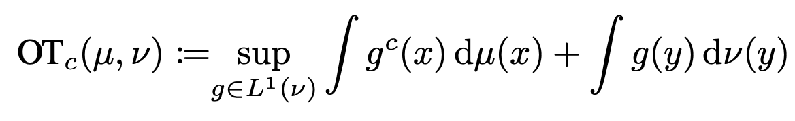
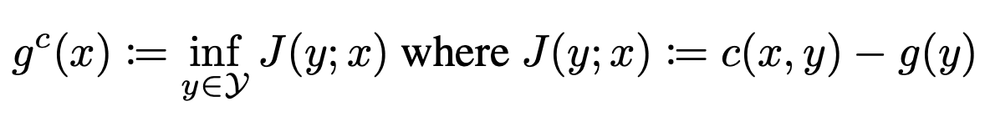
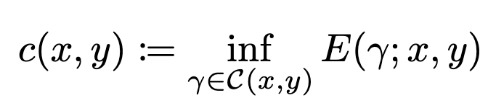
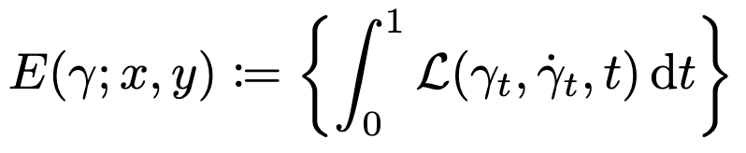

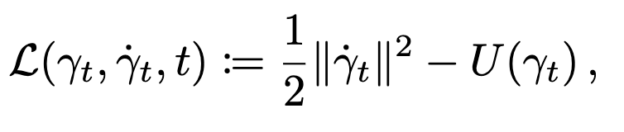
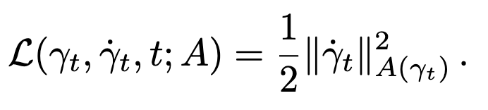
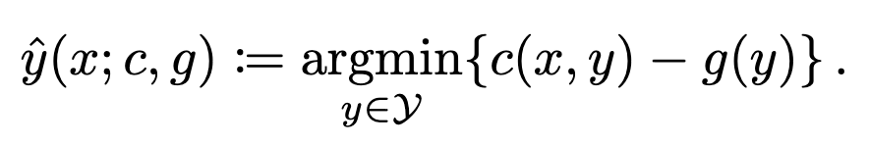
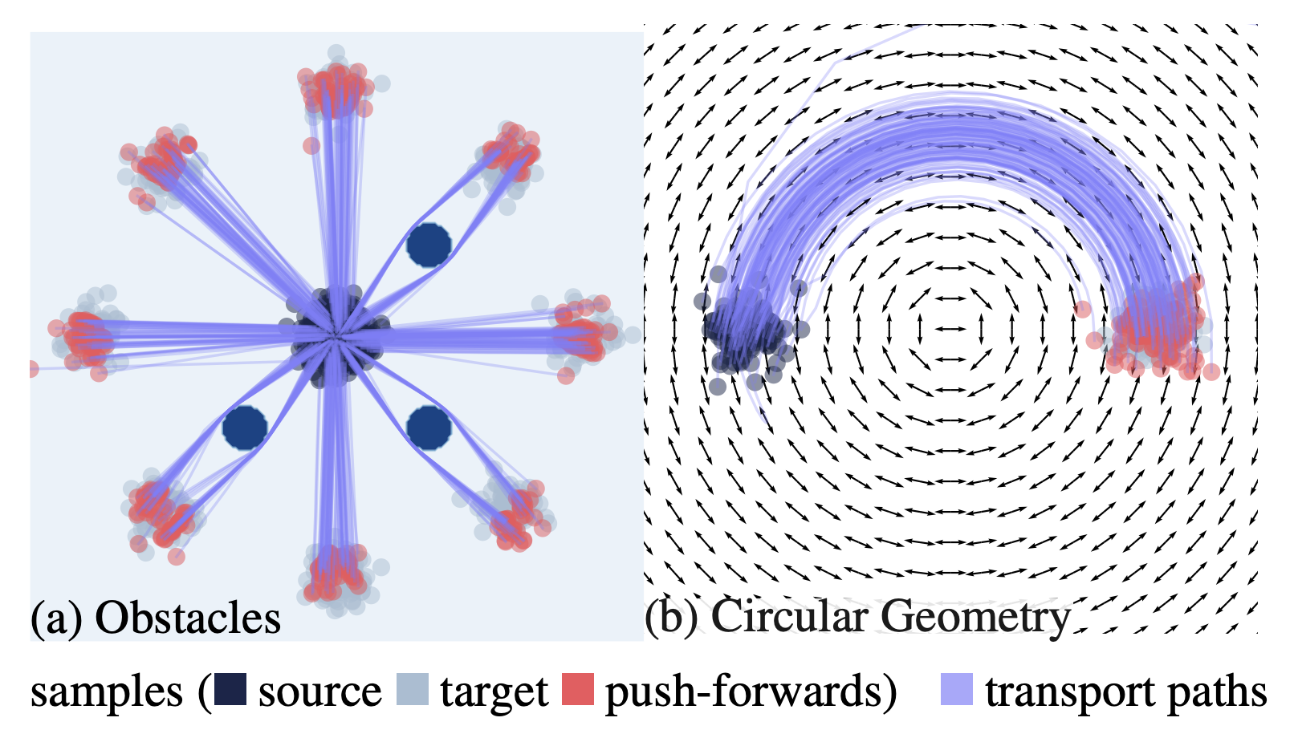
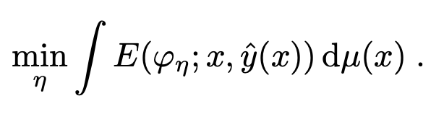
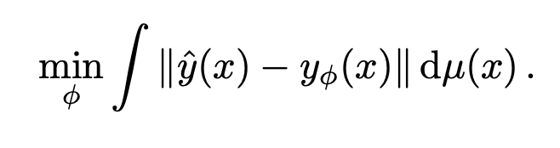
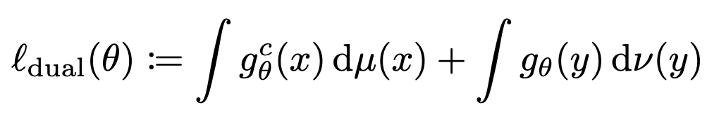
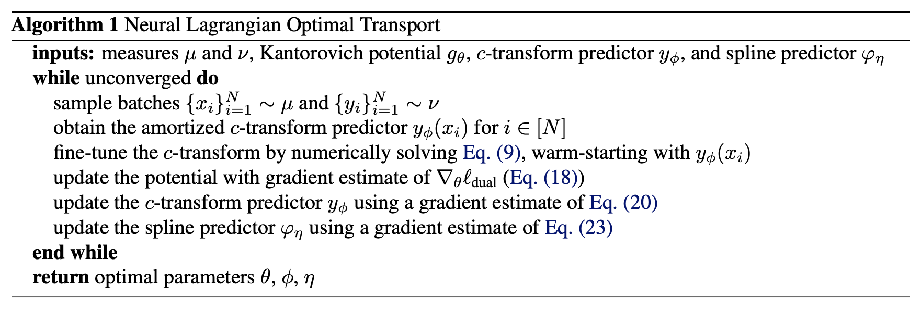
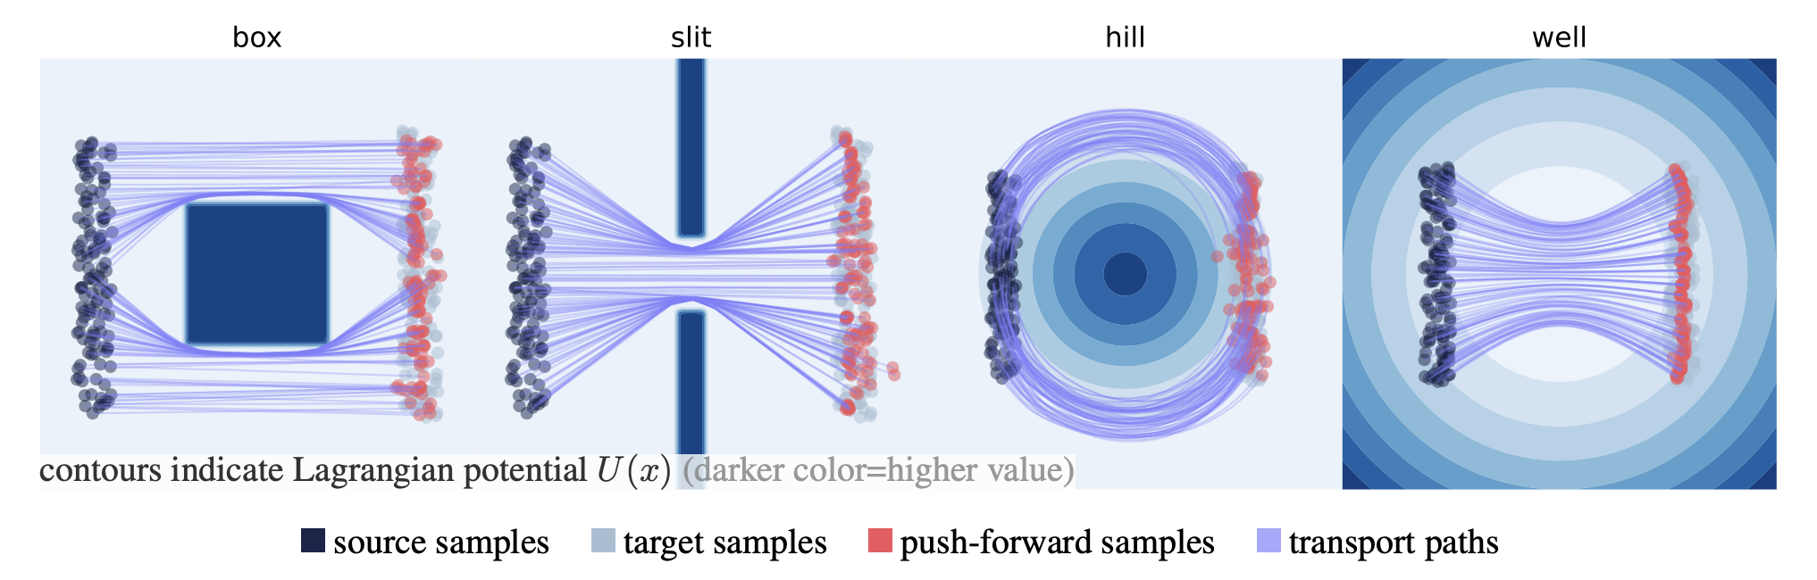
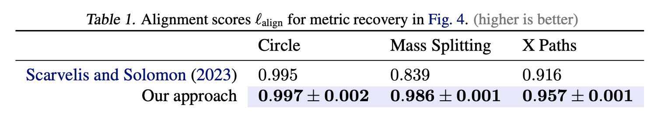
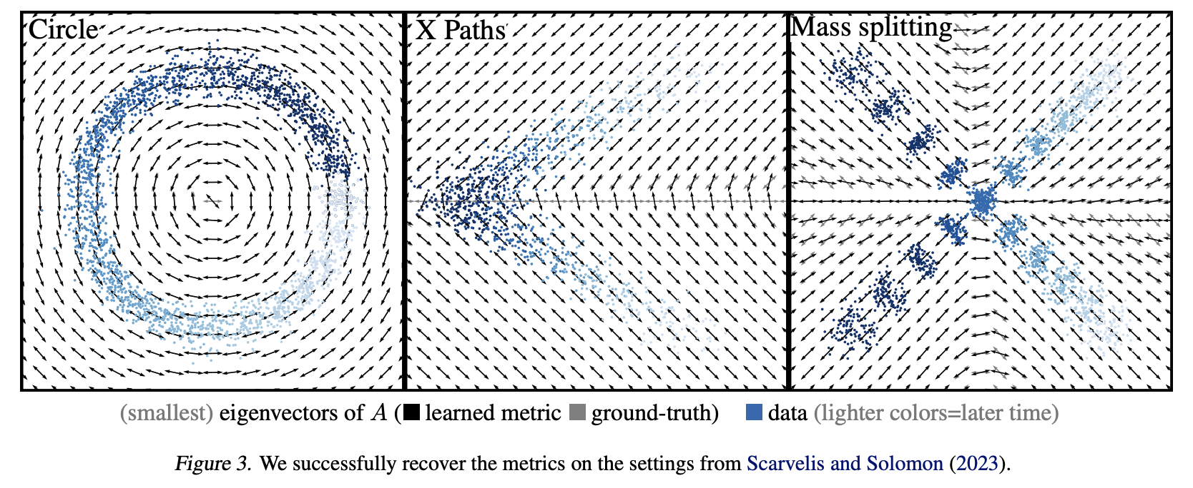
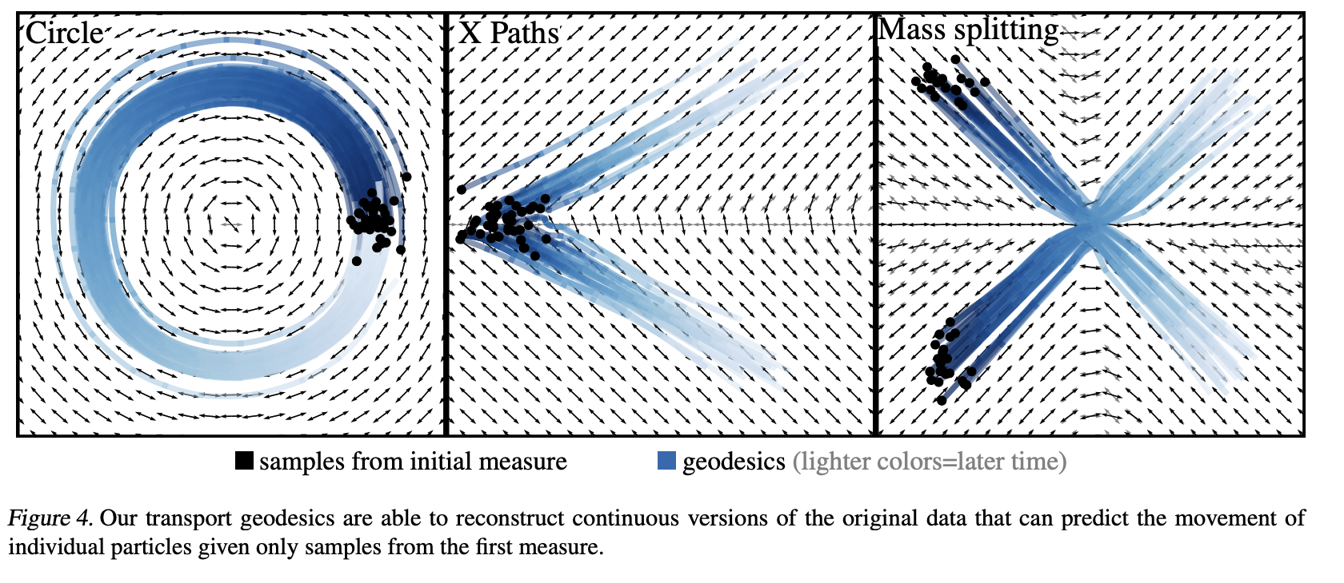




Neural Optimal Transport with Lagrangian Costs
paper
code
Aram-Alexandre Pooladian Carles Domingo-Enrich Ricky T. Q. Chen Brandon Amos NYU, Meta AI NYU, Meta AI Meta AI Meta AI
Optimal transport (OT) with Lagrangian costs
📚 Optimal Transport: Old and New. Cedric Villani, 2008; Computational Optimal Transport. Gabriel Peyré and Marco Cuturi, 2018.
For a cost function $c :𝒳×𝒴→ℝ$, the (dual) transport problem is given by
$c$-transform:
Lagrangian costs: general-purpose cost function given by an optimization sub-routine over curves
encompasses $ℓ_{p}$ norms, barrier functions, non-Euclidean metrics (geodesics), and more
Examples
3) Riemannian kinetic
1) Euclidean kinetic
2) Euclidean kinetic and potential
$c$ becomes the squared Euclidean distance
$c$ becomes the squared geodesic distance
OT map for general costs: Our goal is to learn
Challenges: computing (1) the cost $c$, (2) the $c$-transform, (3) the optimal potential $g$
Our approach: approximate (1), (2), (3) with neural networks (obviously!)
❗
Neural OT with Lagrangian Costs
📚 Deep generalized Schrödinger bridge. Liu et al., NeurIPS 2023; Neural Lagrangian Schrödinger bridge. Koshizuka and Sato, ICLR 2023; Optimal transport mapping via input convex neural networks Makkuva et al., ICML 2020; Wasserstein-2 Generative Networks, Korotin et al., ICLR 2021; On amortizing convex conjugates for optimal transport. Amos, ICLR 2023; Tutorial on amortized optimization. Amos, FnT in ML, 2023.
Parametrization with neural networks: Optimize (1) Lagrangian path $φ_{η}$ (2) OT map $y_{φ}$ (3) potential $g_{θ}$
Metric learning with Lagrangian OT
📚 Riemannian Metric Learning via Optimal Transport. Scarvelis and Solomon, ICLR 2023.
Task: learn the underlying metric with pairs of probability measures

