Slide 1
One to one label assignment

Slide 2
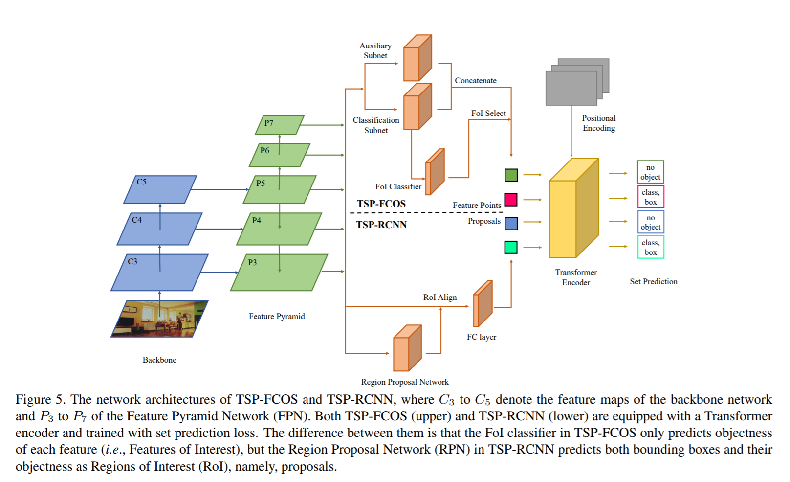
Rethinking Transformer-based Set Prediction for Object Detection
21 Nov 2020
Transformer + FPN(R-CNN or FCOS)
Eliminate decoder

Slide 3
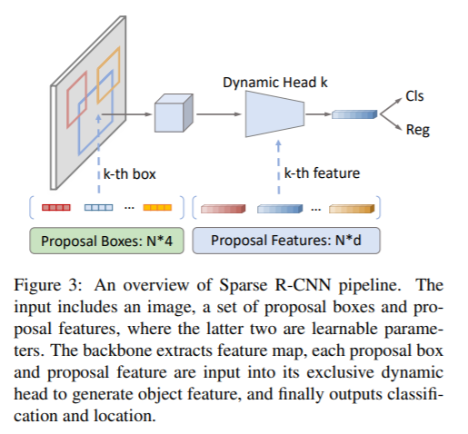
Sparse R-CNN: End-to-End Object Detection with Learnable Proposals
25 Nov 2020
FasterRCNN + Bipartite matching loss
Eliminate positional encoding

Slide 4
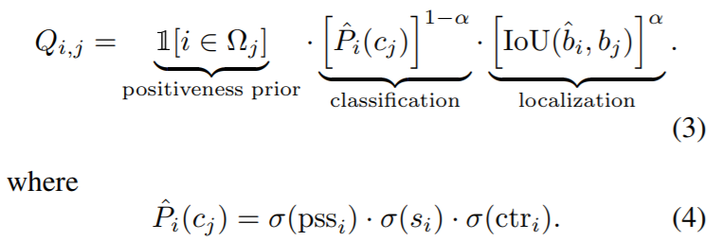
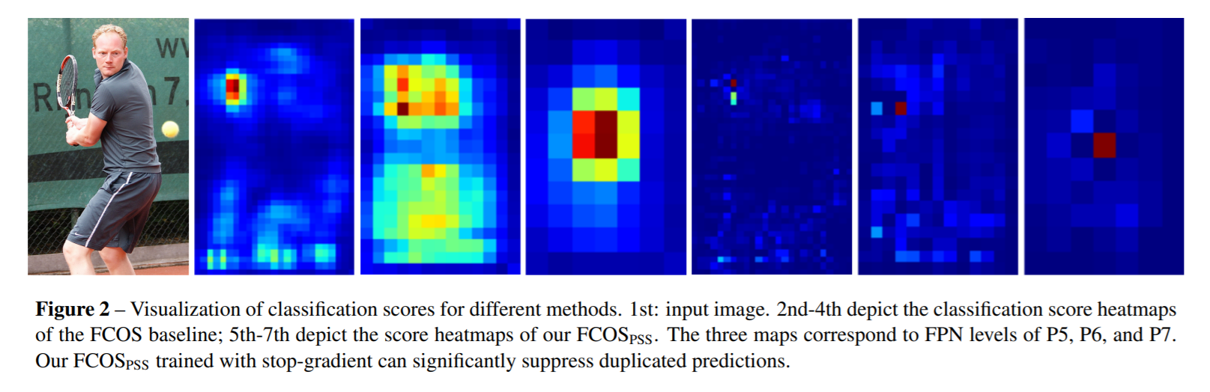
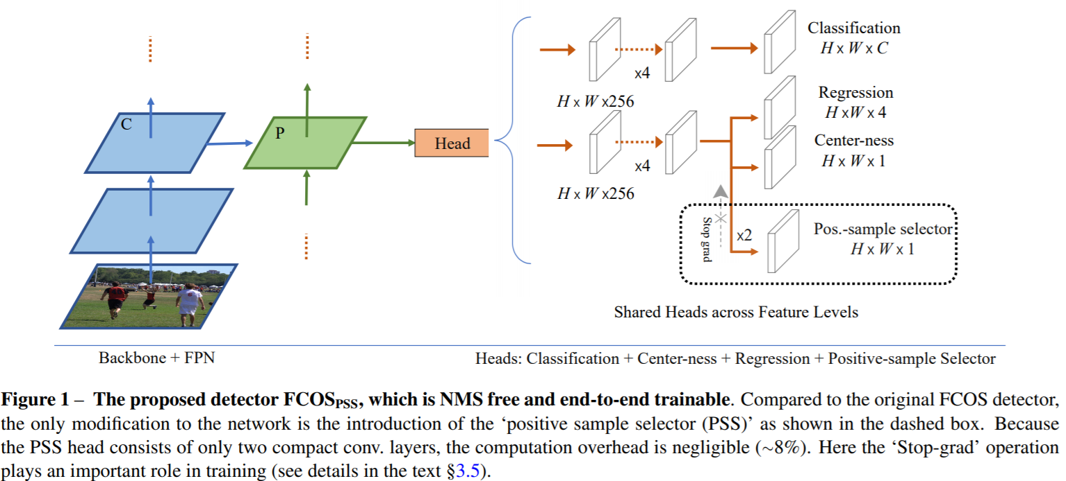
Object Detection Made Simpler by Eliminating Heuristic NMS
7 Dec 2020

Slide 5
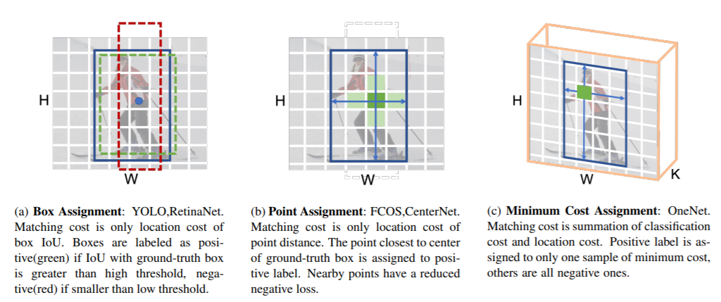
OneNet: Towards End-to-End One-Stage Object Detection
10 Dec 2020

Slide 6
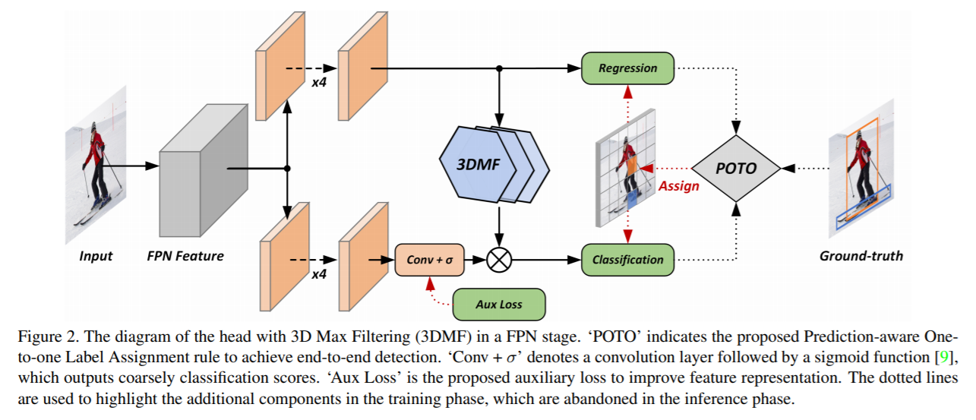
End-to-End Object Detection with Fully Convolutional Network
28 Jan 2021

Slide 7
補足｜タイトル
内容

