Slide 1
Author disambiguation
Authors:
Brian Ampwera Sandra Pietrowska

Slide 2
Author disambiguation
Outline
Introduction
Data preparation
Algorithm
Experiments
Results and evaluation
Conclusion

Slide 3
Introduction

Slide 4
Introduction
What is author disambiguation?
Why?
Enable searching the publications of specific author,
calculating statistics of social network and author impacts
citation analysis
Measure in funding
Challenges
define the variety of name formats
choose characteristics - variables
define an algorithm

Slide 5
Data preparation

Slide 6
DATA preparation
Dataset:
from 2007 to 2010
318591 unique publications
2328539 authors
261741 institutions
250 fields
Data cleaning

Slide 7
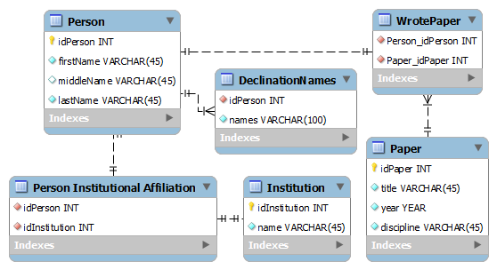
Entity relationship diagram

Slide 8
Algorithm

Slide 9
Method
Create the n clusters S_{i} with the papers written by the authors with the same surname
Create the m clusters D_{i} from the cluster S_{i} , where i = 1,2...n with the papers belonging to the same discipline
Create the j clusters I_{i} from the cluster D_{i} where i =1,2...m with the papers published in the same institutions
For each cluster I_{i} derive the full names and assign a probability that relates the paper, surname and name

Slide 10
SPLIT BY AUTHOR
for each name N which is a set of unigrams of the form X₁,X₂...X_{n}
remove X_{n}
convert the name N-X_{n} to lower case
obtaining the clusters S_{i} each containing the papers published by the same author (surname).

Slide 11
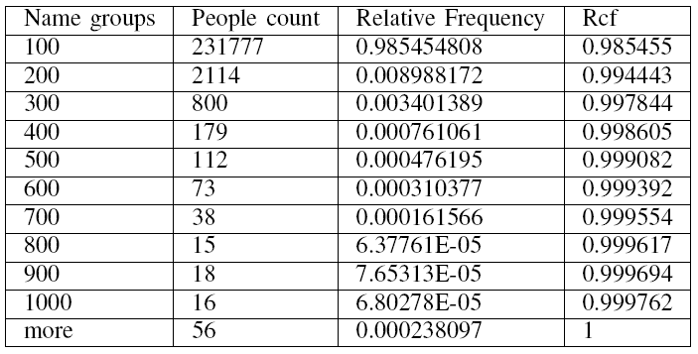
SPLIT BY AUTHOR

Slide 12
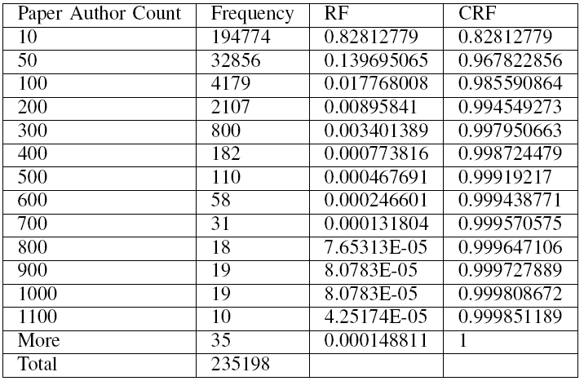
SPLIT BY AUTHOR

Slide 13
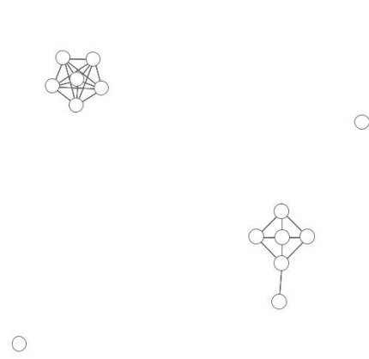
SPLIT BY DISCIPLINE
Based on the distance between the disciplines create the new subsets D_{i} using this algorithm:
for each paper P in S_{i} we compute the discipline distance with respect to P₂,P₃...P_{v} and as a result
obtain the matrix M(v x v)
transform it into an adjacency matrix of papers of size (n² - n)/2
obtain the set of clusters visualized as an undirected graph with the sets of connected components.

Slide 14
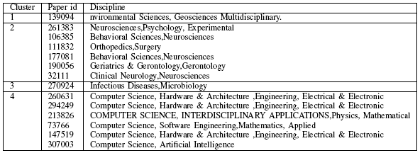
SPLIT BY DISCIPLINE

Slide 15
SPLIT BY INSTITUTION
Probabilistic estimation based on that the institutes that have the highest frequency in a set that emerges.
The most frequent institution is the basis of the split.

Slide 16
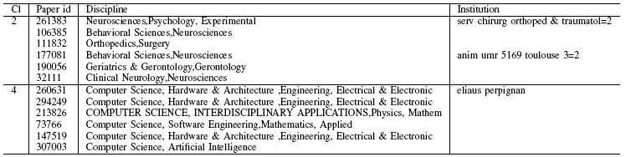
SPLIT BY INSTITUTION

Slide 17
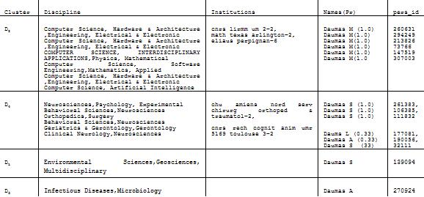
NAME GENERATION
derive the full name of the author = possible declinations of the full names
regarding the number of different formats we assign the corresponding probabilities

Slide 18
Experiments

Slide 19

Experiment 1
Commutative property
The experiment execution workflow is as follows:
consider the institution of the paper
if yes accept
else no
consider the discipline distance
consider the surname if the surname is the same
consider the declination probability for the name, if lower assign NO else assign YES

Slide 20
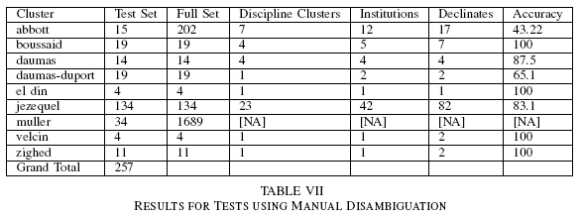
Experiment 2
Estimation based on manually assignment set

Slide 21
Results and conlusions

Slide 22
RESULTS
Commutative property: the conclusion is that it attempts to be commutative.
The second experiment: for the small sets the results have a high accuracy, while the bigger sets produce noise and effectively, the worse results.

Slide 23
FURTHER WORK
problem of misspelling or the common change of the surname
build a validation dataset that spans various fields and institutions where the authors institutions are concretely defined.
learning algorithm that would create the links of the most commonly visited papers given the authors

Slide 24

Thank you for your attention

