Slide 1

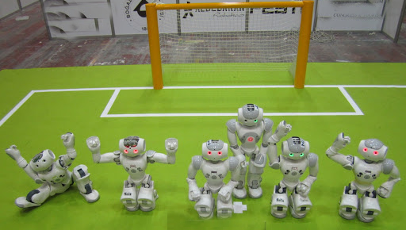
All for one one for All
Author: Bamshad Shirmohammadi
Supervisor: Professor Arend Hintze

Slide 2
Overview
Research aim
Method
(Data)
preliminary results
Time plan

Slide 3
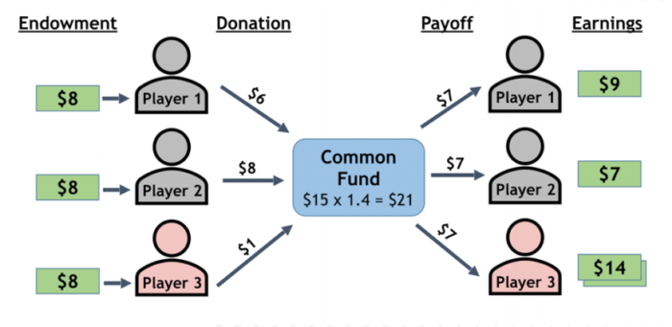
Research aim
Collaboration
Public goods game

Slide 4
Research aim
Is it a research in the field of human science?
No, it is about Artificial Intelligence
Self-driving car

Slide 5
Research aim
Public goods game
Different rules and setting (for example they can not keep their endowment, or we select all the players from one family)
Different collaborations
8$
12$
12$
8$
12$
12$
24*1.5 =
36 $
8$
12$
12$

Slide 6
Research aim
This research seeks to improve the way we train groups of AI controllers (agents) to perform better individually and in teams at the same time.
This is a basic research question is about optimization of neural networks using genetic algorithms: develop an objective function that encourage teamwork.
This objective function can also be used in reinforcement learning.
It has direct applications to robotics and other autonomous AI decision making systems that need to work in groups.

Slide 7
Method
We defined a game that AI controllers (agents) should work together.
In different scenarios (such as reward schemes) we check their way of collaboration.

Slide 8


Method

Slide 9
Method (data)
Experiment (MABE C++)
Calculate and visualize results (Analyzer Python)
Interpret

Slide 10
Method (data)
LOD.csv
Column name | Explanation
Generation | Generation number
2. ID | ID of each agent
3. Score | This field based on rewarding scheme value has the following meanings:
Reward mode | Score Meaning
0 | Individual score
1 | Mean score of the four agents
2 | Max score of the four agents
3 | Minimum score of the four agents
4. rawScores | Scores of all the group members
5. ownScore | The own score of the agent which is selected in the line of decent

Slide 11
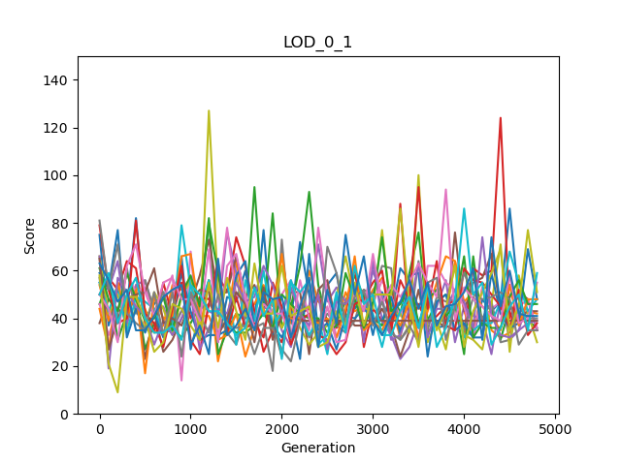
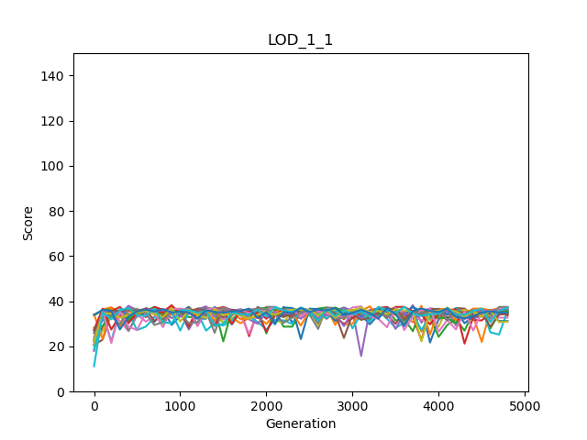
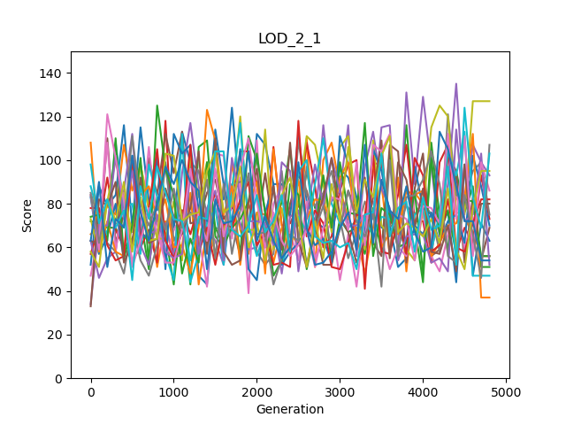
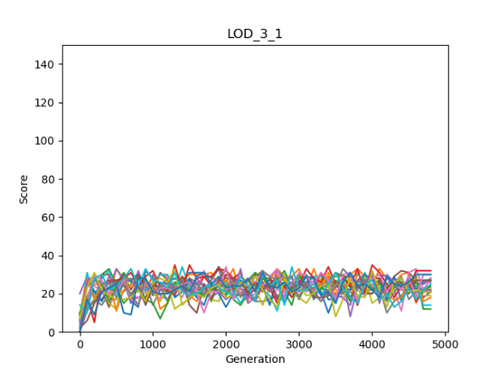
Preliminary results
X: generation
Y: score
Four settings
Four signals
It looks the game is so simple!
Individual | Group
Mean | Group
Maximum | Group
Minimum | Group

Slide 12
Time plan
November
Extend analysis and maybe more experiments
December
Conclusion and documentation

Slide 13

Thank you!

