Slide 1

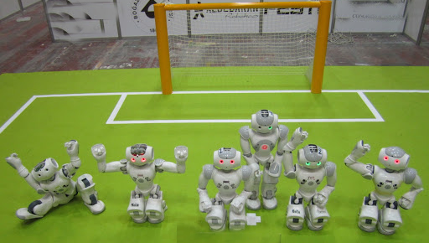
All for one one for All
Author: Bamshad Shirmohammadi
Supervisor: Professor Arend Hintze

Slide 2
Overview
Research aim
Method
Current results
Time plan

Slide 3
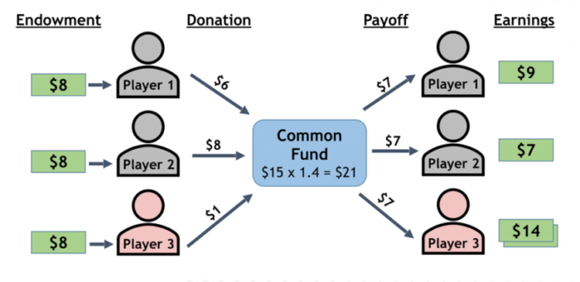
Research aim
Collaboration
Public goods game

Slide 4
Research aim
Is it a research in the field of human science?
No, it is about Artificial Intelligence
Self-driving car

Slide 5
Research aim
This research seeks to improve the way we train groups of AI controllers (agents) to perform better individually and in teams at the same time.
it has direct applications to robotics and other autonomous AI decision making systems that need to work in groups.

Slide 6
Method
We defined a game that AI controllers (agents) should work together.
In different scenarios (such as reward schemes) we check their way of collaboration.

Slide 7

Method
Here we can add a video or picture to describe the game

Slide 8
Method
Experiment (MABE C++)
Calculate and visualize results (Analyzer Python)
Interpret

Slide 9
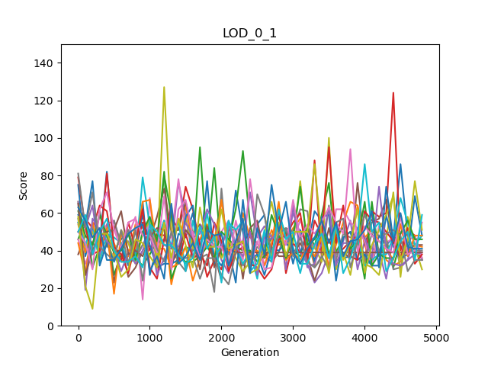
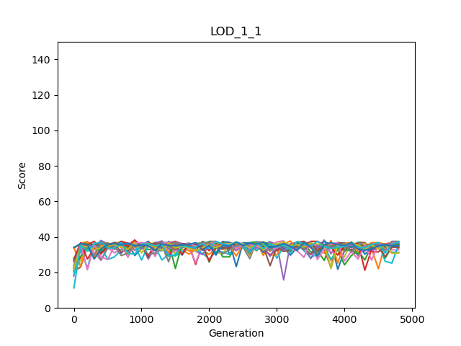
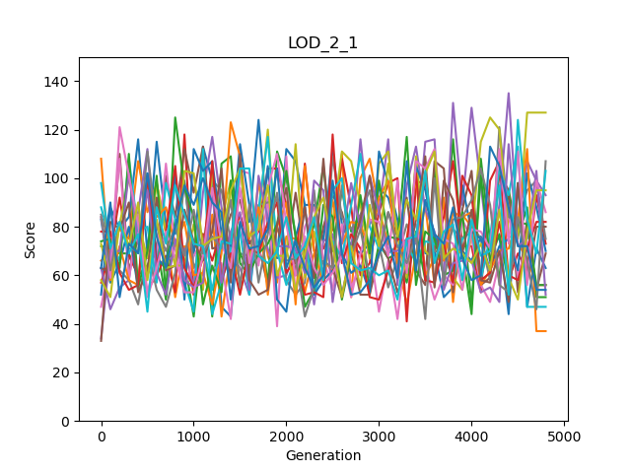
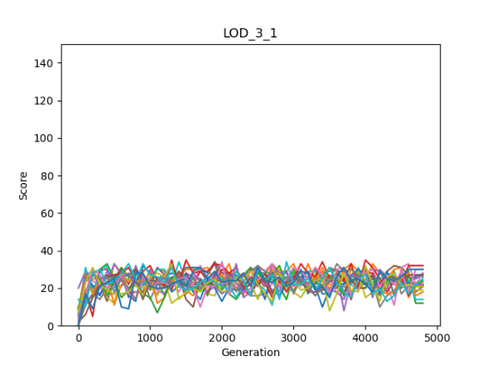
Current results
Individual | Group
Mean | Group
Maximum | Group
Minimum | Group

Slide 10
Time plan
November
Do more experiments and analysis
December
Conclusion and documentation

Slide 11

Thank you!

