Slide 1
영어 수행평가
20509 박재현

Slide 2
I

Slide 3
will be

Slide 4

a great android programmer.

Slide 5

and OpenGL

Slide 6
What is
Go to Wiki please :)
https://namu.wiki/w/OpenGL

Slide 7
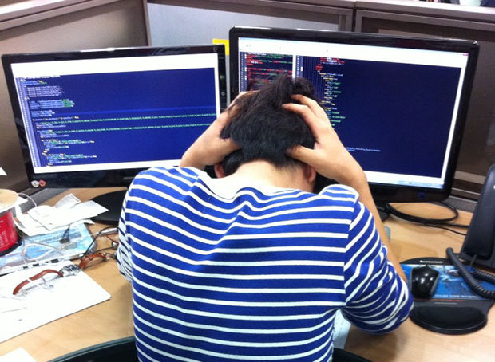
To get this job

Slide 8
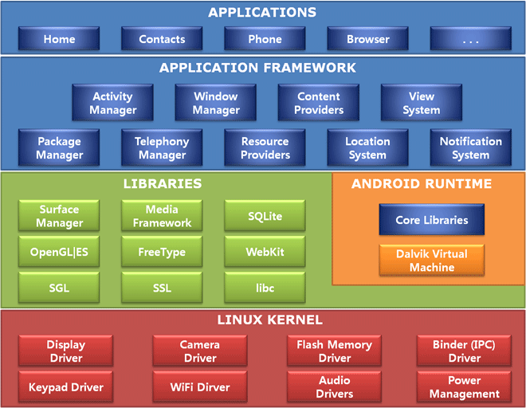
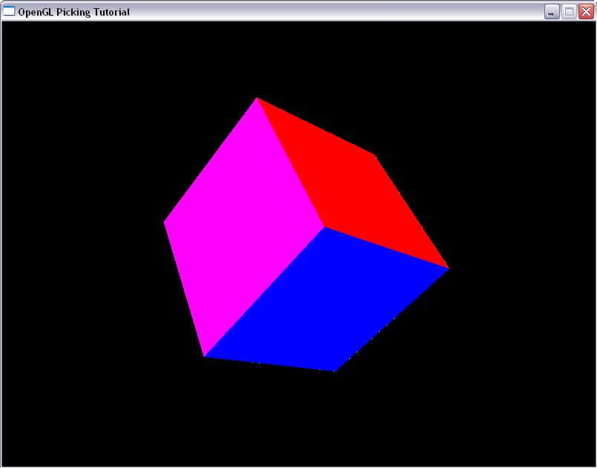

Slide 9
GAME ENGINE!

Slide 10


Slide 11
In Campus Life

Slide 12
game
Portfolio
contest

Slide 13


Slide 14
Thank you

