Slide 1
영어 수행평가
20509 박재현

Slide 2
I
Notes:
I

Slide 3
will be
Notes:
will be

Slide 4

a great android programmer.
Notes:
a great android programmer.
but sometimes

Slide 5

and OpenGL
Notes:
I will develop pc games support the cross platform by opengl

Slide 6
What is
Go to Wiki please :)
https://namu.wiki/w/OpenGL
Notes:
(opengl explain?)

Slide 7
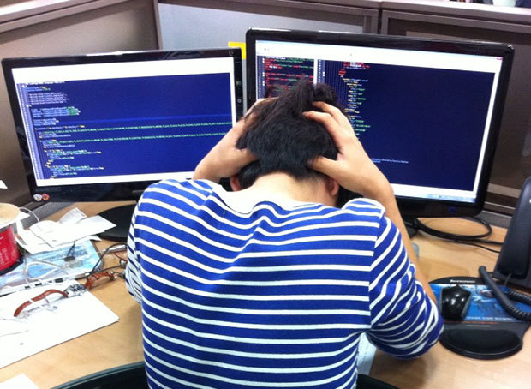
To get this job
Notes:
To get this job,

Slide 8
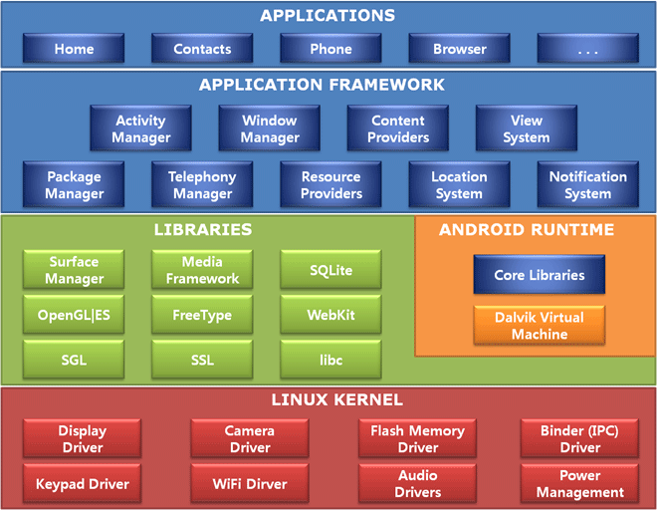
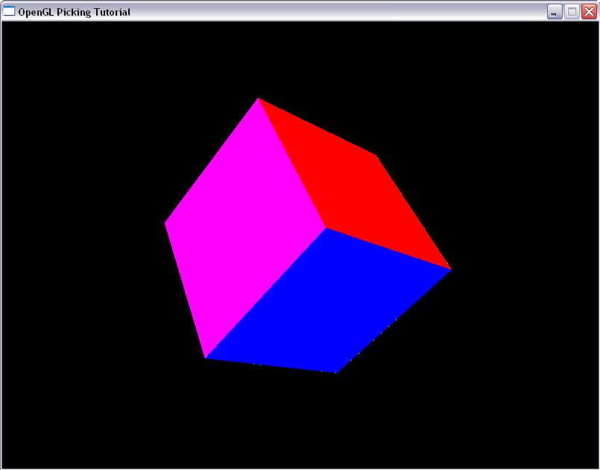
Notes:
I should learn about android OS’s minutely structure, and (I should learn) 3d rendering at least I deal opengl like a piece of cake. (simply i screwed up)

Slide 9
GAME ENGINE!
Notes:
then I will make something can call “Game Engine”. In fact, close to a wish list.

Slide 10

Notes:
I will study nodejs and open the web server to use a game server if I can.

Slide 11
In Campus Life
Notes:
Until campus life, I hope to make games solo or two people.

Slide 12
game
Portfolio
contest
Notes:
Make various games and Take part in contest, so I will build my career to write my own portfolio.

Slide 13

Notes:
then I would lead my way to advantage direction.

Slide 14
Thank you

