Slide 1
U.S Flights Delay Analysis
By
Ban Qu

Slide 2
The Problem:
Flight delays and cancellations are always a major topic in air travel service
Notes:
The Bureau of Transportation Statistics (BTS) has been recording airline customer data to help decision makers better understand statistics on transportation
The goal is to improve operational efficiency, to examine emerging topics, and to create relevant and timely information that foster understanding of transportation and its transformational role in society

Slide 3
The Solution:
Predict potential flight delays with machine learning models on real datasets.
Notes:
The raw dataset involves 3 different files: airlines, airports, and flights
Airline data contains 14 unique airlines and their codes, and the table contains no missing data. Airports data contains 322 rows and 7 columns that are related to locations of airports.
Flights data contains 5819079 rows and 31 columns

Slide 4
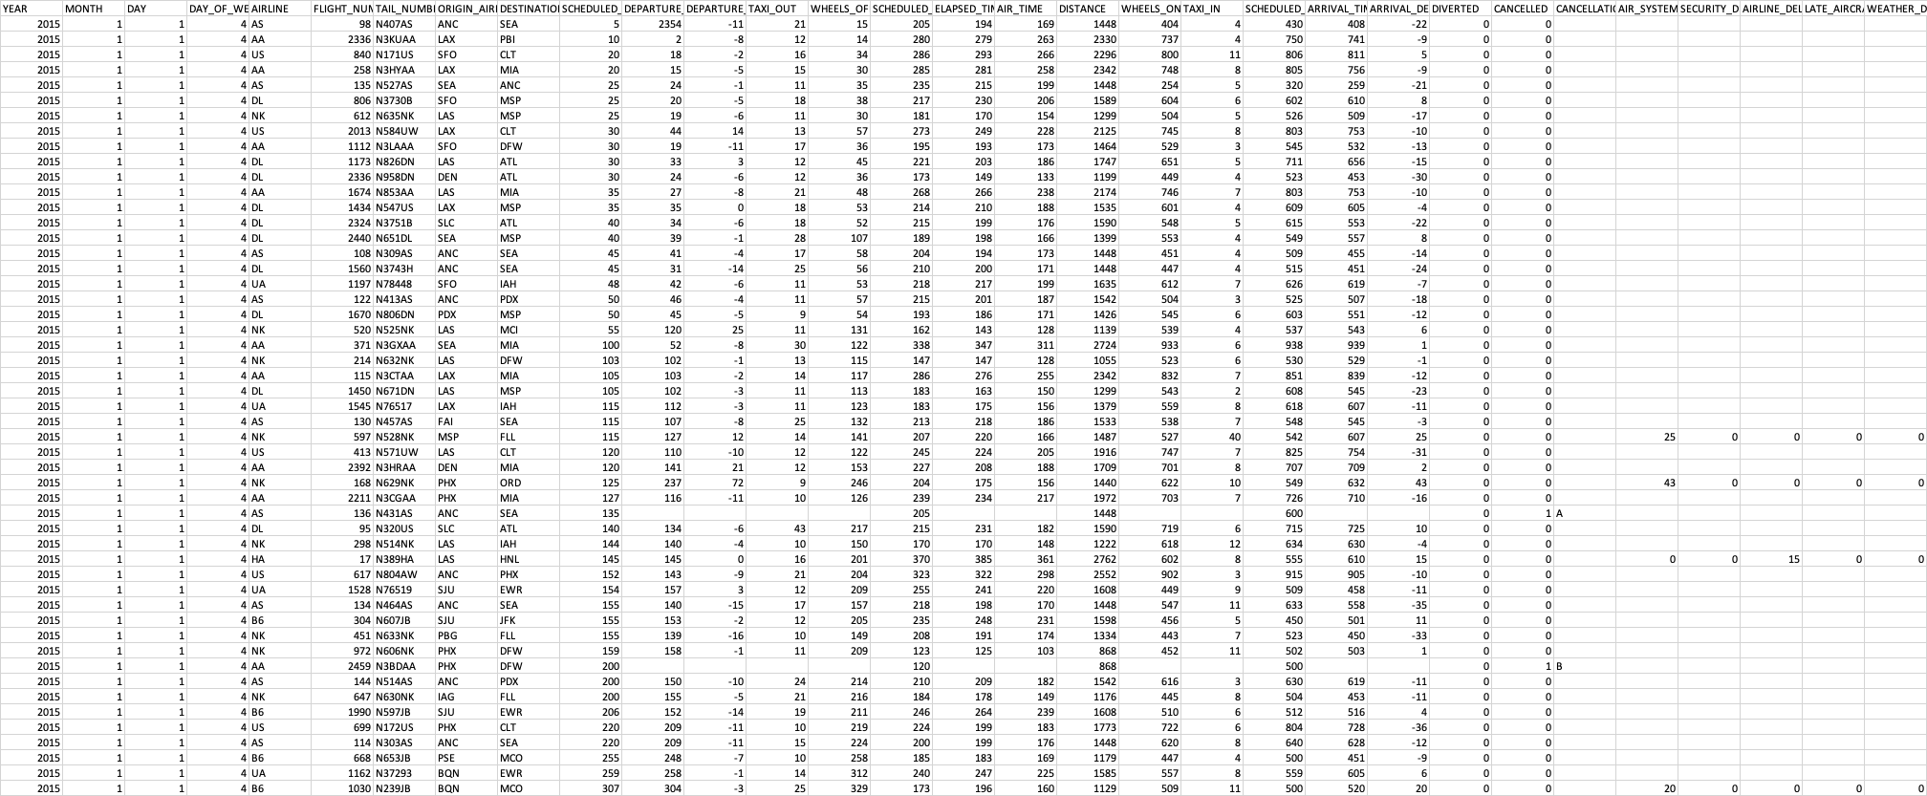
The Data
Data Source:https://www.kaggle.com/datasets/usdot/flight-delays?select=flights.csv

Slide 5
Data Wrangling
Target Variable: delayed
Variables removed
Missing values filled with zeros: “CANCELLATION_REASON”, “WEATHER_DELAY”, “LATE_AIRCRAFT_DELAY”, “AIRLINE_DELAY”, “SECURITY_DELAY”, and “AIR_SYSTEM_DELAY”
Inner join 3 datasets on “IATA_CODE”
Original dataset had 5819079 rows and 31 columns
Notes:
“ARRIVAL_TIME” and “SCHEDULED_ARRIVAL” are removed because “ARRIVAL_DELAY” simply summarizes these two features.
Similarly, “SCHEDULED_DEPARTURE” and “DEPARTURE_TIME” are removed because “DEPARTURE_DELAY” summarizes the two.
Columns not interested in the current study are also dropped: “TAXI_OUT”, “TAXI_IN”, “WHEELS_OFF”, “WHEELS_ON”, “AIR_TIME”, “SCHDULED_TIME”, and “ELAPSED_TIME”.
Missing values under “TAIL_NUMBER” are dropped since missed aircraft identifier rows are useless.
The final cleaned dataset contains 5309350 rows and 28 columns.

Slide 6
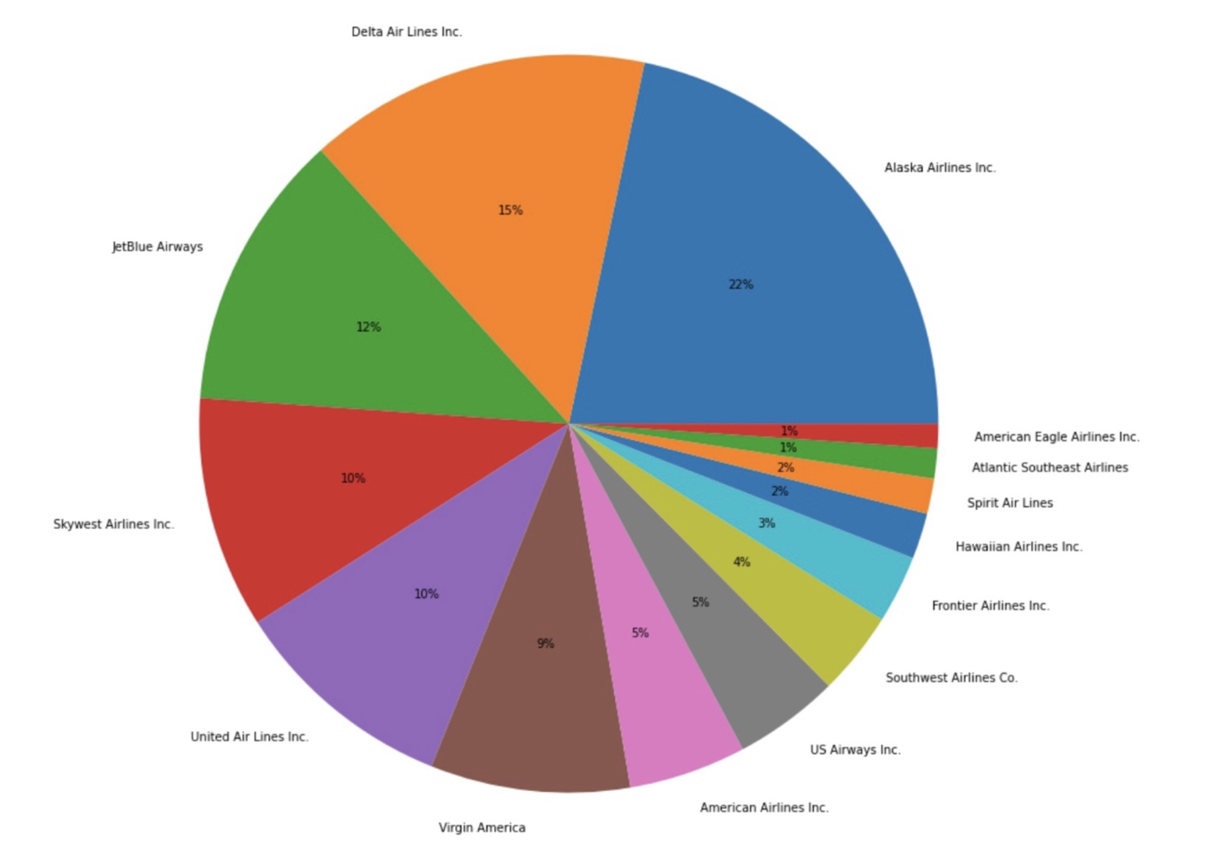
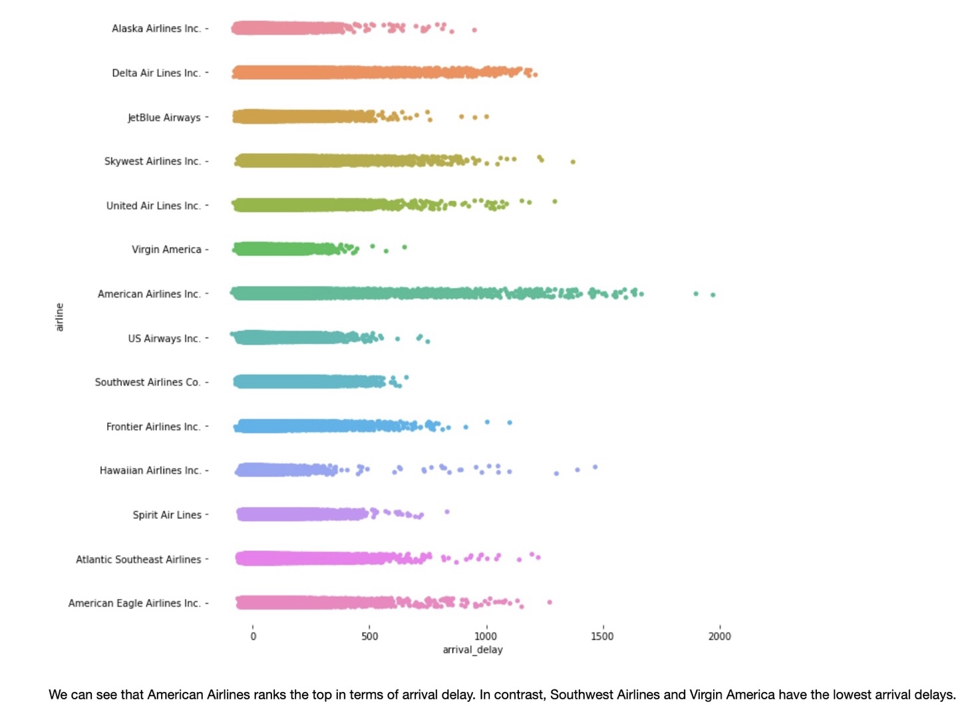
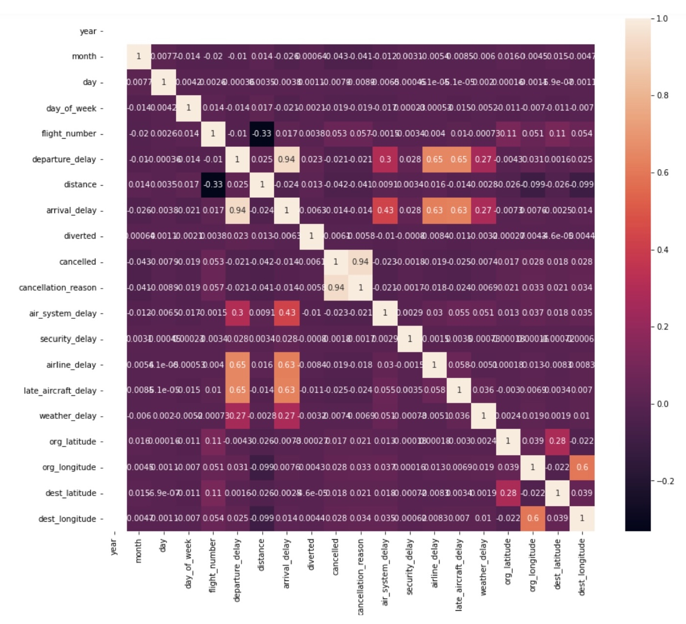
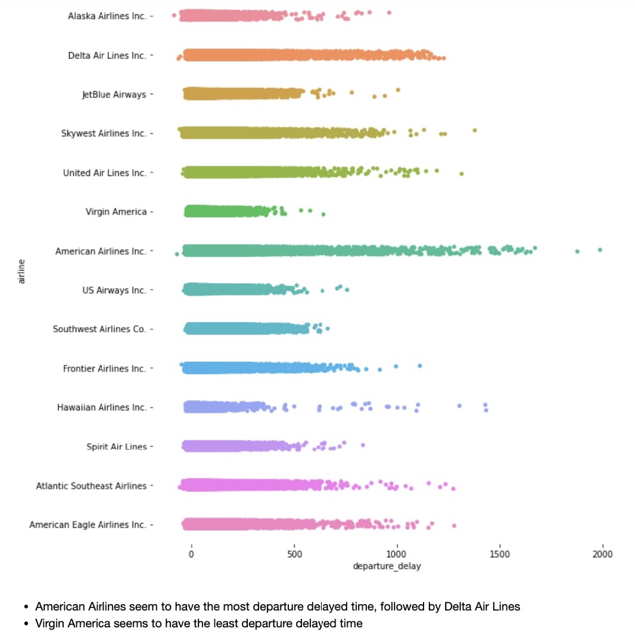
Exploratory
Data Analysis

Slide 7
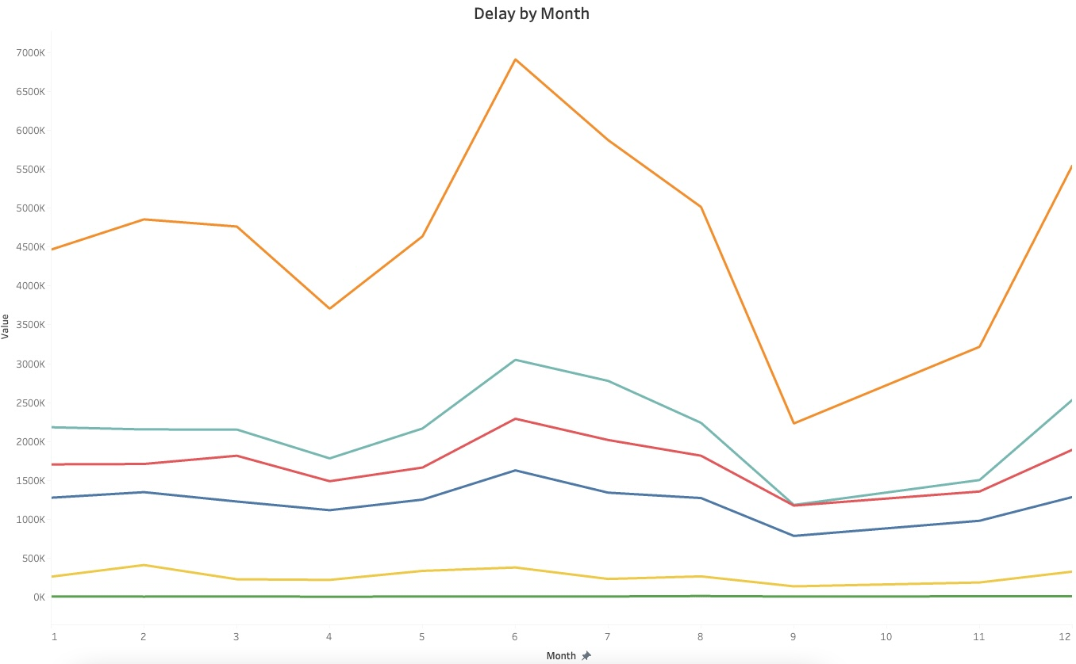
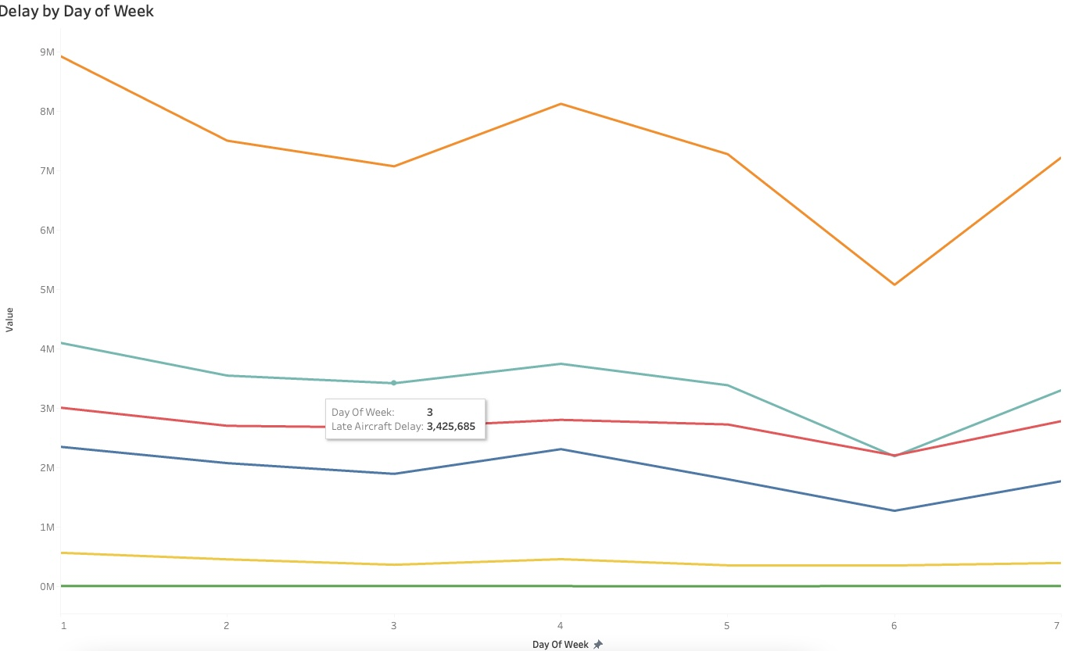
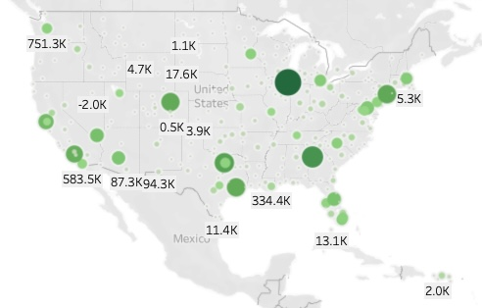
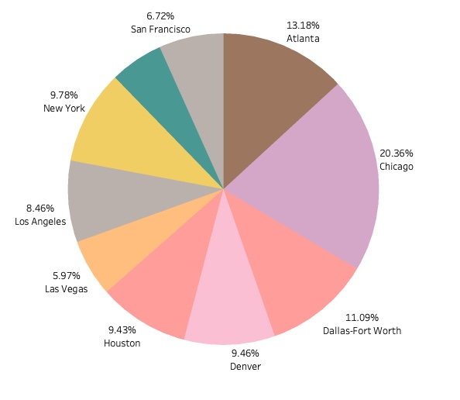
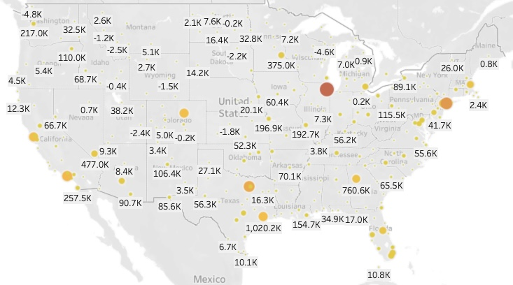
Exploratory
Data Analysis

Slide 8
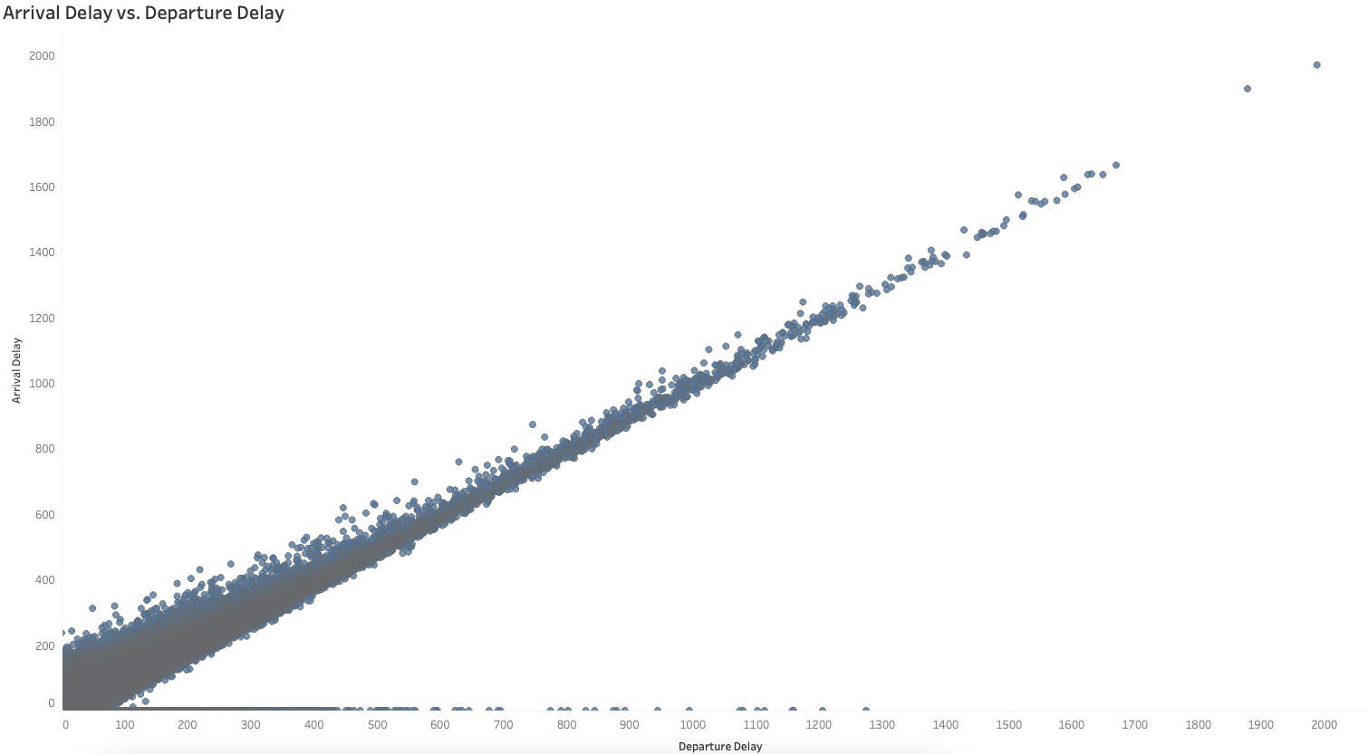
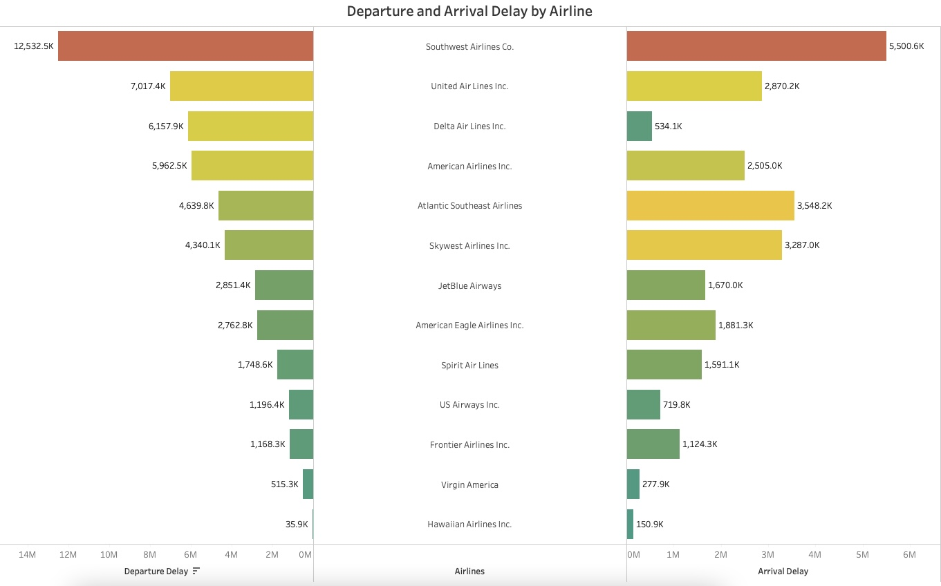
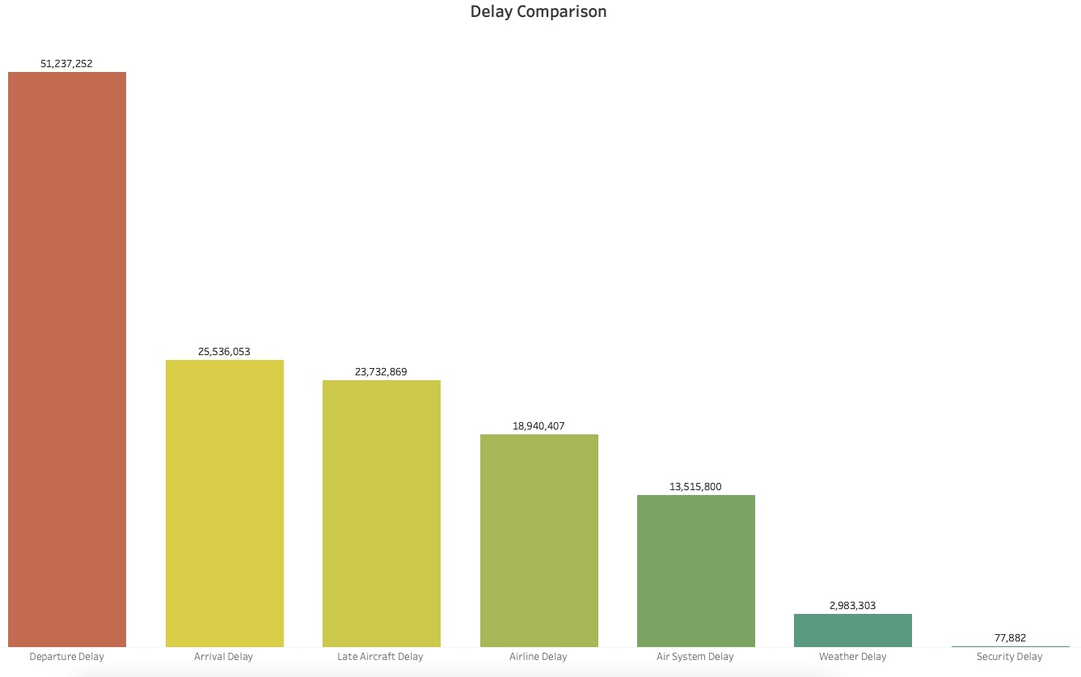
Exploratory
Data Analysis

Slide 9
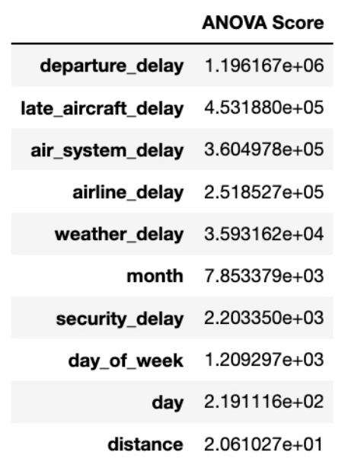
Feature Selection
Numerical Features
Final Features: month, day, day_of_week, air_system_delay, airline_delay, weather_delay, late_aircraft_delay, departure_delay, security_delay
Final Sample Size: 50000
Notes:
Age is further grouped in ranges (5 groups with 10 years as range)
RestingBP will be dropped based on Chi Squared Test and ANOVA Test for categorical and numerical features, respectively

Slide 10
Train-Test Split
Model Selection (Classification Problem)
Training Data vs. Testing Data: 80% vs. 20%
X_train: (50000, 9) ; X_test: (40000, 9)
y_train: (50000, ); y_test: (40000, )
KNN
Logistic Regression
Random Forest
Support Vector Machine
Naïve Bayes
Gradient Boosting

Slide 11
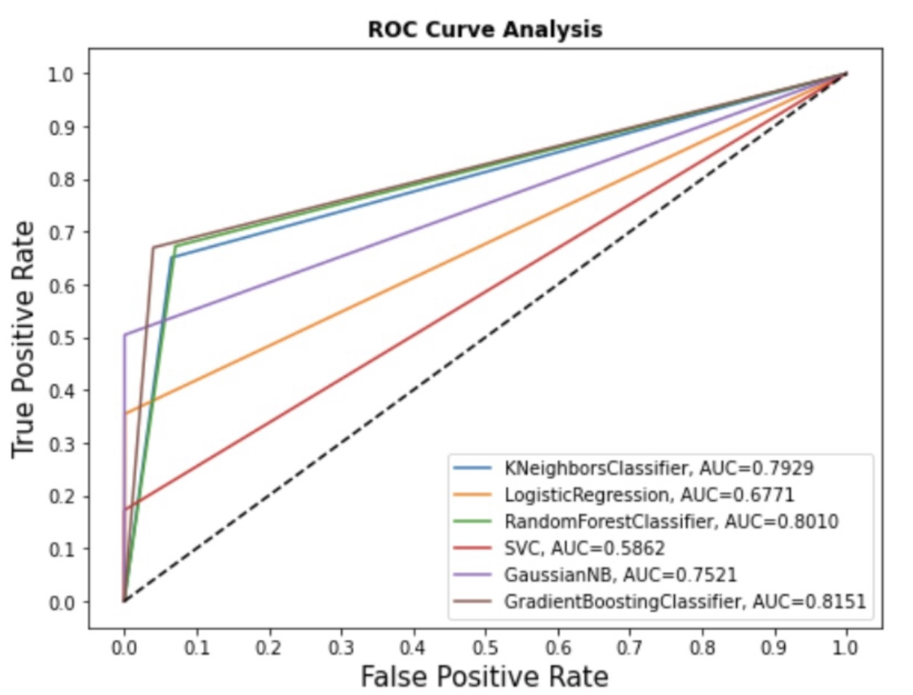
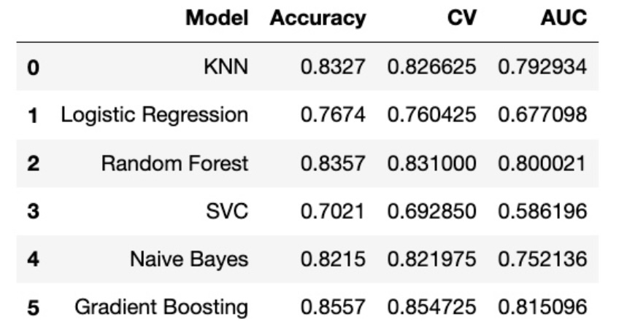
Modelling
Metrics: Accuracy Score, CV Score, ROC-AUC Score

Slide 12
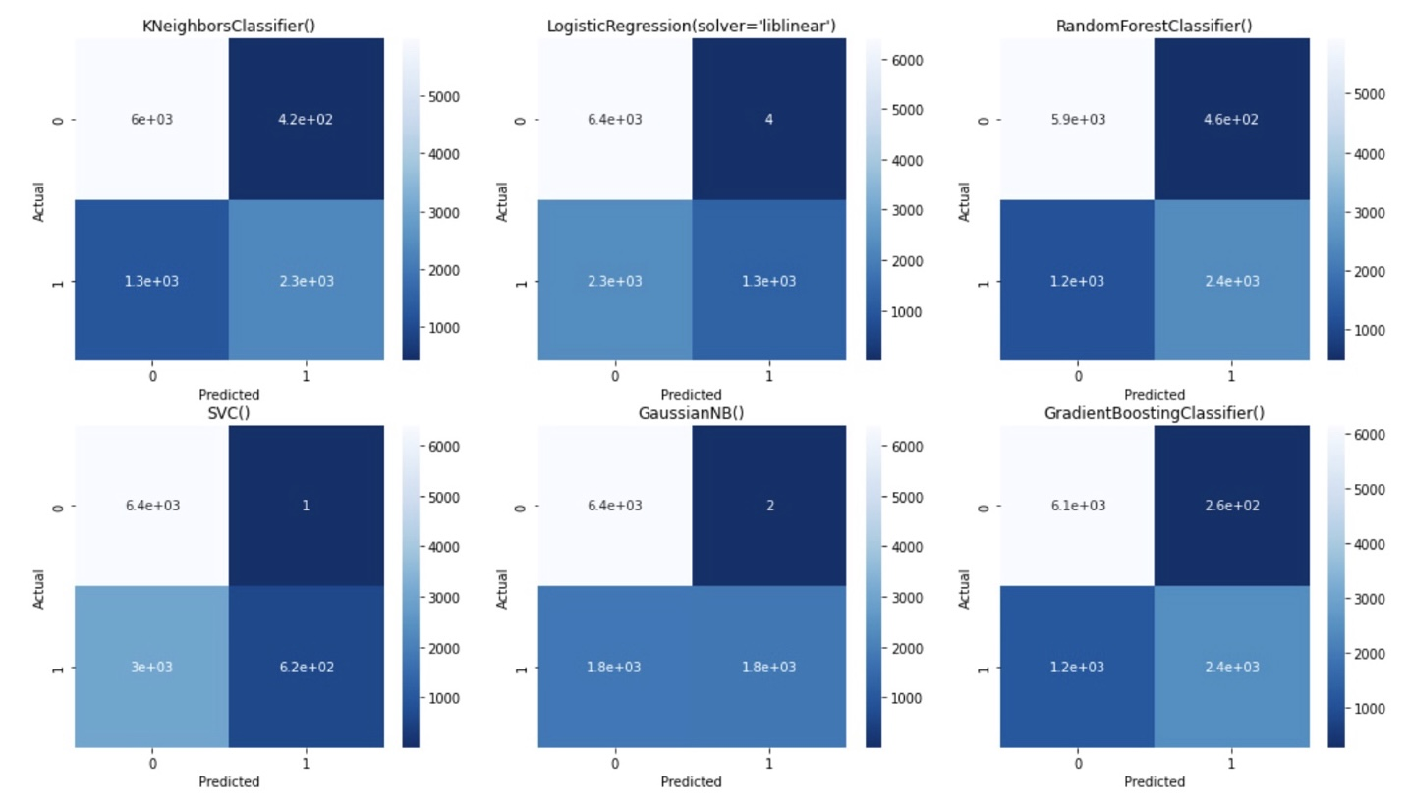
Modelling
Metrics: Accuracy Score, CV Score, ROC-AUC Score
Notes:
Gradient Boosting has the highest accuracy score and AUC score, followed by Random Forest.
Logistic Regression and SVC seem to be not doing well
KNN and Naïve Bayes are acceptable discrimination.
We only train each model with its default parameters
Model performance might be different if applying different parameters

Slide 13
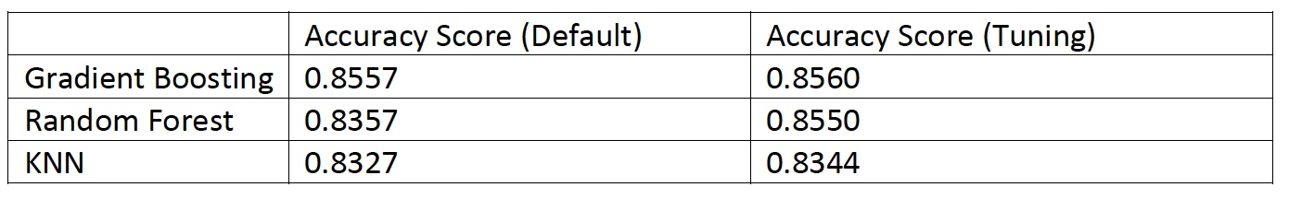
Hyperparameter Tuning
Grid Search Cross Validation

Slide 14
Hyperparameter Tuning
Accuracy Score Improvement:
Random Forest: 83.57% to 85.50%
Gradient Boosting: 85.57% to 85.60%
KNN: 83.27% to 83.44%

Slide 15
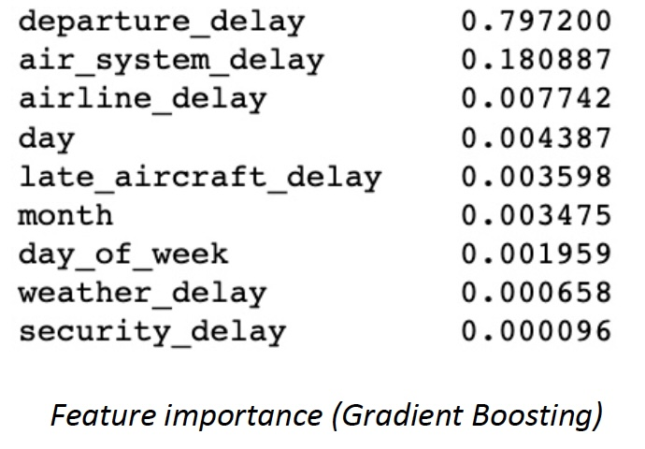
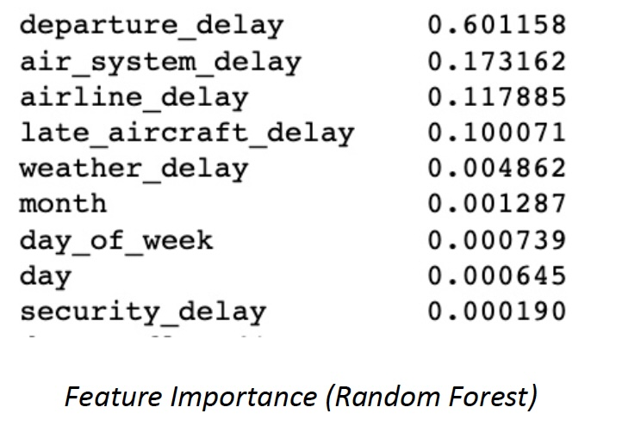
Important Findings

Slide 16
Takeaways
Highest accuracy score is Gradient Boosting
Highest cv score is Gradient Boosting
Random Forest and Gradient Boosting agree on the most predicting feature: departure delay
Air system delay is the second main cause
Weather, month, day, day of week not important predicting features

Slide 17
Recommendations
U.S. Department of Transportation (DOT) should focus on making measures to reduce departure delay
DOT should pay more attention to Southwest Airlines (highest total departure delay time, arrival delay time, and number of departure and arrival delays)
DOT should also consider air system delays (second top reason causing domestic delay)

Slide 18
Future Research
Integrate data to include more countries for a global view
Try with more parameters
Add more recent years’ data

Slide 19
Thank You!

Slide 20
Questions?

