Slide 1
Heart Failure Prediction Analysis
By
Ban Qu

Slide 2
The Problem:
Heart failures are the major causes of cardiovascular diseases – leading cause of death
Notes:
Cardiovascular diseases (CVDs) are the leading cause of death worldwide. To be specific, around 80 percent of deaths caused by CVDs are due to heart attacks and strokes, in which one-third of these deaths happen among people under 70 years old
It is crucial to understand which factors contribute to heart failure for early detection

Slide 3
The Solution:
Predict potential heart failures with machine learning models on real datasets.
Notes:
The present study contains a dataset with 12 features that could be used to predict a potential heart failure
The raw dataset is derived from 5 datasets combined together that are related to heart.
It is also the largest heart disease dataset available so far for research purposes

Slide 4
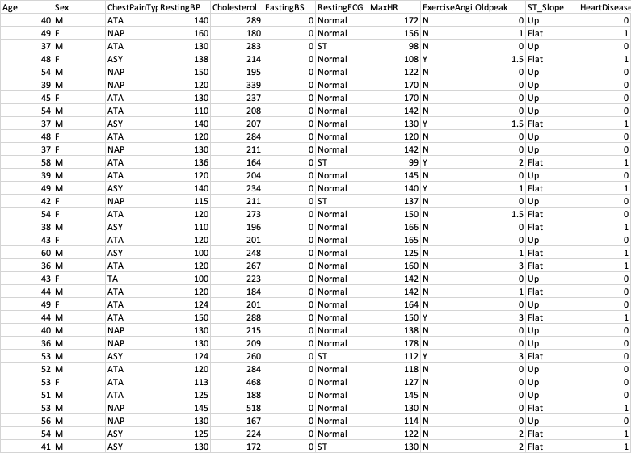
The Data
Data Source: https://www.kaggle.com/datasets/fedesoriano/heart-failure-prediction?select=heart.csv

Slide 5
Data Wrangling
Target Variable: HeartDisease
Five categorical variables converted to numeric: Sex, ChestPainType, RestingRCG, ExerciseAngina, ST_Slope
Dropped 0 on RestingBP (blood pressure)
Removed outliers on Oldpeak, Cholesterol, RestingBP, MaxHR
Original dataset had 918 rows and 12 columns

Slide 6
New Dataset

Slide 7
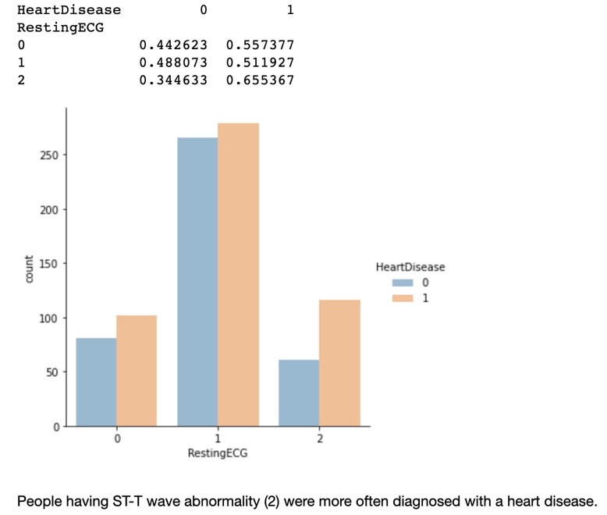
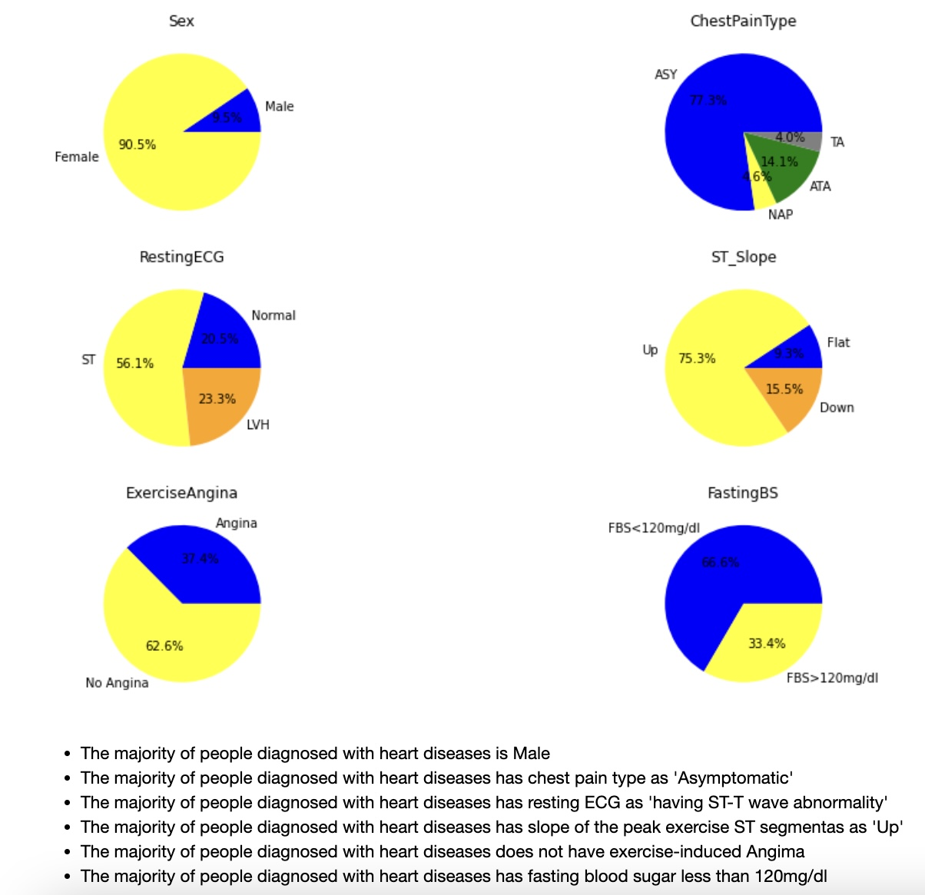
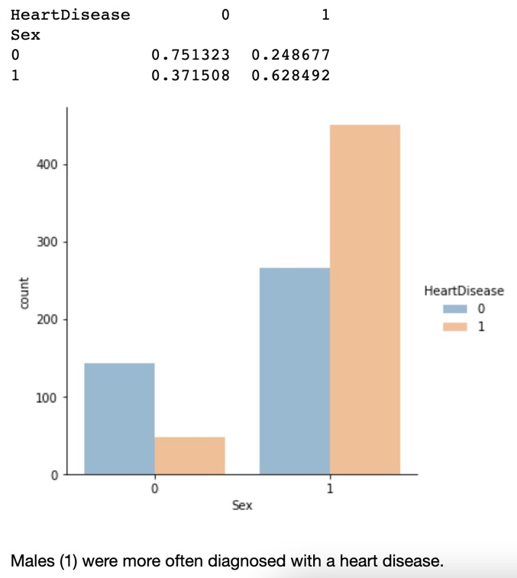
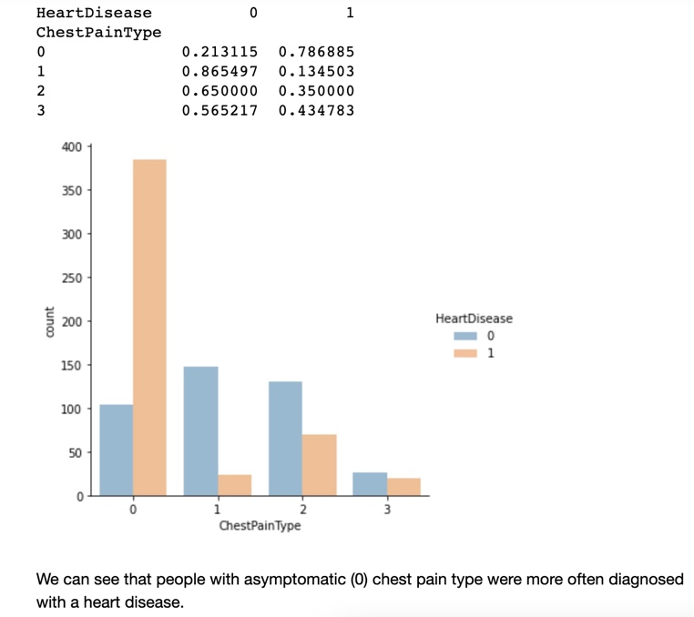
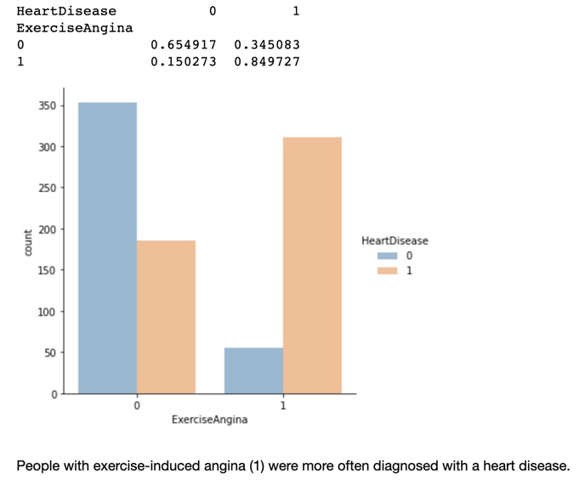
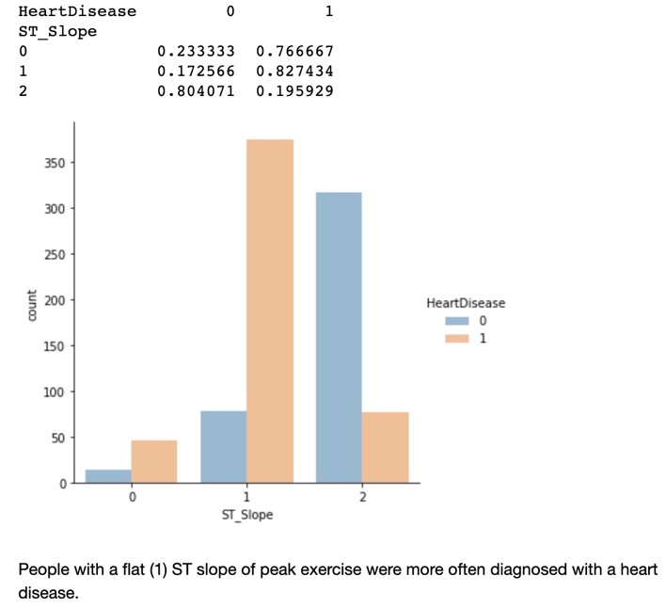
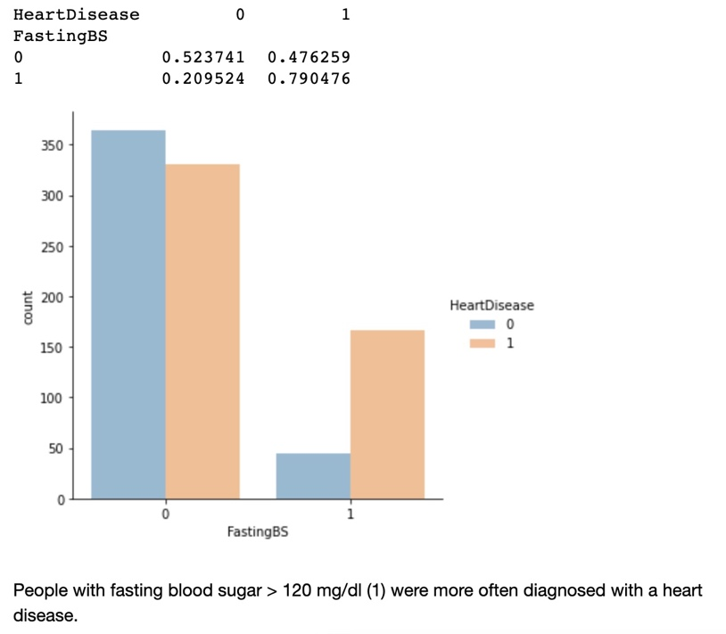
Exploratory
Data Analysis

Slide 8
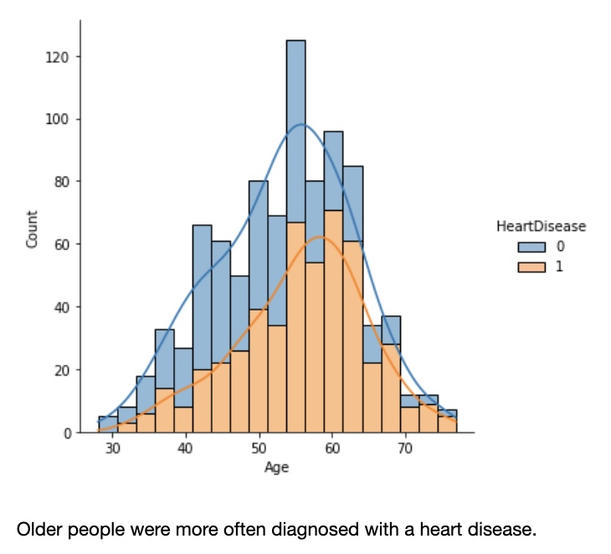
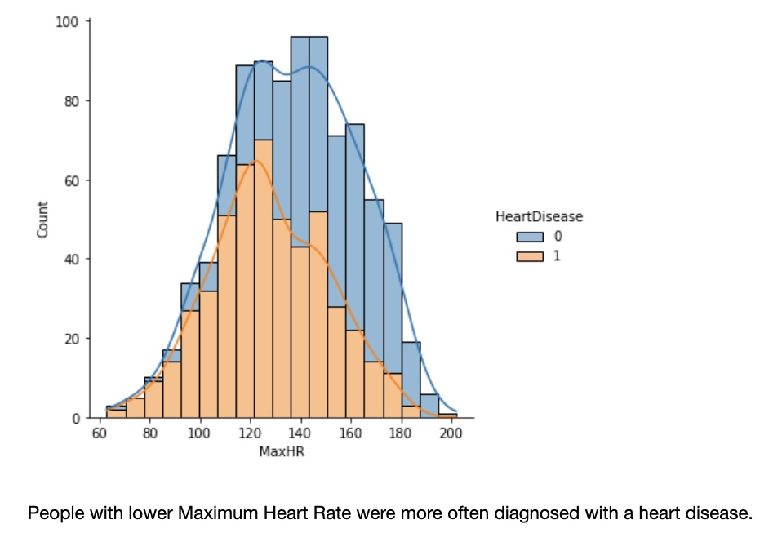
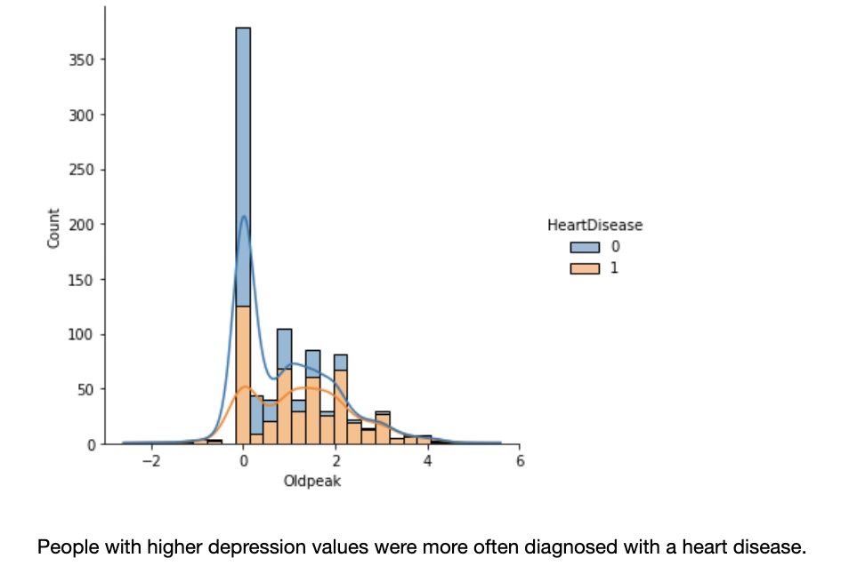
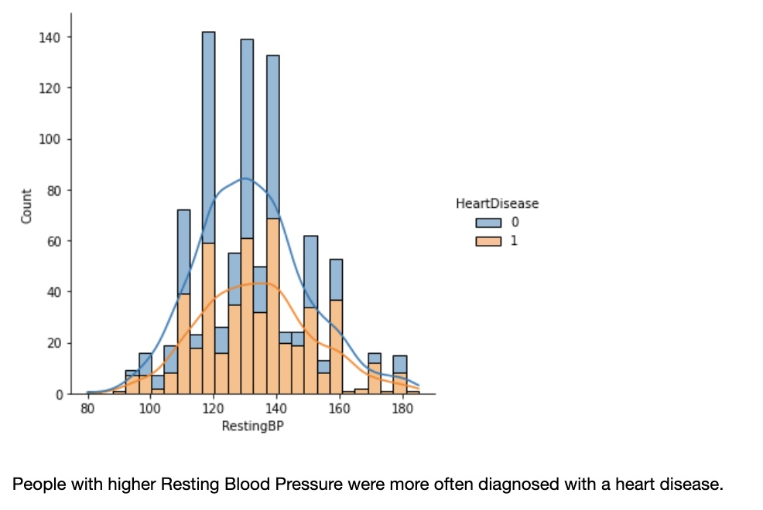
Exploratory
Data Analysis

Slide 9
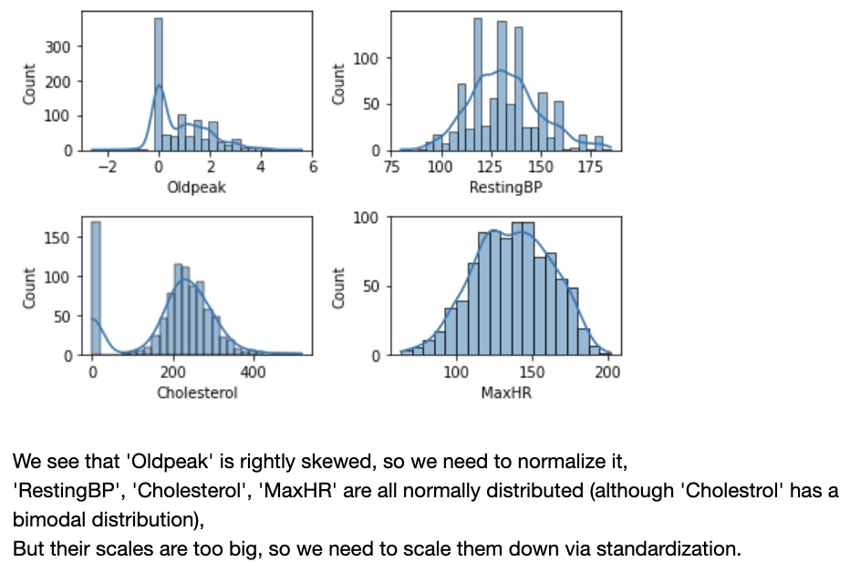
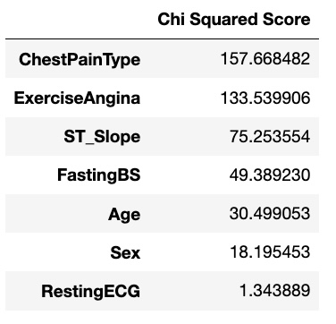
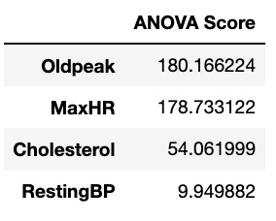
Feature Selection
Pre-Processing
Categorical Features
Numerical Features
Final Features: ChestPainType, ExerciseAngina, ST_Slope, FastingBS, Age, Sex, Oldpeak, MaxHR, Cholesterol
Notes:
Age is further grouped in ranges (5 groups with 10 years as range)
RestingBP will be dropped based on Chi Squared Test and ANOVA Test for categorical and numerical features, respectively

Slide 10
Train-Test Split
Model Selection (Classification Problem)
Training Data vs. Testing Data: 80% vs. 20%
X_train: (724, 9) ; X_test: (181, 9)
y_train: (724, ); y_test: (181, )
KNN
Logistic Regression
Random Forest
Support Vector Machine
Naïve Bayes
Gradient Boosting

Slide 11
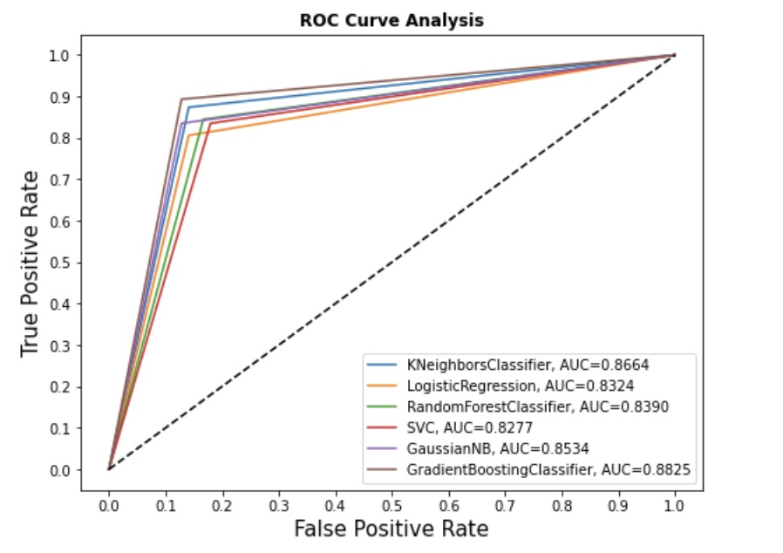
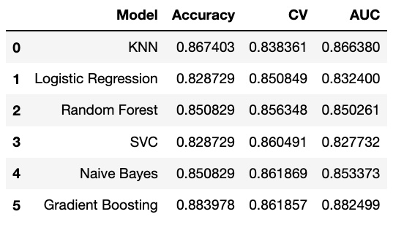
Modelling
Metrics: Accuracy Score, CV Score, ROC-AUC Score

Slide 12
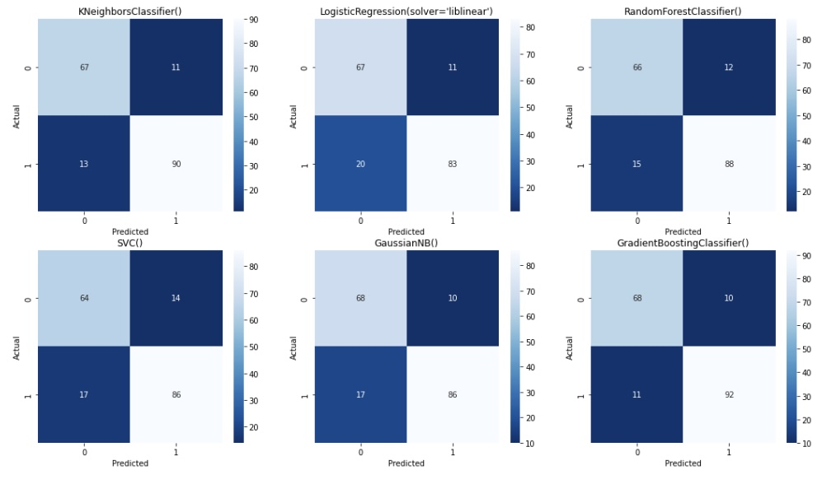
Modelling
Metrics: Accuracy Score, CV Score, ROC-AUC Score
Notes:
Gradient Boosting has the highest accuracy score and AUC score, followed by KNN.
Logistic Regression and SVC seem to be not doing well
Random Forest has the highest Cross validation score, followed by Gradient Boosting.
We only train each model with its default parameters
Model performance might be different if applying different parameters

Slide 13
Hyperparameter Tuning
 | Accuracy Score | Cross Validation Score | AUC Score
Random Forest | 0.8619 | 0.9235 | 0.9349
Gradient Boosting | 0.8564 | 0.5000 | 0.9349
KNN | 0.8785 | 0.9229 | 0.9349
Grid Search Cross Validation

Slide 14
Hyperparameter Tuning
Accuracy Score Improvement:
Random Forest: 85.1% to 86.2%
Gradient Boosting: 88.4% to 85.6%
KNN: 86.7% to 87.9%
AUC Score Improvement:
Random Forest: 85.0% to 93.5%
Gradient Boosting: 88.2% to 93.5%
KNN: 86.6% to 93.5%

Slide 15
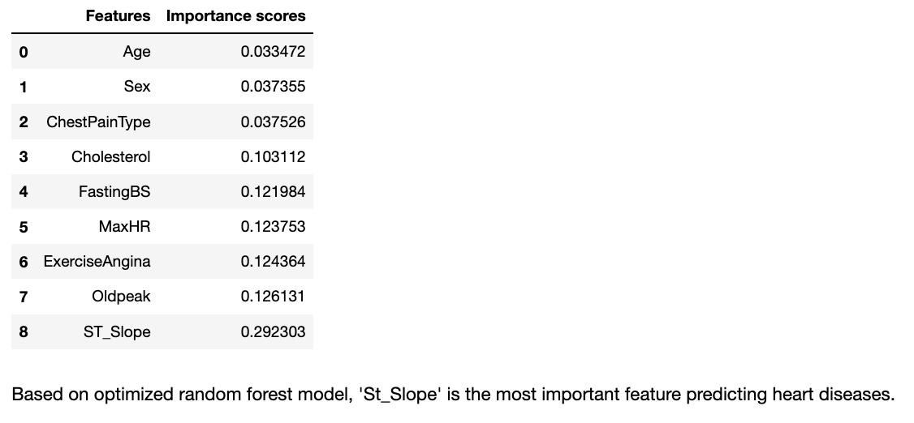
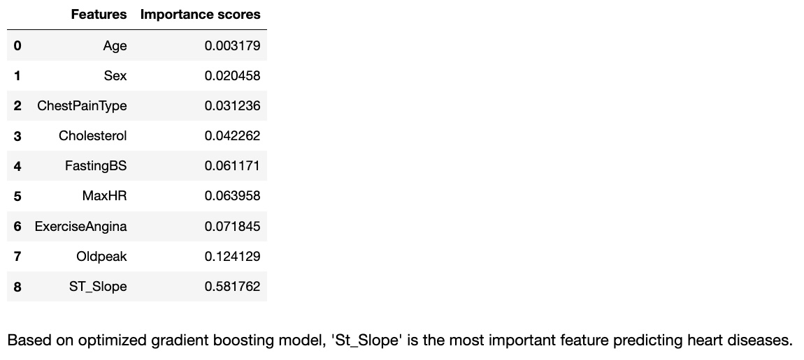
Important Findings

Slide 16
Takeaways
Highest accuracy score is Gradient Boosting
Highest cv score is Random Forest
Random Forest and Gradient Boosting agree on the most predicting feature: ST_Slope

Slide 17
Future Research
Integrate data to include more countries
Expand to more parameters
Add more recent years’ data

Slide 18
Thank You!

Slide 19
Questions?

