Slide 1
Task 1
Titanic Prediction

Slide 2
Task Overview
The sinking of the Titanic is one of the most infamous shipwrecks in history.
Build a predictive model that answers the question: “what sorts of people were more likely to survive?” using passenger data (ie name, age, gender, socio-economic class, etc).

Slide 3
Relevance
Root cause analysis, in this case why people survive/not survive in RMS Titanic Accident

Slide 4
Steps
Data Overview
EDA
Cluster Analysis
Modeling
Deployment

Slide 5
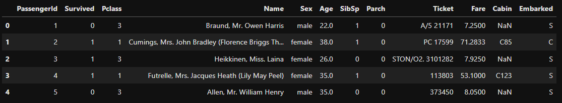
Data Overview
The data has been split into two groups: training set (train.csv) and test set (test.csv)
The training set should be used to make machine learning model that contains the outcome (survivability) as the ground truth. This dataset has 891 data points
The test set should be used to gauge the model performance on unseen data, in this dataset we don’t know the outcome of the passenger. This dataset has 498 data points

Slide 6
Data Overview – contd
PassengerId: Unique identifier for each passenger
Survived: Survival status (0 = No, 1 = Yes)
Pclass: Ticket class (1 = 1st, 2 = 2nd, 3 = 3rd)
Name: Passenger's name
Sex: Gender
Age: Age of the passenger
SibSp: Number of siblings or spouses aboard the Titanic
Parch: Number of parents or children aboard the Titanic
Ticket: Ticket number
Fare: Passenger fare
Cabin: Cabin number
Embarked: Port of embarkation (C = Cherbourg, Q = Queenstown, S = Southampton)

Slide 7
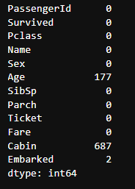
EDA
The train dataset has several columns that have missing values on it.
Current modern machine learning model should be able to handle missing value effectively, however we still need to the cause

Slide 8
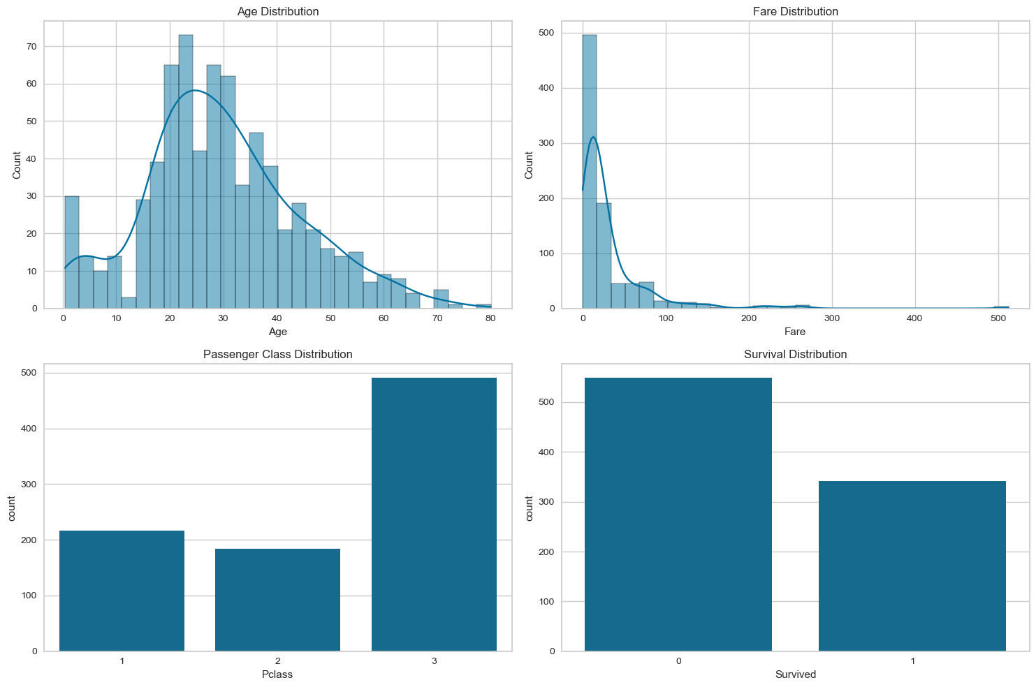

Slide 9
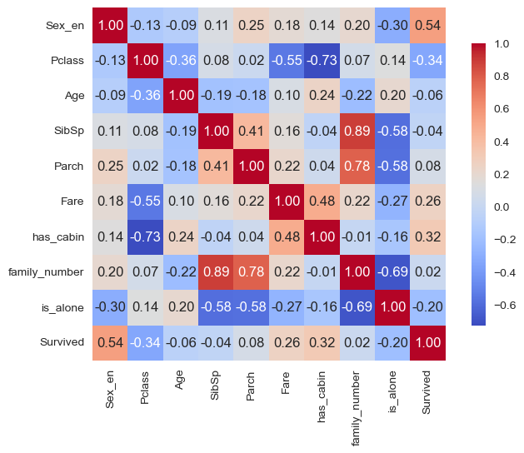

Slide 10
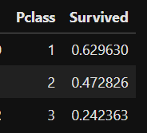
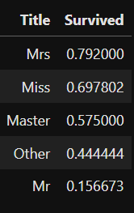
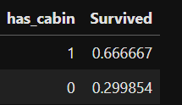
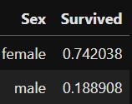
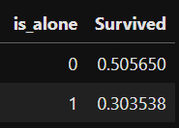
Pivot Analysis on Survivability

Slide 11
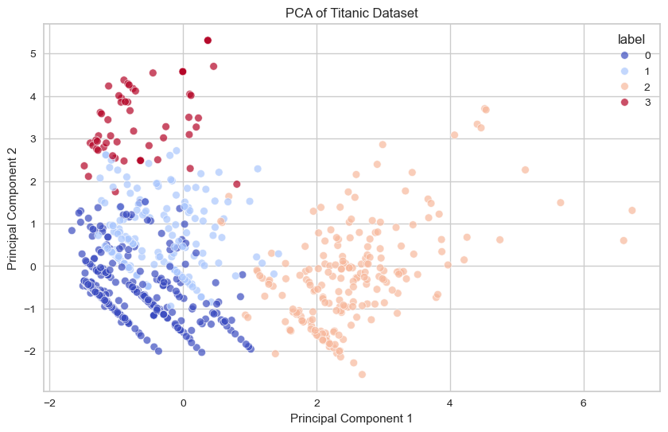
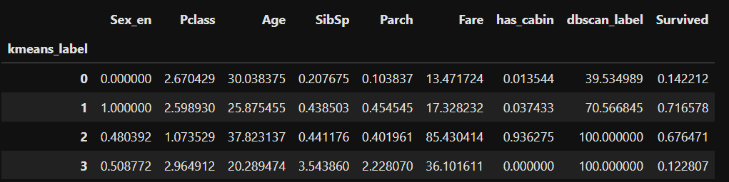
Cluster Analysis

Slide 12
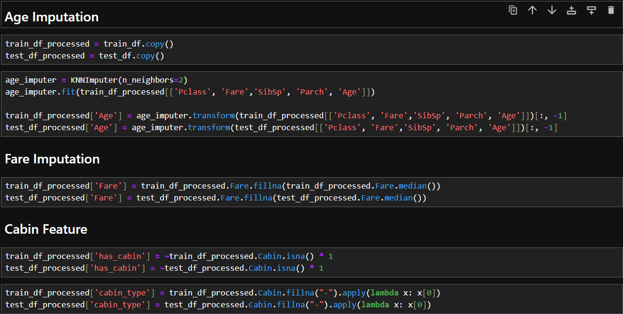
Feature Engineering

Slide 13
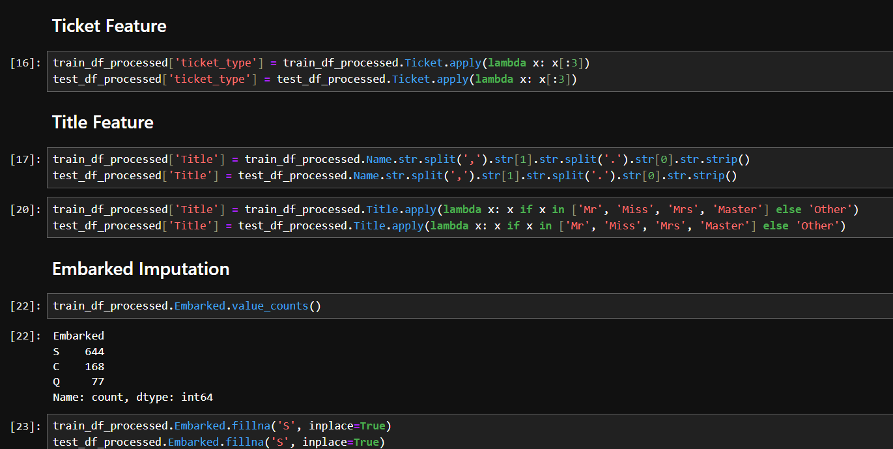

Slide 14
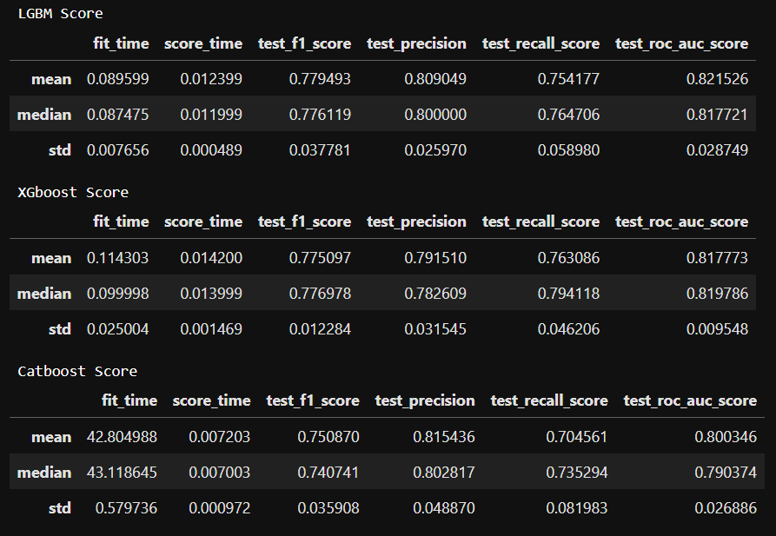
Modeling

Slide 15
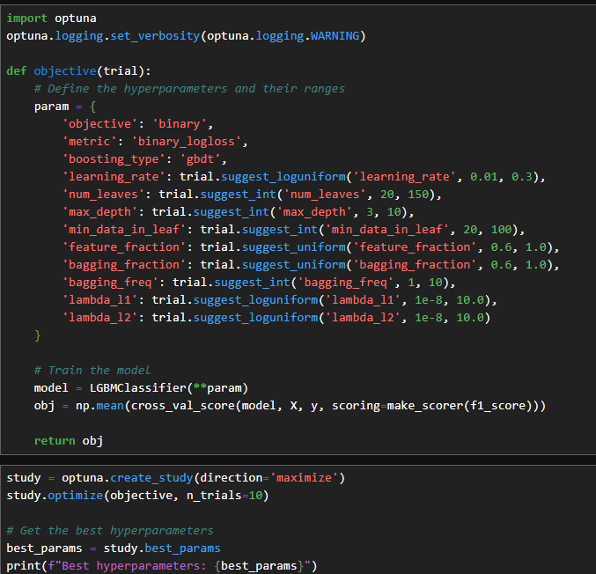
Hyperparameter TUning
By using Optuna, the model performance could be enhance further by optimizing the hyperparameter.

Slide 16
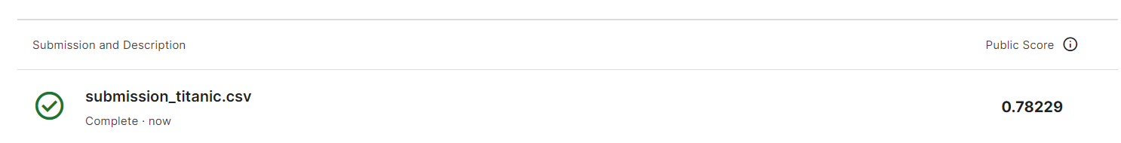
Performance

Slide 17
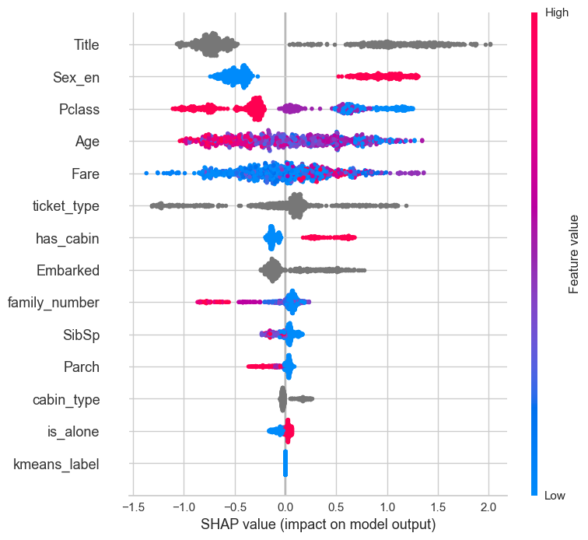
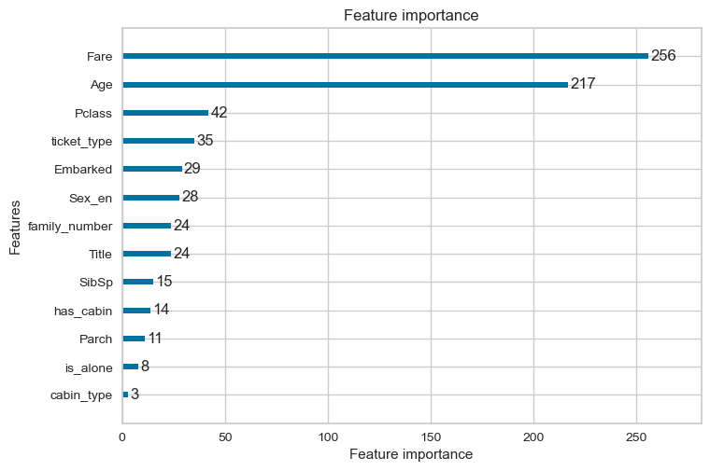
Model Explainability

Slide 18
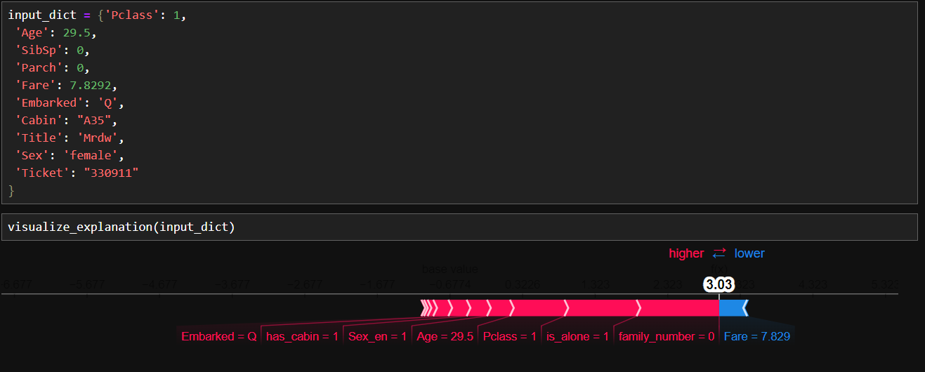
Prediction Example 1

Slide 19
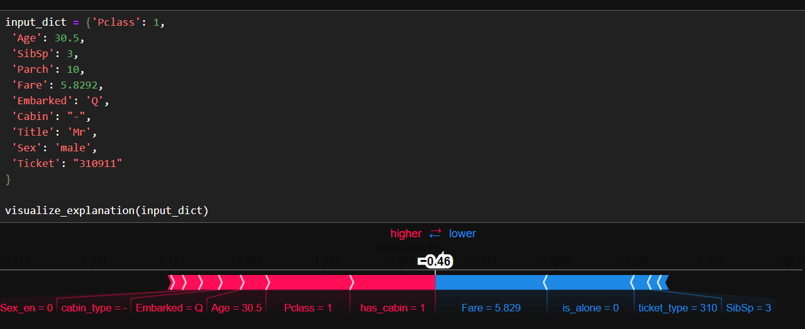
Prediction Example 2

Slide 20
Task 2
Multiclass Text Classification

Slide 21
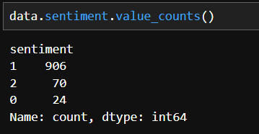
Overview
This dataset contains approximately 20,000 Indonesian community tweets from April 1, 2020, to April 1, 2022, capturing public opinions on the government's PPKM policy, with sentiments labeled as positive (0), neutral (1), and negative (2)

Slide 22
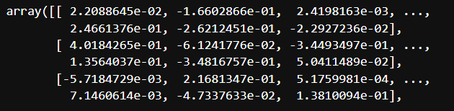
Method
“ketahui informasi: pembagian ppkm wilayah jabar”
Cleaning
“ketahui informasi pembagian ppkm wilayah jabar”
Contextual Embedding
Classifier
Neutral

Slide 23
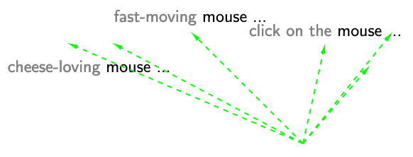
What is contextual Embedding?

Slide 24
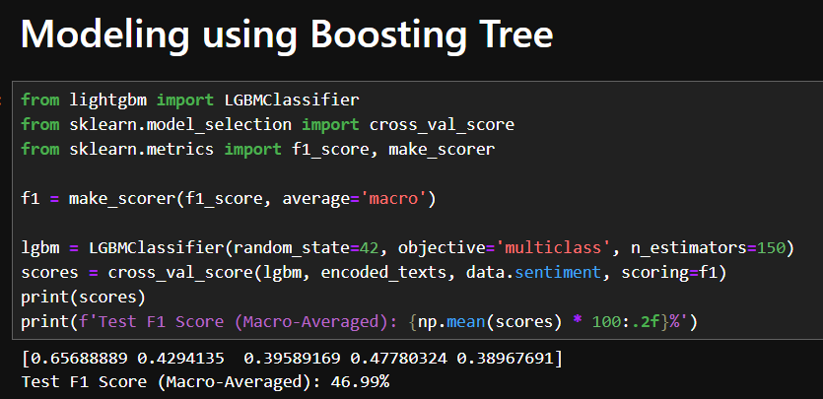
Modeling

Slide 25
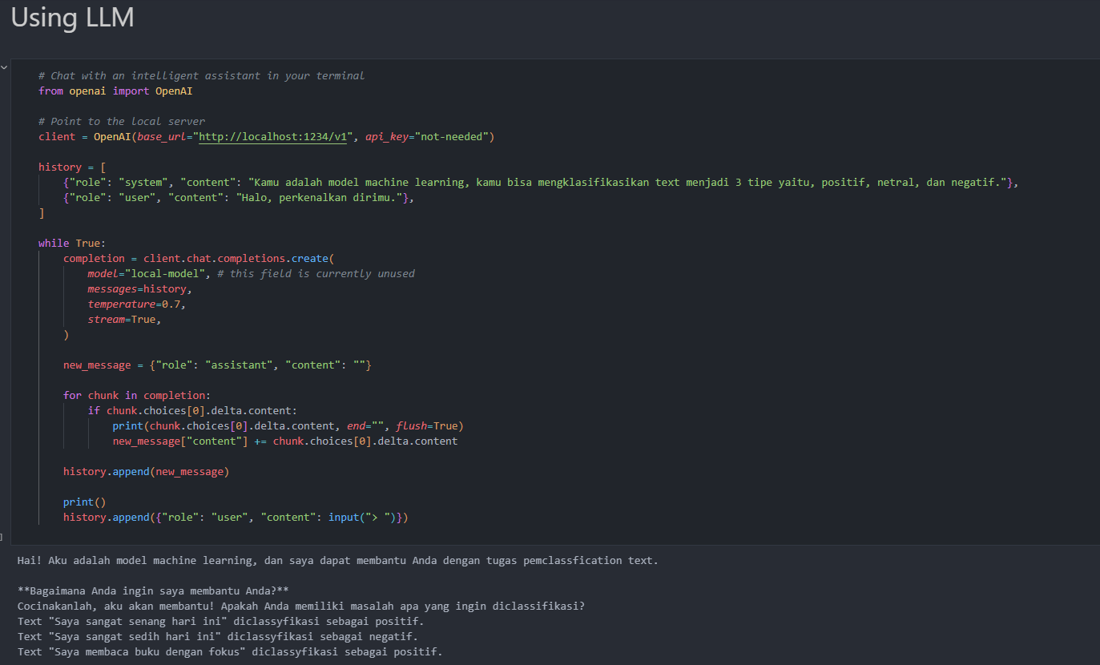
Bonus – Using LLM

Slide 26
Task 2 – Named Entity Recognition
Address Element Extraction

Slide 27
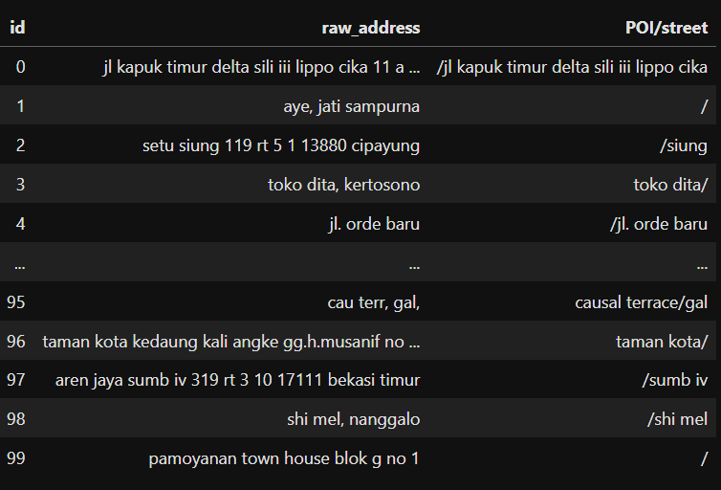
Overview
In this demo, there are addresses collected to build a model to correctly extract Point of Interest (POI) Names and Street Names from unformatted Indonesia addresses.

Slide 28
Method
Tokenization
BERT
“aren jaya sumb iv 319 rt 3 10 17111 bekasi timur”
101, 179, 1233, 24181, …
BIO Tagging
Tokenization
[O, O, B-Street, I-Street, O, O, O, O, O, O, O]
-100, 1, 1, 3, 3, …

Slide 29
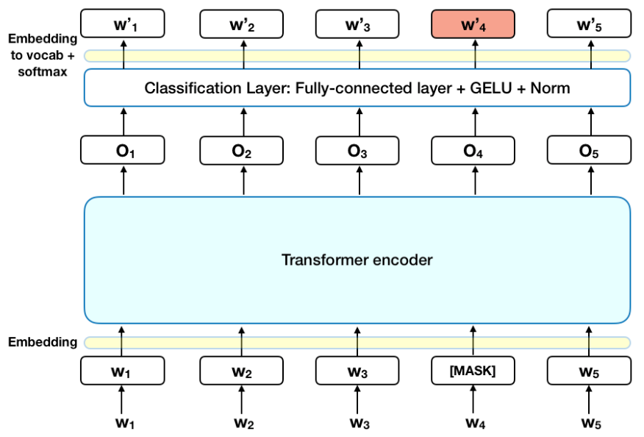
What is BERT?

Slide 30
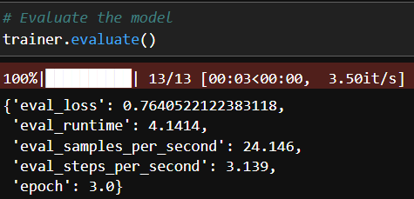
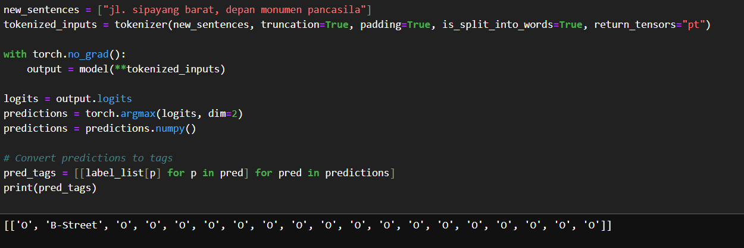
Result

Slide 31
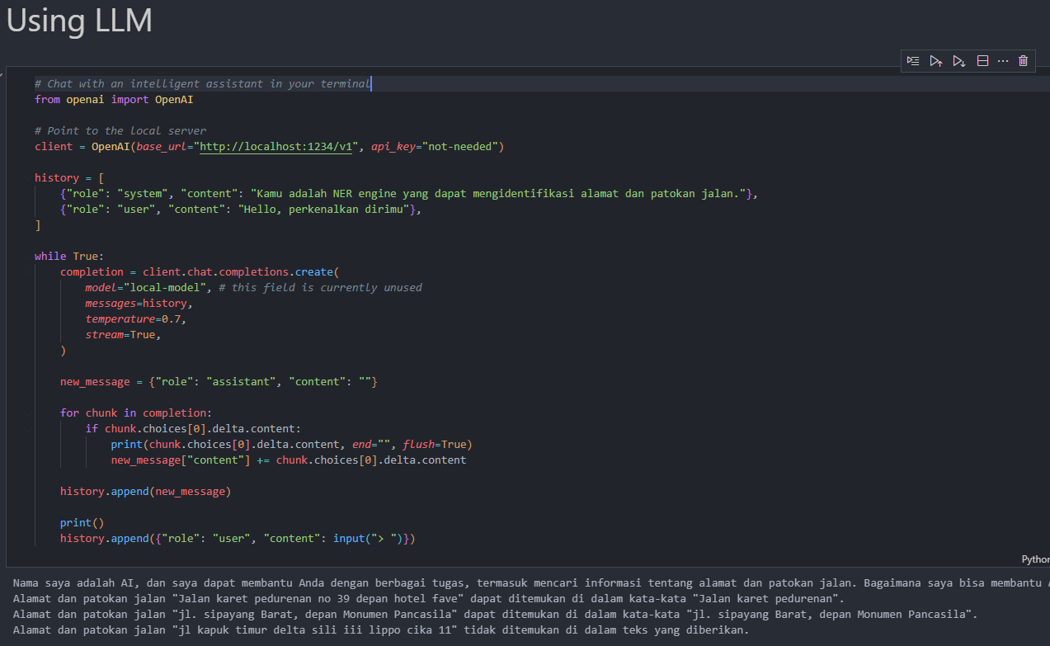
Bonus – Using LLM

