Slide 1
The effect of news articles on the stock market
Presented by:
Nacer Khalil

Slide 2
Table of content
I- Introduction
2- Technology use
3- Structure of the software
4- How the software works
3- Conclusion

Slide 3
Introduction
A predictive machine learning approach for financial news articles.

Slide 4
Technology used
Programming language: Java SE
DBMS: MySQL server
External programs: HTML as Text (freeware)
External APIs used:
  WIKI media API
  Google Data API
  Yahoo finance API

Slide 5
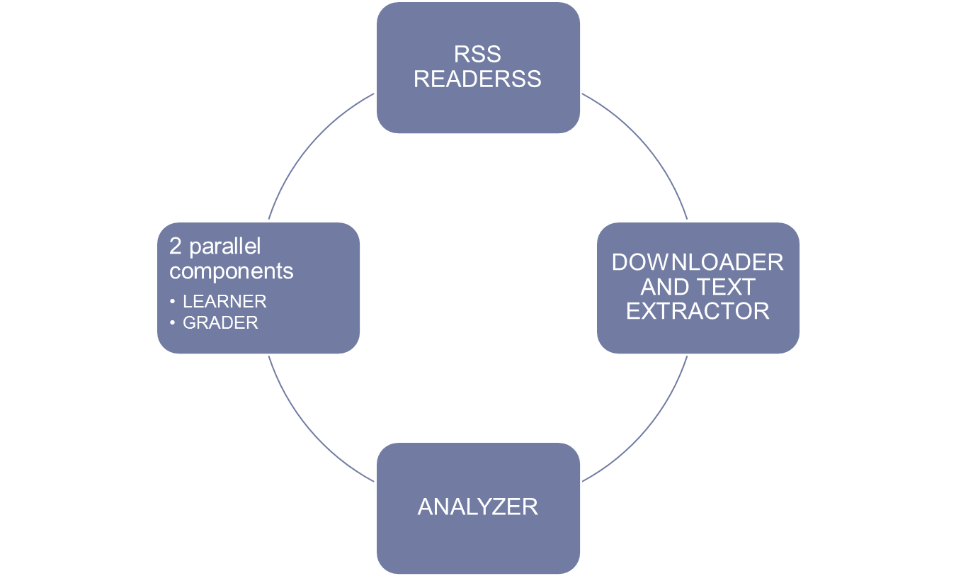
Structure of the software
(Relationships)

Slide 6
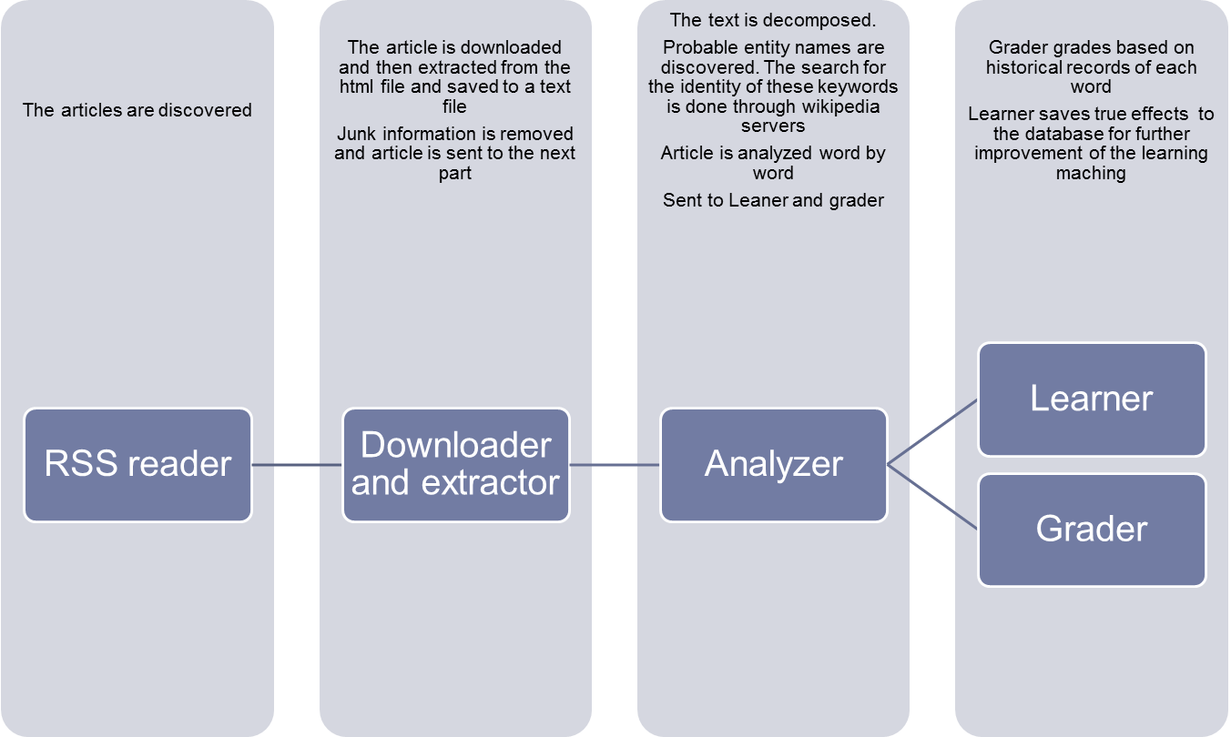
Structure of the software

Slide 7
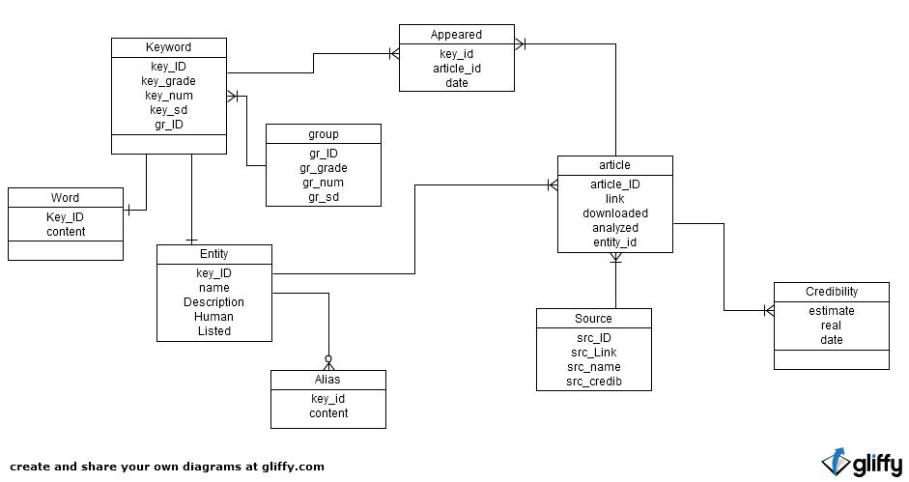
Database design

Slide 8
How the software works
A collection of four processes working in parallel:
  RSS READER: downloads links of the latest articles
  BRAIN: downloads extracts the articles
  ANALYZER: Analyzes the news articles and invokes the learning and grading threads
  Screen: the display of data

Slide 9
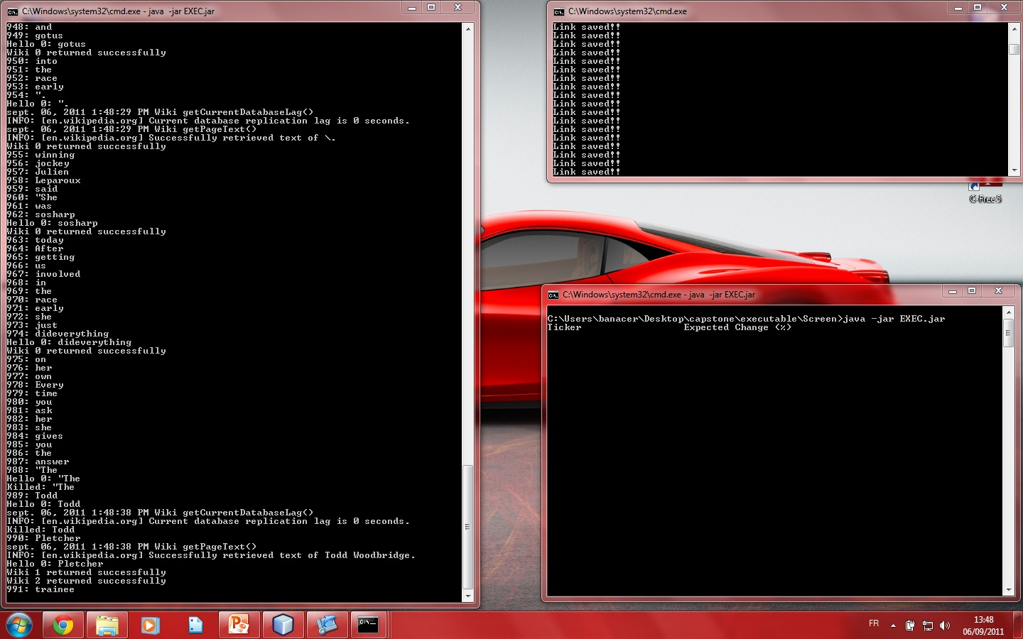
Screenshot

Slide 10
Conlusion
Learning machine
Precise result will need mature data
  Program should analyze hundreds of thousands of news article
In constant improvement
In need of powerful hardware for faster processing

