Slide 1
ShopNow: an end-to-end CI/CD pipeline on AWS EKS
HERO VIRED · DEVOPS CAPSTONE
How we built it, sprint by sprint: Terraform, Jenkins, Docker, Kubernetes, Ansible, Prometheus and Grafana
Team: Susmitha · Kaushik · Avinash · Ravi | November 2026
github.com/banalasusmitha/Capstone_Project-Web-Application-with-CI-CD-DevOps
Notes:
Good morning. Our capstone is ShopNow, an online store, and the project is the DevOps around it: how code goes from GitHub to a running app on AWS automatically. There are four of us, each with one workstream. I owned the AWS infrastructure, built with Terraform, so I’ll go a bit deeper there, but I’ll walk through the whole project.

Slide 2


ShopNow: order online, collect in store
A MERN e-commerce app. The customer orders and gets a pickup token; the shop gets it ready; the customer collects and pays.
1 · Browse
2 · Cart
3 · Check out
4 · Invoice
Customer
search by name or category
add items, change quantities
name, phone and email
with a pickup token, downloaded
Shop owner (admin)
5 · Get ready
6 · Collect
status: pending → ready
token checked → collected, paid
ShopNow · DevOps Capstone
02
Notes:
First, the app itself. ShopNow is an order-online, pick-up-in-store shop. Top row is the customer: they browse and search, add things to a cart, check out with their name and phone, and get an invoice with a pickup token. Then it moves to the shop owner, in the bottom row: in the admin dashboard they move the order from pending to ready, and when the customer arrives they check the token and mark it collected and paid. Behind it there’s a React storefront, a React admin panel, an Express API and MongoDB. We didn’t write this app; our job was everything around it.

Slide 3
Why we automate it
Our goal: every change to ShopNow goes live safely, by itself, on AWS, and we can see when something breaks.
What we gain | Doing it by hand | With our pipeline
Speed | Someone builds the app and copies it to a server | A push to GitHub builds, tests and deploys it
Consistency | “Works on my machine”, but not on the server | The same tested Docker image runs everywhere
Repeatable | Servers clicked together in the AWS console | Terraform rebuilds everything from code
Security | AWS keys copied into scripts and tools | No stored keys, only IAM roles
Visibility | Customers notice a problem first | Dashboards and alerts tell us first
Cost | A forgotten server keeps billing for weeks | Same-day teardown and a $50 budget alert
ShopNow · DevOps Capstone
03
Notes:
So why go to all this trouble? Our goal is that every change goes live by itself, safely, and that we notice problems before customers do. The left column is how it usually goes by hand: someone copies files to a server, it works on their laptop but not on the server, servers are clicked together in the console, keys get pasted into scripts. The right column is what our pipeline does instead. The last row we learned the hard way: a forgotten server kept billing us, so now we tear everything down the same day.

Slide 4



Before we started: prerequisites
Accounts and access
Tools on our laptops
Set up once
One shared AWS account, region ap-south-1 (Mumbai)
An IAM user for each of us; access keys only on our own laptops, never in Git
Free Plan credits ran out, so we moved to the paid plan with a $50 budget alert
GitHub repo with a branch per person; a classic token (repo scope) to push
Terraform 1.10 or newer (for S3 state locking)
AWS CLI v2, with a named profile
kubectl 1.36 and Helm 3
Docker and Git
Ansible with the amazon.aws collection
On Windows we used WSL (Ubuntu)
bootstrap/ creates the S3 state bucket and lock table
An ed25519 SSH key for the CI agent: public key in tfvars, private key shared privately
Our existing ECR repos imported into Terraform
Team IPs (curl ifconfig.me) added to admin_cidrs
install-jenkins.sh puts Java 21, Jenkins, Docker, Terraform, kubectl, Helm and Ansible on the Jenkins server
ShopNow · DevOps Capstone
04
Notes:
Before any of the real work, we had to get set up. We all work in one shared AWS account in the Mumbai region, each with our own IAM user, and the access keys stay on our own laptops, never in Git or in Jenkins. When the Free Plan credits ran out we moved to the paid plan and added a 50-dollar budget alert. On our laptops we needed Terraform, the AWS CLI, kubectl, Helm, Docker, Git and Ansible; on Windows we used WSL. And some things are done once: the bootstrap stack creates the S3 bucket that holds Terraform’s state, we made an SSH key for the CI agent, imported the existing ECR repos, and added our IPs to the firewall allowlist. The Jenkins server gets all its tools from Kaushik’s install script.

Slide 5
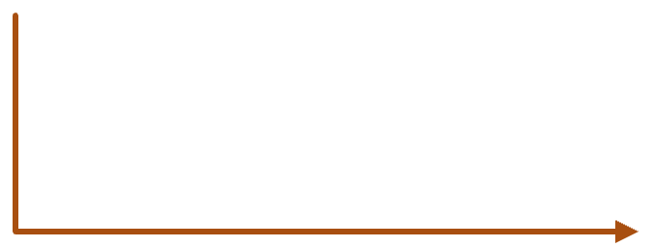


The whole pipeline, end to end
From a git push to a running shop that we can watch. Terraform builds the ground it all runs on.
Developer
GitHub
Jenkins
Amazon ECR
git push to GitHub
webhook tells Jenkins
lint, build, test 3 images (Kaushik)
images tagged with the build no.
pull
deploy
Customers
Load balancer
Amazon EKS
open the shop in a browser
ingress-nginx, routes by URL
runs the app (Avinash’s manifests)
metrics
Underneath it all
Monitoring
Terraform builds the network, EKS, ECR, IAM, the Jenkins server and the CI agent, which Ansible configures.
Prometheus, Grafana, alerts (Ravi)
ShopNow · DevOps Capstone
05
Notes:
This is the whole thing on one slide. Orange is the delivery path: a developer pushes to GitHub, the webhook tells Jenkins, Jenkins lints, builds and tests the three images, pushes them to ECR tagged with the build number, and deploys them to EKS, which pulls the images. Blue is the customer’s path: they come in through the load balancer to the app on EKS. Prometheus and Grafana watch the cluster. Underneath all of it is my Terraform, which builds the network, the cluster, the registry, the IAM roles, the Jenkins server and the CI agent that Ravi’s Ansible configures.

Slide 6


What Terraform builds on AWS
The nodes sit in private subnets; only the load balancer, NAT and CI agent face the internet.
AWS · ap-south-1 (Mumbai)
Default VPC
ShopNow VPC · 10.0.0.0/16
Jenkins server
Public subnets · 2 zones
t3.medium, Elastic IP
Load balancer
NAT gateway
CI agent
admin IAM role, no keys
created by ingress-nginx
one, shared, for outbound
c7i-flex.large, set up by Ansible
AWS services
Private subnets · 2 zones
ECR: 3 image repos
EKS node 1
EKS node 2
EKS control plane
S3: Terraform state, locked
m7i-flex.large, runs the pods
m7i-flex.large, scales 2 to 4
Kubernetes 1.36, run by AWS
IAM: roles, no access keys
ShopNow · DevOps Capstone
06
Notes:
This is the AWS side, which is my part. Everything is in the Mumbai region. The ShopNow VPC has public and private subnets across two availability zones. The worker nodes live in the private subnets, so they’re not reachable from the internet. Customer traffic comes in through the load balancer, and the nodes reach out through one shared NAT gateway; one instead of one per zone, to save cost. The CI agent sits in a public subnet so Jenkins and Ansible can reach it over SSH. The Jenkins server lives in the default VPC in its own Terraform stack, and ECR, the S3 state bucket and the IAM roles complete the picture.

Slide 7


One click, three Jenkins jobs in a chain
Each job starts the next one when it finishes, so a fresh environment goes from nothing to a tested, running shop.
JOB 1 · 1-infra-terraform
JOB 2 · 2-config-ansible
JOB 3 · 3-app-cicd
terraform init + validate
find the CI agent by its tag
lint, build the 3 images
terraform plan
run site.yml
container tests
A person approves
check Docker, kubectl, Java
push to ECR, deploy to EKS
terraform apply: VPC, EKS, CI agent
run again: must change nothing
smoke test the live site
No AWS keys anywhere: the log of job 1 shows assumed-role/shopnow-jenkins-server-role. A push to GitHub runs job 3 on its own.
ShopNow · DevOps Capstone
07
Notes:
Kaushik built three Jenkins jobs and chained them. Job 1 runs my Terraform: init, validate, plan, and then a person has to approve before apply, which is the safety check. When it finishes it starts job 2, which finds the CI agent, runs Ravi’s playbook, checks the tools are there, and runs it a second time to prove nothing changes. That starts job 3, the app pipeline: build, test, push, deploy and a smoke test on the live site. Jenkins uses an IAM role, never stored keys, and you can see the role name in the log. Day to day, only job 3 runs, on every push.

Slide 8




What happens when someone opens the shop
Inside the cluster: the path one request takes, from the browser to the data.
Storefront
React on nginx, at /avinash
Browser
Ingress
Backend API
MongoDB
a customer, or the shop owner
nginx sends each URL to the right app
Express on :5000, /api/…
StatefulSet on a gp3 disk
Admin panel
React on nginx, at /avinash-admin
ShopNow · DevOps Capstone
08
Notes:
Here’s a single request, inside the cluster. A browser hits the load balancer, and the nginx Ingress looks at the URL: /avinash goes to the storefront, /avinash-admin goes to the admin panel, and /avinash/api goes straight to the backend. Both front ends are React apps served by nginx, and whenever they need data they call the backend API under /api. The API reads and writes MongoDB, which runs as a StatefulSet with a persistent gp3 disk, so the data survives a pod restart. All of these pieces are Avinash’s manifests, and we ran exactly this path live on 12 November.

Slide 9
How our repository is laid out
DIRECTORY STRUCTURE
github.com/banalasusmitha/Capstone_Project-Web-Application-with-CI-CD-DevOps · app code: github.com/banalasusmitha/shopNow
Capstone_Project-…-DevOps/
One folder per person
├── Jenkinsfile app pipeline (job 3)
Your name is on your folder, so it’s clear who owns what and nobody overwrites anyone else.
├── README.md, architecture.png
├── terraform-Sushmita/ AWS infrastructure
├── jenkins-Kaushik/ jobs, server setup
Jenkinsfile at the root
├── docs-Kaushik/ guides
├── docker-Avinash/ Dockerfiles
The GitHub webhook starts the app pipeline from here on every push.
├── kubernetes-Avinash/ K8s manifests
├── ansible-Ravi/ playbook
├── monitoring-Ravi/ Prometheus, Grafana
Own branch, then a PR
└── screenshots/ demo-day evidence
e.g. susmitha-final, kaushik-pipeline, ravi-ansible-monitoring. Kaushik reviews and merges into main.
ShopNow · DevOps Capstone
09
Notes:
This is the top of our repository. Each of us has a folder with our name on it: my Terraform, Kaushik’s Jenkins and docs, Avinash’s Docker and Kubernetes files, and Ravi’s Ansible and monitoring. The Jenkinsfile sits at the root because that’s where the GitHub webhook looks for it. Each of us works on our own branch and opens a pull request, and it is reviewed before it goes into main. The next three slides open up the folders.

Slide 10
How I organised the Terraform code
DIRECTORY STRUCTURE
terraform-Sushmita/
Remote state, shared safely
├── bootstrap/ state bucket + lock
State lives in S3 with locking, so all four of us share one environment safely.
├── jenkins/ Jenkins server
├── envs/dev/ the cluster
├── extras/ gp3 StorageClass
├── docs/ runbook, cost, guides
Modules hold the logic
└── modules/
envs/dev only supplies values. A prod copy needs a new tfvars file, not new code.
├── vpc/ network
├── ecr/ image registry
├── iam/ roles, policies
├── eks/ cluster, add-ons
Jenkins in its own stack
└── ci-agent/ EC2 for Ansible
Jenkins runs the cluster’s destroy, so it lives apart: built first, removed last.
Tested offline: 10 terraform tests with a mock provider, no AWS calls, no cost
ShopNow · DevOps Capstone
10
Notes:
This is my part. Bootstrap runs once and creates the S3 bucket that stores Terraform’s state, with locking, so the whole team works on one shared environment and two people can’t apply at the same time. The real logic is in five modules: network, image registry, IAM, the EKS cluster and the CI agent. envs/dev just wires them together with values. The Jenkins server is a separate stack on purpose: Jenkins runs the destroy of the cluster, and it can’t delete the machine it’s running on. Everything is checked with terraform test using a mock provider, so the tests cost nothing.

Slide 11
Jenkins, Docker and Kubernetes folders
DIRECTORY STRUCTURE
jenkins-Kaushik/
docker-Avinash/
├── pipelines/
├── frontend.Dockerfile React → nginx
│ ├── Jenkinsfile.infra job 1: Terraform
├── admin.Dockerfile React → nginx
│ └── Jenkinsfile.config job 2: Ansible
├── backend.Dockerfile Node API
├── server/
├── frontend-nginx/default.conf
│ ├── install-jenkins.sh sets it all up
└── admin-nginx/default.conf
│ ├── casc/jenkins.yaml config as code
│ └── plugins.txt 26 plugins
kubernetes-Avinash/
└── tests/
├── frontend-deployment.yaml, -service.yaml
├── container-test.sh before push
├── admin-deployment.yaml, -service.yaml
└── smoke-test.sh after deploy
├── backend-deployment.yaml, -service.yaml
docs-Kaushik/ setup, pipeline guide, demo checklist, troubleshooting
└── mongodb.yaml, ingress.yaml, hpa.yaml
ShopNow · DevOps Capstone
11
Notes:
On the left is Kaushik’s Jenkins folder. The pipelines folder holds jobs 1 and 2, for Terraform and Ansible; job 3 is the Jenkinsfile at the root. The server folder has the install script, Jenkins’ configuration as code, and the plugin list, so the Jenkins server can be rebuilt from scratch. The tests folder has the two test scripts: one runs before images are pushed, one after deploy. On the right are Avinash’s folders: three Dockerfiles with their nginx configs, a deployment and service for each app, and the MongoDB StatefulSet, the Ingress rules and the autoscaler.

Slide 12
Ansible and monitoring folders
DIRECTORY STRUCTURE
ansible-Ravi/
monitoring-Ravi/
├── site.yml the playbook
├── values.yaml Helm settings
├── ansible.cfg user ec2-user
├── alert-rules.yaml 4 alerts
├── requirements.yml amazon.aws
└── README.md install, test
├── inventory/
│ └── aws_ec2.yml finds the agent
values.yaml holds everything for the Helm chart: the ShopNow dashboard, the Jenkins scrape job, 24-hour retention, and Grafana kept internal.
└── README.md run + verify
The inventory asks AWS for running EC2s tagged Role=ci_agent, so no IP addresses are written anywhere.
Live-run proof: screenshots from our 12 November run are on the slides after the sprints, and in our submission document.
ShopNow · DevOps Capstone
12
Notes:
Ravi’s two folders are small but complete. In ansible-Ravi, site.yml is the playbook, ansible.cfg sets the login user, requirements.yml pulls in the AWS collection, and the inventory file asks AWS for the machine tagged as the CI agent, so we never hard-code an IP. In monitoring-Ravi, values.yaml has all the Helm settings, including the ShopNow dashboard and the Jenkins scrape job, and alert-rules.yaml has the four alerts. Both have a README with the exact commands to run and check them.

Slide 13
Our six sprints
OUR SPRINTS
Sprint | When | What we worked on | Status
1 | Jun – Jul | Repo, architecture, Docker images, first manifests | Done
2 | Jul – Aug | Terraform: VPC, EKS, ECR, IAM, S3 state; Jenkins runs Terraform | Done
3 | October | CI agent and Ansible, run by Jenkins after Terraform | Done
4 | October | App pipeline: build, test, push to ECR, deploy to EKS | Done
5 | October | Prometheus, Grafana and alert rules | Done
6 | 26 Oct – 12 Nov | Chaining the jobs, cost fixes, the full live run on AWS | Done, run live
ShopNow · DevOps Capstone
13
Notes:
Here are our six sprints, and all six are done. The first two built the basics and the infrastructure. Sprints 3 to 5 added Ansible, the build-and-deploy pipeline and monitoring. Sprint 6 joined everything up and ended with a full live run on AWS on 12 November, followed by a same-day teardown. I’ll take each sprint in turn: what each of us did, and what went wrong along the way.

Slide 14
Sprint 1 – Setting up
28 Jun – 26 Jul
Goal: get organised as a team and get ShopNow into containers.
Susmitha
Kaushik
Avinash
Ravi
Terraform / AWS
Jenkins
Docker / Kubernetes
Ansible / monitoring
Created the GitHub repo and README (28 Jun)
Drew the architecture diagram, architecture.png
Owns the repo: reviews and merges PRs
Folder per person + screenshots/ (PR #1, 4 Jul)
First Jenkinsfile (PR #2, 6 Jul)
Stages: welcome, tool check (docker, aws), AWS login test
Used Jenkins credentials for AWS keys at first
Deployment + Service YAML for frontend, admin, backend (26 Jul)
Services are ClusterIP: :80 for the UIs, :5000 for the API
Built the 3 images and pushed them to ECR
Wrote up the Docker build with screenshots
Ravi’s hands-on work starts in Sprint 3 (Ansible) and Sprint 5 (monitoring).
Where it stands: done. The folder structure and first Jenkinsfile were merged in July.
What went wrong: we started in separate AWS accounts, so we moved to one shared account.
ShopNow · DevOps Capstone
14
Notes:
Sprint 1 was mostly getting set up. I created the repo and drew the architecture. Kaushik made the folder structure, one folder each, and wrote our first Jenkinsfile, which at that point just checked the tools and logged in to AWS with keys. Avinash wrote the first Kubernetes deployment and service files and built the three Docker images. One thing we got wrong early: each of us started in our own AWS account. That doesn’t work, because a cluster in one account can’t pull images from another, so we moved everything into one shared account.

Slide 15
Sprint 2 – Terraform and the AWS setup
27 Jul – 28 Aug
Goal: put the whole AWS setup into code, so any of us can build it or tear it down.
Susmitha
Kaushik
Avinash
Ravi
Terraform / AWS
Jenkins
Docker / Kubernetes
Ansible / monitoring
4 Terraform modules: vpc, ecr, iam, eks (PR #3)
VPC 10.0.0.0/16: 2 public + 2 private subnets, 1 NAT
State in S3 with a DynamoDB lock (bootstrap/)
EKS with managed nodes and 5 add-ons, incl. EBS CSI
Imported the existing ECR repos into state
Applied and verified on the shared account (26 Aug)
Removed AWS access keys from the Jenkinsfile (3 Aug)
Terraform pipeline: init → validate → plan on envs/dev (27 Aug)
Pointed it at the S3 state, fixed the bucket name in backend.hcl
Jenkins logs in to AWS with an IAM role, not keys
Dockerfiles for all 3 apps in docker-Avinash/ (28 Aug)
UIs: multi-stage, node:18-alpine → nginx:1.24-alpine
API: npm ci --only=production, runs as non-root appuser
nginx: React fallback + /api/ proxy to backend-service:5000
HEALTHCHECK on every image
Deployments now pull from the shared ECR
Ravi’s hands-on work starts in Sprint 3 (Ansible) and Sprint 5 (monitoring).
Where it stands: done. Terraform merged on 27 Jul and running on the shared account since 26 Aug.
What went wrong: the Free Plan blocked Spot nodes (moved to m7i-flex.large), and a for_each error needed fixed map keys.
ShopNow · DevOps Capstone
15
Notes:
Sprint 2 was my big one. I wrote four Terraform modules, for the network, the image registry, IAM and the EKS cluster, and put the state in S3 with a lock so we all share one environment. Avinash’s ECR repos already existed, so I imported them rather than recreate them. It was all applied and checked on the shared account on 26 August. Kaushik took the AWS keys out of the Jenkinsfile and built the first Terraform pipeline, which ran init, validate and plan. Avinash finished the Dockerfiles: the two React apps are built in Node and then served by nginx, and the API runs as a non-root user. A couple of things went wrong for me. The AWS Free Plan wouldn’t give us Spot nodes, so I moved to an allowed type. And a for_each loop failed because its keys weren’t known until apply, so I rewrote it with fixed keys.

Slide 16
Sprint 3 – Ansible and the CI agent
14 – 29 Oct
Goal: configure a server with Ansible, and the server has to be one that Terraform built.
Susmitha
Kaushik
Avinash
Ravi
Terraform / AWS
Jenkins
Docker / Kubernetes
Ansible / monitoring
New module modules/ci-agent (14 Oct)
Amazon Linux 2023 EC2, c7i-flex.large, IMDSv2 only
SSH key from a public key in tfvars; private key never in Git
Tagged Role=ci_agent so Ansible can find it
3 terraform tests, e.g. a pasted private key is rejected
Job 2-config-ansible, started after the Terraform job
Finds the agent from the aws_ec2 inventory or terraform output
Syntax check → run → verify → run again
Second run must change nothing (idempotency)
SSH key stored as the Jenkins credential ci-agent-ssh
No separate deliverable this sprint. Avinash’s Kubernetes work picks up in Sprints 4 and 6.
site.yml: Docker, Git, Java 21, kubectl v1.36.2
kubectl checked against its SHA-256 before install
Adds ec2-user to the docker group, starts Docker
Dynamic inventory: amazon.aws.aws_ec2, tag Role=ci_agent
Fails fast on any host outside ci_agent or not AL2023
Where it stands: done. The CI agent, Ravi’s playbook and Kaushik’s job 2 are all merged into main.
Live result (12 Nov): the Ansible job passed: playbook, tool checks, and a second run with changed=0.
ShopNow · DevOps Capstone
16
Notes:
Sprint 3 said Ansible has to run on a server that Terraform built. Our only EC2s were the EKS nodes, and AWS manages those, so Ansible shouldn’t touch them. So I added a small CI agent machine in Terraform, tagged so Ansible can find it. The private SSH key never goes into Git; we share it privately. Ravi wrote the playbook. It installs Docker, Git, Java and kubectl, checks the kubectl download against its checksum, and refuses to run on any machine that isn’t the CI agent. Kaushik’s Jenkins job runs it right after Terraform, then runs it a second time to prove nothing changes. We also realised our Jenkins server had been created by hand in the console, so I moved it into Terraform too. In our live run, job 2 passed, including that second run with nothing changed.

Slide 17
Sprint 4 – The build and deploy pipeline
26 – 28 Oct
Goal: every push to GitHub builds, tests and deploys the app on its own.
Susmitha
Kaushik
Avinash
Ravi
Terraform / AWS
Jenkins
Docker / Kubernetes
Ansible / monitoring
jenkins/ stack: t3.medium, Elastic IP, admin IAM role
gp3 StorageClass + EBS CSI for MongoDB’s disk
metrics-server installed for the HPA
Public subnets tagged for the load balancer
GitHub webhook IPs allowed on :8080 (28 Oct)
docs/app-integration.md: found 2 app bugs
Job 3-app-cicd: root Jenkinsfile, 8 stages
npm audit + hadolint on all 3 Dockerfiles
container-test.sh runs all 3 together before push
Images tagged with BUILD_NUMBER, pushed to ECR
smoke-test.sh hits /api/products through the ingress
GitHub webhook trigger, email on failure
3 Deployments + 3 ClusterIP Services in the repo
Pulling avinash-shopnow/* images from ECR
MongoDB, Ingress, HPA and the admin nginx fix: see Sprint 6
No separate deliverable this sprint. Ravi’s monitoring setup is Sprint 5.
Where it stands: done. Job 3 is in main, and with Avinash’s Sprint 6 manifests it deploys the whole app.
Live result (12 Nov): app build #1 passed every stage: build, container tests, ECR push, EKS deploy, smoke test.
ShopNow · DevOps Capstone
17
Notes:
Sprint 4 is the main pipeline. Kaushik wrote it as job 3, with eight stages. It runs npm audit and lints the Dockerfiles, builds the three images, and before pushing anything it runs all three together and checks their health endpoints. Then it pushes to ECR with the build number as the tag, deploys to EKS, and smoke-tests the live site; the products API call proves MongoDB is working. On my side I built the Jenkins server in Terraform and made sure the cluster has what the app needs: a gp3 storage class for MongoDB’s disk and metrics-server for autoscaling. While checking the app I also found two bugs, which I wrote up. Avinash had the deployments and services in; MongoDB, the Ingress and the autoscaler came in Sprint 6. In the live run, app build number 1 passed every stage.

Slide 18
Sprint 5 – Monitoring
28 – 29 Oct
Goal: see what’s happening inside the cluster, and get an alert when something breaks.
Susmitha
Kaushik
Avinash
Ravi
Terraform / AWS
Jenkins
Docker / Kubernetes
Ansible / monitoring
Firewall rule: only the cluster’s NAT IP may reach Jenkins :8080
New output nat_public_ips in the vpc module
Covered by terraform test (28 Oct)
Prometheus plugin in Jenkins → /prometheus
Build and job metrics for Ravi’s scrape job
Steps written up in setup-guide.md, section 7
No separate deliverable this sprint. Avinash’s HPA and probes are in Sprint 6.
kube-prometheus-stack via Helm, settings in values.yaml
Prometheus, Grafana: ClusterIP + port-forward
Dashboard: replicas, restarts, CPU, memory per pod
4 alerts in alert-rules.yaml; NodeNotReady is critical
Scrapes Jenkins /prometheus; keeps 24 h, max 5 GB
Where it stands: done. Ravi’s monitoring files and my firewall rule are both merged into main.
Live result (12 Nov): Grafana dashboards live, Prometheus scraping Jenkins (UP), backend scaled 2 → 4.
ShopNow · DevOps Capstone
18
Notes:
Sprint 5 is Ravi’s monitoring work. He installs kube-prometheus-stack with Helm, which brings Prometheus, Grafana and Alertmanager together. He built a ShopNow dashboard showing replicas, restarts, CPU and memory, and wrote four alert rules; a node going down is the critical one. Grafana isn’t open to the internet; we reach it with port-forward. Kaushik turned on the Prometheus plugin in Jenkins, so Prometheus can watch the build server too. That needed a small change from me: Jenkins is outside the cluster’s network, so I opened port 8080 to the cluster’s NAT IP only, nothing else. In our live run we installed it on the cluster: the dashboards filled with live data, Prometheus was scraping Jenkins, and during a load test we watched the backend scale from two pods to four.

Slide 19
Sprint 6 – Putting it together
26 Oct – 12 Nov
Goal: connect the three jobs, run everything live on AWS, and keep the bill small.
Susmitha
Kaushik
Avinash
Ravi
Terraform / AWS
Jenkins
Docker / Kubernetes
Ansible / monitoring
EKS 1.33 → 1.36: extended support was 6× per hour
Cost write-up: ~$0.55–0.60/hour, ~$5 a demo day
$50 budget alert + a zero-cost check after teardown
Teammate IPs in admin_cidrs; docs refreshed (PR #6)
Trial live run 12 Nov: built, tested, torn down
Chained jobs: Terraform → Ansible → app
Destroy option cleans up the LB and PVCs first
install-jenkins.sh + JCasC + 26 plugins
5 guides in docs-Kaushik/
Pipeline live run 12 Nov: all 3 jobs passed
Admin nginx: /api/ proxy to the backend (7 Nov)
MongoDB StatefulSet on a 5Gi gp3 disk
3 Ingresses with path rewrite
Probes, CPU requests, HPA: 2–4 pods at 70%
Merged into main, PR #8 (12 Nov)
Screenshot checklists for Ansible + monitoring
Crash-loop test to fire an alert on purpose
Cleanup steps so monitoring leaves nothing behind
Where it stands: done. Everything is merged into main, and the full chain ran live on AWS on 12 Nov.
Teardown: the same night, and the zero-cost check came back empty every time.
ShopNow · DevOps Capstone
19
Notes:
Sprint 6 is where it all comes together. Kaushik chained the three jobs, so one click runs Terraform, then Ansible, then the app. His destroy option cleans up the load balancer and disks before Terraform runs. For me this sprint was mostly about cost: we found a test cluster left running on Kubernetes 1.33, which had moved to extended support at six times the price, so I moved us to 1.36, wrote up the costs, set a 50-dollar budget alert, and wrote a runbook so every session ends with a teardown and a check that nothing is left billing. Avinash finished the Kubernetes side: MongoDB with its own disk, the Ingress rules, probes and the autoscaler, plus the admin nginx fix. Ravi added screenshot checklists and a test that deliberately triggers an alert. On 12 November we ran it all live: my trial run from the laptop, Kaushik’s run through the Jenkins pipeline, and that night a final full run through Jenkins with monitoring and a load test, which the next slides show. Every run was torn down the same day.

Slide 20
One click: from nothing to a monitored, scaling shop
LIVE RUN · 12–13 NOVEMBER 2026
Jenkins ran Terraform → Ansible → build and deploy. Then we used the shop, watched it, loaded it, and tore it down.
61
AWS resources built by Jenkins, after a person approved the plan
changed=0
Ansible’s second run: nothing left to change
~4 min
from checkout to a tested deploy on EKS, smoke tests passed
2 → 4
backend pods added by the autoscaler under load
0
resources left billing after the same-night teardown
What Jenkins ran
• Job 1: Terraform plan → approval → apply (61 resources)
• Job 2: Ansible set up the CI agent; the re-run changed nothing
• Job 3: built, tested and pushed 3 images, deployed to EKS
• Smoke tests through the load balancer: /avinash, /avinash-admin, API
• Destroy: also through Jenkins, with the cluster name typed to confirm
What we checked ourselves
• Ordered in the storefront; the order showed in the admin panel
• Grafana dashboards live; Prometheus scraping Jenkins (UP)
• Load test: backend scaled 2 → 4 pods, with 0 restarts
• Deleted the MongoDB pod: recreated, and the orders were kept
• Zero-cost check after teardown: every line empty
ShopNow · DevOps Capstone
20
Notes:
This is our final live run, on the night of 12 to 13 November. One click in Jenkins started the whole chain. Job 1 ran Terraform: it planned, waited for a person to approve, then built 61 AWS resources. That started job 2, Ansible, which configured the CI agent and ran a second time to prove nothing was left to change. Then job 3 built, tested and pushed the three images and deployed them to EKS in about four minutes, finishing with smoke tests through the load balancer. On top of that we used the shop and placed an order, installed Prometheus and Grafana, ran a load test that made the backend scale from two pods to four, deleted the database pod to show the data survives, and then tore everything down the same night. The next five slides are the screenshots.

Slide 21
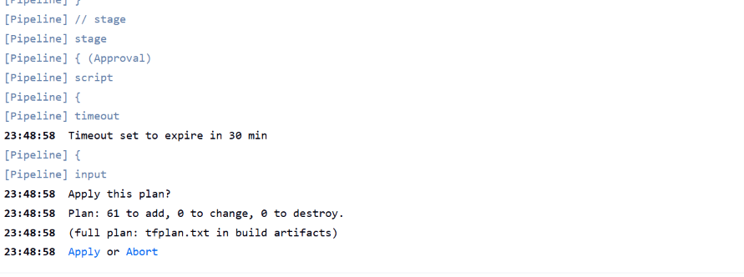
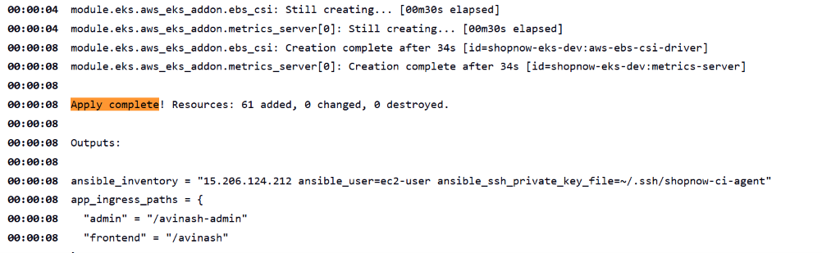
A person approves, then Jenkins builds 61 resources
LIVE RUN · TERRAFORM IN JENKINS
The approval gate
Job 1 stops after the plan and asks: apply 61 to add, 0 to change, 0 to destroy? Nothing is built until someone clicks Apply.
Apply complete
61 added: VPC, NAT, EKS 1.36 with its add-ons, IAM, ECR and the CI agent. Jenkins uses its IAM role, with no access keys anywhere.
ShopNow · DevOps Capstone
21
Notes:
This is my Terraform, run by Kaushik’s Jenkins job. On top, the approval gate: the job plans, shows the summary, and waits. Nothing changes until a person clicks Apply. Underneath, the result: 61 resources added, the network, the EKS cluster on 1.36 with its add-ons, the IAM roles, the image registry and the CI agent for Ansible. Jenkins does all of this with its IAM role; there are no access keys in Jenkins or in Git.

Slide 22
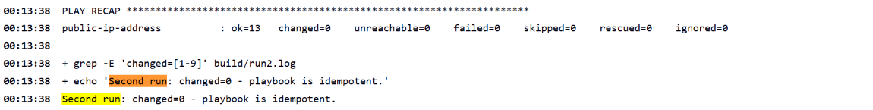
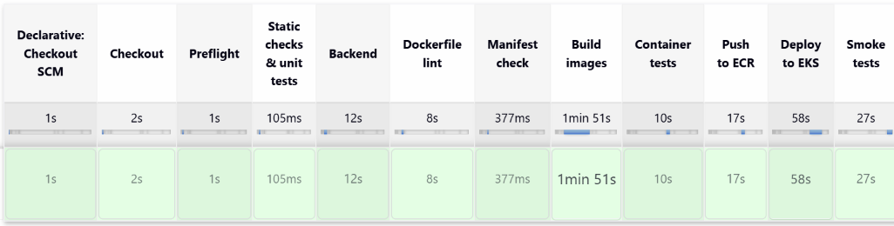
Configured, then built, tested and deployed
LIVE RUN · ANSIBLE AND THE APP PIPELINE
Ansible: run it twice
The second run of Ravi’s playbook changes nothing (changed=0), which proves the setup is repeatable.
App pipeline: every stage green
Lint and checks, build 3 images, container tests, push to ECR, deploy to EKS, smoke tests. About 4 minutes end to end.
ShopNow · DevOps Capstone
22
Notes:
Job 2 runs Ravi’s Ansible playbook on the CI agent, then runs it again. The second run changed nothing, which is what idempotent means: running it twice is safe. Then job 3, Kaushik’s app pipeline, starts by itself. Every stage is green: static checks and Dockerfile linting, building the three images, testing the containers together before anything is pushed, pushing to ECR with the build number as the tag, deploying to EKS, and smoke tests from inside the cluster and through the load balancer.

Slide 23
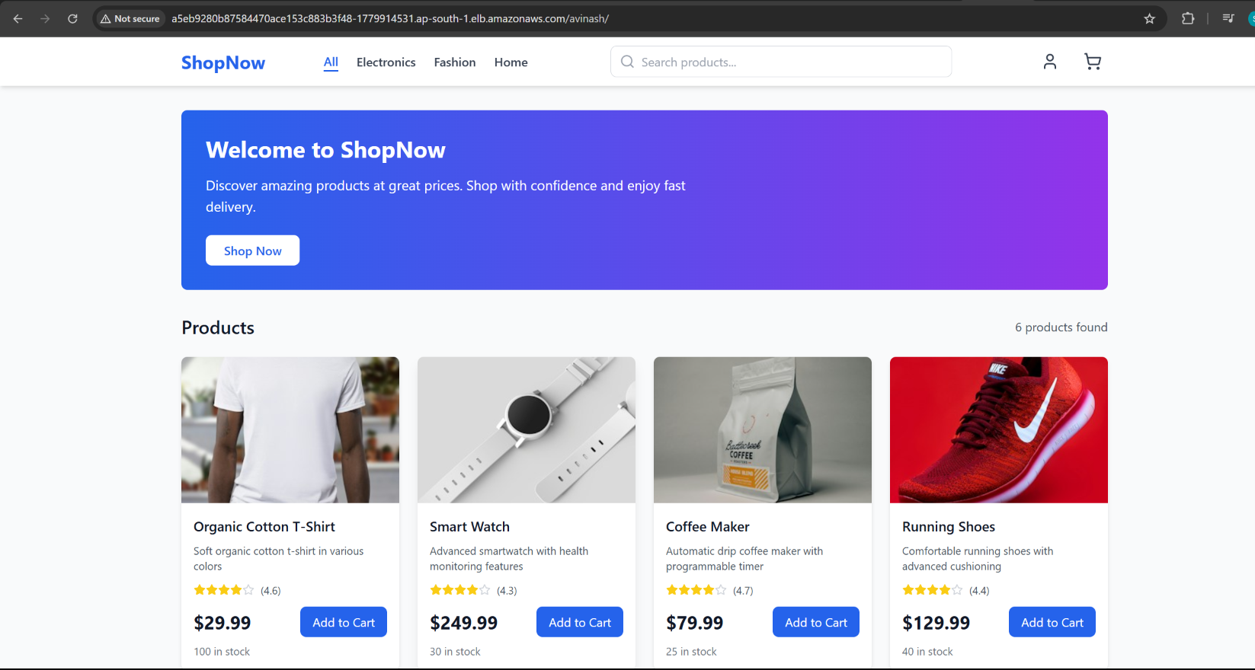
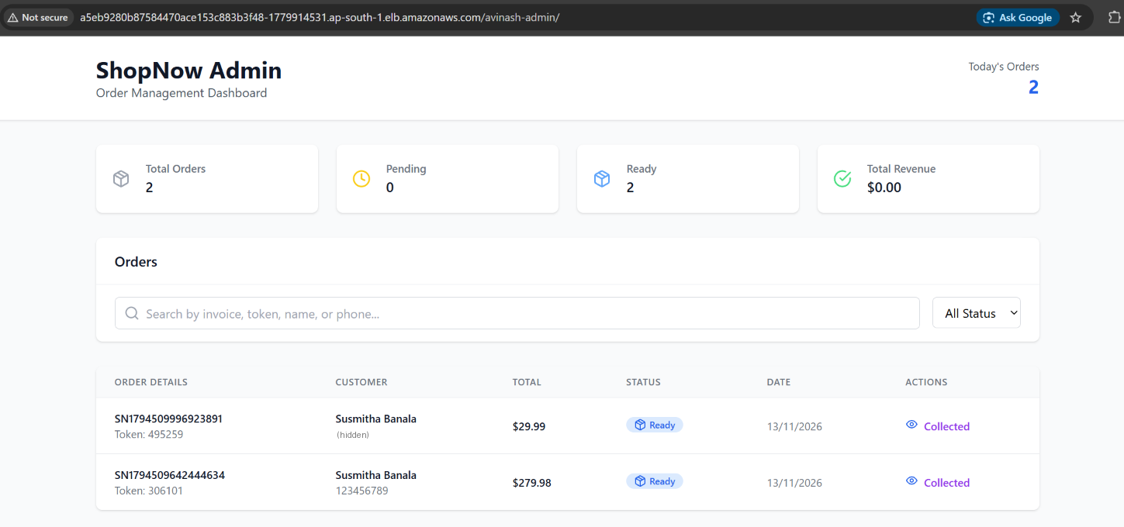
ShopNow live at /avinash, with a real order
LIVE RUN · THE SHOP
Storefront: /avinash
Built by the pipeline for our path; the products come from MongoDB through the API.
Admin panel: /avinash-admin
The orders we placed (tokens 306101 and 495259), both marked Ready for pickup.
ShopNow · DevOps Capstone
23
Notes:
And this is what the customer and the shop owner see. On the left, the storefront at slash avinash, served through the load balancer and the ingress. I added items to the cart and checked out, and got a pickup token. On the right, the admin panel at slash avinash-admin shows those real orders from the database, and I marked them ready for pickup. One order touches every layer: the load balancer, the ingress, both front ends, the API and MongoDB.

Slide 24
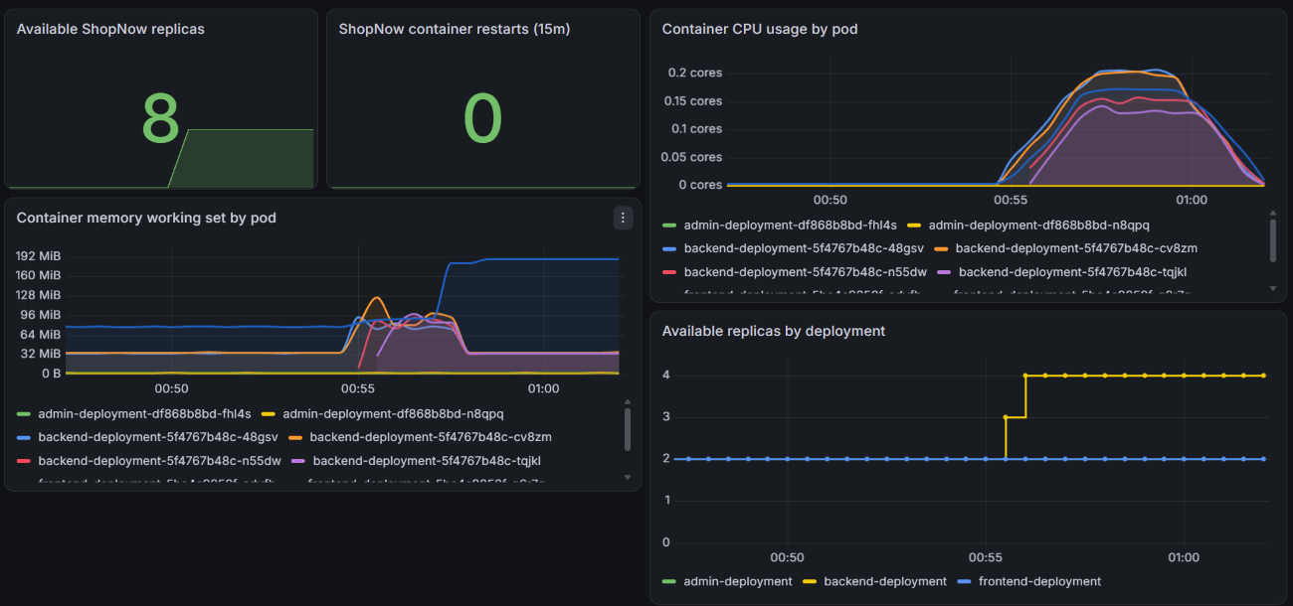
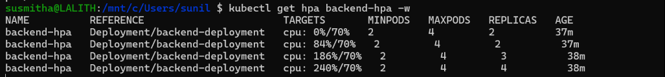
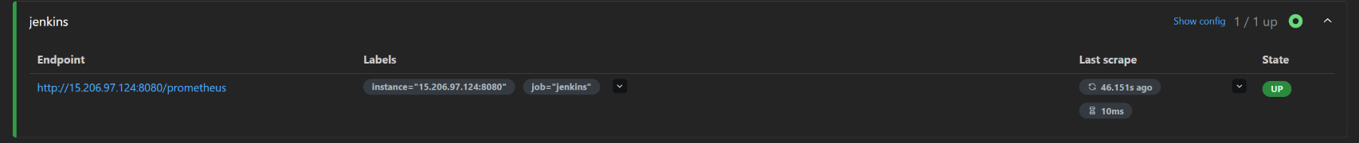
We could watch it scale under load
LIVE RUN · MONITORING AND AUTOSCALING
Autoscaler (HPA)
Backend CPU went past the 70% target; pods 2 → 3 → 4.
Prometheus → Jenkins: UP
The cluster also watches the Jenkins server’s build metrics.
Ravi’s ShopNow dashboard in Grafana
During the load test: replicas 6 → 8, backend 2 → 4, CPU up and back down, 0 restarts.
ShopNow · DevOps Capstone
24
Notes:
Ravi installed Prometheus and Grafana with Helm. On the left is his ShopNow dashboard during our load test: we sent nonstop requests to the backend, its CPU went past the 70 percent target, and the autoscaler added pods, from two to four, which you can see in the replicas panel. No container restarted. Top right is the autoscaler itself showing the same thing. Bottom right, Prometheus inside the cluster is also scraping the Jenkins server’s metrics, which works because of a firewall rule I added in Terraform that lets only the cluster’s NAT address reach Jenkins.

Slide 25
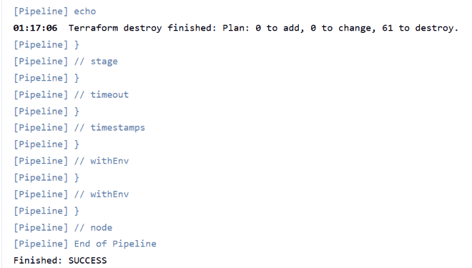
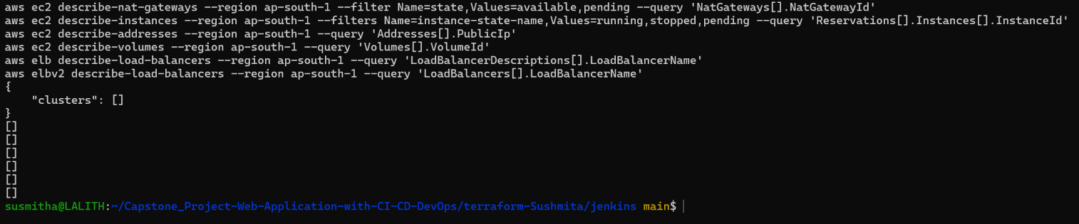
Torn down the same night, nothing left billing
LIVE RUN · TEARDOWN
Destroy, through Jenkins
Job 1 with ACTION = destroy: load balancer and disks first, then 61 resources removed. The Jenkins server itself went last, from a laptop.
Zero-cost check
No cluster, NAT gateway, EC2 instance, Elastic IP, disk or load balancer left in ap-south-1. Every line is empty.
ShopNow · DevOps Capstone
25
Notes:
Last, the teardown, which matters for the cost marks. Job 1 has a destroy option: it first deletes what Kubernetes created, the load balancer and the disks, then asks for the cluster name to be typed as a confirmation, and destroys all 61 resources. The Jenkins server can’t delete itself, so I destroyed it from my laptop. Then the zero-cost check: every command asks AWS for something that bills by the hour, and every line came back empty.

Slide 26
About $5 for a full demo day
COST OPTIMISATION · 10% OF THE GRADE
$0.55–0.60
How we keep it low
per hour with everything running
Build up and tear down the same day, then a zero-cost check
One shared NAT gateway instead of one per zone
Kubernetes 1.36: $0.10 an hour, not $0.60 on extended support
ECR keeps the last 10 images; logs kept 7 days
A $50 AWS budget alert as a safety net
~$5
for an 8-hour demo day
~$0
Lesson from October: a forgotten test cluster on an older Kubernetes version used up our AWS credits. Now every session ends with a teardown.
between sessions: only image and state storage remain
ShopNow · DevOps Capstone
26
Notes:
Cost is 10% of the marks, so we measured it. With everything running (the cluster, two nodes, Jenkins, the CI agent, the NAT gateway and the load balancer) it’s about 55 to 60 cents an hour, so roughly 5 dollars for a demo day. Between sessions we destroy it, and only a few cents of storage remain. The biggest lesson came in October: a test cluster was left running on Kubernetes 1.33, which had moved to extended support at six times the hourly price, and it used up our credits. We moved to 1.36, brought the Jenkins server into Terraform, and every session now ends with a teardown and a zero-cost check, with a 50-dollar budget alert as a backup.

Slide 27



What we delivered
13 Nov
Built
Proved live
All AWS infrastructure in Terraform, 10 tests (Susmitha)
Runbook, cost write-up, live-proof doc (Susmitha)
3 chained Jenkins jobs with tests (Kaushik)
Docker images and all K8s manifests (Avinash)
Ansible playbook and monitoring config (Ravi)
61 AWS resources built by Jenkins, after approval
Ansible re-run changed nothing; app deployed in ~4 min
Shop and admin live at /avinash, with real orders
Grafana live; backend autoscaled 2 → 4 under load
Torn down the same night; zero-cost check empty
One session, start to finish, as we ran it
1 · Terraform
2 · Ansible
3 · Build + deploy
4 · Test it live
5 · Tear down
ShopNow · DevOps Capstone
27
Notes:
So, what we delivered. Built: my Terraform with its tests, the runbook, the cost write-up and the live-proof document; Kaushik’s three chained Jenkins jobs; Avinash’s images and the full set of Kubernetes manifests; and Ravi’s Ansible playbook and monitoring configuration. Proved live: Jenkins built 61 resources after an approval, Ansible’s second run changed nothing, the app was built, tested and deployed in about four minutes, real orders went through the shop and the admin panel, Grafana showed it all, and the backend scaled from two pods to four under load. The bottom row is one session as we ran it: Terraform, then Ansible, then build and deploy, test it live, and tear it all down the same day.

Slide 28
Thank you
SHOPNOW · DEVOPS CAPSTONE
Questions?
The repository
github.com/banalasusmitha/Capstone_Project-Web-Application-with-CI-CD-DevOps
Worth a look: final-delivery/README.md (the live run, step by step) · terraform-Sushmita/README.md
Notes:
Thank you. Happy to take questions. If you’d like to look at the code, the repository is linked here. The README in my folder explains the layout, the runbook describes the demo day step by step, and the cost write-up has the numbers and the October lesson.

