Slide 1
Optimal Binary Search Tree
0110889 王德鈞

Slide 2
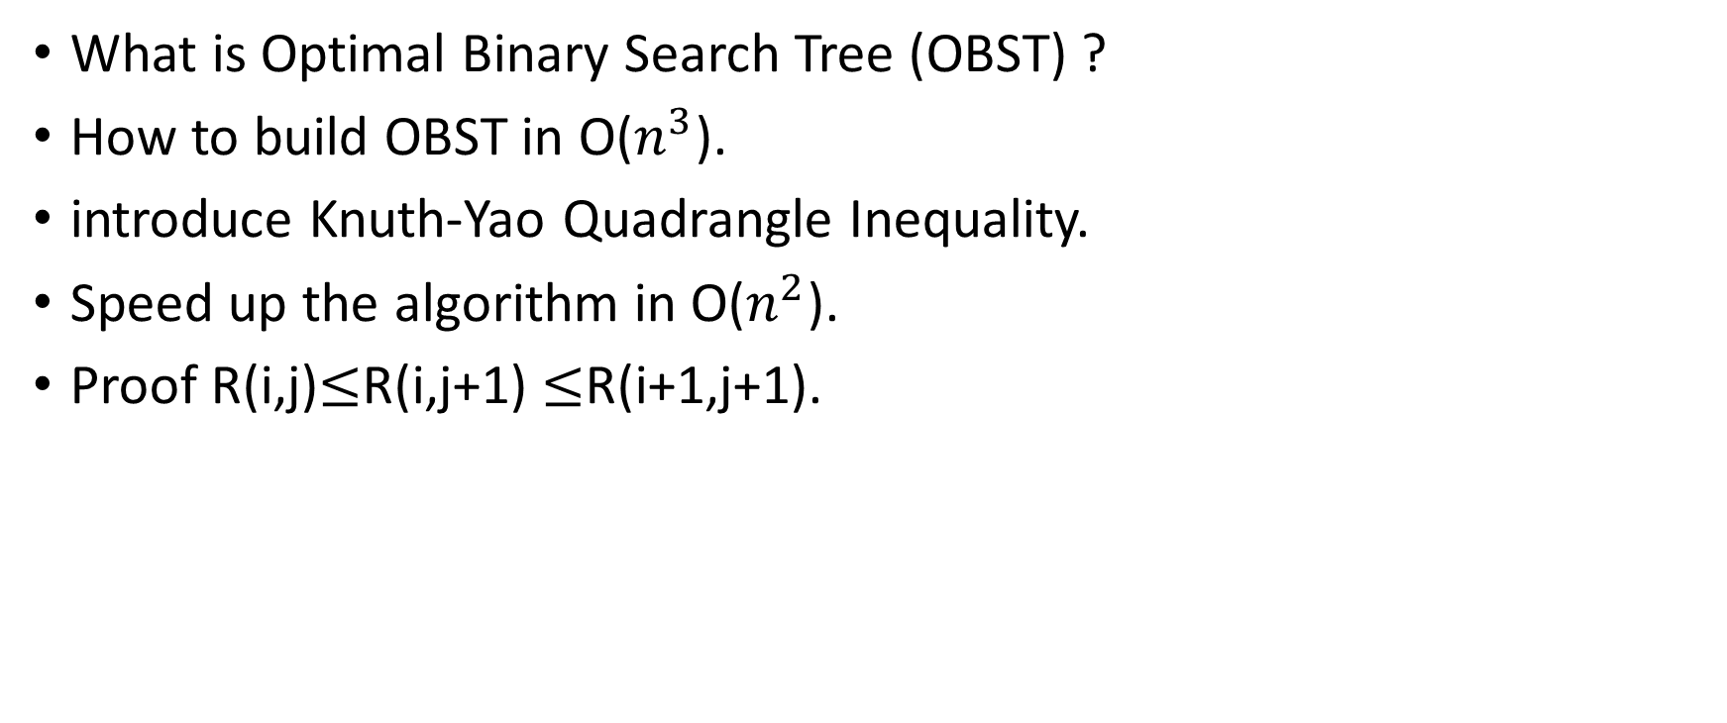
OUTLINE
What is Optimal Binary Search Tree (OBST) ?
How to build OBST in O($n^{3}$).
introduce Knuth-Yao Quadrangle Inequality.
Speed up the algorithm in O($n^{2}$).
Proof R(i,j)$≤$R(i,j+1) $≤$R(i+1,j+1).

Slide 3
What is OBST ?

Slide 4

What is OBST ?
Now, we are given <ki>, <pi>, <qi>
<ki> : <k1,k2,k3,…..,kn> of n distinct keys in sorted order (k1 $≤$ k2 $≤$ ….. $≤$ kn)
<pi> : <p1,p2,p3,.…,pn> represent the probability search in <ki>
<qi> : <q0,p1,p2,.…,qn> represent the probability search not in <ki>
NOTE: $\sum{pi+\sum{qi}}=1$

Slide 5
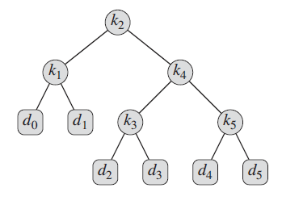

What is OBST ?
The expected cost of a search in a given binary search tree T
E[T] = $\sum_{i=1}^{n}{(depth\left(ki\right)+1)×pi}+\sum_{i=0}^{n}{(depth\left(di\right)+1)×qi}$
= 1+$\sum_{i=1}^{n}{depth\left(ki\right)×pi}+\sum_{i=0}^{n}{depth\left(di\right)×qi}$
OBST: a binary search tree whose expected search cost E[T] is smallest

Slide 6
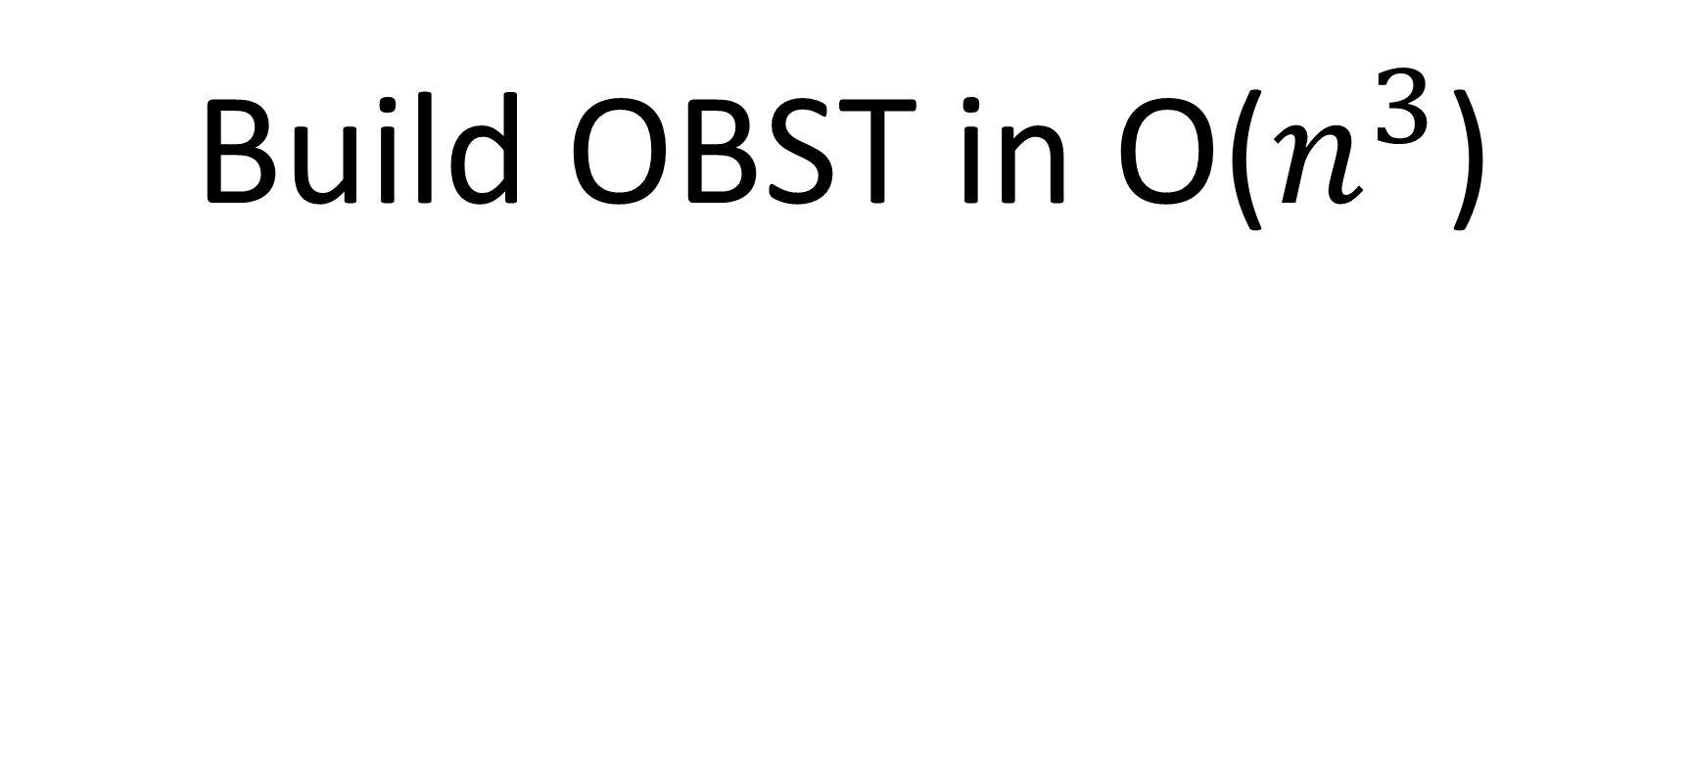
Build OBST in O($n^{3}$)

Slide 7
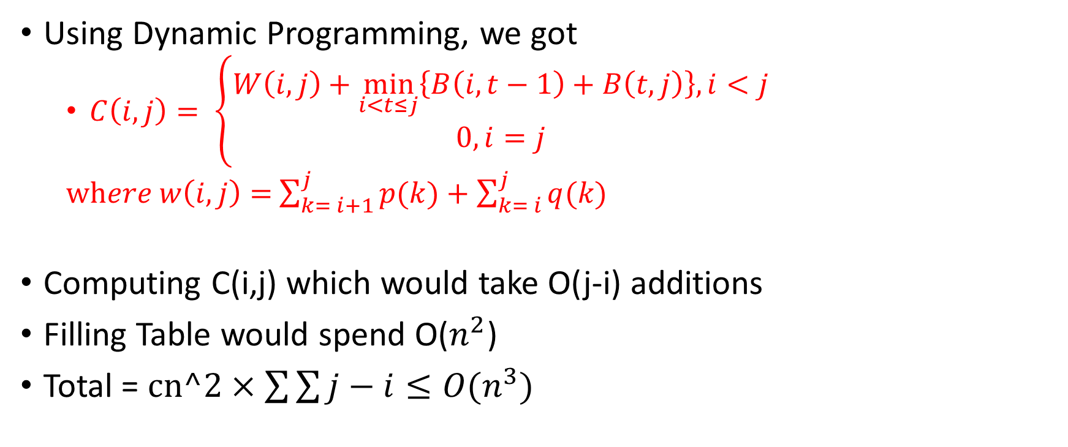
Build OBST in O(n^3)
Using Dynamic Programming, we got
$C\left(i,j\right)= \left\{\begin{aligned}W\left(i,j\right)+\min_{i<t≤j}\left\{B\left(i,t−1\right)+B\left(t,j\right)\right\}, i<j \\ 0, i=j\end{aligned}\right.$
$where w\left(i,j\right)=$ $\sum_{k= i+1}^{j}{p(k)}+\sum_{k= i}^{j}{q(k)}$
Computing C(i,j) which would take O(j-i) additions
Filling Table would spend O($n^{2}$)
Total = $cn^2×\sum{\sum{j−i}}≤O(n^{3})$

Slide 8
Knuth-Yao Quadrangle Inequality(KY)

Slide 9
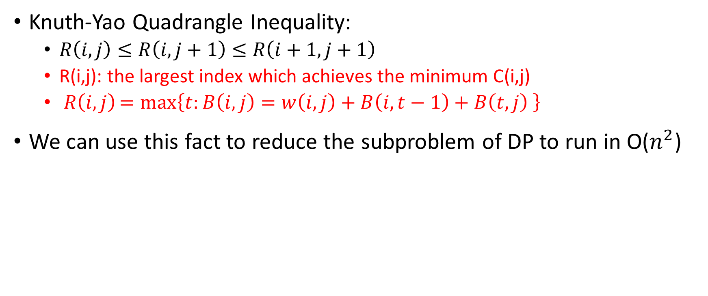
Knuth-Yao Quadrangle Inequality
Knuth-Yao Quadrangle Inequality:
$R\left(i,j\right)≤R\left(i,j+1\right)≤R\left(i+1,j+1\right)$
R(i,j): the largest index which achieves the minimum C(i,j)
$R\left(i,j\right)=\max_{}\left\{t:B\left(i,j\right)=w\left(i,j\right)+B\left(i,t−1\right)+B\left(t,j\right) \right\}$
We can use this fact to reduce the subproblem of DP to run in O($n^{2}$)

Slide 10
Speed up

Slide 11

Speed up
By the Knuth-Yao Quadrangle Inequality, We got
$C\left(i,j\right)= \left\{\begin{aligned}W\left(i,j\right)+\min_{R\left(i,j−1\right)≤t≤R\left(i+1,j\right)}\left\{B\left(i,t−1\right)+B\left(t,j\right)\right\}, i<j \\ 0, i=j\end{aligned}\right.$
Computing C(i,j), we just take O(R(i+1,j)-R(i,j-1)) additions

Slide 12

Speed up
$T\left(n\right)= \sum_{d=1}^{n−1}{\sum_{i=0}^{n−d}{\text{R}\text{(}\text{i}\text{+1,}\text{i}\text{+}\text{d}\text{)−}\text{R}\text{(}\text{i}\text{,}\text{i}\text{+}\text{d}\text{−1)} }}$
$≤ \sum_{d=1}^{n−1}{\text{K}\text{(}\text{n}\text{−}\text{d}\text{+1,}\text{n}\text{)}}$
$≤$ $\sum_{d=1}^{n−1}{n=O(n^{2})}$
d=j-i d=1 d=2 d=3……..

Slide 13
Proof

Slide 14
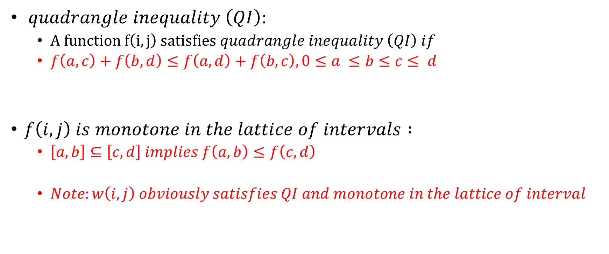
Proof (KY)
$quadrangle inequality \left(QI\right)$:
$A function f\left(i,j\right) satisfies quadrangle inequality \left(QI\right) if$
$f\left(a,c\right)+f\left(b,d\right)≤f\left(a,d\right)+f\left(b,c\right), 0≤a ≤b≤c≤ d$
$f\left(i,j\right) is monotone in the lattice of intervals :$
$\left[a,b\right]⊆\left[c,d\right] implies f\left(a,b\right)≤f\left(c,d\right)$
$Note:w\left(i,j\right) obviously satisfies QI and monotone in the lattice of interval$

Slide 15
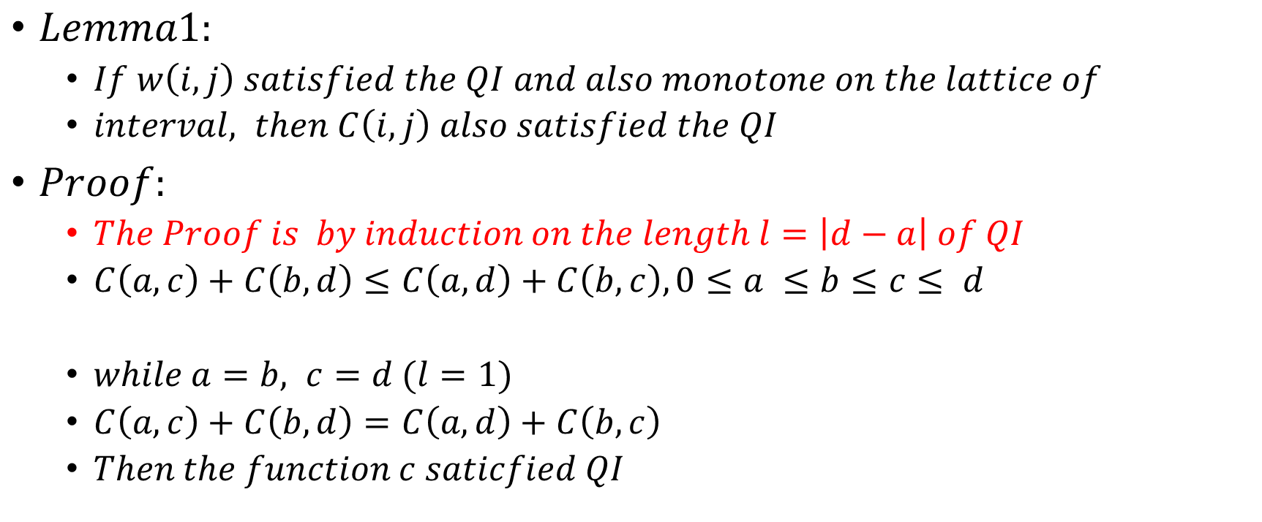
Proof (KY)
$Lemma1:$
$If w\left(i,j\right) satisfied the QI and also monotone on the lattice of$
$interval, then C\left(i,j\right) also satisfied the QI$
$Proof:$
$The Proof is by induction on the length l=\left|d−a\right| of QI$
$C\left(a,c\right)+C\left(b,d\right)≤C\left(a,d\right)+C\left(b,c\right), 0≤a ≤b≤c≤ d$
$while a=b, c=d (l=1)$
$C\left(a,c\right)+C\left(b,d\right)=C\left(a,d\right)+C\left(b,c\right)$
$Then the function c saticfied QI$

Slide 16
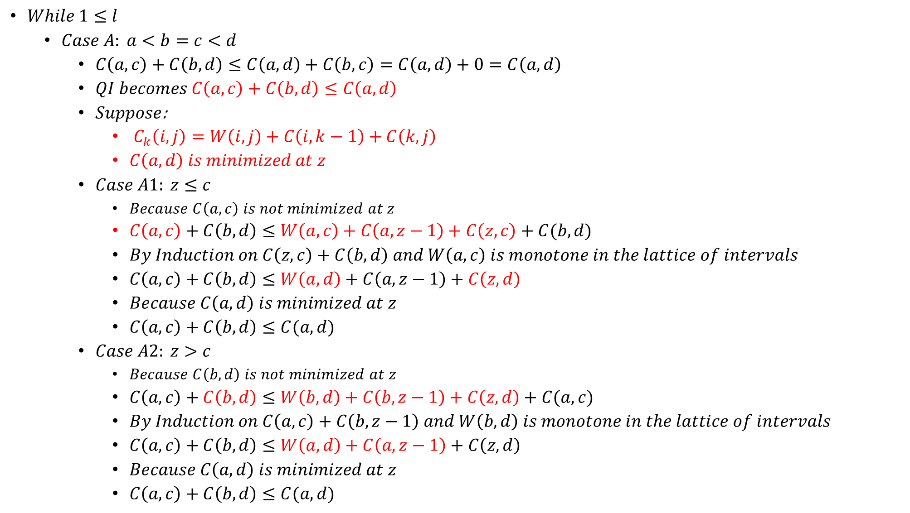
$While 1≤l$
$Case A: a<b=c<d$
$C\left(a,c\right)+C\left(b,d\right)≤C\left(a,d\right)+C\left(b,c\right)=C\left(a,d\right)+0=C\left(a,d\right)$
$QI becomes C\left(a,c\right)+C\left(b,d\right)≤C\left(a,d\right)$
$Suppose$:
${ C}_{k}\left(i,j\right)=W\left(i,j\right)+C\left(i,k−1\right)+C\left(k,j\right)$
$C\left(a,d\right) is minimized at z$
$Case A1: z≤c$
$Because C\left(a,c\right) is not minimized at z$
$C\left(a,c\right)+C\left(b,d\right)≤W\left(a,c\right)+C\left(a,z−1\right)+C\left(z,c\right)+C(b,d)$
$By Induction on C\left(z,c\right)+C\left(b,d\right) and W\left(a,c\right) is monotone in the lattice of intervals$
$C\left(a,c\right)+C\left(b,d\right)≤W\left(a,d\right)+C\left(a,z−1\right)+C\left(z,d\right)$
$Because C\left(a,d\right) is minimized at z$
$C\left(a,c\right)+C\left(b,d\right)≤C(a,d)$
$Case A2: z>c$
$Because C\left(b,d\right) is not minimized at z$
$C\left(a,c\right)+C\left(b,d\right)≤W\left(b,d\right)+C\left(b,z−1\right)+C\left(z,d\right)+C(a,c)$
$By Induction on C\left(a,c\right)+C\left(b,z−1\right) and W\left(b,d\right) is monotone in the lattice of intervals$
$C\left(a,c\right)+C\left(b,d\right)≤W\left(a,d\right)+C\left(a,z−1\right)+C\left(z,d\right)$
$Because C\left(a,d\right) is minimized at z$
$C\left(a,c\right)+C\left(b,d\right)≤C(a,d)$

Slide 17
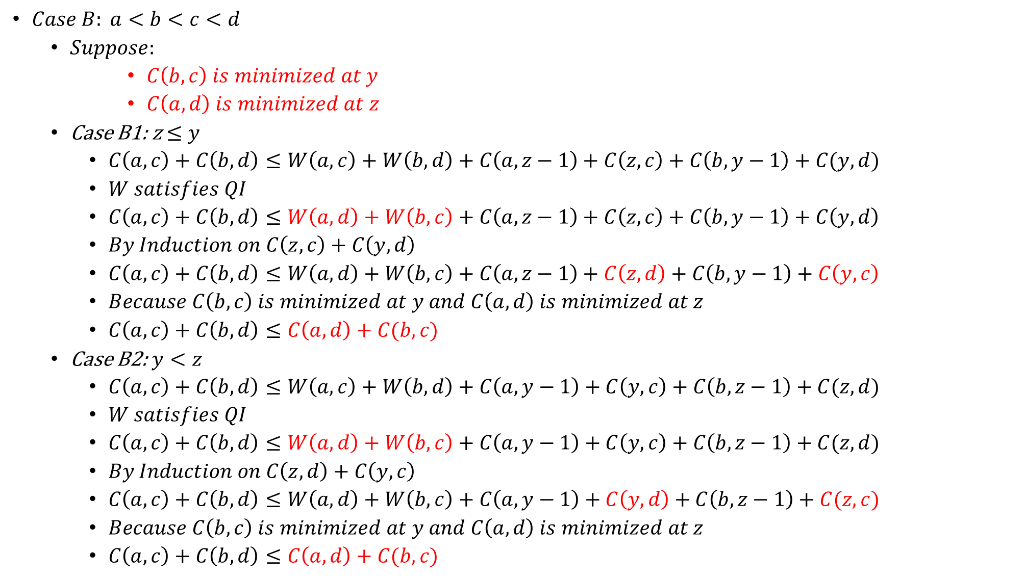
$Case B: a<b<c<d$
$Suppose:$
$C\left(b,c\right) is minimized at y$
$C\left(a,d\right) is minimized at z$
Case B1: z$≤y$
$C\left(a,c\right)+C\left(b,d\right)≤W\left(a,c\right)+W\left(b,d\right)+C\left(a,z−1\right)+C\left(z,c\right)+C\left(b,y−1\right)+C(y,d)$
$W satisfies QI$
$C\left(a,c\right)+C\left(b,d\right)≤W\left(a,d\right)+W\left(b,c\right)+C\left(a,z−1\right)+C\left(z,c\right)+C\left(b,y−1\right)+C\left(y,d\right)$
$By Induction on C\left(z,c\right)+C\left(y,d\right)$
$C\left(a,c\right)+C\left(b,d\right)≤W\left(a,d\right)+W\left(b,c\right)+C\left(a,z−1\right)+C\left(z,d\right)+C\left(b,y−1\right)+C\left(y,c\right)$
$Because C\left(b,c\right) is minimized at y and C\left(a,d\right) is minimized at z$
$C\left(a,c\right)+C\left(b,d\right)≤C\left(a,d\right)+C(b,c)$
Case B2: $y<z$
$C\left(a,c\right)+C\left(b,d\right)≤W\left(a,c\right)+W\left(b,d\right)+C\left(a,y−1\right)+C\left(y,c\right)+C\left(b,z−1\right)+C(z,d)$
$W satisfies QI$
$C\left(a,c\right)+C\left(b,d\right)≤W\left(a,d\right)+W\left(b,c\right)+C\left(a,y−1\right)+C\left(y,c\right)+C\left(b,z−1\right)+C(z,d)$
$By Induction on C\left(z,d\right)+C\left(y,c\right)$
$C\left(a,c\right)+C\left(b,d\right)≤W\left(a,d\right)+W\left(b,c\right)+C\left(a,y−1\right)+C\left(y,d\right)+C\left(b,z−1\right)+C(z,c)$
$Because C\left(b,c\right) is minimized at y and C\left(a,d\right) is minimized at z$
$C\left(a,c\right)+C\left(b,d\right)≤C\left(a,d\right)+C(b,c)$

Slide 18

Proof (KY)
$End Lemma 1$
$Now we know thatIf w\left(i,j\right) satisfied the QI and also monotone on the lattice of$
$interval, then C\left(i,j\right) alsosatisfied the QI$

Slide 19
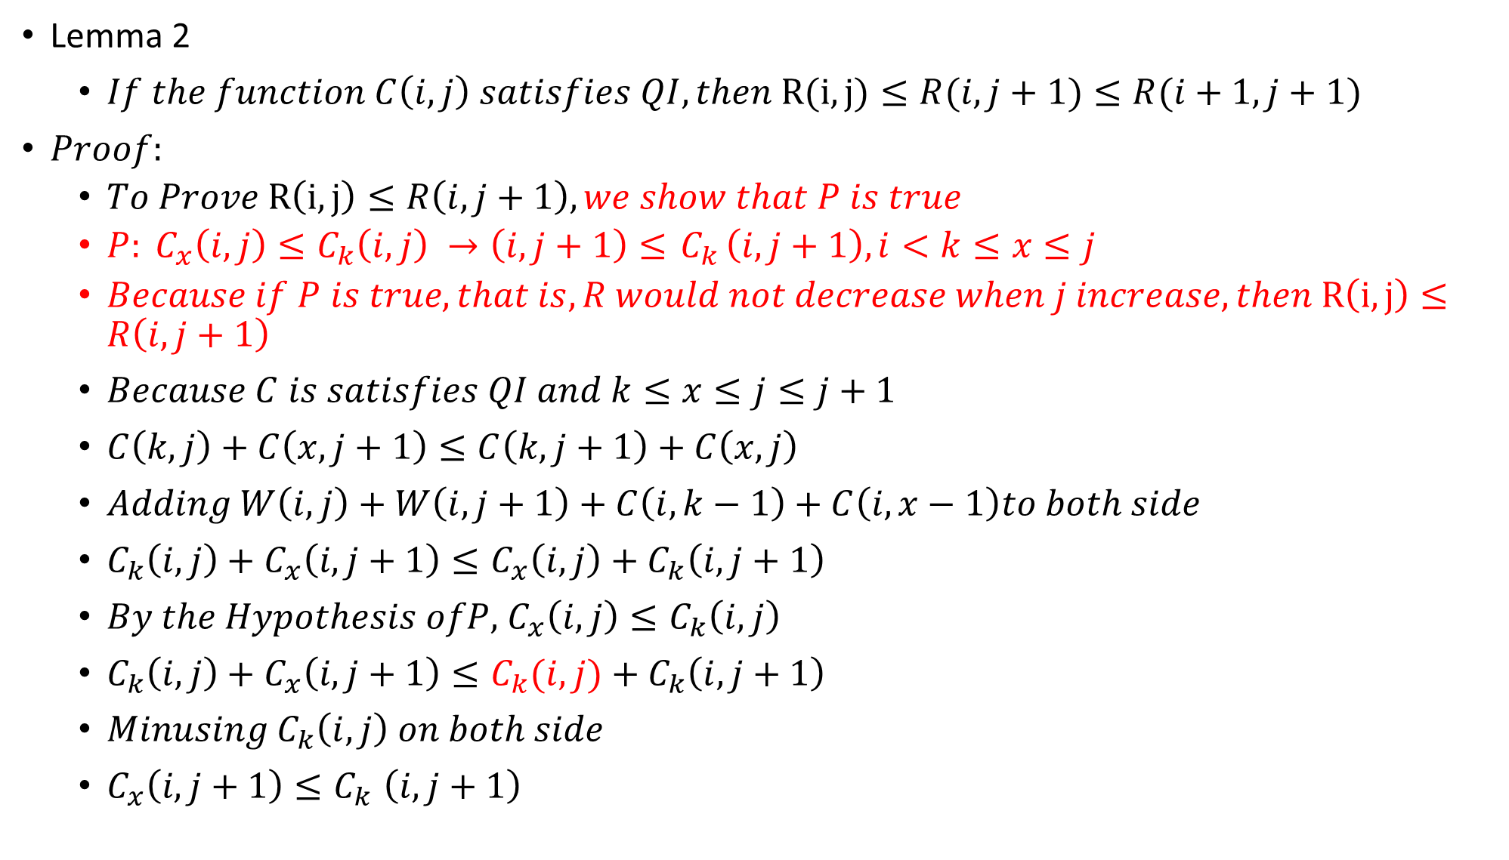
Lemma 2
$If the function C\left(i,j\right) satisfies QI, then R(i,j)≤R(i,j+1)≤R(i+1,j+1)$
$Proof:$
$To Prove R\left(i,j\right)≤R\left(i,j+1\right), we show that P is true$
${P: C_{x}\left(i,j\right)≤C}_{k}\left(i,j\right) →\left(i,j+1\right)≤{ C}_{k}\left(i,j+1\right), i<k≤x≤j$
$Because if P is true, that is,R would not decrease when j increase, then R\left(i,j\right)≤R\left(i,j+1\right)$
$Because C is satisfies QI and k≤x≤j≤j+1$
$C\left(k,j\right)+C\left(x,j+1\right)≤C\left(k,j+1\right)+C\left(x,j\right)$
$Adding W\left(i,j\right)+W\left(i,j+1\right)+C\left(i,k−1\right)+C\left(i,x−1\right)to both side$
${C_{k}\left(i,j\right)+C_{x}\left(i,j+1\right)≤C}_{x}\left(i,j\right)+C_{k}\left(i,j+1\right)$
$By the Hypothesis ofP,$ $C_{x}\left(i,j\right)≤C_{k}\left(i,j\right)$
${C_{k}\left(i,j\right)+C_{x}\left(i,j+1\right)≤C}_{k}(i,j)+C_{k}\left(i,j+1\right)$
$Minusing{ C}_{k}\left(i,j\right) on both side$
$C_{x}\left(i,j+1\right){≤C}_{k}\left(i,j+1\right)$

Slide 20

Proof (KY)
$Similarly,the second inequality R\left(i,j+1\right)≤R\left(i+1,j+1\right) follows from the QI of C\left(i,j\right) at i<i+1≤k≤x$

Slide 21

Proof (KY)
$End Lemma 2$
$Now we know that If the function C\left(i,j\right) satisfies QI, then R(i,j)≤R(i,j+1)≤R(i+1,j+1)$

Slide 22
END

