Slide 1

Learn Infrastructure as Code with Terraform
Robert Jordan
Notes:
Main Cover Slide. If a presentation will not be submitted for upload to the platform, providing a cover slide at a minimum is recommended for display throughout the Live Training.

Slide 2
About Me
Over 25 years in the IT industry
10 years primary focus in cloud technologies
Networking and HPC operations background
Notes:
Recommended for use as title slides for each section/segment of the course

Slide 3
About this course
Beginner level
No previous Terraform or IaC experience required.
Familiarity with command line is recommended.
Notes:
Content Slide Style Option #1: Recommended for the body of each section

Slide 4
About this course
Beginner level
No previous Terraform or IaC experience required.
Familiarity with command line is recommended.
Demo based
Online format can be hard to follow… Review the recordings.
Use devcontainers to set up your environment.
Notes:
Content Slide Style Option #1: Recommended for the body of each section

Slide 5
About this course
Beginner level
No previous Terraform or IaC experience required.
Familiarity with command line is recommended.
Demo based
Online format can be hard to follow… Review the recordings.
Use devcontainers to set up your environment.
Ask questions!
Notes:
Content Slide Style Option #1: Recommended for the body of each section

Slide 6
About this course
Focused on open source tools.
We may touch on some of the Terraform and IaC ecosystem but won’t cover commercial offerings.
Notes:
Content Slide Style Option #1: Recommended for the body of each section

Slide 7
About this course
Focused on open source tools.
We may touch on some of the Terraform and IaC ecosystem but won’t cover commercial offerings.
Certification prep
This is not a certification prep course however, I will try to point out concepts that are likely to be covered on the exam.
Notes:
Content Slide Style Option #1: Recommended for the body of each section

Slide 8
About this course
Focused on open source tools.
We may touch on some of the Terraform and IaC ecosystem but won’t cover commercial offerings.
Certification prep
This is not a certification prep course however, I will try to point out concepts that are likely to be covered on the exam.
Not affiliated with or approved by Hashicorp.
Notes:
Content Slide Style Option #1: Recommended for the body of each section

Slide 9
About this course
Materials
The example code is in GitHub.
There is a link in the resources panel.
https://github.com/bananalab/Learn-Infrastructure-as-Code-with-Terraform
Notes:
Content Slide Style Option #1: Recommended for the body of each section

Slide 10

Course overview
Introduction to IaC
Terraform Basics
Terraform in Practice
Notes:
Recommended for use as title slides for each section/segment of the course

Slide 11
Course overview
Introduction to IaC
Terraform Basics
Terraform in Practice
Notes:
Recommended for use as title slides for each section/segment of the course

Slide 12
Introduction to IaC
What is Infrastructure as Code?
Notes:
Content Slide Style Option #1: Recommended for the body of each section

Slide 13
Introduction to IaC
What is Infrastructure as Code?
A software engineering practice that involves managing and provisioning infrastructure resources using machine-readable definition files rather than manually configuring them.
Notes:
Infrastructure as Code (IaC) is a software engineering practice and approach that involves managing and provisioning infrastructure resources using machine-readable definition files rather than manually configuring them. It treats infrastructure resources, such as virtual machines, networks, storage, and other components, as code.

Slide 14
Introduction to IaC
What is Infrastructure as Code?
A software engineering practice that involves managing and provisioning infrastructure resources using machine-readable definition files rather than manually configuring them.
Treats infrastructure resources, such as virtual machines, networks, storage, and other components, as code.
Notes:
Traditionally, infrastructure provisioning and management required manual, time-consuming processes where system administrators would manually configure servers, networks, and other infrastructure components. This approach was prone to errors, lacked consistency, and made it difficult to replicate environments accurately.

Slide 15
Introduction to IaC
Benefits of IaC
Consistency
Notes:
Infrastructure configurations are defined in code, ensuring consistency across environments and reducing configuration drift.

Slide 16
Introduction to IaC
Benefits of IaC
Consistency
Change Management
Notes:
Infrastructure code can be stored in version control systems, allowing teams to track changes, collaborate, and roll back to previous versions if needed.

Slide 17
Introduction to IaC
Benefits of IaC
Consistency
Change Management
Reproducibility
Notes:
Infrastructure deployments can be automated, enabling teams to spin up identical environments quickly and reliably.

Slide 18
Introduction to IaC
Benefits of IaC
Consistency
Change Management
Reproducibility
Scalability
Notes:
Infrastructure can be scaled up or down automatically by modifying the code, allowing for efficient resource management.

Slide 19
Introduction to IaC
Benefits of IaC
Consistency
Change Management
Reproducibility
Scalability
Collaborative
Notes:
Infrastructure code can be shared, reviewed, and improved by teams, fostering collaboration and knowledge sharing.

Slide 20
Introduction to IaC
Approaches to IaC
Imperative | Declarative
Notes:
There are two major approaches to IaC. Imperative and declarative.

Slide 21
Introduction to IaC
Approaches to IaC
Imperative Instruction | Declarative Instruction
Create a VM | There should be a VM

Slide 22
Introduction to IaC
Approaches to IaC
Imperative Tools | Declarative Tools
Cloud SDKs Cloud CLIs | Terraform CloudFormation Pulumi (Hybrid) CDK (Hybrid)

Slide 23
Introduction to IaC
Benefits of Declarative IaC
Simplicity
Focus on desired state. No need to understand how desired state is achieved.
Notes:
Infrastructure code can be shared, reviewed, and improved by teams, fostering collaboration and knowledge sharing.

Slide 24
Introduction to IaC
Benefits of Declarative IaC
Simplicity
Focus on desired state. No need to understand how desired state is achieved.
Idempotence
Code can be applied any number of times without changing the infrastructure.
Notes:
Infrastructure code can be shared, reviewed, and improved by teams, fostering collaboration and knowledge sharing.

Slide 25
Introduction to IaC
Benefits of Declarative IaC
Simplicity
Focus on desired state. No need to understand how desired state is achieved.
Idempotence
Code can be applied any number of times without changing the infrastructure.
Change management
Easy to understand changes to desired state.
Notes:
Infrastructure code can be shared, reviewed, and improved by teams, fostering collaboration and knowledge sharing.

Slide 26
Introduction to IaC
Benefits of Declarative IaC
Auditability and compliance.
Static analysis of desired state can flag compliance issues before application.
Single Source of Truth (SSoT).
IaC should be authoritative of the desired state of the infrastructure.
If infrastructure doesn’t match then apply the code.
Notes:
Infrastructure code can be shared, reviewed, and improved by teams, fostering collaboration and knowledge sharing.

Slide 27
Introduction to IaC
Drawbacks of Declarative IaC
Limited flexibility.
Some things are tedious or impossible to express in a declarative approach.
Loops
Conditionals
Notes:
Infrastructure code can be shared, reviewed, and improved by teams, fostering collaboration and knowledge sharing.

Slide 28
Introduction to IaC
Drawbacks of Declarative IaC
Limited flexibility.
Some things are tedious or impossible to express in a declarative approach.
Loops
Conditionals
Opaque operations.
Difficult to debug or reason about.
Notes:
Infrastructure code can be shared, reviewed, and improved by teams, fostering collaboration and knowledge sharing.

Slide 29
Introduction to IaC
Drawbacks of Declarative IaC
Learning curve.
Custom DSLs and runtimes.
Notes:
Infrastructure code can be shared, reviewed, and improved by teams, fostering collaboration and knowledge sharing.

Slide 30
Course overview
Introduction to IaC
Terraform Basics
Terraform in Practice
Notes:
Recommended for use as title slides for each section/segment of the course

Slide 31
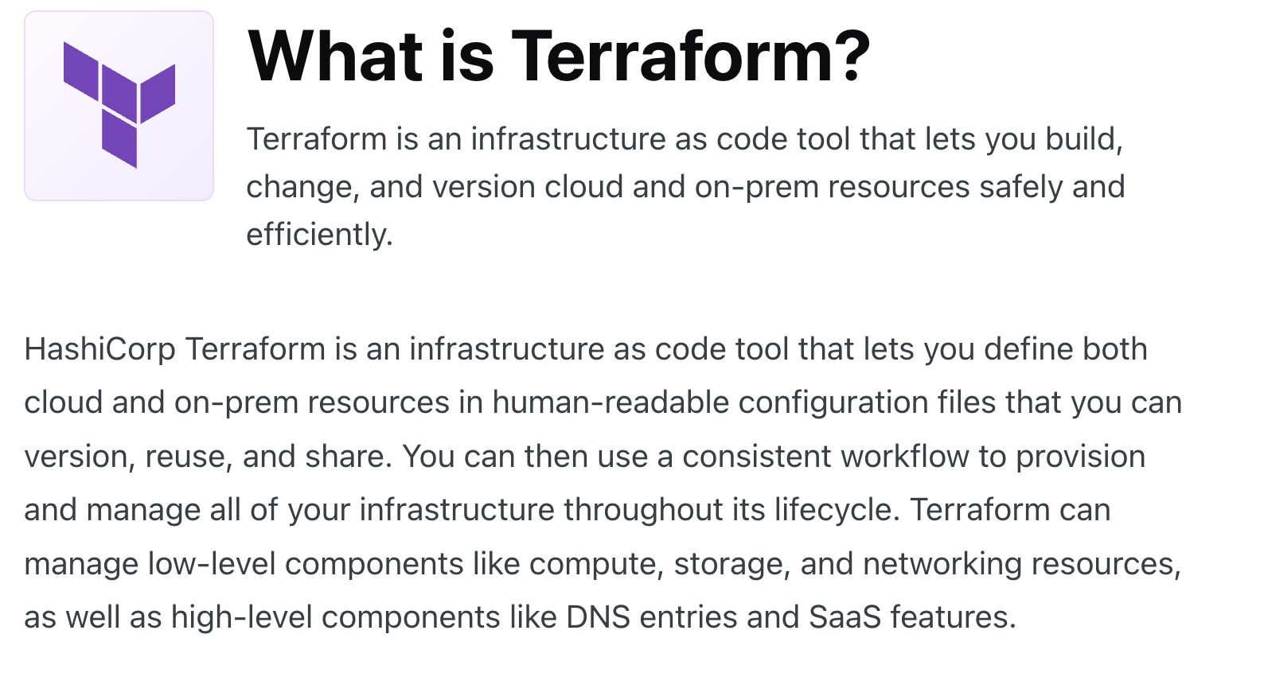
Terraform Basics

Slide 32
Terraform Basics
What is Terraform?
Open source tool.

Slide 33
Terraform Basics
What is Terraform?
Open source tool.
Command line interface (cli).

Slide 34
Terraform Basics
What is Terraform?
Open source tool.
Command line interface (cli).
Multi Cloud Declarative IaC.

Slide 35
Terraform Basics
What Terraform is not.

Slide 36
Terraform Basics
What Terraform is not.
A multi cloud abstraction layer.

Slide 37
Terraform Basics
What Terraform is not.
A multi cloud abstraction layer.
A shortcut to cloud provider management.

Slide 38
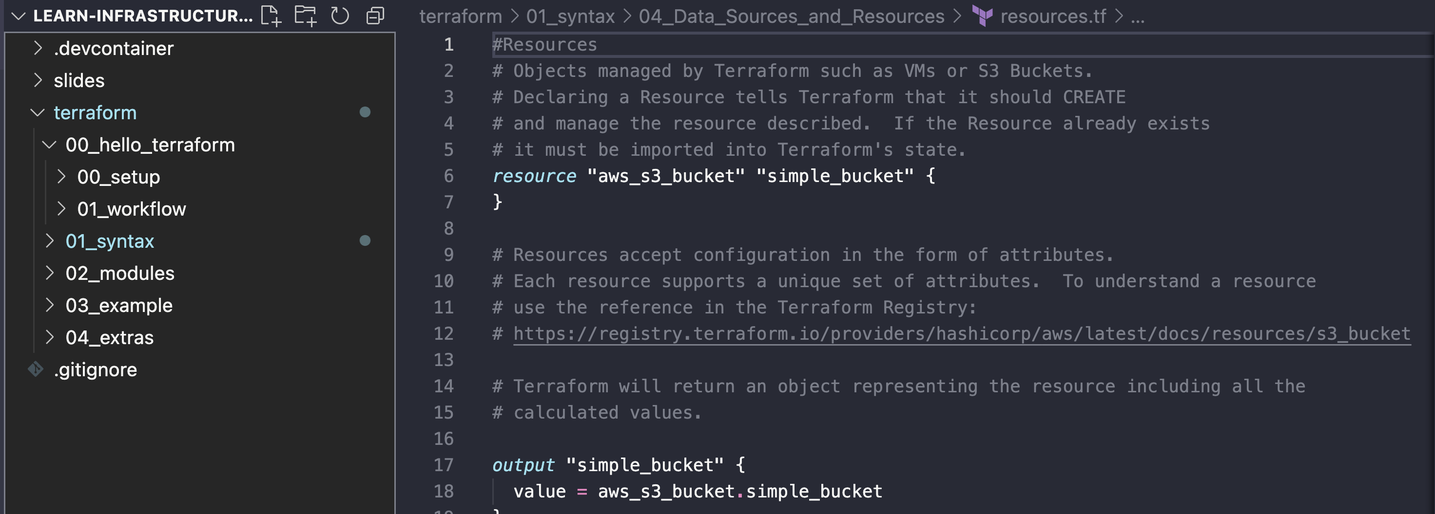
Terraform Basics
Demo: Hello Terraform

Slide 39
Terraform Basics
Demo: Terraform Syntax

Slide 40
Course overview
Introduction to IaC
Terraform Basics
Terraform in Practice
Notes:
Recommended for use as title slides for each section/segment of the course

Slide 41
Terraform in Practice
State
Terraform’s view of the world.

Slide 42
Terraform in Practice
State
Terraform’s view of the world.
Can be local or remote.

Slide 43
Terraform in Practice
State
Terraform’s view of the world.
Can be local or remote.
Many providers.
Notes:
https://developer.hashicorp.com/terraform/language/settings/backends/local

Slide 44
Terraform in Practice
State
Terraform’s view of the world.
Can be local or remote.
Many providers.
Locks.
Notes:
https://developer.hashicorp.com/terraform/language/settings/backends/local

Slide 45
Terraform in Practice
State
Do not edit state.
Notes:
https://developer.hashicorp.com/terraform/language/settings/backends/local

Slide 46
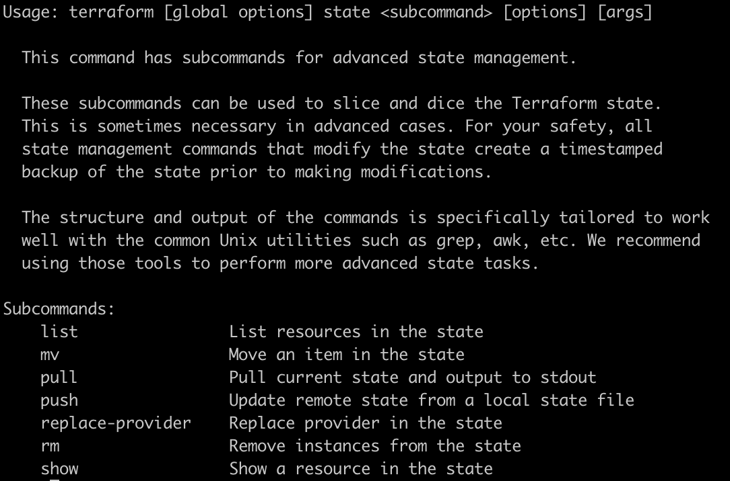
Terraform in Practice
State
Do not edit state.
Use `state` command:
Notes:
https://developer.hashicorp.com/terraform/language/settings/backends/local

Slide 47
Terraform in Practice
Modules

Slide 48
Terraform in Practice
Modules
Reusable libraries of Terraform code.

Slide 49
Terraform in Practice
Modules
Reusable libraries of Terraform code.
Can be local or remote.

Slide 50
Terraform in Practice
Modules
Reusable libraries of Terraform code.
Can be local or remote.
Versioned.

Slide 51
Terraform in Practice
Registry
Hashicorp maintains a public repository of reusable modules. https://registry.terraform.io/

Slide 52
Terraform in Practice
Registry
Hashicorp maintains a public repository of reusable modules. https://registry.terraform.io/
Quality is not guaranteed.

Slide 53
Terraform in Practice
Demo: Modules

Slide 54
Terraform in Practice
Demo: Putting it together

