Slide 1
The Crawl
Ryan Costin | Josh Gillum | Ben Givens | Michael King
Jacob McKenzie | Chris Soto

Slide 2
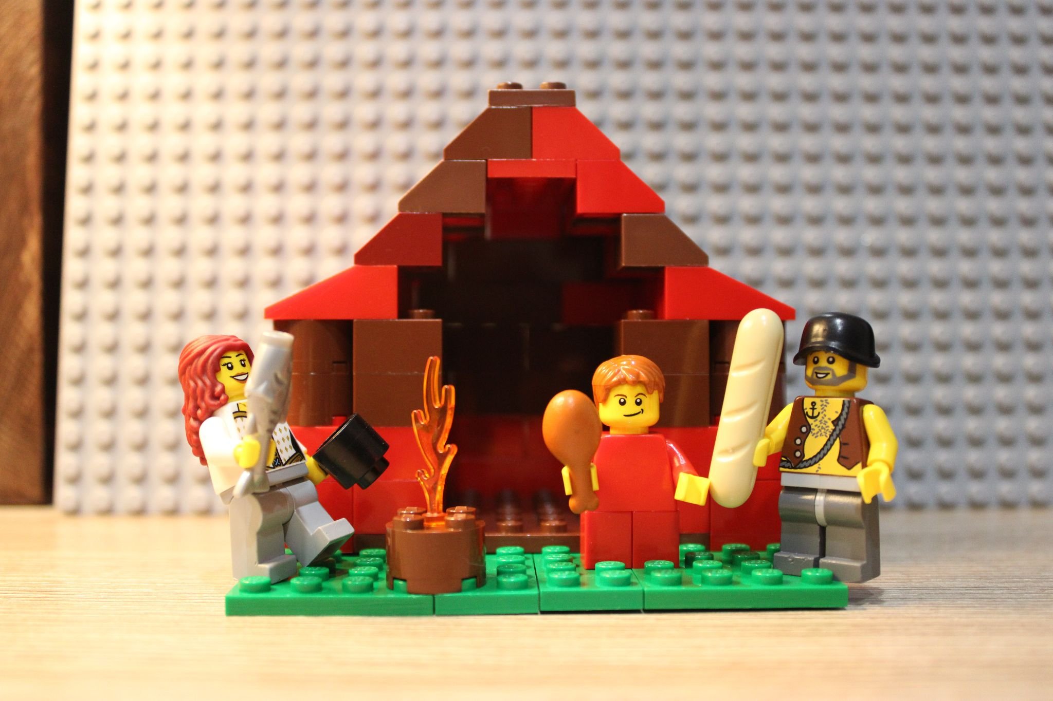
Our story begins with a young lad. He lived a normal life with a normal family. They all lived in a small village in a peaceful valley. Their life was very quiet until this fateful day…

Slide 3
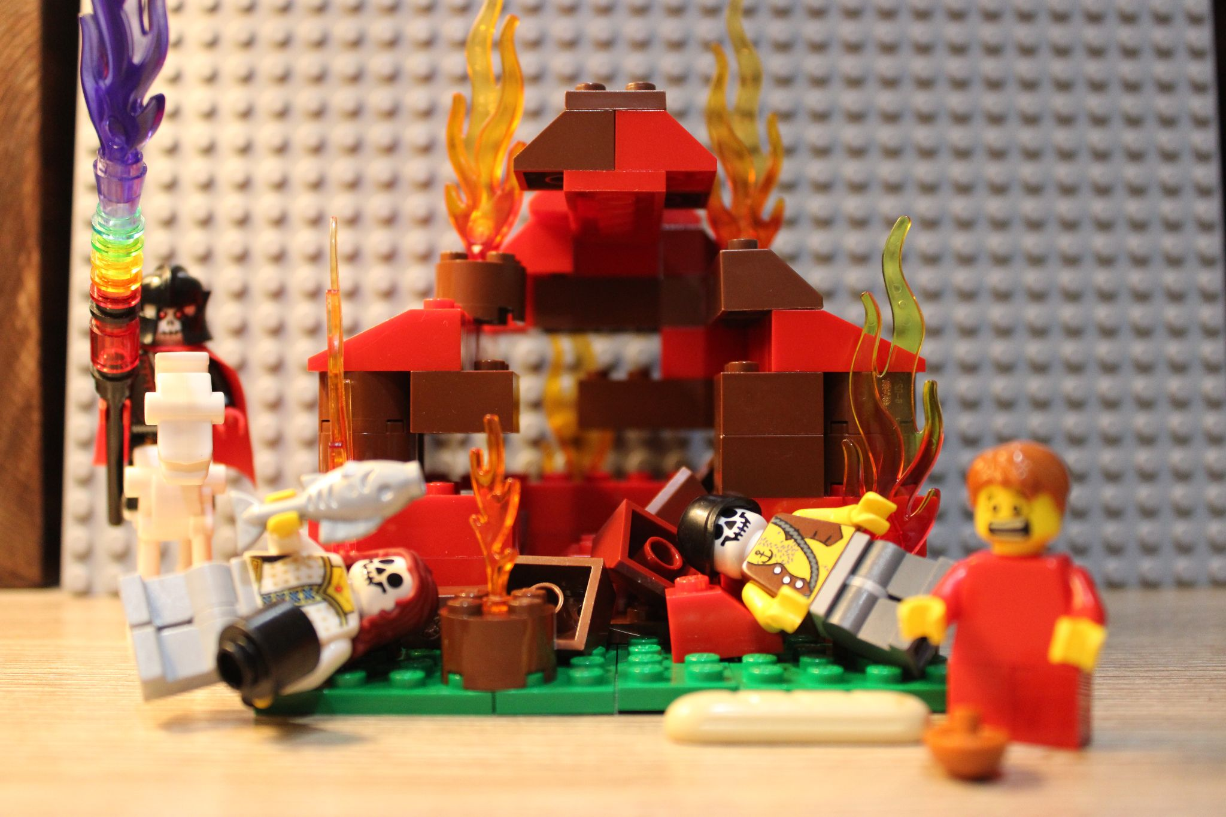
A man with a skull face rode a skeletal horse into town. The villagers quietly hushed amongst themselves, stunned by this new arrival. Lightning cracked through the air and set buildings on fire. This strange man did not stop until every last building was ablaze. As the events that just transpired set into your mind, a look of terror fills your face. You realize that your parents, and everybody you ever knew are now dead.

Slide 4
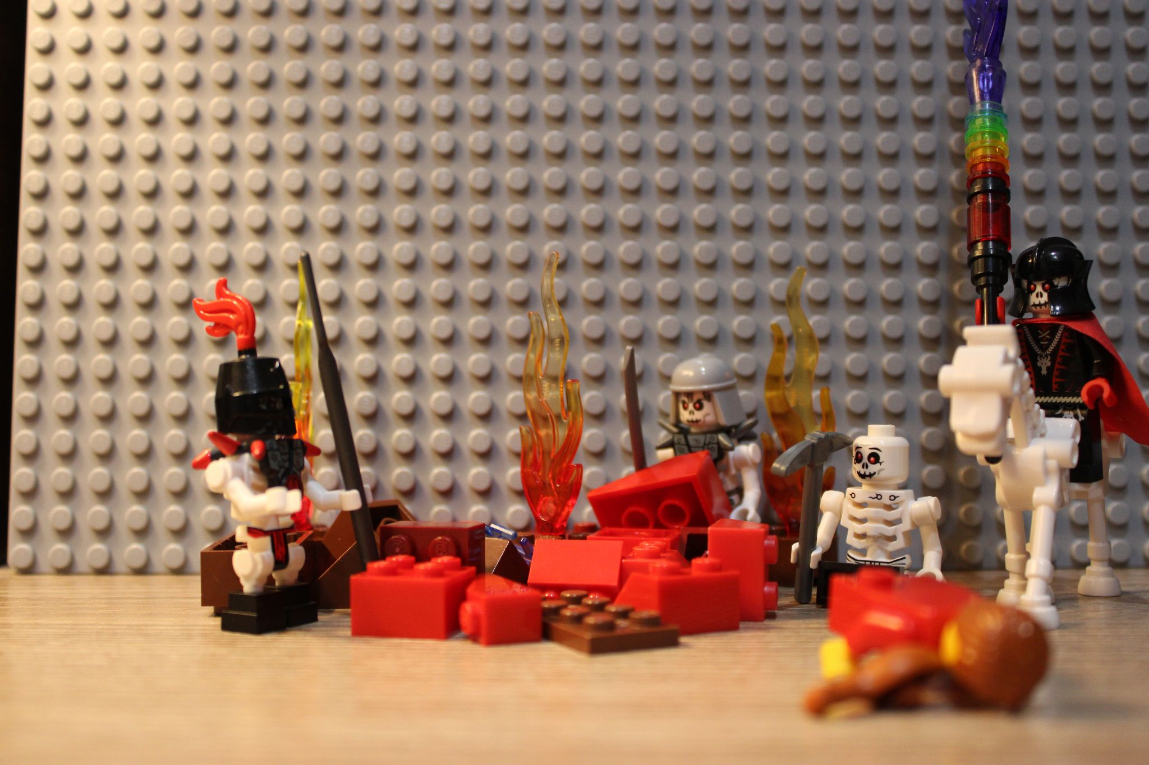
You throw yourself to the ground and pretend to be dead, praying that the stranger does not notice your racing heart and ragged breathing. After the last of the buildings have collapsed, the evil magician calls out, “Come forth my deceased warriors. Rise to serve your master.” You sneak a glance behind you and see skeletal figures rise from the rubble.

Slide 5
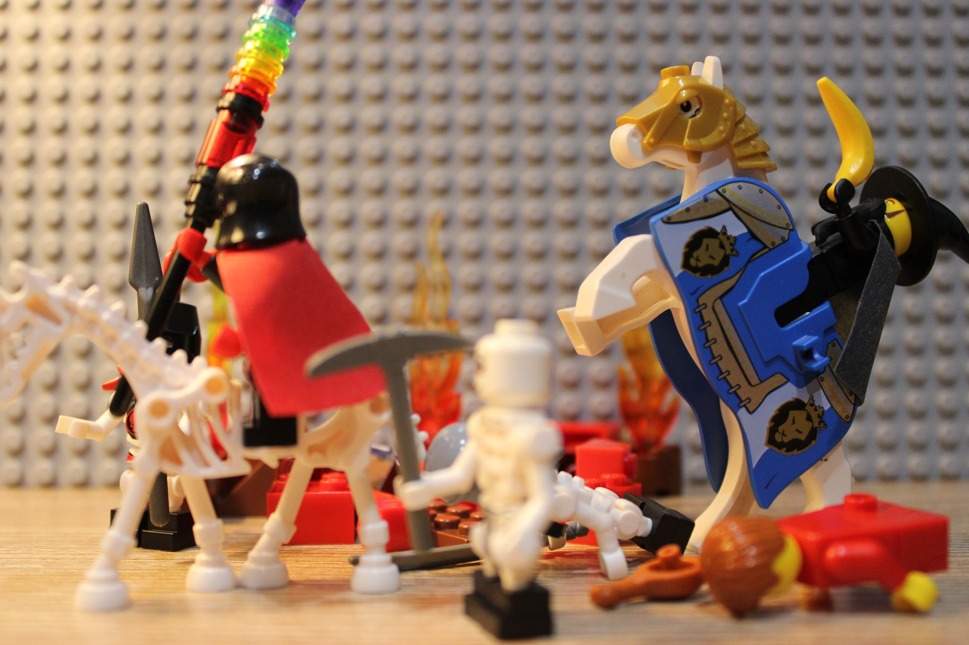
You hear the familiar clip-clop of a horse from off to your side, except this horse seems to be traveling at an otherworldly speed. The horse stops directly in front of the magician and rears back up on its two hind legs. You look up and see that the magician is turning around and running away.

Slide 6
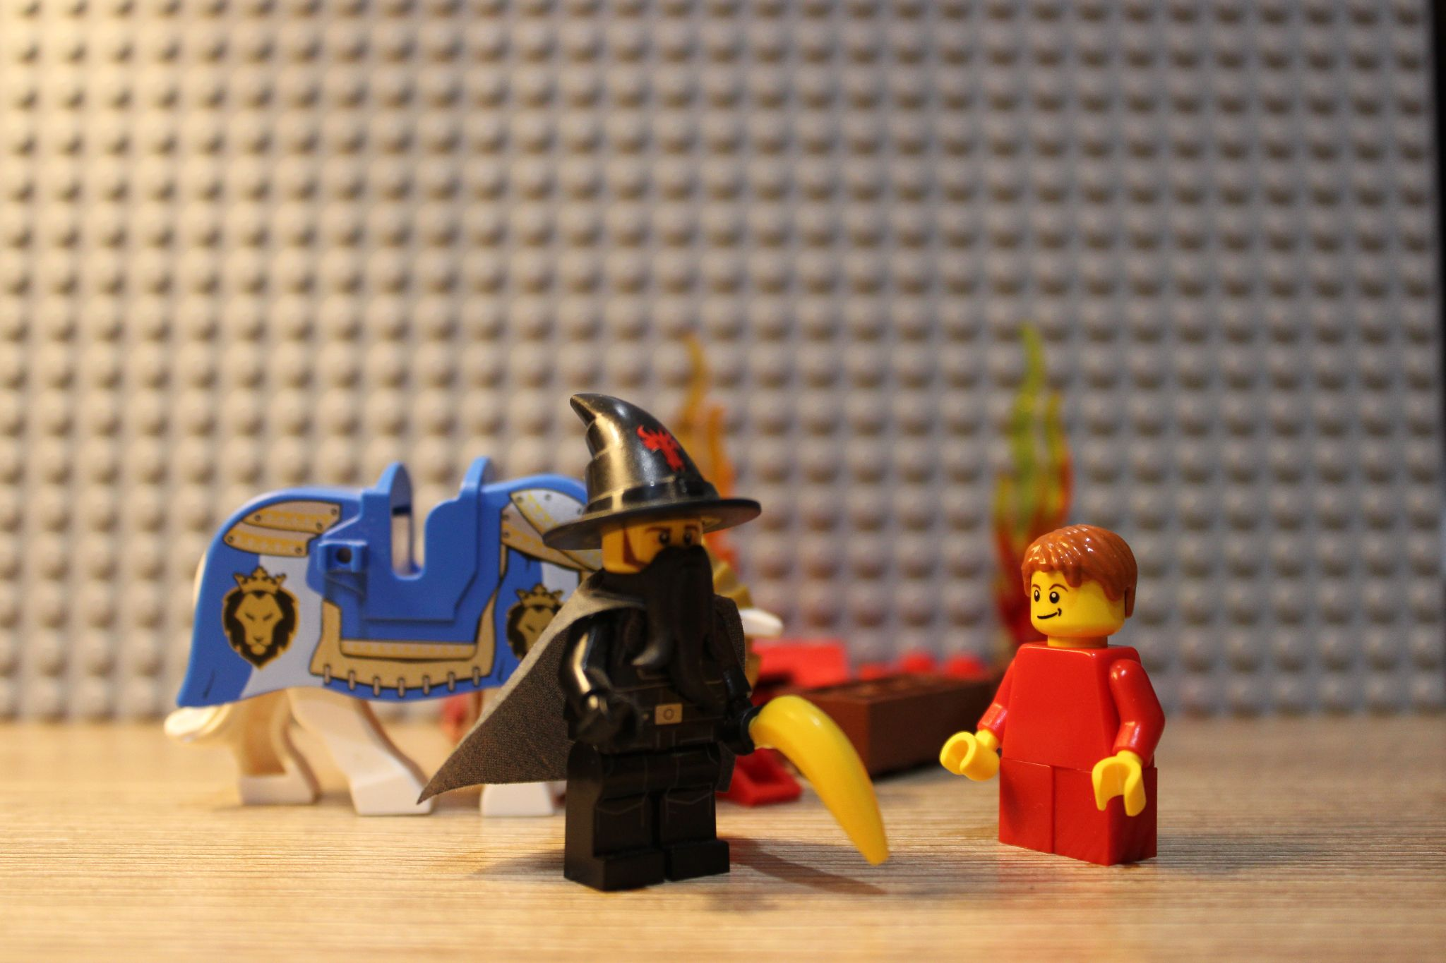
This newcomer has a powerful aura about him, yet you are not scared. His voice booms, “I am Orwick, the great wizard of the East. That evil man that destroyed your village is known simply as The Overlord. He used to be a normal man until he sold his soul to the underworld. He has become a powerful lich that advances the cause of the underworld—to rid our world of life. Come with me to my homeland boy. It is there that you will train to defeat The Overlord.”

Slide 7
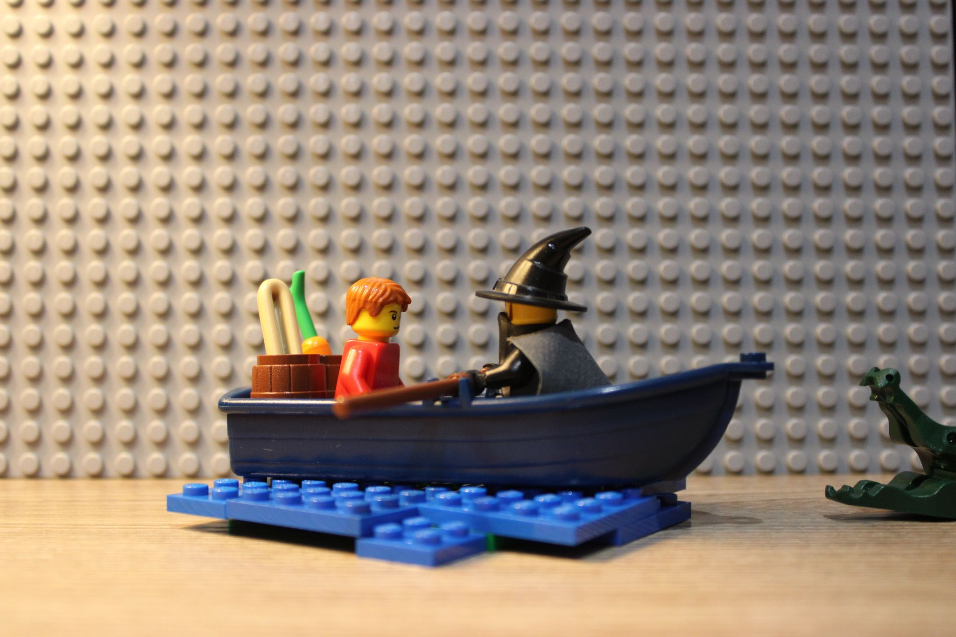
You and Orwick travel for what seems like ages. The days blend together as you struggle to survive. It seems like everything in this world is out to kill you. You reminisce on your simple life of the past, and thinking about your parents fills you with sorrow. After 9 days (according to Orwick), you reach his home. It is here that you spend the next 20 years of your life training and preparing to get your revenge.

Slide 8
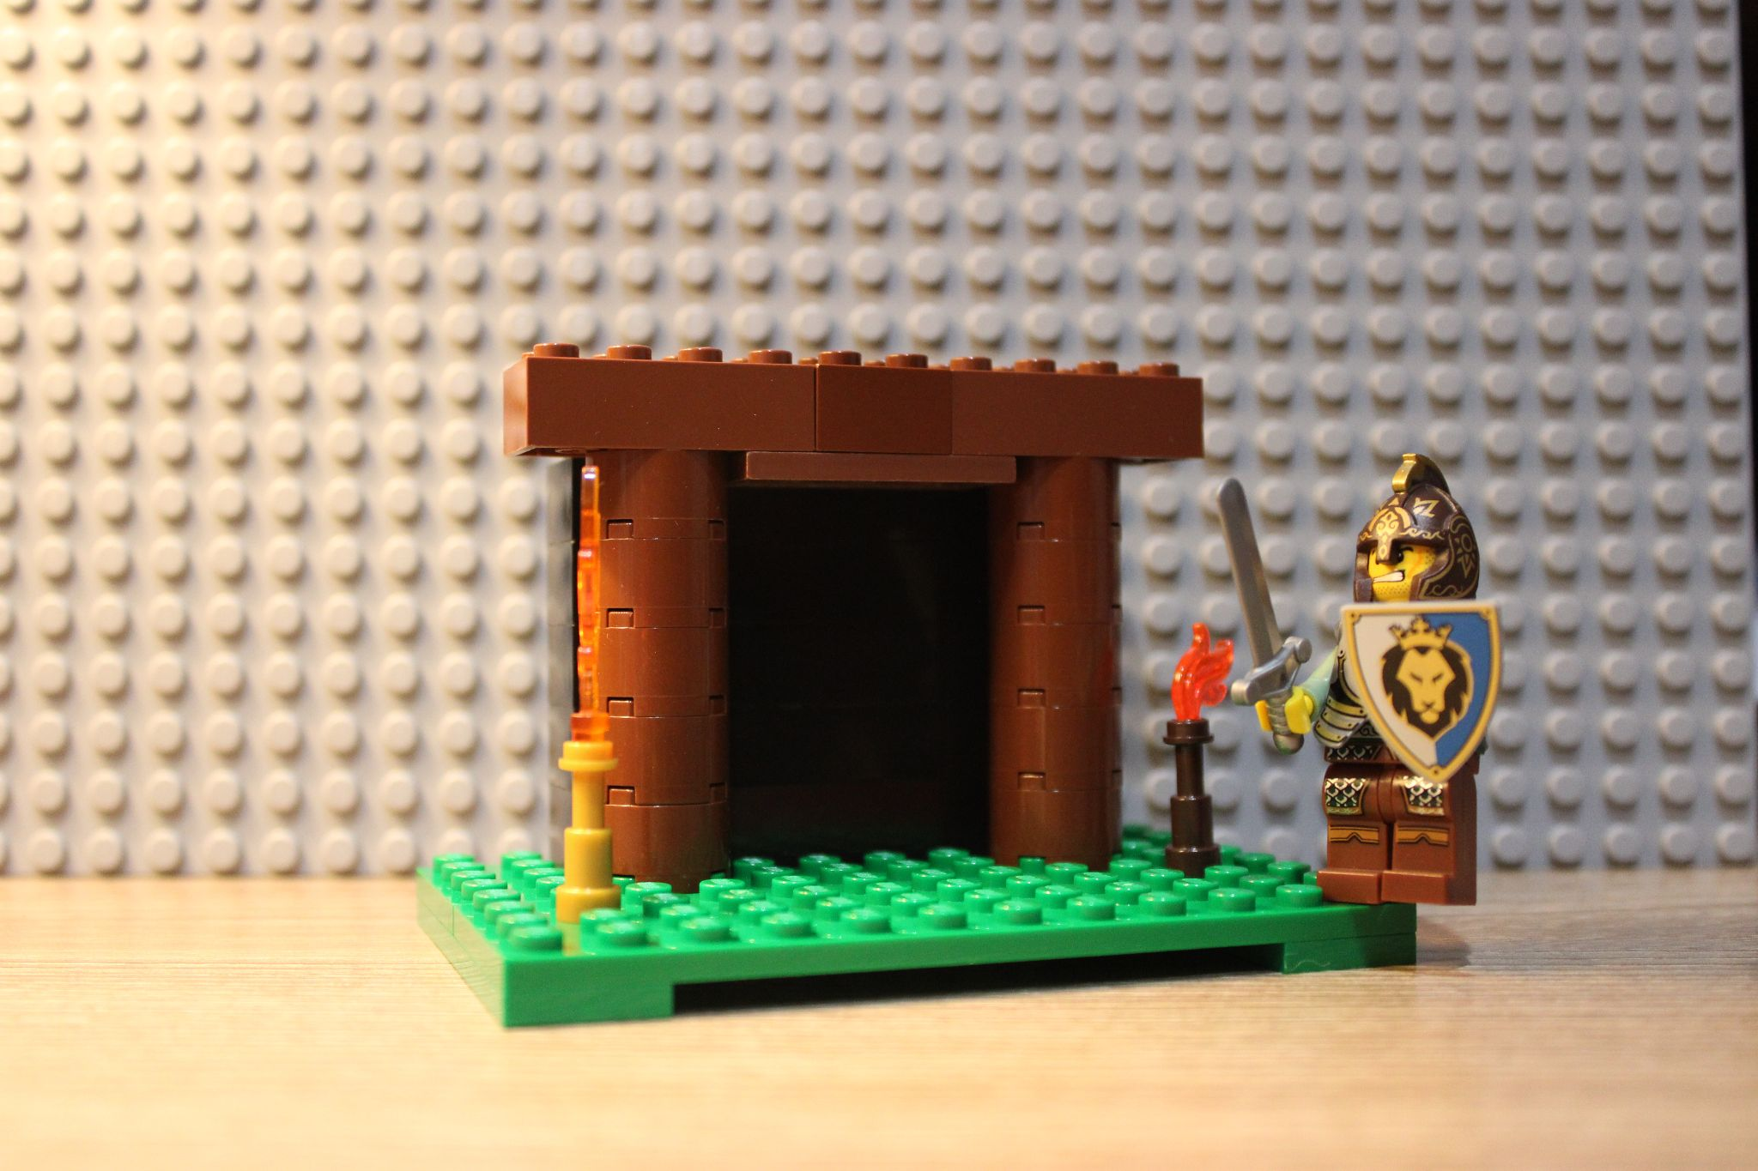
On the day of your 27th birthday, Orwick confirms what you were already thinking—that you are finally ready to take on the lich. You travel back to your old home, and spend the next several months searching for his hideout. Eventually, you learn that he has constructed an elaborate dungeon in the bottom of an old mineshaft.

Slide 9
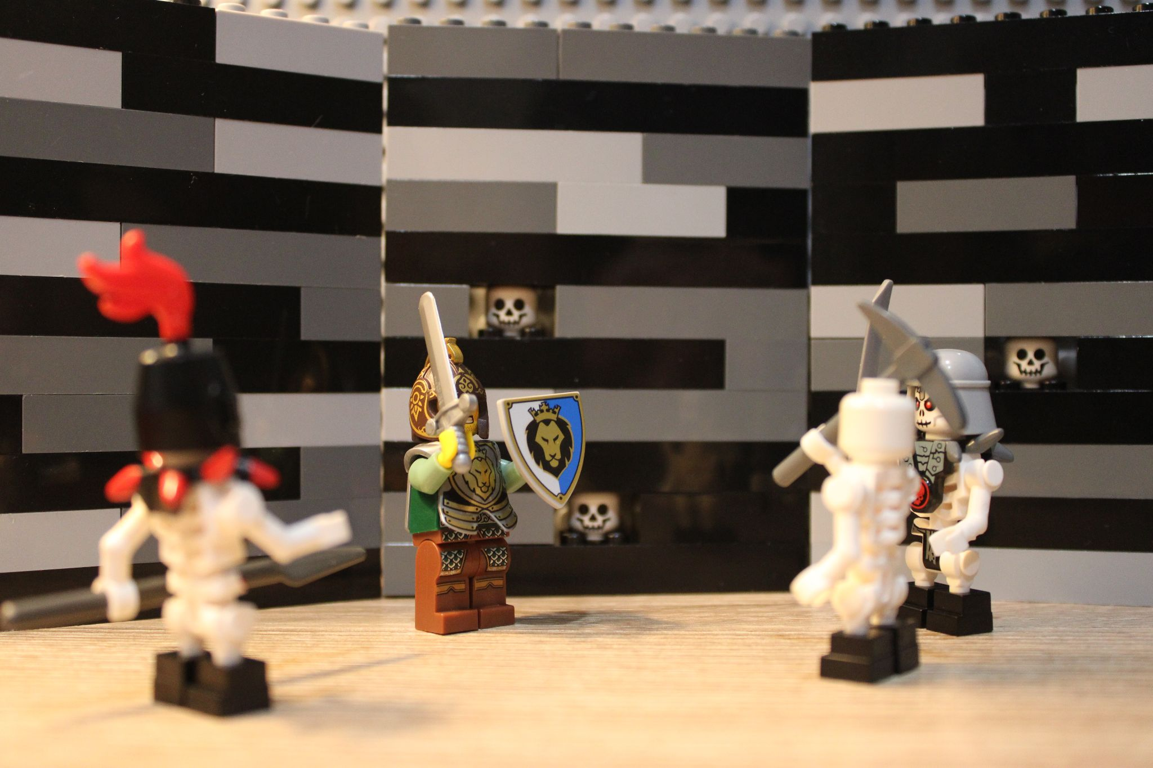
Immediately upon entering, you are greeted by a host of skeletons. It pains you to know that they were once living people, they might have even been someone you knew. You continue exploring this maze-like dungeon, until you find a room that seems different than the others…

Slide 10
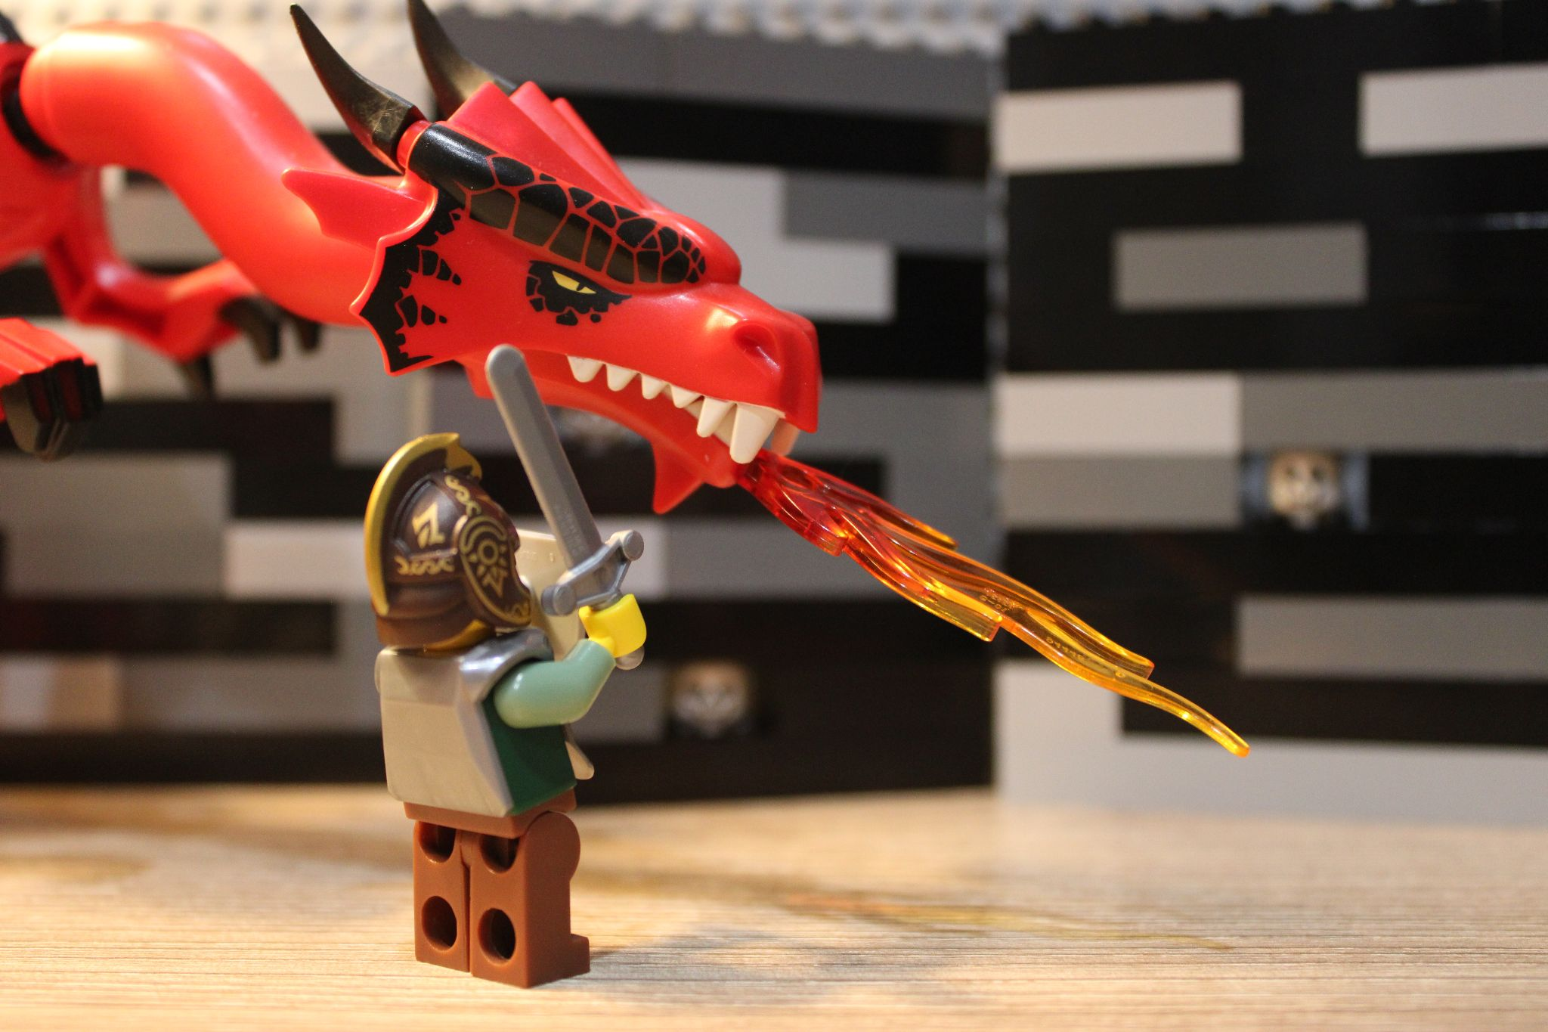
It’s a tamed drake from the old world! It has long been believed that they went extinct millenia ago. It doesn’t seem possible to be fighting one, unless the lich’s foul magic had something to do with it. You slay the dragon and head deeper into the dungeon. The next level is largely the same as the previous one. Rooms upon rooms of underlings, with a large monster guarding the staircase.

Slide 11
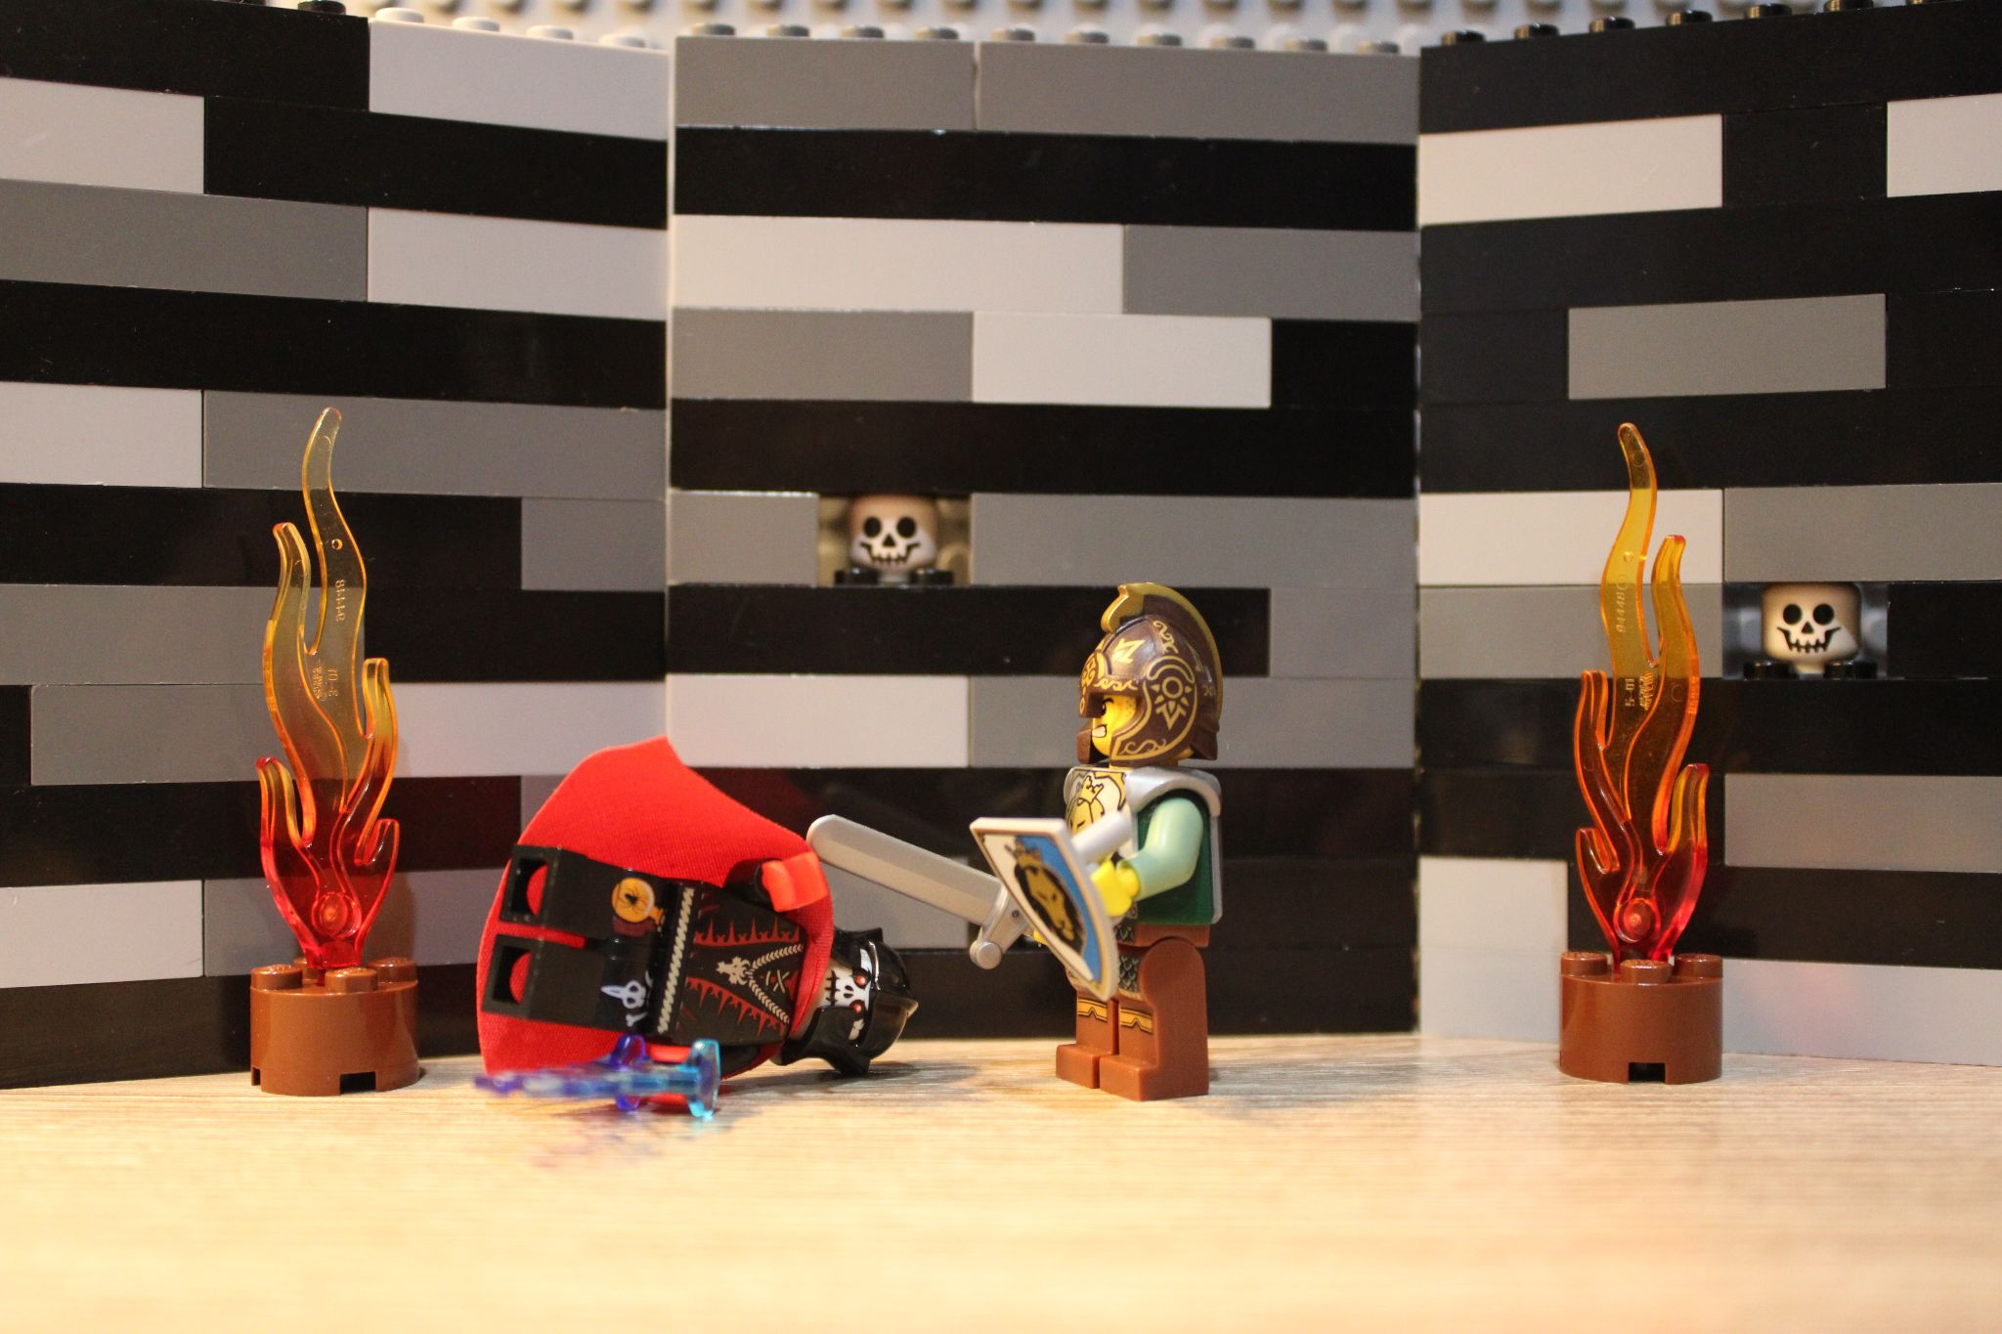
You enter another one of the large rooms, expecting one of The Overlords elites, only to be surprised by The Overlord himself. He puts up a tough fight, using various magical abilities, nearly killing you. In the end, you emerge victorious, filled with a sense of accomplishment that you have avenged all of the villages destroyed by this monster. A tinge of sorrow sweeps over you as you remember your parents, but it goes away when you realize that they are free now.

Slide 12
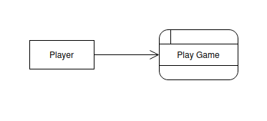
Context Diagram

Slide 13
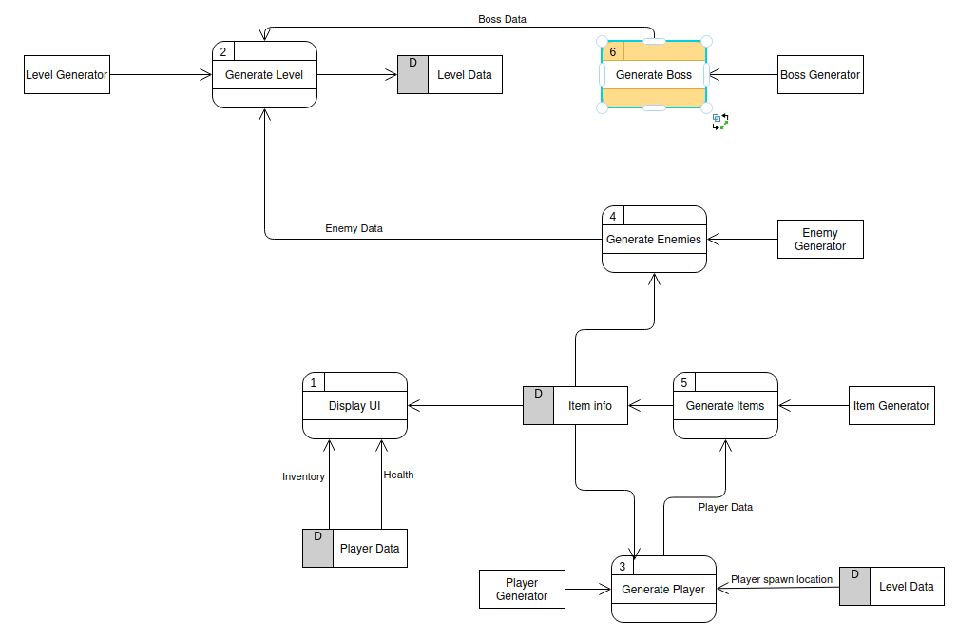

Slide 14
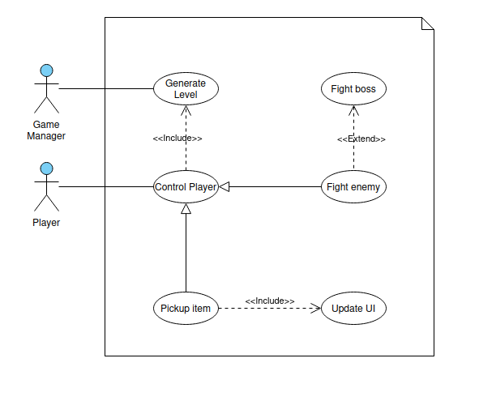

Slide 15
Level Generation
Each level will be randomly generated
Each level will have a “tier” for difficulty
Priority: 1
Complexity: 1-2 most complex
Jacob

Slide 16
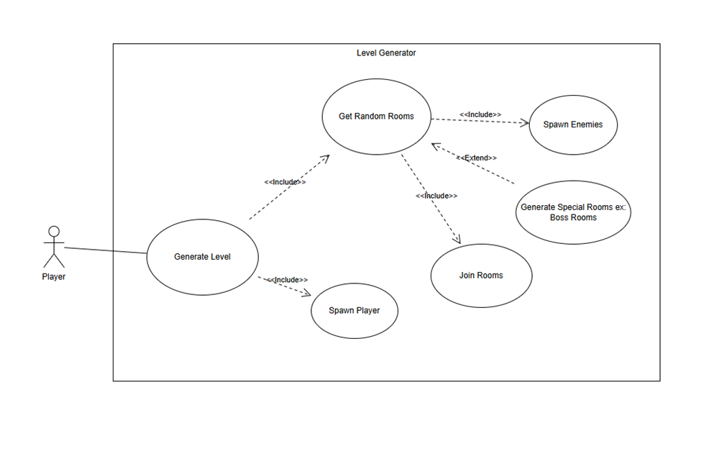
Use Case Diagram
Jacob

Slide 17
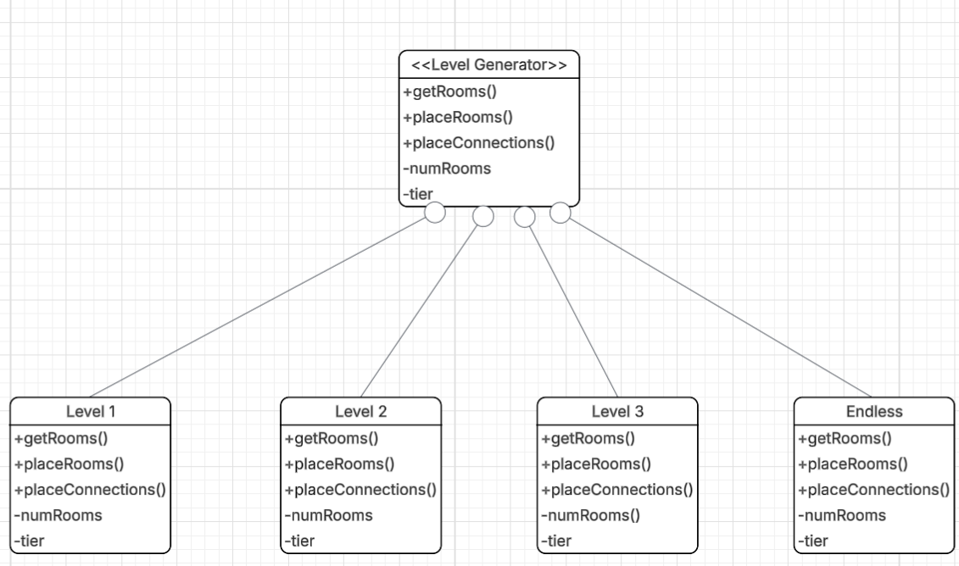
Class Diagram (first draft)
The real class diagram will be done saturday
Jacob

Slide 18
Player Overview
Player will have multiple classes to choose from
These classes will have special abilities to that class, starting health values, starting items/equipment
Each weapon type will have different control schemes for the player - ranged will have to aim and release- shields must be directional in blocking
Implement Controls for Player on Keyboard/Mouse and Controller
Priority 1
Complexity compared to random room generation or ai enemy algorithms my feature would be less complex
Chris-Team Lead 6

Slide 19
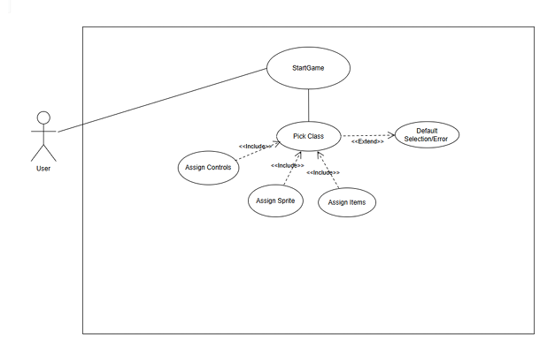
Player Overview- Use Case
Chris-Team Lead 6

Slide 20
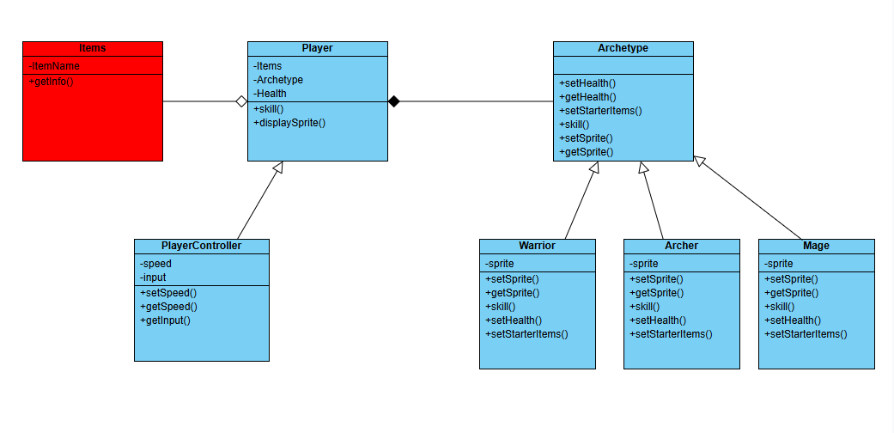
Player Overview- Class Diagram
Bridge Design
Aggregates items
Composition of Archetype
Chris-Team Lead 6

Slide 21
Enemy A.I. - Overview
Tier difficulty levels based on floor level
Consist of melee and ranged enemies with differing abilities
  Wandering/idling, chasing player, shooting projectiles, casting buffing/debuffing spells
Pathfinding utilizing navigation mesh
  Allows to find player while avoiding obstacles and other objects
Chance of dropping items/currency upon death
Priority Level - 1*
Complexity - Complexity will scale with amount of varying enemies types implemented
*1 = Necessary, 2 = Good to have, 3 = Not necessary
Team Lead 5 - Ryan

Slide 22
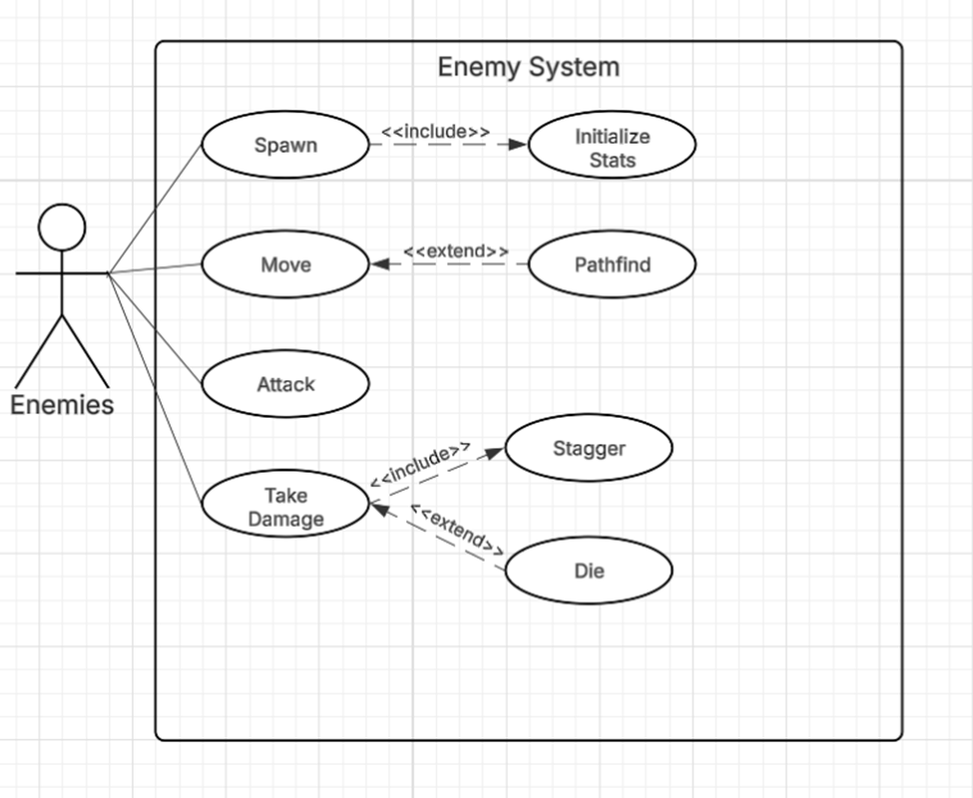
Enemy A.I. - Use Case
Team Lead 5 - Ryan

Slide 23
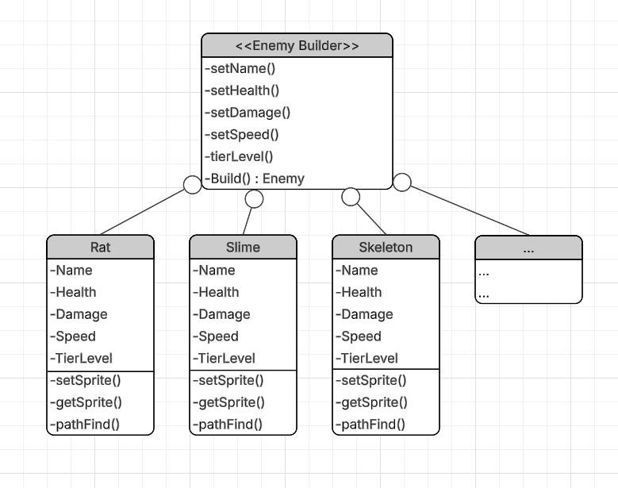
Enemy A.I. - Class Diagram
Builder Design
Construction of objects through its representation
Allows for customizing multiple classes
Team Lead 5 - Ryan

Slide 24
Boss Fight Encounters
One per level.
  Bar you from using the stairs until beat.
Several options per level. Randomly chosen.
Bosses will have unique mechanics and abilities
Boss on the third floor will always be The Overlord
  Technical end of game
Josh

Slide 25
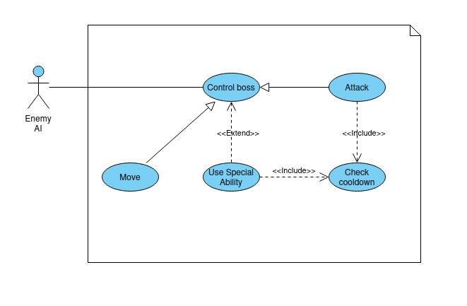
Josh

Slide 26
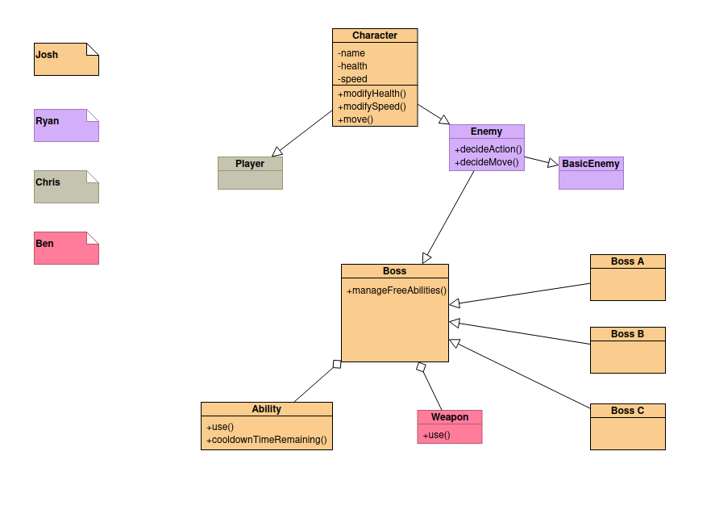
Josh

Slide 27
Item Implementation
Two different types of Items Consumables and Weapons
Consumables will offer one time buffs and/or deal damage
  e.g: health potion, fireball potion, etc.
Weapons will be a permanent equipable item
  e.g: Axe, bow, etc.
Can be dropped by beating enemies and bosses
Will differ in rarity and power. Later floors get more powerful items
Ben

Slide 28
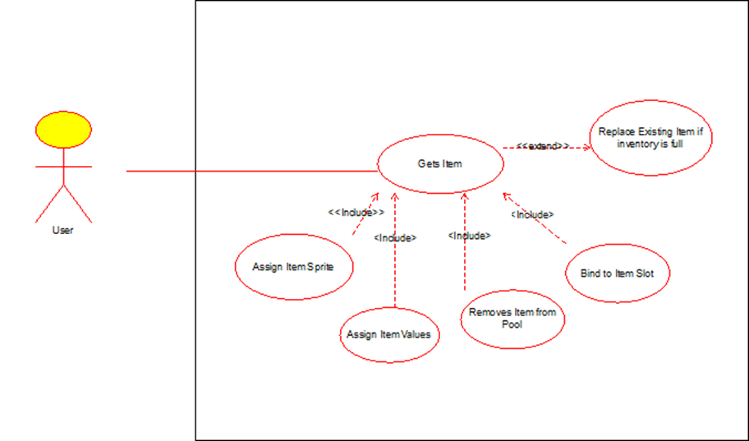
Item/ability Implementation - Use Case
Ben

Slide 29
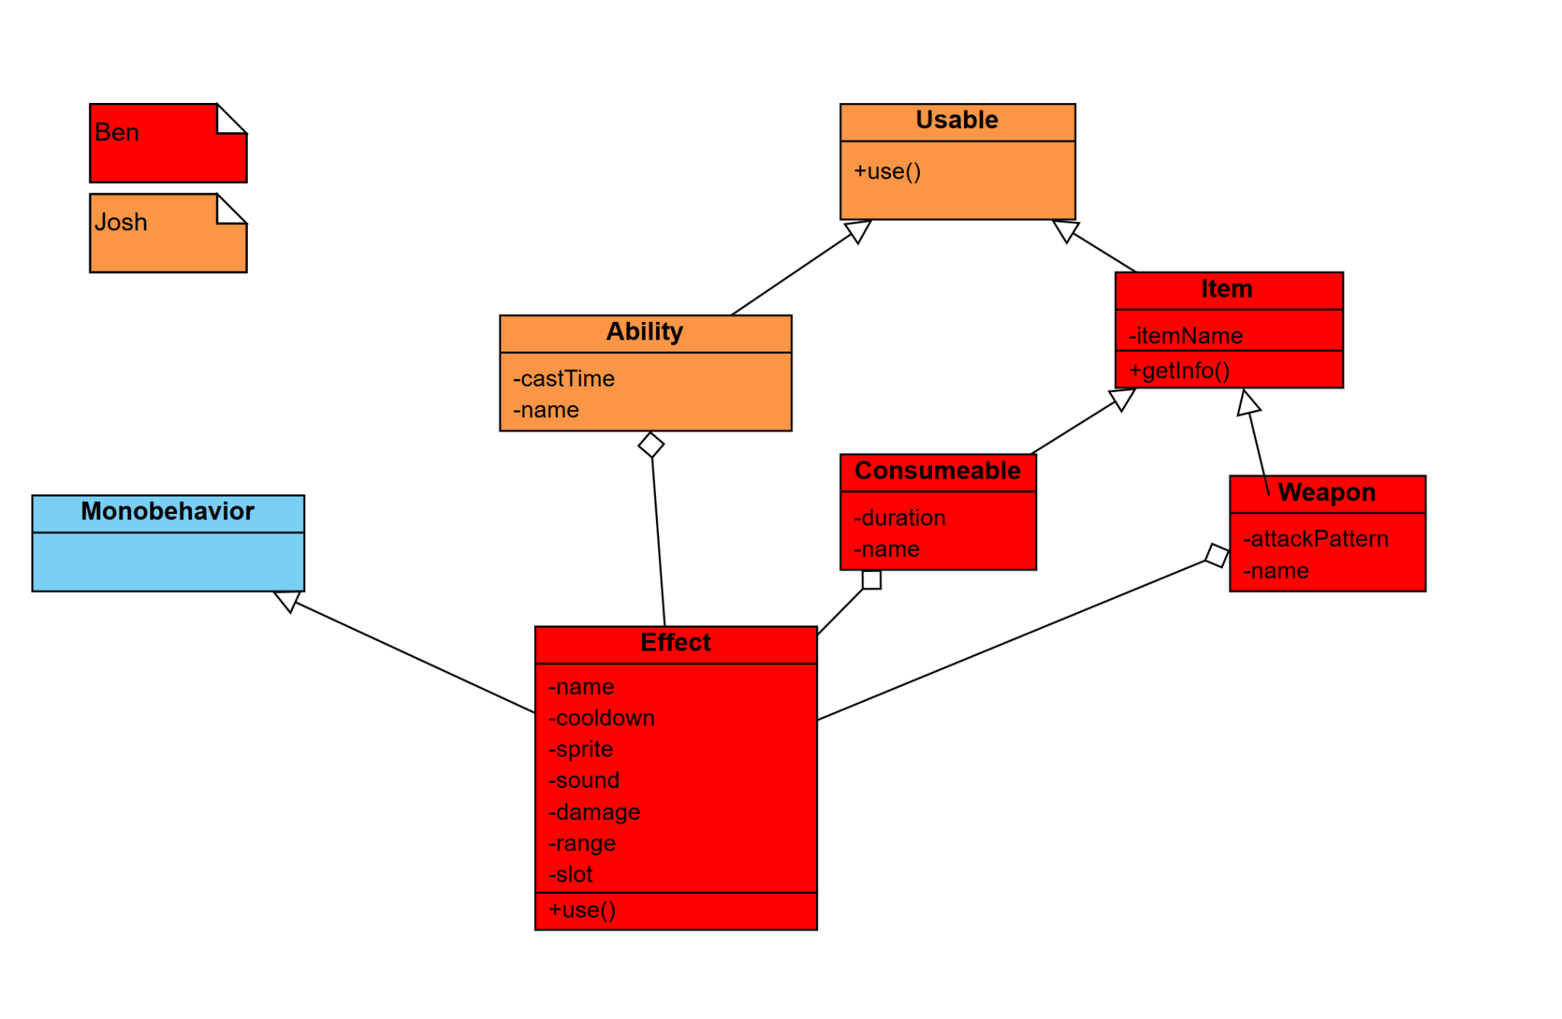
Item/ability Implementation - Class Diagram
Ben

Slide 30
UI HP and Resource bar item bag and Menu
Menu With three options, One to start the game one to go over the rules and controls of the game and the finally and option to quit the game.
Display your characters current hp and class resource amounts on your screen.
Hp bar will flash if below 20%
If you try to use an ability when you don't have enough of your classes resource will also make a no mana sound.
Will display what items you have and what the keybinds are for the items.
Michael

Slide 31
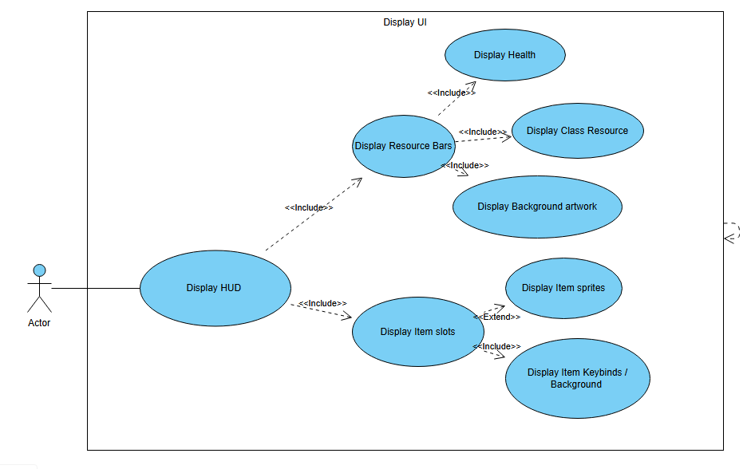
UI Implementation - Use Case
Michael

Slide 32
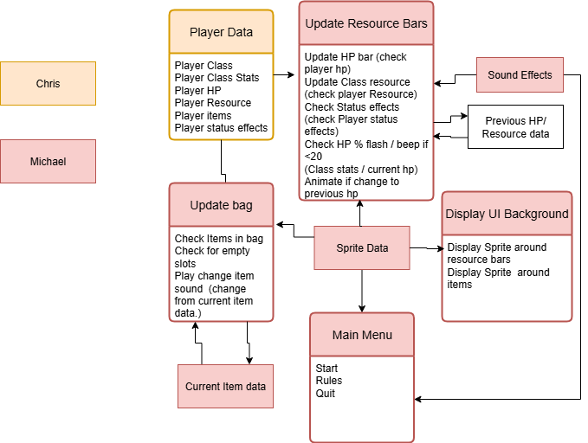
UI Implementation - Class Diagram
Michael

