Slide 1

AuraFarm
Part 3 • Mobile App Development
AI-generated vibe cards from an outfit and expression.
CIT2C18
Leon Jr Chua
2500593E • PC08 • AY2026/27

Slide 2
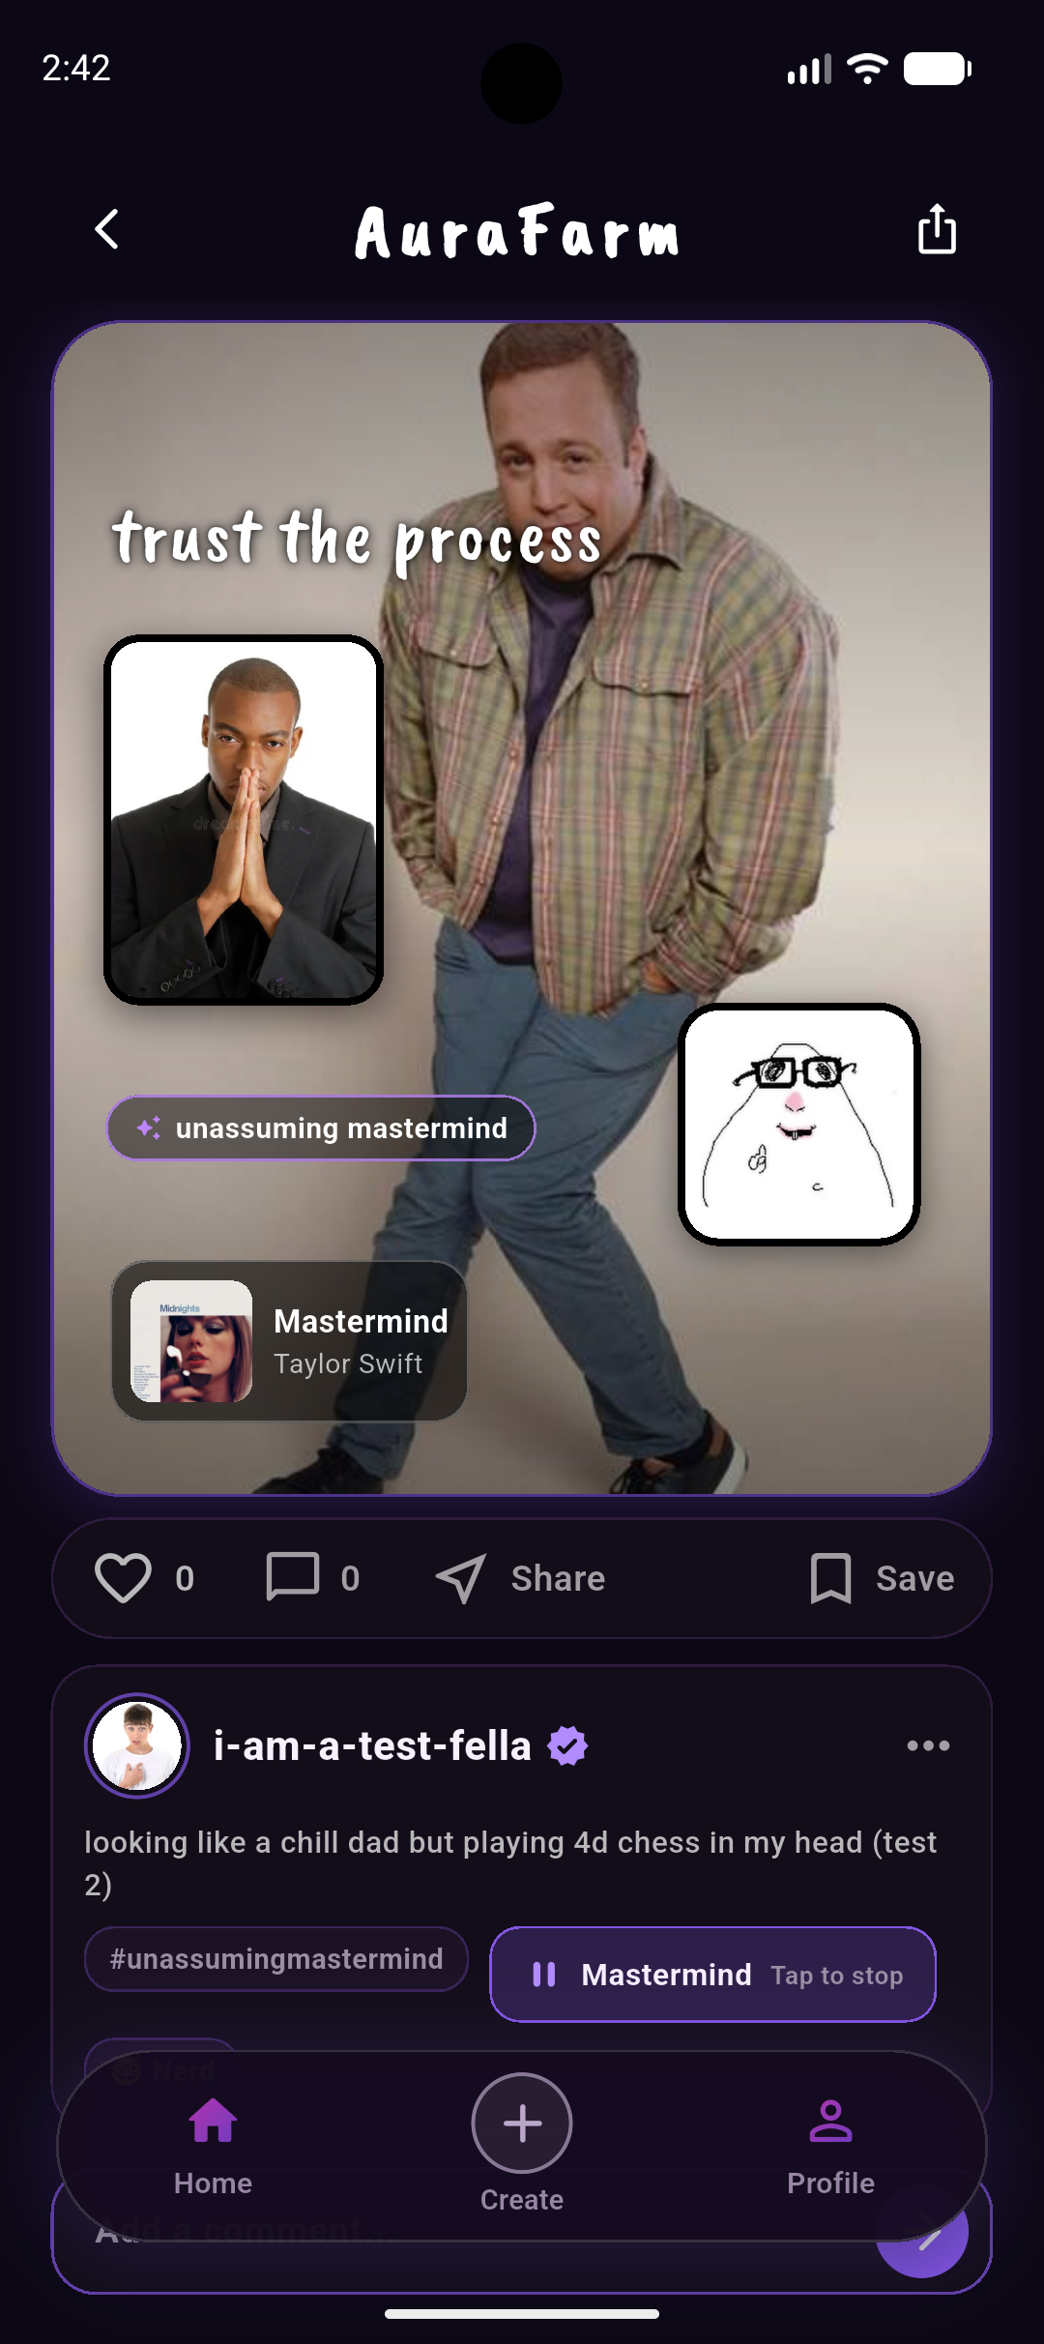
AuraFarm turns two photos into one editable social artifact
Designed for students and young adults aged 15–25, AuraFarm brings visuals, music and humour into one guided creation flow.
The problem
Mood-based posts usually require separate choices for photos, captions, music and memes.
The response
Recommendations reduce initial decision effort; editing controls keep the user in charge of the final result.
01
02
03
04
Outfit + face
→
AI suggestions
→
Edit card
→
Publish + share
AURAFARM • PART 3
02

Slide 3
Part 3 extends one complete data-and-AI workflow
5
5
1
6
CRUD operations
query categories in the UI
core AI workflow
additional features
Implementation path
Flutter UI
→
Riverpod
→
Services
→
External systems
screens + widgets
async state
auth • data • AI
Firebase • Gemini • music (iTunes)
Authentication carried over from Part 2
Email sign-up and login, password reset, change password and email verification, plus Google and GitHub sign-in on web.
AURAFARM • PART 3
03

Slide 4
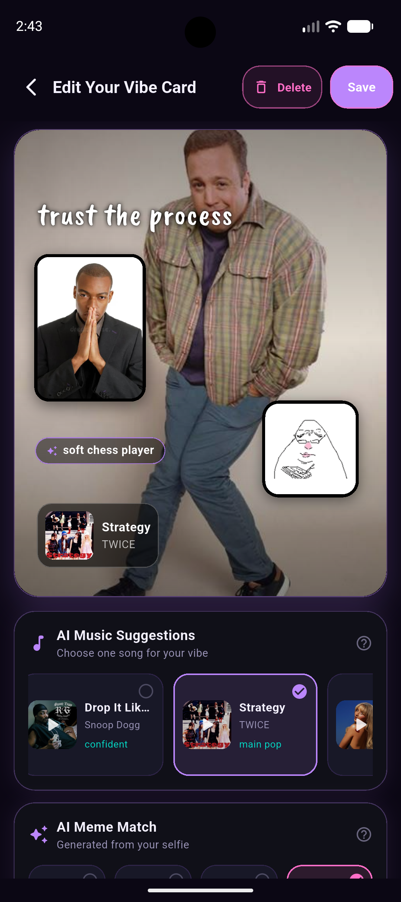
One Vibe Card domain completes all five CRUD operations
01
Insert
The editor writes a completed card to Firestore.
02
Select all
The home feed streams every card in the posts collection.
03
Select one
Detail streams one ID; edit loads one snapshot.
04
Update
Only editable fields are written back.
05
Delete
The owner confirms before permanent removal.
AURAFARM • PART 3
04

Slide 5
Five required advanced-query categories are implemented
Rubric category
Firestore logic
Visible proof
One non-ID filter
memeName == value
Meme filter result
Same-field criteria
likes ≥ minimum AND likes ≤ maximum
Likes-range result
Different fields
memeName == value AND likes in range
Meme + likes result
Sort order
orderBy(createdAt) / orderBy(likes)
Newest vs Trending
Aggregation
count + sum(likes) + average(likes)
Profile statistics
All five categories are reachable in the UI, like ranges do not overlap, and every composite index is deployed.
AURAFARM • PART 3
05

Slide 6
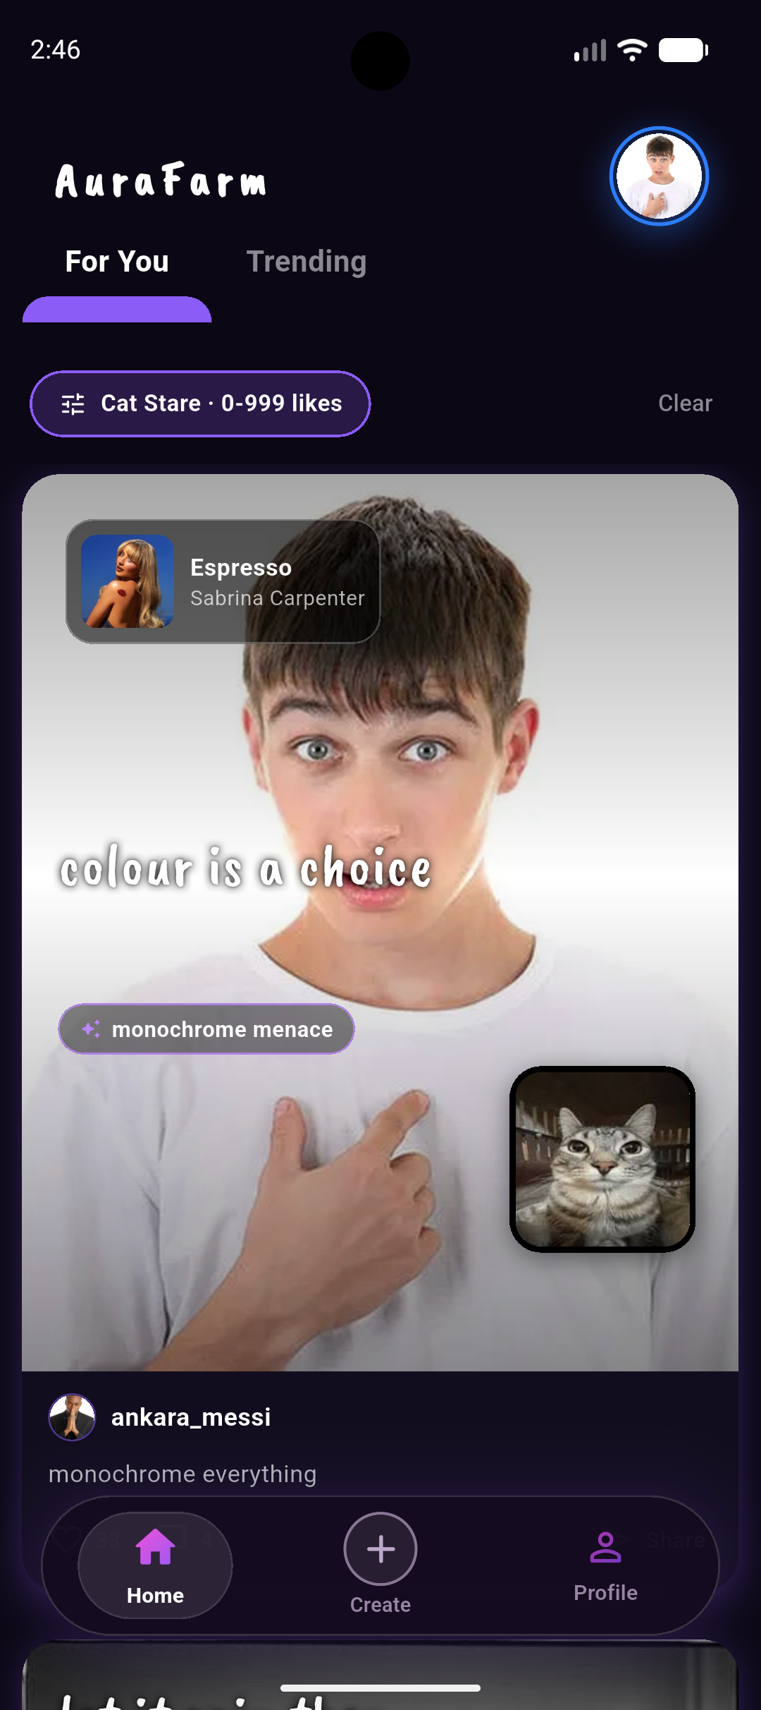
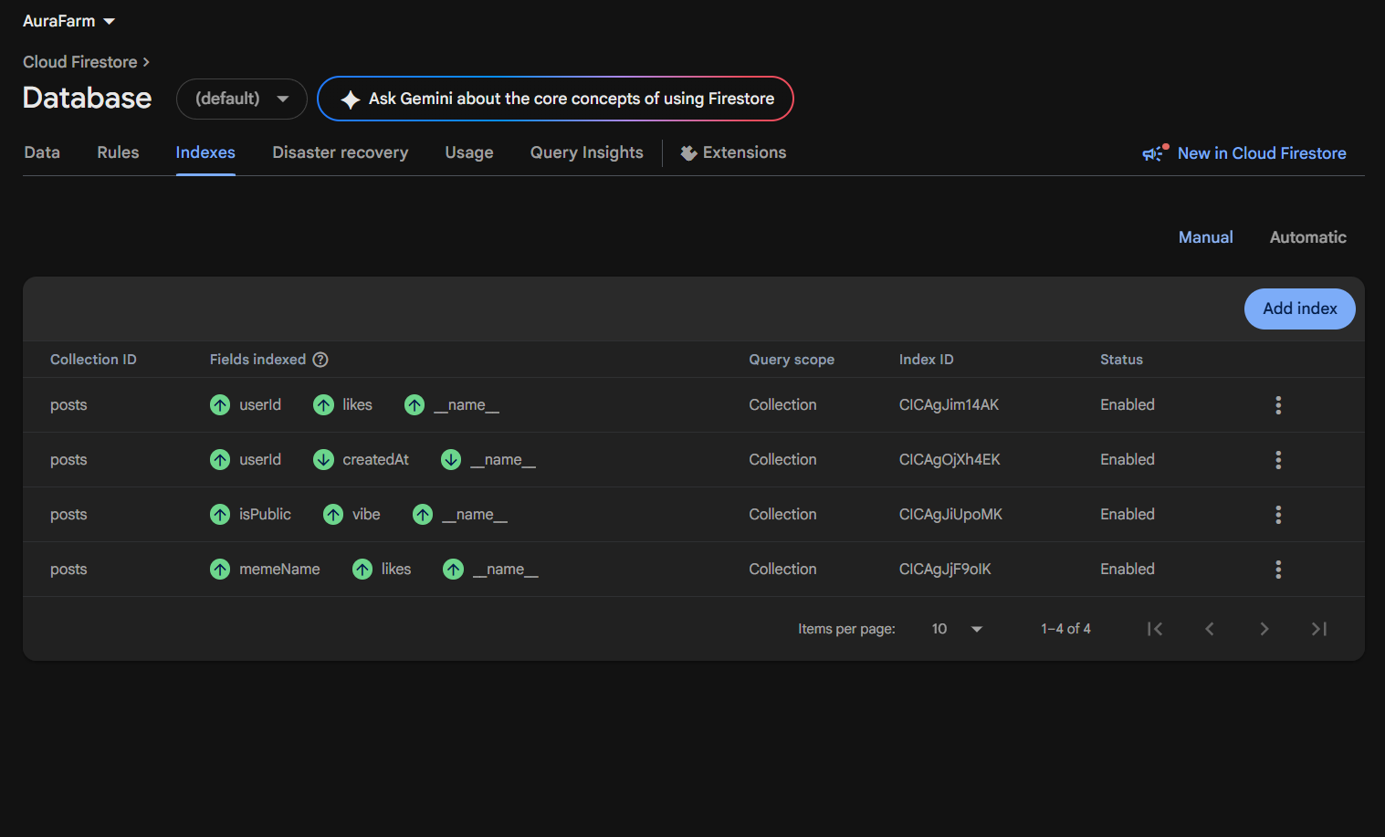
Every query category is proven against real records
The filter runs a Firestore query on the server, not a client-side filter over an already-downloaded list.
Composite indexes deployed and enabled
An equality on one field plus a range on another cannot use the automatic single-field indexes, so this pair is declared explicitly.
Meme + likes, one query
memeName == 'Cat Stare' AND likes 0-999 (Filter)
AURAFARM • PART 3
06

Slide 7
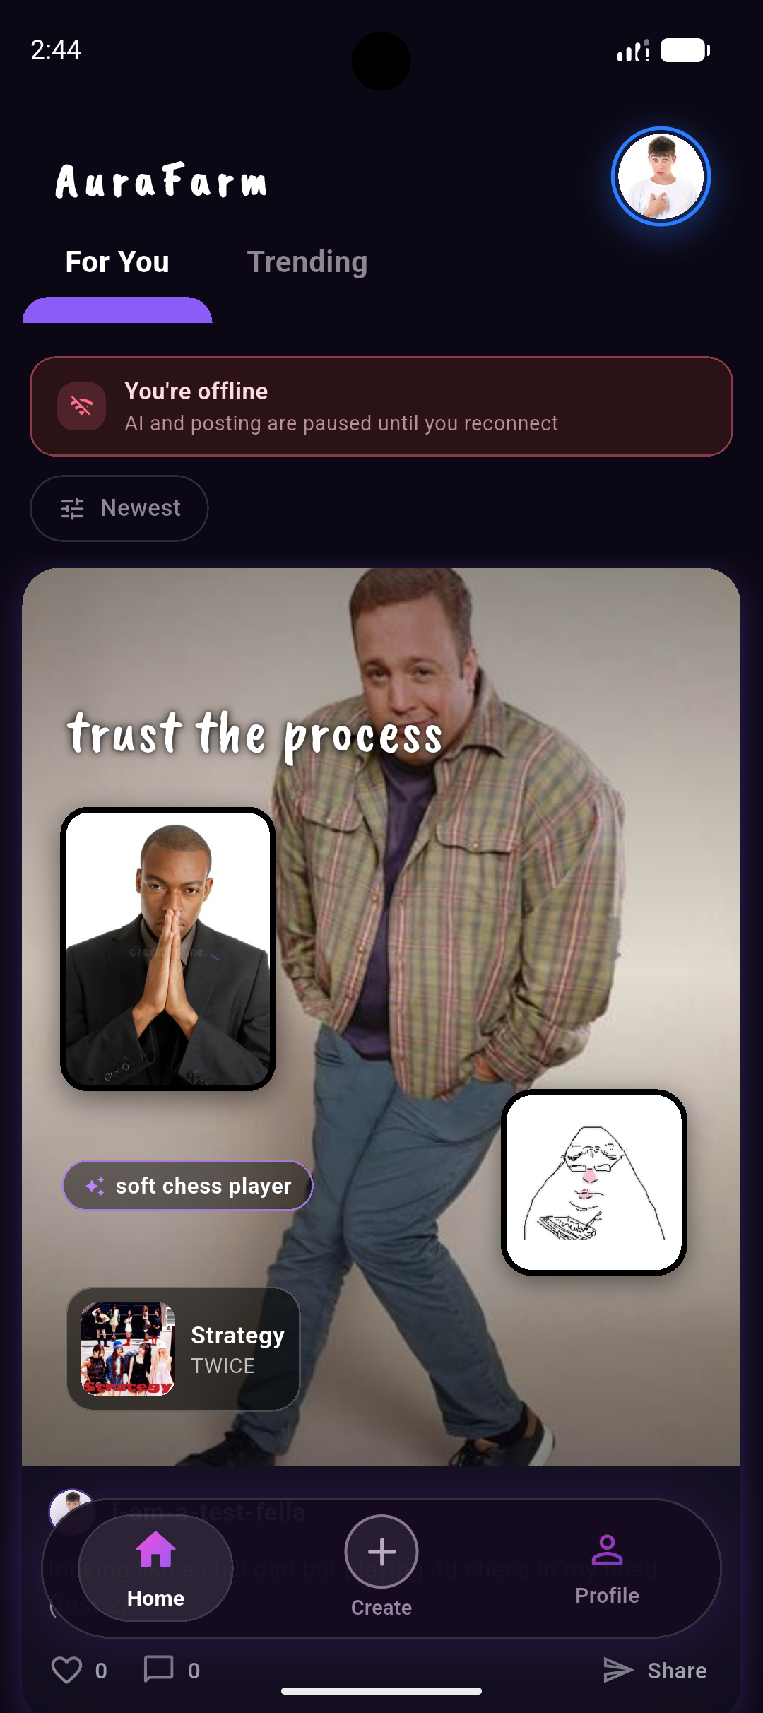
Reliable evidence depends on data, validation and feedback
Meaningful records
Varied users, vibes, public states, timestamps and like totals make every query observable.
Every input is validated
Forms check required values and boundaries before Firebase or AI is called.
Feedback supports recovery
Inline errors, SnackBars, AlertDialogs, loading states and the offline banner explain what happened and what to do next.
Final evidence: prepared Firestore records + known results + visible validation states
AURAFARM • PART 3
07

Slide 8
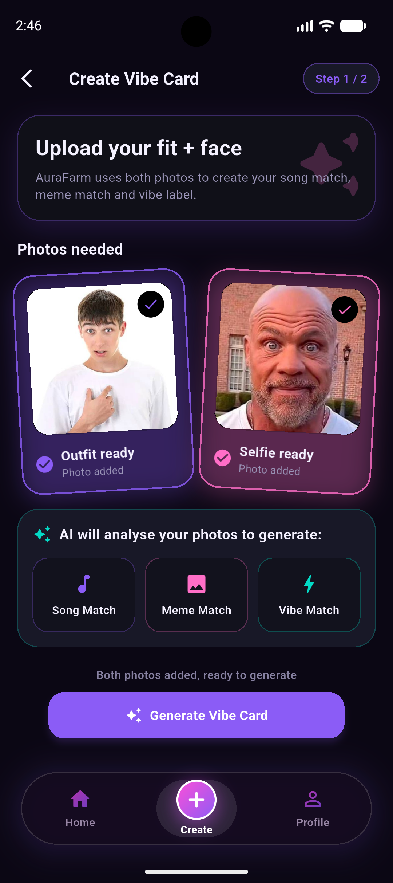
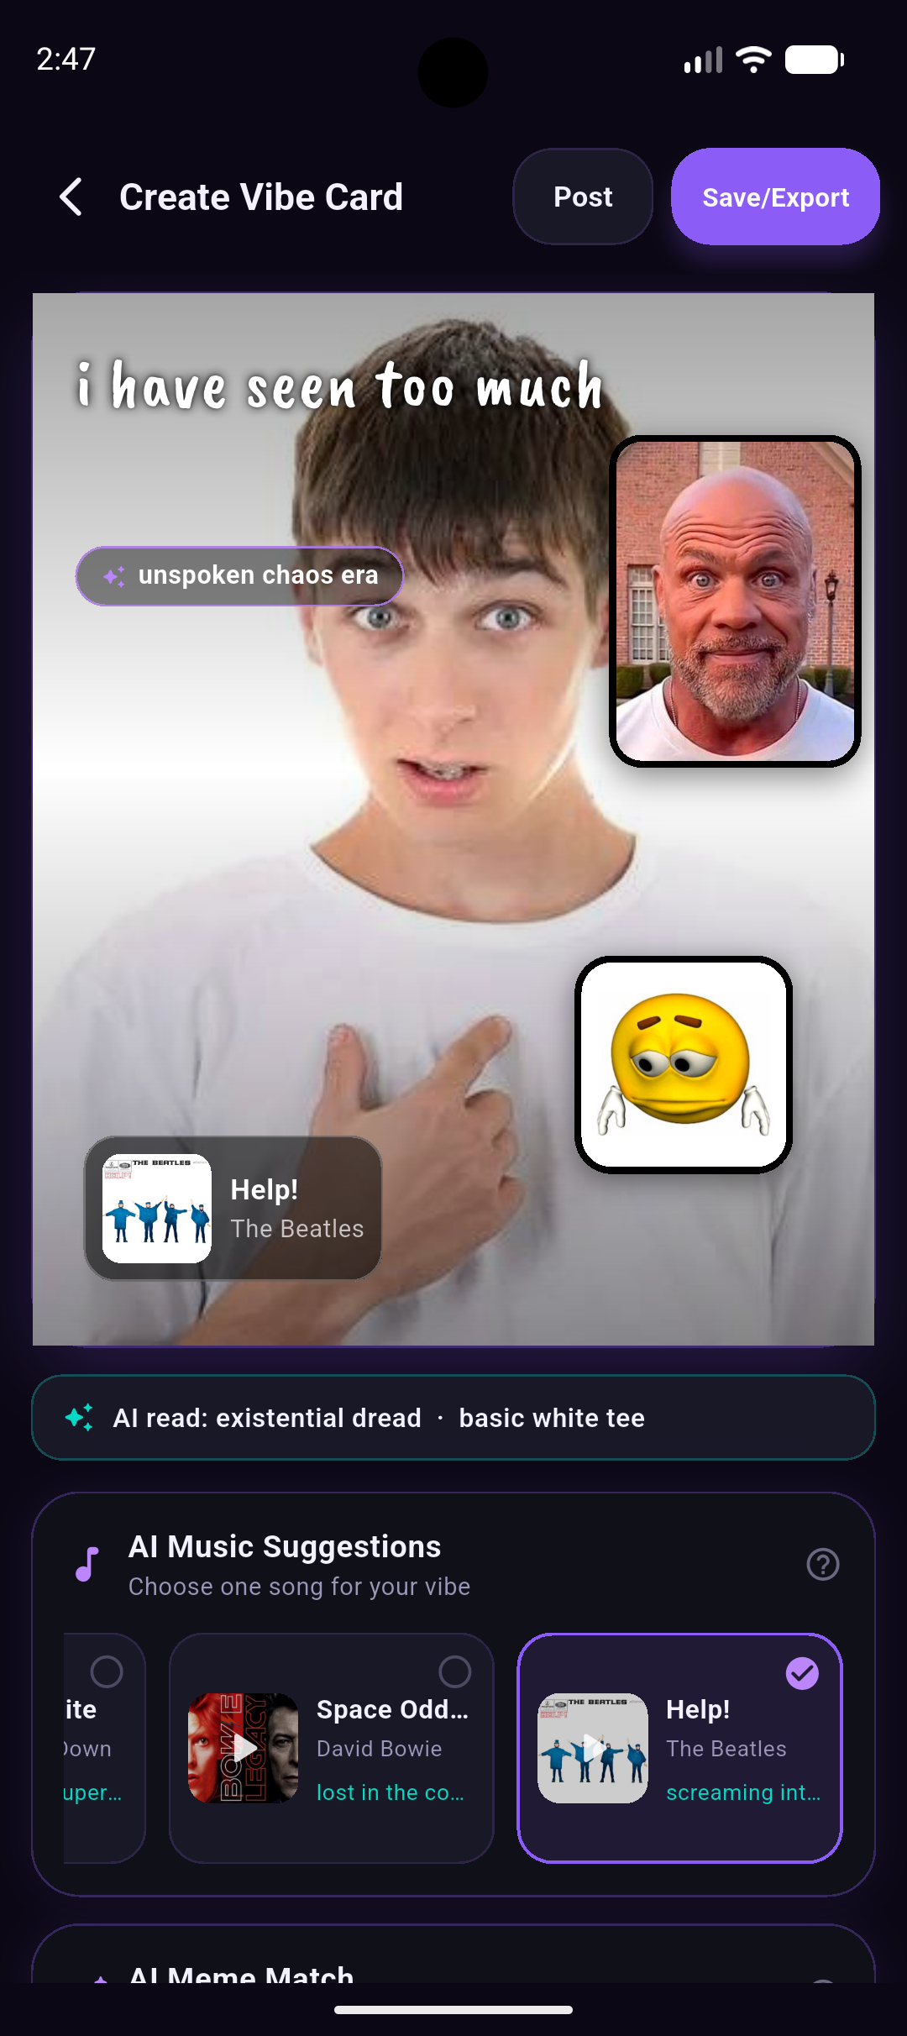
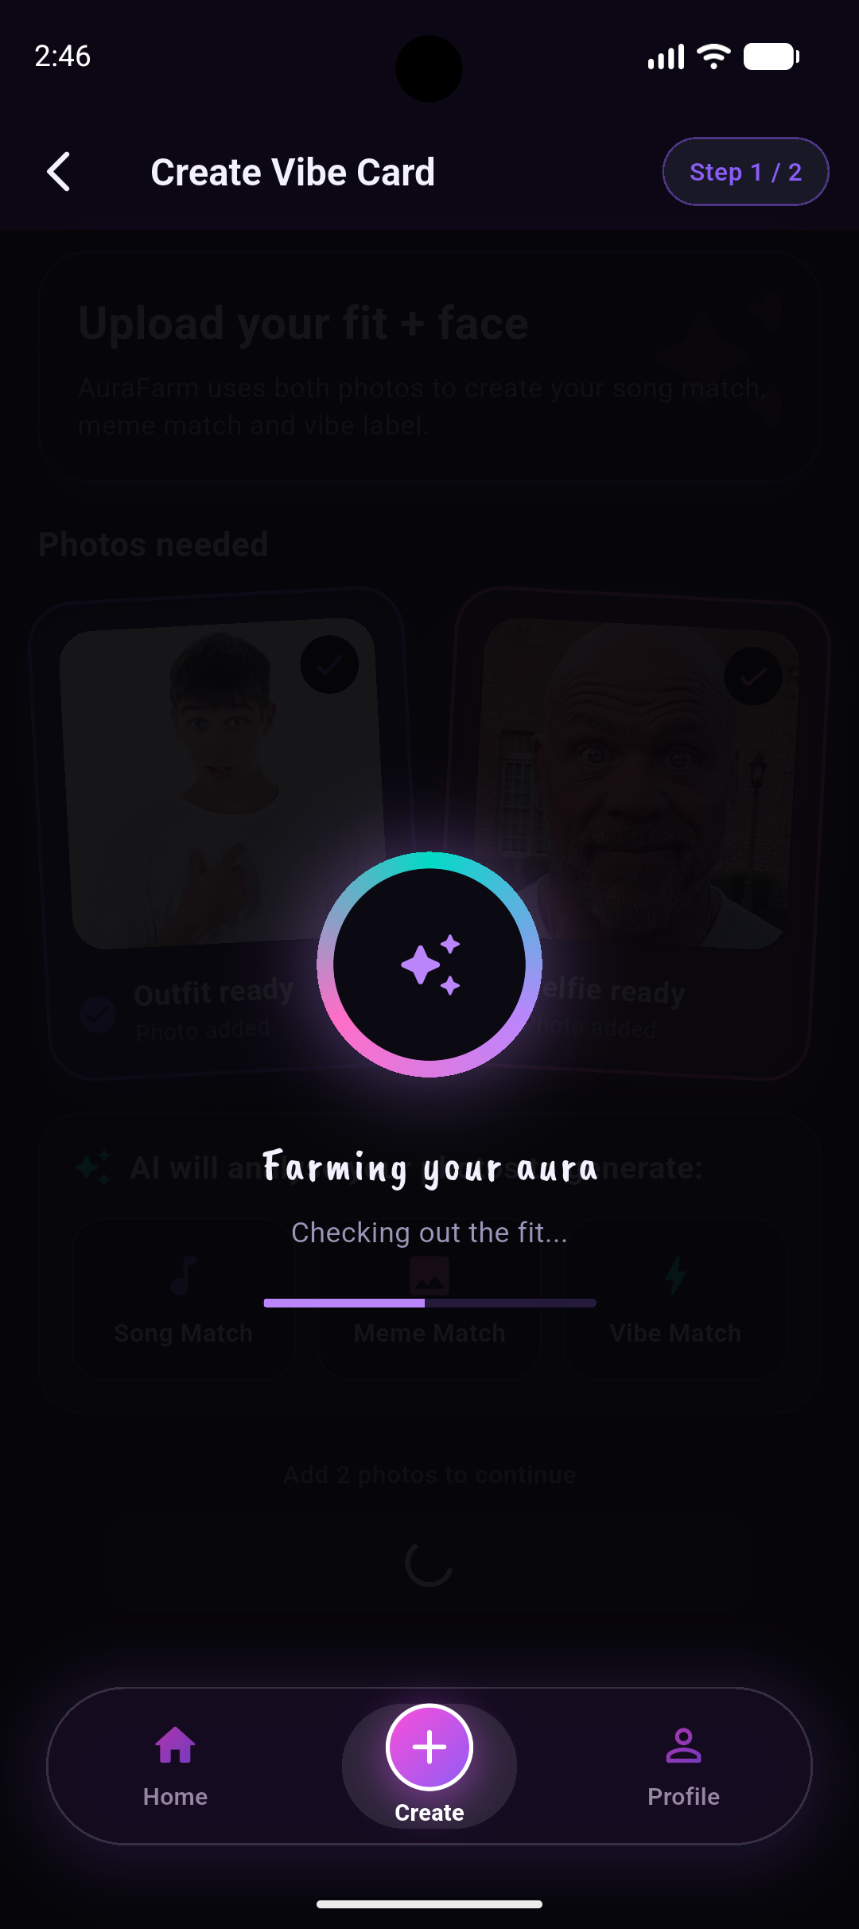
Applied AI drives the core creation workflow
A multimodal Gemini request returns structured, editable suggestions for the card.
Prompt-constrained category • Free-text expression label • User approves before storage
→
→
1 • Fit + face
2 • JSON suggestions
3 • User edits
AURAFARM • PART 3
08

Slide 9
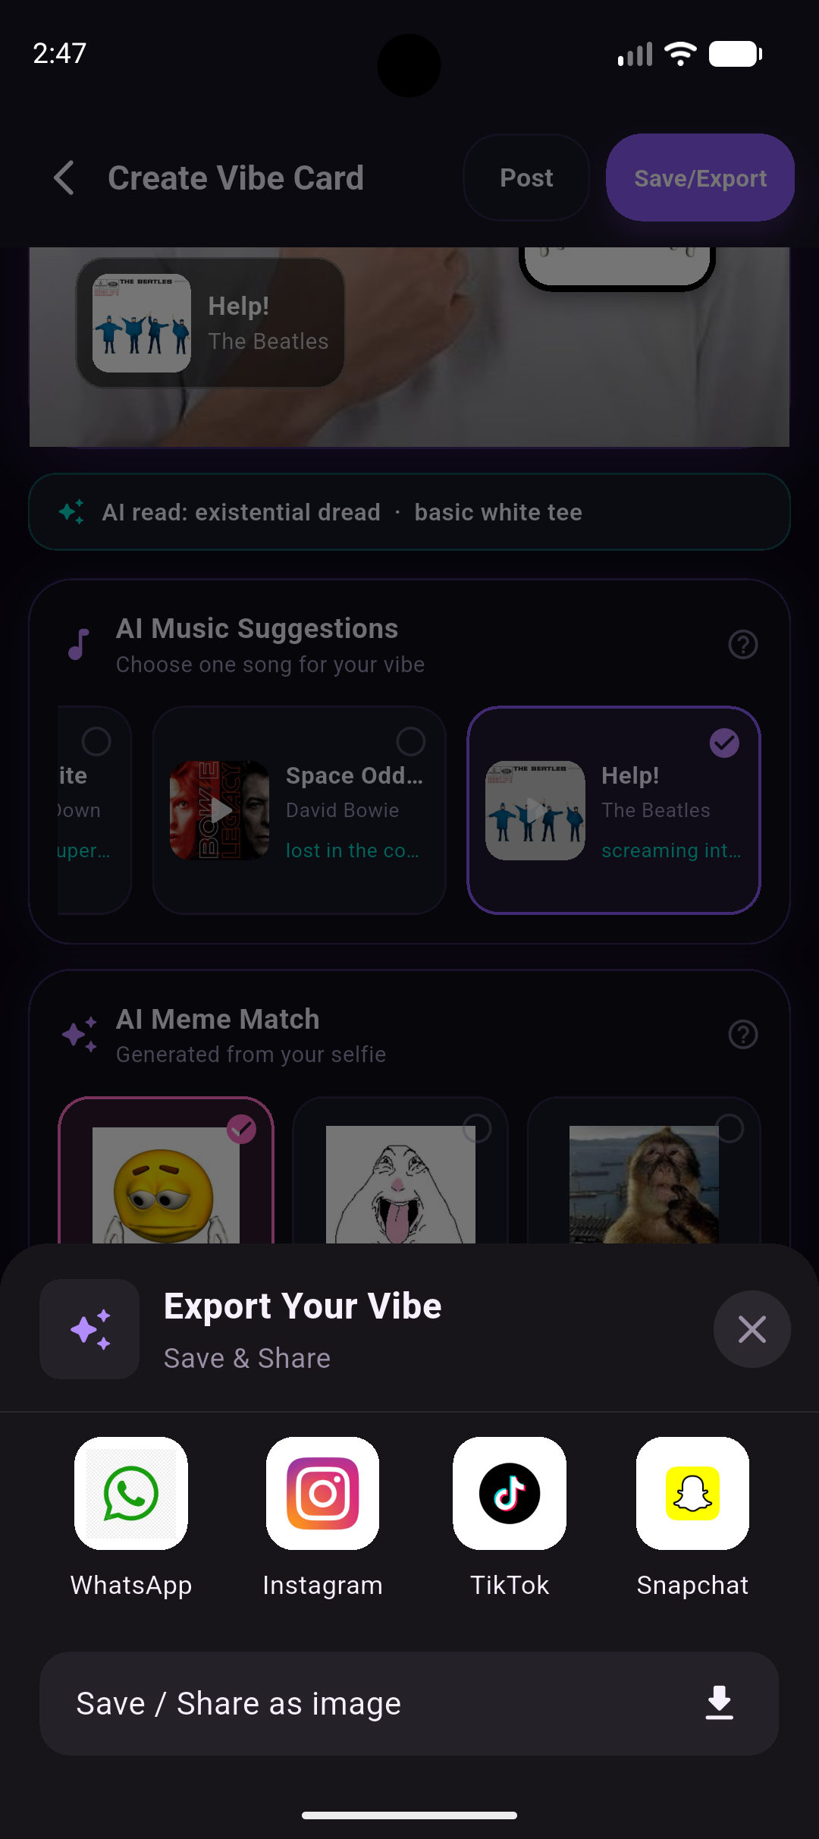
Four advanced and two simple additional features
Vibe Card export (advanced)
Biometric authentication (advanced)
The card is rendered into a single exportable image, then shared through the system sheet or saved to the device.
local_auth gates the remembered Firebase session; device PIN remains an accessible fallback.
Offline handling (advanced)
Song preview playback (advanced)
A connectivity stream blocks AI generation and posting before the call, rather than letting them fail.
One shared just_audio player with play, stop and state kept in sync across screens.
Web service consumption (simple)
Camera and gallery access (simple)
The iTunes Search API returns album artwork and a 30-second clip, verified against the artist name.
image_picker supplies both source photos and the profile picture, resized as they are picked.
The spec classifies web service consumption and camera access as simple; the other four are device or render capabilities.
AURAFARM • PART 3
09

Slide 10
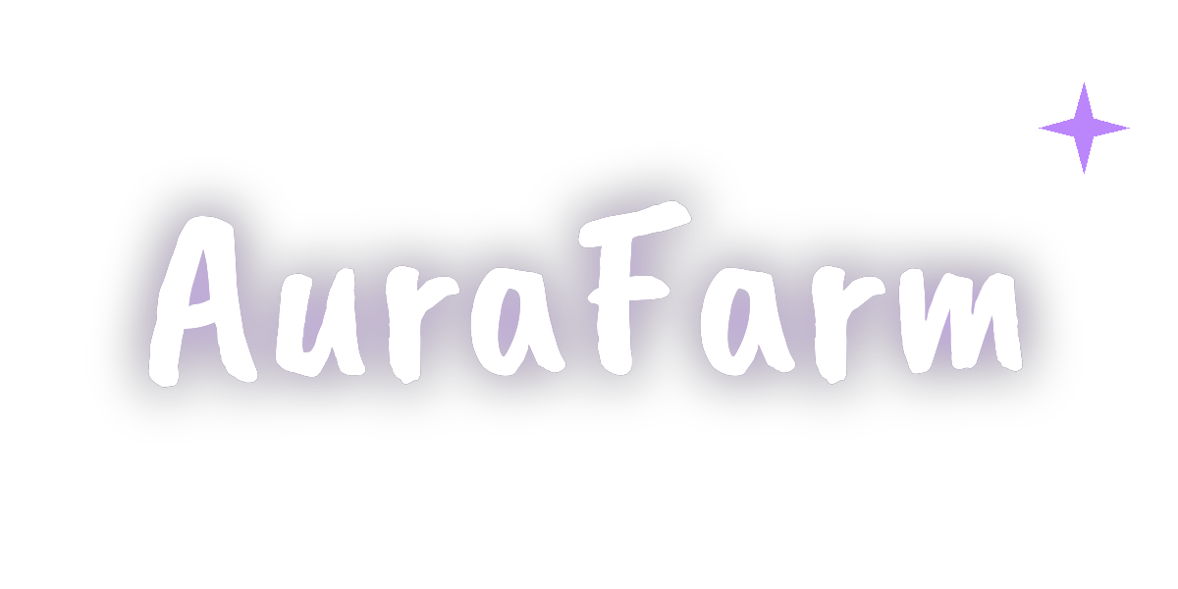
Personalisation supports a focused market position
Named comparison
Canva
Broad AI photo editing and template-led design.
TikTok
Sound-led creation and social publishing.
AuraFarm
Outfit + expression → editable vibe card with song and meme suggestions.
Target + return loop
Custom icon + splash
Students and young adults, 15–25
Create → personalise → share → discover → return
Five persisted palettes
Neon Purple • Hot Pink • Cyber Cyan
Golden Hour • Ice Blue
Future Aura+: optional premium themes, layouts and exports; trusted payment verification remains server-side future work.
AURAFARM • PART 3
10

Slide 11
Implementation Decisions
Cards keep their parts, not a flat picture
Photos as base64 in Firestore
Eight proposed tables became one collection
A card stores the two photos, where each overlay sits, the song and the meme, and is composed again every time it is drawn. That is why editing a card changes the card itself and it stores less than the flattened image it replaced.
The specification rules out paid services, and Mini-Project 9 states that Cloud Storage requires a Blaze plan. Both photos are compressed as they are picked, so a document stays well under the 1 MiB limit.
Firestore is document based and Part 3 grades one CRUD set, so song, meme and vibe live as fields on the post rather than as separate collections.
NETS QR was proposed in Part 1 when it was compulsory. Once optional, it was dropped: the specification classifies it as a simple additional feature, and four advanced ones were already implemented.
AURAFARM • PART 3
11

Slide 12
AuraFarm Video Demo
Video demonstration • maximum 5 minutes
https://youtu.be/ePYmI5uU8bU
Demo goes through all parts of the app, additional features and CRUD
AURAFARM • PART 3
12

