Slide 1
Salarycalc
$
Developer Salary Estimator
A Streamlit machine learning web app that estimates annual developer compensation from real survey profiles
3-minute investor pitch
Regression model
Real dataset
Profile → Prediction
Leon Jr Chua · 2500593E
Machine Learning for Developers (CAI2C08)
Notes:
Hi, I'm Leon. My project is Salarycalc, a developer salary estimator. The idea is simple: turn real survey data into a usable web app that helps developers understand what their profile may be worth in the market.

Slide 2
PROBLEM & DATASET
01
Salary decisions need evidence, not guessing.
DATASET FUNNEL
Developers often compare salaries using vague online averages. Salarycalc turns profile details into a personalised salary benchmark.
Raw survey
49,191
Employed
33,750
49,191
17,650
Salary present
19,500
Raw Stack Overflow survey rows
Final modelling records after cleaning
$10k–$500k
17,679
USD salary
Regression
Final records
17,650
Target variable
ML task
Why this matters
•
Salary expectations affect job choice, negotiation and career planning.
•
A numeric estimate is more useful than broad salary bands.
Notes:
The problem is that developers often need salary evidence, especially when comparing roles or offers. My dataset is the 2025 Stack Overflow Developer Survey. It starts with 49,191 respondents and after filtering for employed developers with usable salary and experience data, I modelled 17,650 records. Since the target is yearly compensation in USD, this is a regression problem.

Slide 3
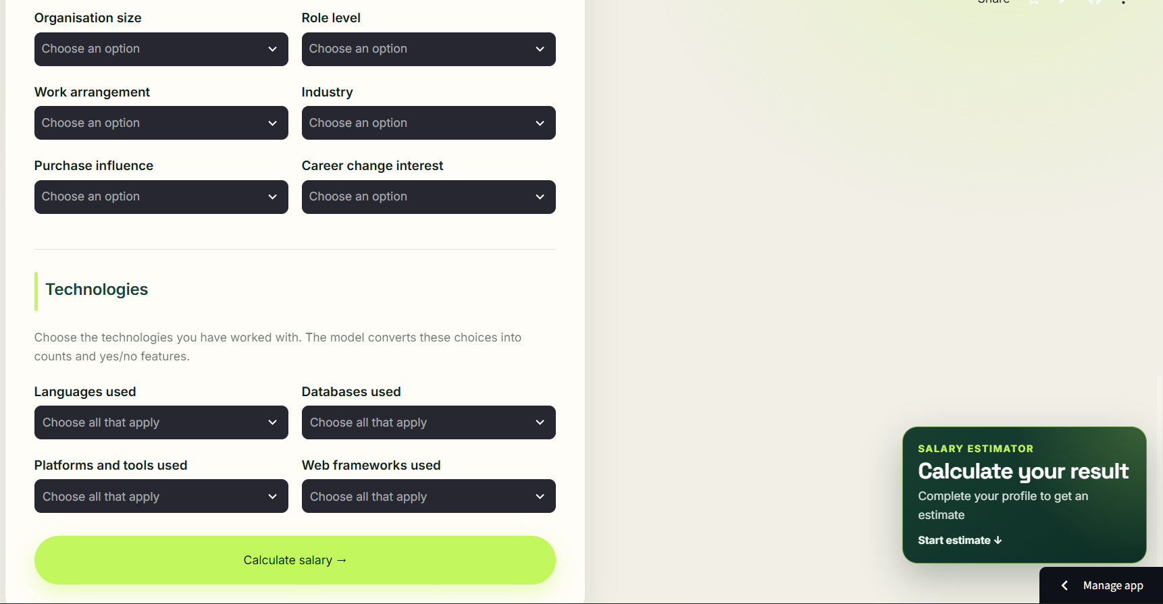
WEB APP DEMONSTRATION
02
The app turns a profile into a salary estimate.
DEMO FLOW
Use a real held-out survey profile for the demo.
Prefill the fields before presenting so the live demo is quick, realistic and does not waste time typing.
1
Profile inputs
country, experience, role, education, tech stack
2
Click Calculate
model processes the exact saved feature pipeline
3
Output
estimated annual salary + experience curve
Live demo target: 20 seconds

Slide 4
KEY APPROACH
03
The model was selected on evidence, not preference.
I compared multiple algorithms on the same split, then tuned the strongest candidates using RandomizedSearchCV.
PROCESSING CHOICES
DEFAULT MODEL COMPARISON — TEST MAE
•
Cleaned salary scope to $10k–$500k to reduce extreme reporting noise.
Linear Reg.
$30,301
•
Engineered technology counts and flags instead of unstable full multi-hot combinations.
Random Forest
$30,540
•
Excluded CompTotal to avoid direct salary leakage.
Grad. Boosting
$30,600
•
Kept preprocessing consistent between notebook and Streamlit app.
Decision Tree
$43,727
PCA rejected
Classification rejected
MAE-focused tuning kept
Why Gradient Boosting moved forward
Linear Regression was the best untuned model, but ensembles had more room to improve after tuning.
Notes:
For the approach, I focused on evidence. The task is regression, and I used MAE because the error is measured directly in dollars. I cleaned unrealistic salary values, engineered technology counts and key yes-no flags, and removed CompTotal because it would leak the answer. I compared linear regression, random forest, gradient boosting and decision tree. Linear regression was actually strongest before tuning, but I tuned ensembles to see if they could beat it. PCA and classification were tested but rejected because they did not serve the app goal as well.

Slide 5
RESULTS & BUSINESS IMPACT
04
Final model lowers the typical dollar error.
$27,974
$28,332
−7.7%
Final test MAE
Training CV MAE
Improvement vs Linear Regression
Like-for-like comparison on the same split
MAE is the main metric because users understand “off by about $X” better than abstract regression scores.
Linear Regression
$30,301
Tuned Gradient Boosting
$27,974
Business interpretation
•
Helps developers form realistic salary expectations.
•
Supports career planning and offer evaluation.
•
Gives evidence without pretending to be an exact salary truth.
Notes:
The final model is Gradient Boosting tuned for MAE. Its test MAE is 27,974 dollars, compared with 30,301 for the linear regression baseline on the same split, which is a 7.7 percent improvement. The cross-validation MAE is also very close to the test MAE, so the result looks consistent rather than lucky. For the business problem, this means the app gives users a more useful salary benchmark in understandable dollar terms.

Slide 6
CONCLUSION & NEXT STEPS
05
Useful as a decision-support tool — with honest limits.
Salarycalc does not tell a developer exactly what they should earn. It gives them evidence to make a better career decision.
WHERE IT WORKS BEST
MAIN DRIVERS
$50k–$250k
Country: USA
0.204
Most reliable in common salary ranges represented well in the survey.
WorkExp
0.128
YearsCode
0.065
Limitations
•
Self-reported survey data is not the whole developer market.
Next step
USD conversion does not adjust for tax or cost of living.
Add country-specific salary normalisation or richer seniority/company data, so the estimate better reflects local labour markets.
•
Closing: evidence for better salary decisions
Notes:
To conclude, Salarycalc is a decision-support tool. It is most useful in common salary ranges from about 50,000 to 250,000 dollars, and the most important drivers are country and experience. I am also clear about its limits: the survey is self-reported, and USD salary does not fully account for cost of living or tax. The next improvement would be country-specific normalisation and richer seniority or company features.

Slide 7
SOURCES
References
Dataset and project artefacts
•
Stack Overflow. (2025). Annual Developer Survey results. Public survey dataset used for Salarycalc.
•
Submitted project artefacts: salary_5.2.ipynb, salary_5.2.pkl and salary_app_5.2.py.
•
Streamlit Community Cloud deployment and GitHub repository listed in the submitted Word document.
AI use note
•
Generative AI was used to help prepare pitch slide wording and layout.

