Slide 1
AnalyseTS
Automated stock watchlist monitoring and reporting robot
Robotic Process Automation (CAI2C01) · AY2026/2027 April Semester
Leon Jr Chua · 2500593E · Tutorial Group P02

Slide 2
THE BUSINESS CASE
Problem statement
Current scenario: done by hand
43 minutes becomes under 3
Open a stock site and search each symbol, one at a time
Read the latest price and percentage change off the page
Copy both figures into a spreadsheet without mistyping them
Work out the biggest gainer, biggest drop and overall movement
Build charts, write a short summary, and send it on
A full run capture, validation, dashboard, digest, report and delivery — completes in under 3 minutes with nobody present. That is about 40 minutes saved per update, and the same steps performed identically every time rather than differently by hand.
Why it needs automating
What the robot must do
Read only the stocks the user marked Include, capped at 10
Capture live figures without depending on the site's HTML
Validate every figure before it is used in a calculation
Explain the day in plain language, never as financial advice
Deliver the result, and say so clearly when something failed
Roughly 43 minutes per update for a 10-stock watchlist
Easy to copy a wrong price, miss a stock, or mis-calculate a percentage
IBM reports manual data entry error rates ranging from 0.55% to 26.9%
Prices move constantly, so a slow update is a less useful one
The judgement involved is simple and rule-based — ideal for a robot
AnalyseTS | Leon Jr Chua | 2500593E
1

Slide 3
END TO END
Process
1
Capture
Read the watchlist, open each quote page, and extract the figures with Get OCR Text
Excel + Chrome + OCR
2
Validate
Parse and check every row, mark it Valid or Needs Review, calculate the movement indicators
Python
3
Visualise
Render a dashboard of the run in the browser and capture it as an image
Streamlit
4
Summarise
Turn the validated figures into a plain-English digest, with a template fallback if it fails
ChatGPT
5
Deliver
Build an archived report, then send the update, the report and any alert to Discord
Word / PDF + Discord
2
Notes:
Walk the five stages top to bottom, naming the application at each. The key point is that no single stage failing takes the run down with it.

Slide 4
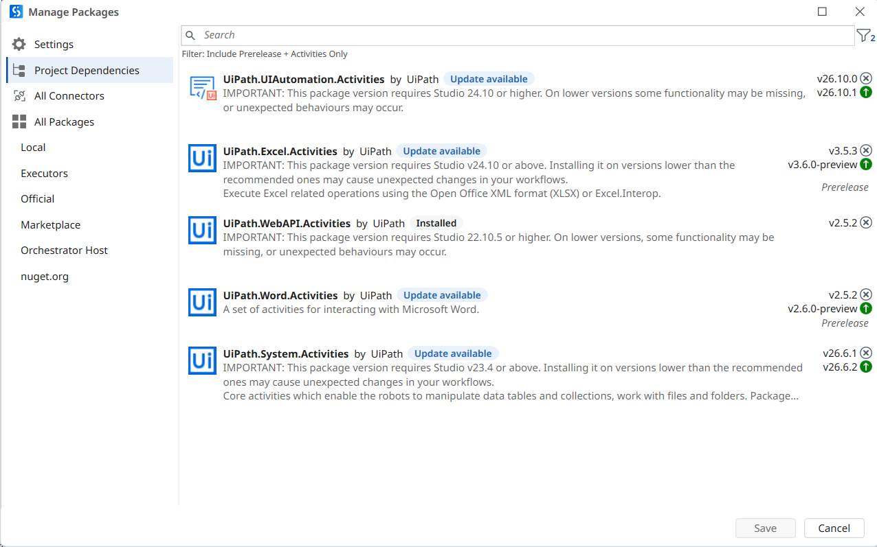
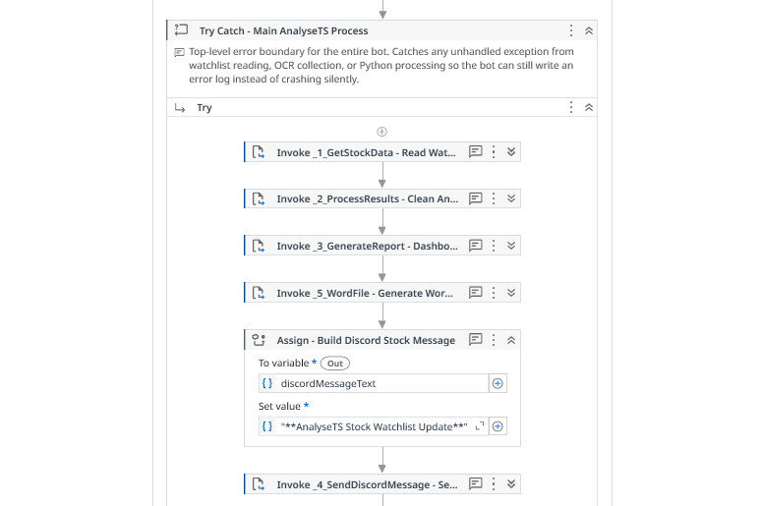
FIVE PACKAGES USED
Packages (project dependencies)
UiPath.Excel.Activities
3.5.3
Use Excel File, Read Range
UiPath.System.Activities
26.6.1
Start Process, Log Message, Delay, Write/Read Text File, Write/Read CSV, Set/Get Clipboard, Multiple Assign, Create Folder, Delete — plus Get Asset, Get Queue Item and Set Transaction Status, Kill Process
UiPath.UIAutomation.Activities
26.10.0
Open Browser, Navigate To, Get OCR Text, App Card, Check App State, Send Hotkey, Click, Take Screenshot, Save Image, Close Tab.
UiPath.WebAPI.Activities
2.5.2
HTTP Request — the Discord webhook POST
Studio → Manage Packages → Project Dependencies
UiPath.Word.Activities
2.5.2
Word Application Scope, Append Text, Add Picture, Export to PDF
Main.xaml — the five Invoke Workflow File activities
AnalyseTS | Leon Jr Chua | 2500593E
3

Slide 5
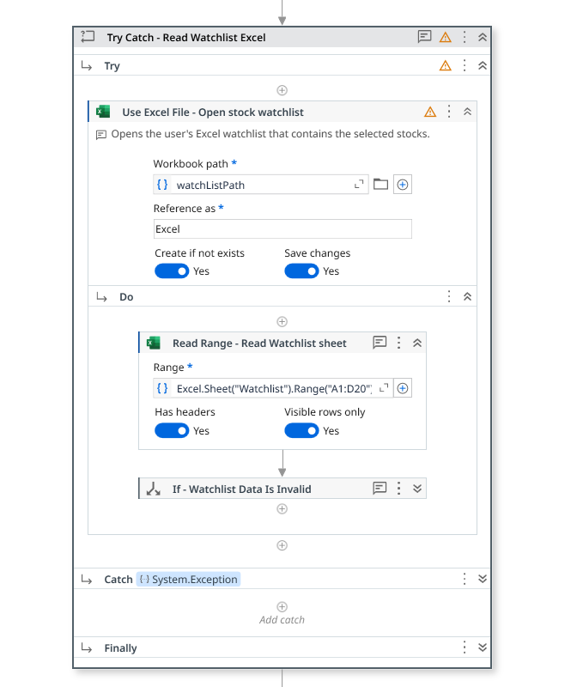
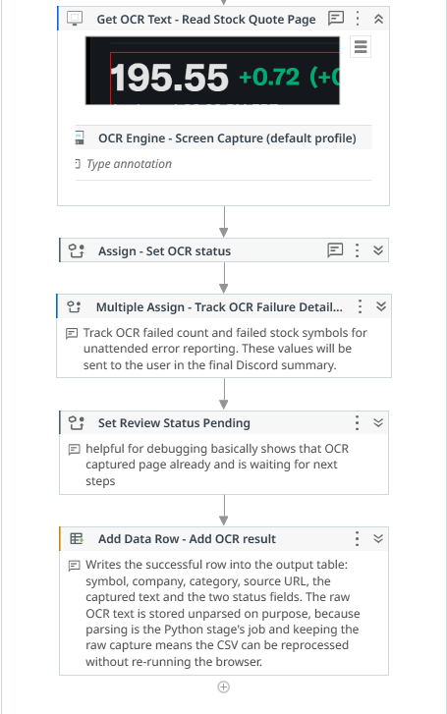
SOLUTION 1 OF 4
Capture — watchlist and OCR
Activities used
Use Excel File — opens the user's watchlist workbook
Read Range — reads the Watchlist sheet into a DataTable
If — fails early if the sheet is empty or missing a column
Open Browser — launches Chrome on the quote site
For Each Row — iterates every watchlist entry
If ×2 — skips rows not marked Include, stops at the 10-stock cap
Navigate To — loads that symbol's quote page
Get OCR Text — reads the rendered figures off the page
Add Data Row — records the result, successful or failed
Close Tab / Write CSV — tidies up and saves the raw capture
A failed stock leaves a record, not a gap
The Try Catch sits inside the loop rather than around it, so one dead page fails only its own stock, and the failed row is still written with the exception as its reason.
Use Excel File and Read Range, inside their own Try Catch
Four failures means stop trusting the run
Four or more OCR failures suggests something systemic, so the run writes a [CRITICAL] line and the Discord message escalates to an urgent alert.
Get OCR Text reading a live quote page — the captured price shows in the activity itself
AnalyseTS | Leon Jr Chua | 2500593E
4

Slide 6
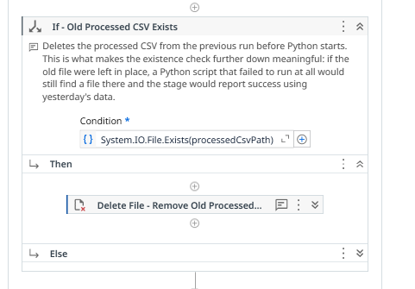
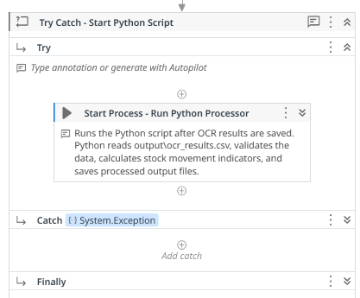
SOLUTION 2 OF 4
Validation — Python processing
Activities used
If / Delete — removes the previous run's processed CSV
Start Process — runs scripts/process_ocr_results.py
Delay — waits for the detached process to finish
If — verifies the output exists and is not empty
Throw — stops the run when it does not
Try Catch ×2, nested — launch failure and processing failure
Rethrow / Log Message — passes the cause up to Main
If - Old Processed CSV Exists → Delete File
Try Catch - Start Python Script
What the Python script does
Deleting the old file first is what makes the check mean anything
Parses price, daily change and percent change from the raw OCR text
Marks every row Valid or Needs Review
Calculates gainer, drop, mover and mood from Valid rows only
Writes the run-wide summary onto row 0 of the processed CSV
If yesterday's CSV were left in place, a Python script that never ran at all would still find a file on disk, and the stage would report success on stale data. The same pattern guards the dashboard screenshot and the error log.
Two nested handlers, because there are two faults
Python failing to launch usually means it is not on PATH. Python running but producing nothing is a different problem with a different fix.
AnalyseTS | Leon Jr Chua | 2500593E
5

Slide 7
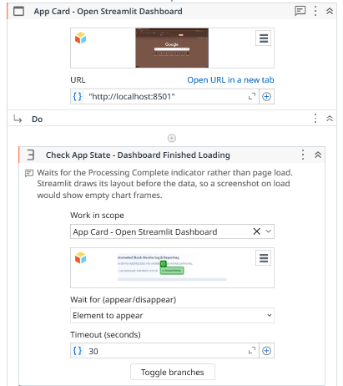
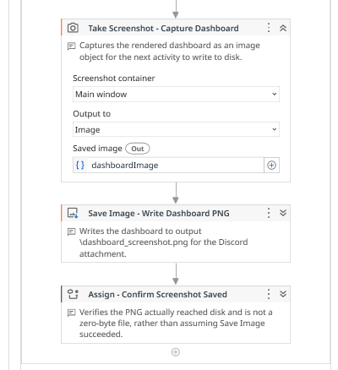
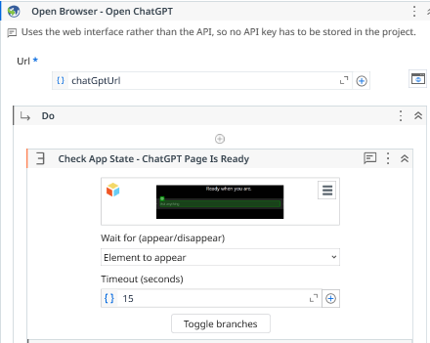
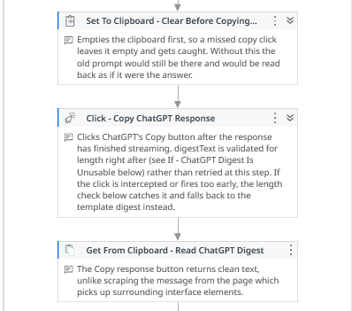
SOLUTION 3 OF 4
Dashboard and digest — Streamlit and ChatGPT
Activities used
Start Process — launches Streamlit headless on port 8501
App Card — attaches to the dashboard in Chrome
Check App State — waits for the completion indicator
Send Hotkey ×5 — resets zoom, then zooms out to fit the page
Take Screenshot / Save Image — captures the dashboard as PNG
Kill Process — stops the Streamlit server
Set To Clipboard — stages the prompt built from validated figures
Click / Send Hotkey — pastes and submits it to ChatGPT
Get From Clipboard — reads the copied response back
If / Throw — rejects a response under 40 characters
App Card → Check App State on the ready indicator
Take Screenshot → Save Image → verify it reached disk
Capturing a page that is not ready yet
Streamlit renders its layout before its data, so a screenshot on load captures empty chart frames, Check App State waits on a completion indicator instead. Ctrl+0 also resets zoom first, because Chrome remembers it per site and every run was shrinking the capture.
The digest can fail and the run still succeeds
Under 40 characters means the copy caught the model mid-generation. The stage falls back to a template digest built from the same validated figures, so the user always receives real numbers, and the message states which source was used.
Open Browser → Check App State — ChatGPT page is ready
Clipboard cleared, then Copy response and read back
AnalyseTS | Leon Jr Chua | 2500593E
6

Slide 8
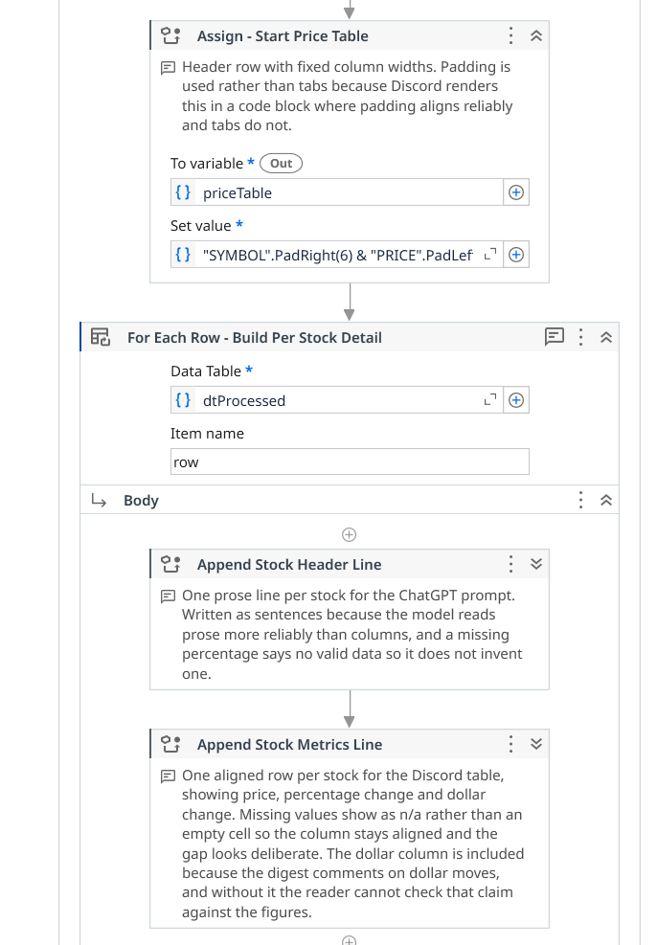
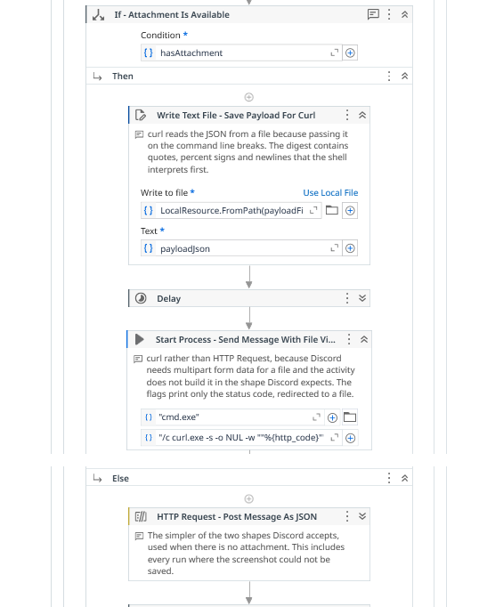
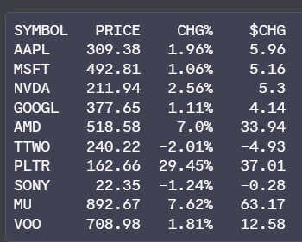
SOLUTION 4 OF 4
Delivery — building the message and sending it
Activities used
Discord needs two different requests
Assign — builds the table header with PadRight and PadLeft
For Each Row — appends one aligned row per stock, and one prose line for the ChatGPT prompt
Assign — wraps the table in a code block and joins it to the digest
HTTP Request — posts the message as JSON when there is no file
Write Text File / Start Process — writes the payload, sends it with curl
Read Text File — reads back the status code curl wrote
If — accepts 200 or 204 as success
Word Scope / Append Text / Add Picture / Export to PDF — archives the same content as a report
Text only is a JSON body and returns 204. With a file it must be multipart form data, which the HTTP Request activity does not build the way Discord expects, so curl is used instead, and returns 200. The check tests both.
The table goes above the digest on purpose
The sender truncates anything over Discord's 2000-character limit by cutting the end. Putting the figures first means an unusually long digest loses commentary, never data.
The delivered table. Columns aligned with PadRight and PadLeft, not tabs — Discord renders a code block in a monospaced font. Missing values show as n/a so the column stays aligned.
Assign - Start Price Table, then one aligned row per stock
If - Attachment Is Available: curl on one branch, HTTP Request on the other
AnalyseTS | Leon Jr Chua | 2500593E
7

Slide 9
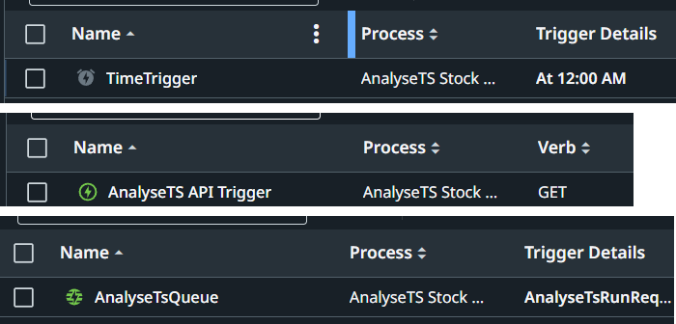
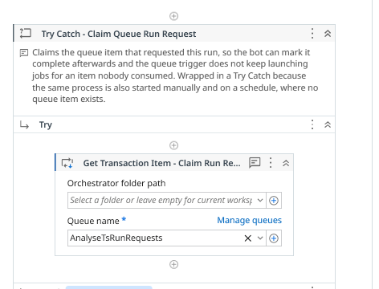
DEPLOYMENT
Orchestrator — running it unattended
Three ways the robot starts
Why not only a schedule?
Time trigger — a weekday close schedule, the routine path
API trigger — an authenticated HTTP endpoint, fired on demand
Queue trigger — for work that needs distributing or retrying
A schedule answers when. It cannot respond to a user who wants fresh data right now because something moved, and it cannot be started by another system. The schedule makes the process automated; the API makes it integrable. Most real deployments need both.
How it is wired
Get Queue Item claims the request; Set Transaction Status marks it Successful so the trigger stops re-firing
Get Asset reads the Discord webhook from Orchestrator, so the credential never sits in the project files
All three entry points are wrapped, so the same published process runs unchanged however it was started
Demonstrated from an iOS Shortcut, a device with no UiPath software on it, using nothing but an authenticated HTTP request
All three triggers in the Orchestrator folder
Get Transaction Item claims the queue request
Flaw with queue trigger
The queue item acts as a run request rather than carrying parameters. The next step is passing stock limit and category filter through its Specific Content.
AnalyseTS | Leon Jr Chua | 2500593E
8

Slide 10
DEMONSTRATION
Watch AnalyseTS run
https://youtu.be/p0aM_X8mZXg
The recording covers a full run end to end: the Excel watchlist and the Include filter, each quote page being read with OCR, Python marking rows Valid or Needs Review, the Streamlit dashboard rendering and being captured, the ChatGPT digest and its fallback, the Word and PDF report, and Discord receiving the update, the report and the run alert, started remotely through the API trigger.

Slide 11
References
IBM — Data quality issues, defined. https://www.ibm.com/think/insights/data-quality-issues (cited for manual data entry error rates of 0.55% to 26.9%)
OpenAI — ChatGPT. https://chatgpt.com/ (used by the robot to generate the stock update digest)
Yahoo Finance — public stock quote pages. https://finance.yahoo.com/ (the robot's data source)
UiPath Documentation — Activities guide. https://docs.uipath.com/activities
UiPath Documentation — Orchestrator triggers and assets. https://docs.uipath.com/orchestrator
Streamlit — Streamlit documentation. https://docs.streamlit.io/
Discord — Webhook Resource, Developer Portal. https://discord.com/developers/docs/resources/webhook

