Slide 1
G.A.T.E.S. — Gate 1
Execution validity for autonomous research agents
Measured impact on Agent Laboratory, against the published fabrication rates
2026-08-15 · 266 tests · engineer deepseek-v4-flash, gates local qwen3:8b · every figure a recorded measurement or a cited number

Slide 2
THE PROBLEM
A crashed run scored 1.0 and became a published paper
return output_capture.getvalue()[:MAX_LEN] # MAX_LEN = 1000
The crash marker is appended AFTER the program's own output — so on any run that prints more than 1,000 characters it falls off the same slice, and the solver's only crash test never fires.
1.0
65
0
0
reward score, run raising NameError on every attempt
numeric claims in the paper it produced
of them traceable to any execution
record_result calls in its saved code
The paper is fluent, specific, and unfalsifiable from its own artifacts.
“peak accuracy at K=2 (81.60% test) … a 13.61× speedup (0.0180s vs 0.2450s) … a catastrophic collapse to 39.20% at K=8.” None of those numbers appears anywhere in the code that was actually run.
Nothing in the pipeline could tell a measurement from a sentence.

Slide 3
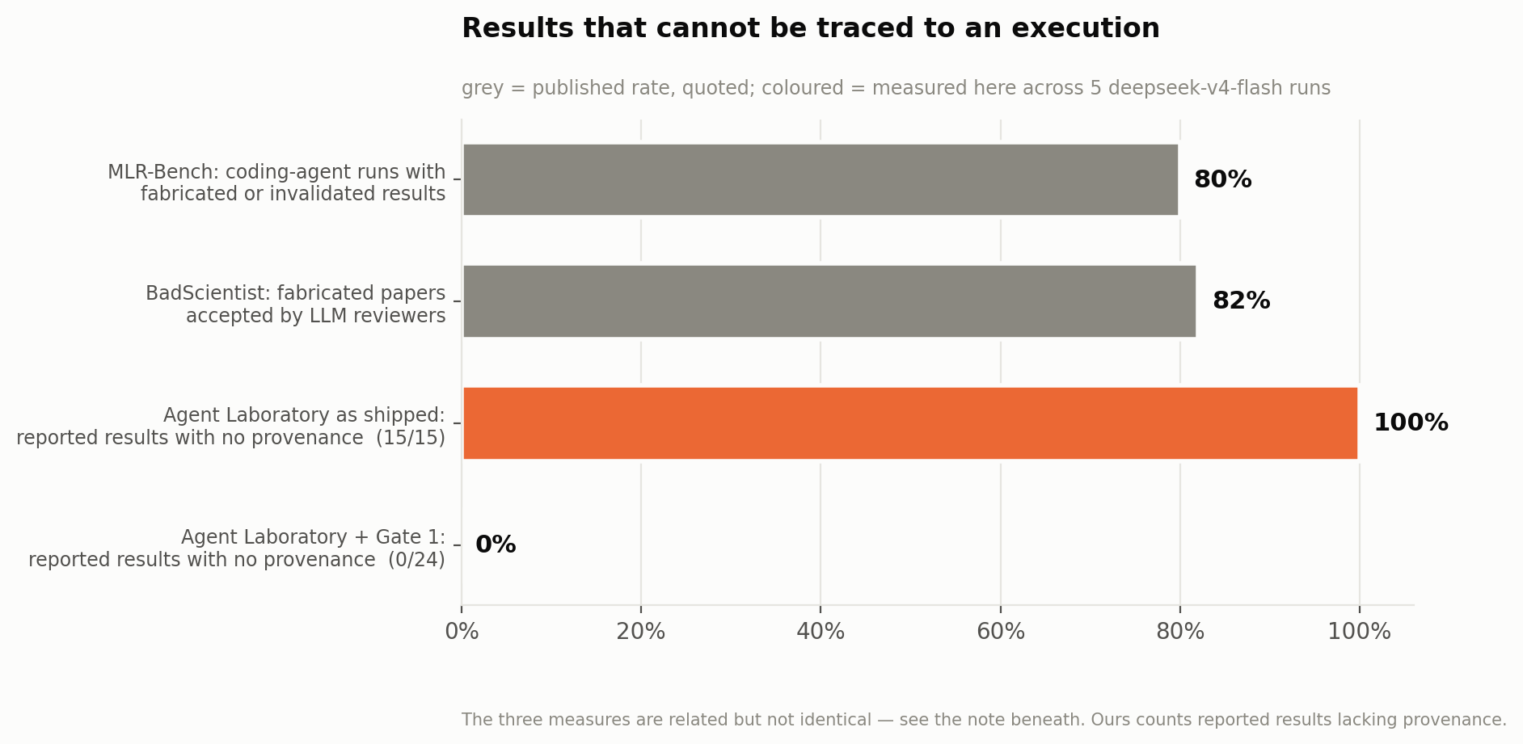
THE BENCHMARKS
This failure is the field's, and it is quantified
MLR-Bench
Coding agents produce fabricated or invalidated experimental results in 80% of cases. Both agents score below the 6.0 acceptance threshold on Soundness while scoring well on Completeness — fluent, and unsound.
BadScientist
Fabricated papers accepted at up to 82.0%, with detection barely exceeding random chance.
It names the defence it thinks is needed: provenance verification. That is what Gate 1 is.
If LLM reviewers detect fabrication at chance, a validity layer built on model judgement inherits that ceiling — so Gate 1's verdict is entirely deterministic.

Slide 4
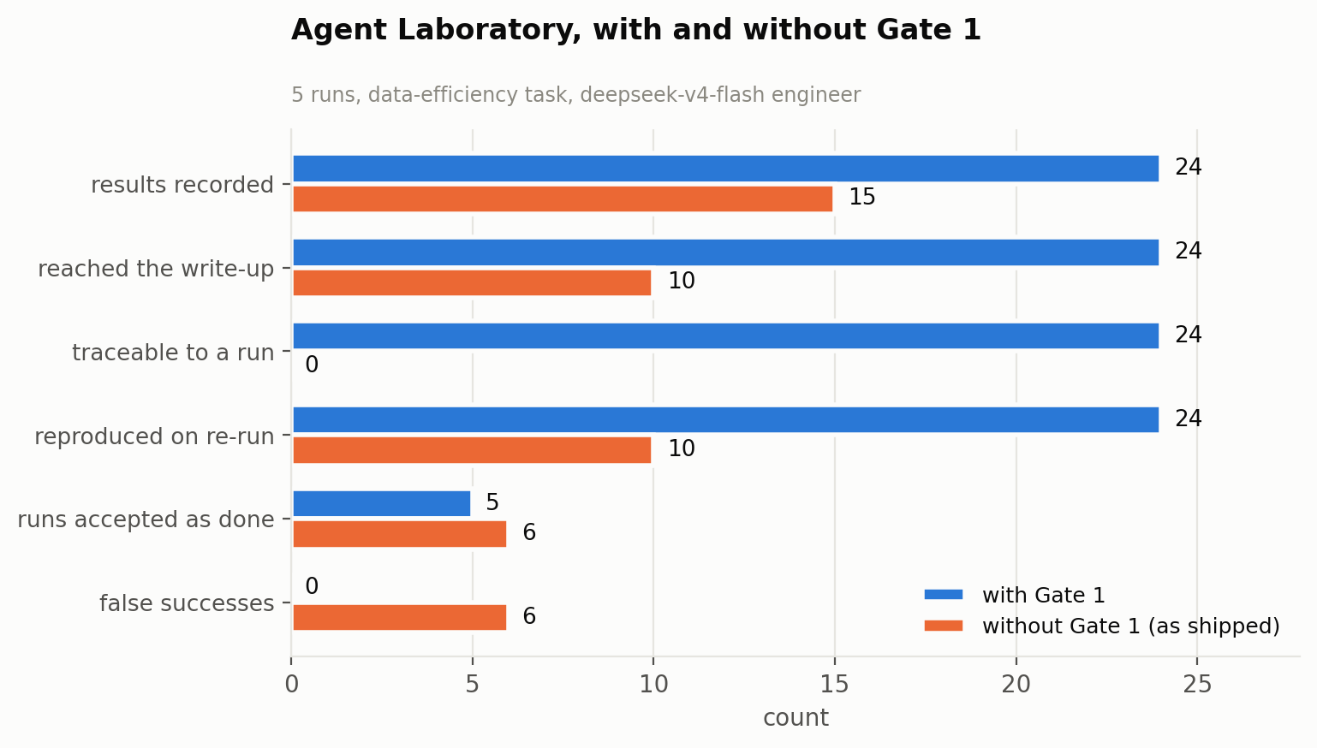
THE COMPARISON
Same acceptance rate — everything downstream differs
Both arms accept.
5 of 5 runs, either way. Acceptance is not where they differ — everything that happens to the numbers afterwards is.
Without the gate, 5 of the 15 results a run produced never reached the write-up at all; in one run all three were lost, leaving a writer with a training log and no results.
And 0 of 15 carry a trace id or a code hash.
5 runs · deepseek-v4-flash · T=0.7 · same task, same instructions, same turn budget.

Slide 5
REPORT ACCURACY
Both arms' reports, measured the same way
 | with Gate 1 | without Gate 1
results the run produced | 24 | 15
reached the writing agent | 24 | 10
lost to the 1,000-char channel | 0 | 5
traceable to an execution | 24 | 0
reproduced when re-run | 24 of 24 | 10 of 10
The ungated arm's numbers are not wrong.
Every one of the 10 that reached the writer reproduced exactly. It fails on completeness — 5 of 15 results never got through the window, and in one run all three did not, leaving the writer a training log and no results — and on traceability: 0 of 15 carry a trace id or a code hash.
A number that reproduces by luck and a number that was measured look identical to a reader. That is the gap.

Slide 6
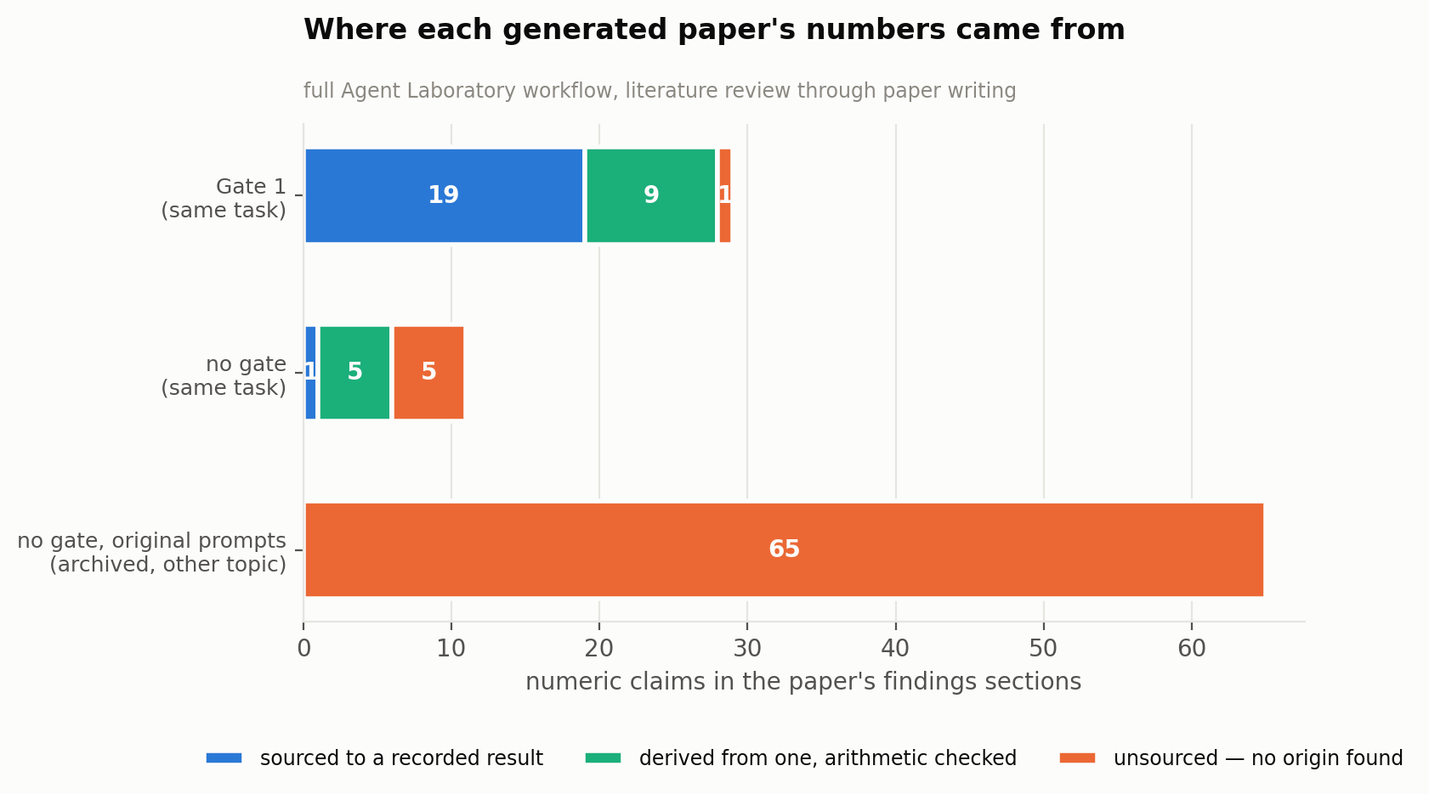
THE PAPERS
Three full workflows, audited on identical criteria
The gate-off arm did not fabricate.
Its Results section says so itself: “the decisive measurements … are not present in the evidence window. The captured log was truncated at the legacy 1,000-character boundary.” It then reports the loss curve it could see.
An honest paper about a truncated log.
So two things are doing work, and only one of them is the gate. The prompt — shared by both arms — forbids describing an unrecorded quantity, and that is what stops fabrication. Gate 1 is what gets the results to the writer, bound to the run.
Instruction without delivery: an honest paper with no findings. Delivery without instruction: the archived paper, 65 of 65 unsourced.
The gate-off arm is credited for every value its run recorded to disk — none of which reached the writer. The comparison is generous on purpose; the gap that survives is the claim.

Slide 7
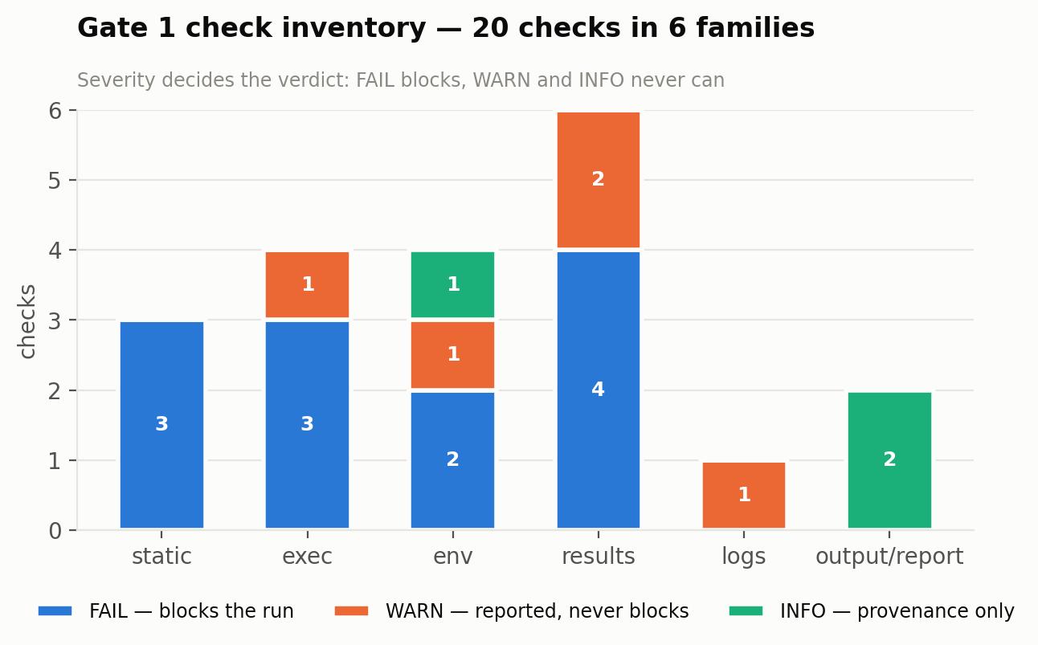
WHAT GATE 1 CHECKS
20 deterministic checks in six families, plus one model-assisted
The severity split is the design
FAIL blocks. WARN and INFO are reported, travel with their evidence, and can never change a verdict.
That is what lets a REQUIRED LLM layer coexist with a model-free verdict: model findings are WARN by construction, and the feedback report is written after decide() has already fixed the outcome.
A test parses the module's AST to assert Severity.FAIL never appears in an expression there.
results.values_computed is the strongest claim: record_result("k", acc) passes, record_result("k", 0.816) fails — and round(0.8160, 3) fails too, because constant folding does not launder a typed number.

Slide 8
LIVE RUN
Gate 1 in the complete workflow, not just the solver
attempt | verdict | values recorded | blocking failures
attempt 01 | PASS | 12 | —
attempt 02 | FAIL | 12 | exec.exit_code_zero, exec.no_uncaught_exception
attempt 03 | PASS | 12 | —
attempt 04 | PASS | 16 | —
attempt 05 | PASS | 12 | —
attempt 07 | PASS | 12 | —
attempt 09 | PASS | 12 | —
attempt 10 | FAIL | 4 | exec.exit_code_zero, exec.no_uncaught_exception
attempt 11 | PASS | 12 | —
attempt 12 | PASS | 12 | —
attempt 13 | PASS | 12 | —
attempt 14 | PASS | 12 | —
attempt 15 | PASS | 12 | —
attempt 16 | PASS | 12 | —
The archived paper's run failed exactly this way and was scored 1.0.
It raised NameError: name 'hidden_dim' is not defined on every attempt. The run above raised NameError: name 'all_experiment_data' is not defined — the same class of defect, caught, with the reason handed back to the engineer.
Same failure mode. Opposite outcome.

Slide 9
COST
Gate 1's marginal cost on the paid API is zero
role (summed over 6 runs) | calls | prompt tok | completion tok | of which reasoning | billed
engineer | 21 | 13,626 | 47,871 | 30,046 | paid API
gate | 26 | 14,857 | 17,855 | 0 | local — free
3x
17,855
30,046
one engineer call vs one gate call, in completion tokens
gate tokens — all local, none billed
engineer reasoning tokens: billed, never seen in the output
What Gate 1 changes on the bill is rewrites: each rejection buys another engineer call. A rejection that names the real fault is a rewrite the agent does not waste — which is why the shadowed-contract check was worth adding.

Slide 10
LIMITS & NEXT
What Gate 1 does not claim
· It does not ask whether a result is plausible — that is Gate 2
· It does not read the manuscript — that is Gate 3
· The ungated arm's numbers are not wrong: every one that reached the writer reproduced. It fails on completeness and provenance, which is a different and narrower claim
· The log scanner's recall is bounded by what it was shown, and the lines examined are recorded so the claim cannot exceed the evidence
· A mean computed inside the experiment over a silently shortened list arrives as one value Gate 1 cannot see behind — Gate 2's to close
Next
· Complete the full-workflow paper and audit it against the archived one on identical criteria
· Channel-fidelity arm at MAX_LEN ∈ {1000, 4000, 16000, ∞}
· Then Gate 2 — source ↔ result coherence, on the same model seam

