Slide 1
Kaiyue summer student
Continuing work of characterising properties of suction cups
Investigating possible secretions on suction efficiency

Slide 2
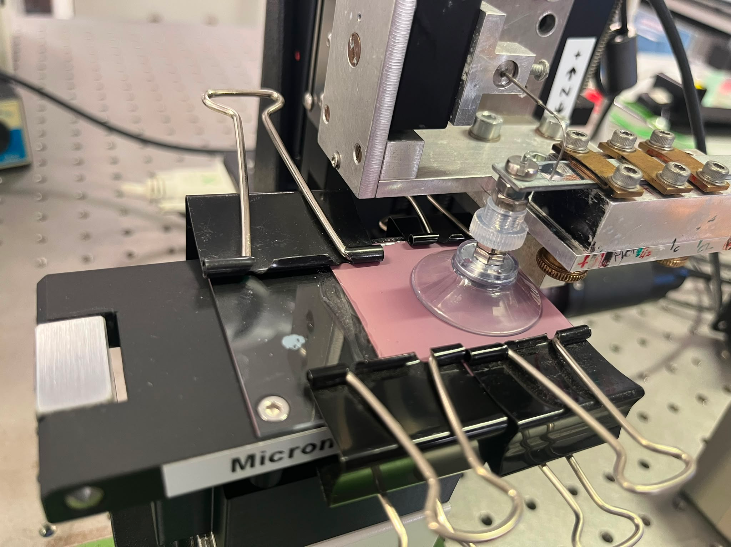
Suction cups
Physical model for passive suction seen in beetle setae
Using the custom force setup allows keeping other variables constant
Measuring hold time (time till detachment)

Slide 3
Hold times
Hold displacement
Hold force (force feedback)

Slide 4
Preload displacement
Smooth glass
PMMC=0.950, p<0.05
0.5 micron substrate
PMMC = 0.921, p>0.05
Positive correlation likely due to higher force forcing out more air and creating a stronger seal

Slide 5
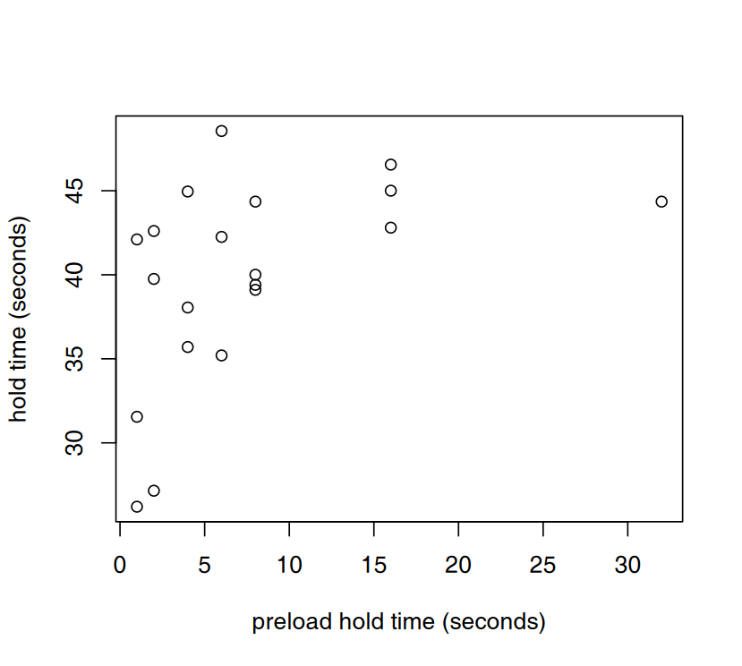
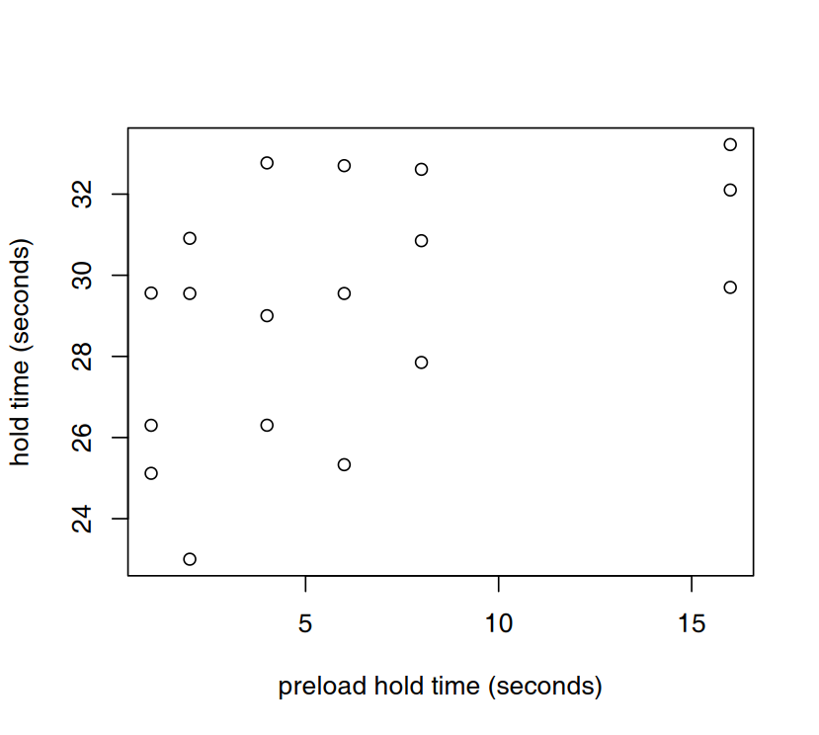
Preload hold time
Smooth glass
PMMC=0.477, p<0.05
0.5 micron substrate
PMMC = 0.493, p>0.05
Very weak positive correlation as more air is forced out, seems to plateau

Slide 6
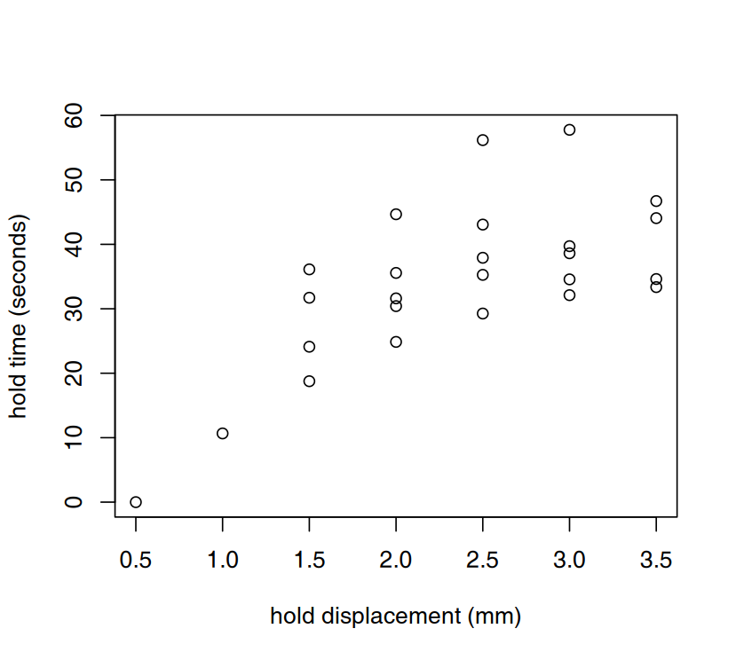
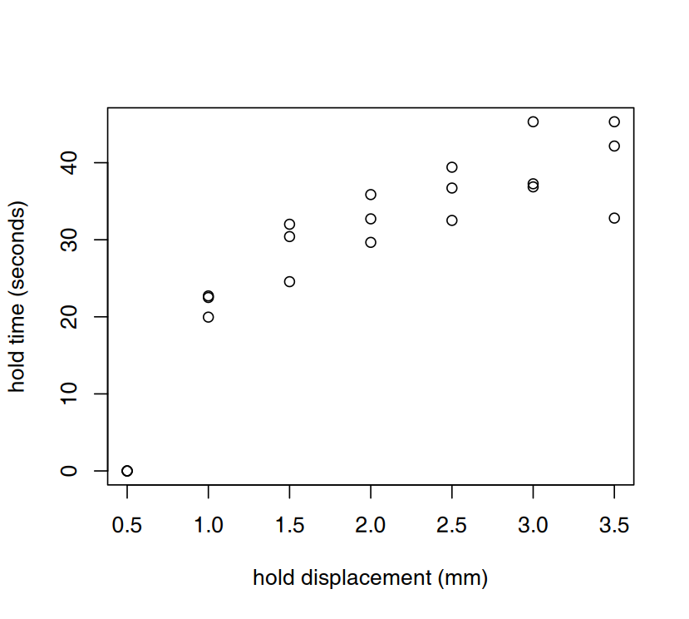
Hold displacement
Smooth glass
PMMC=0.684, p<0.05
0.5 micron substrate
PMMC = 0.869, p>0.05
Positive correlation as greater displacement increases internal pressure

Slide 7
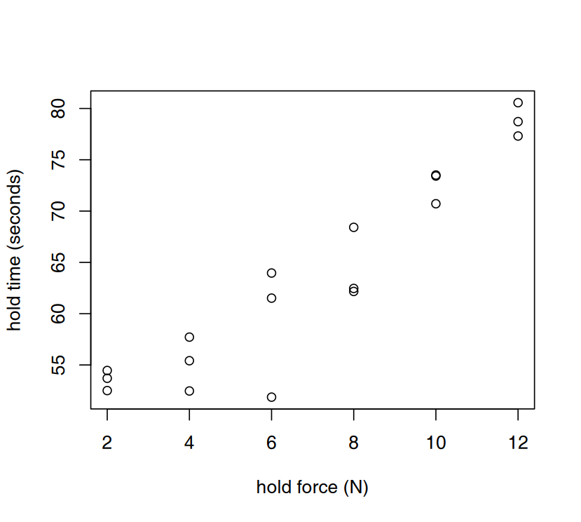
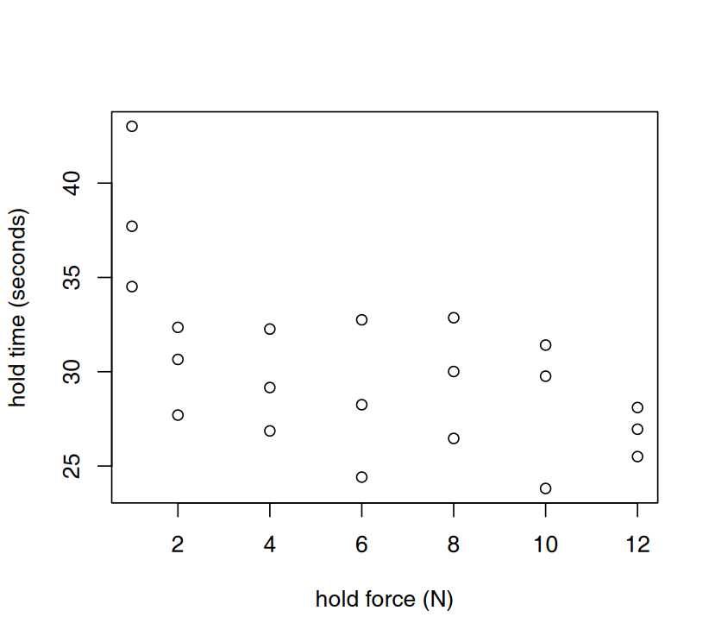
Hold force
Smooth glass
PMMC=0.938, p<0.05
0.5 micron substrate
PMMC = -0.579, p>0.05
Reverse trend seen...

Slide 8
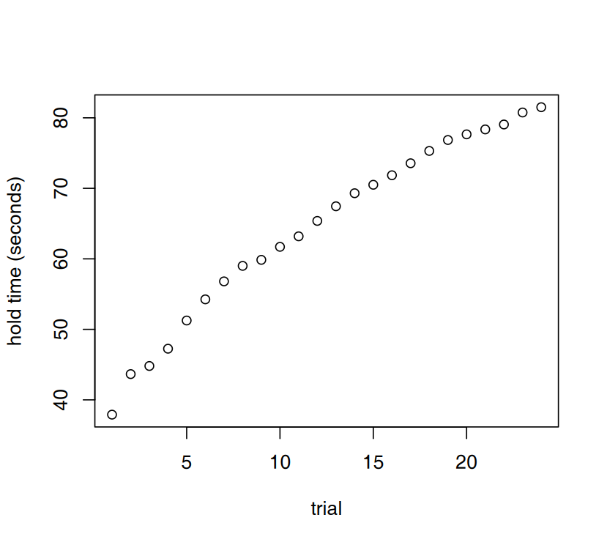
Viscoelasticity

Slide 9
Footprint staining
Staining with Fast Green FCF and Alcian Blue
Fast Green FCF did not show much but not expected to since it binds histones and shows DNA (mucus sample)
Alcian Blue showed results but have only

Slide 10
Footprint collection
Footprint collection is a fiddly process

Slide 11
Underwater
Non-newtonian fluid (fluid with yield stress)

