Slide 1
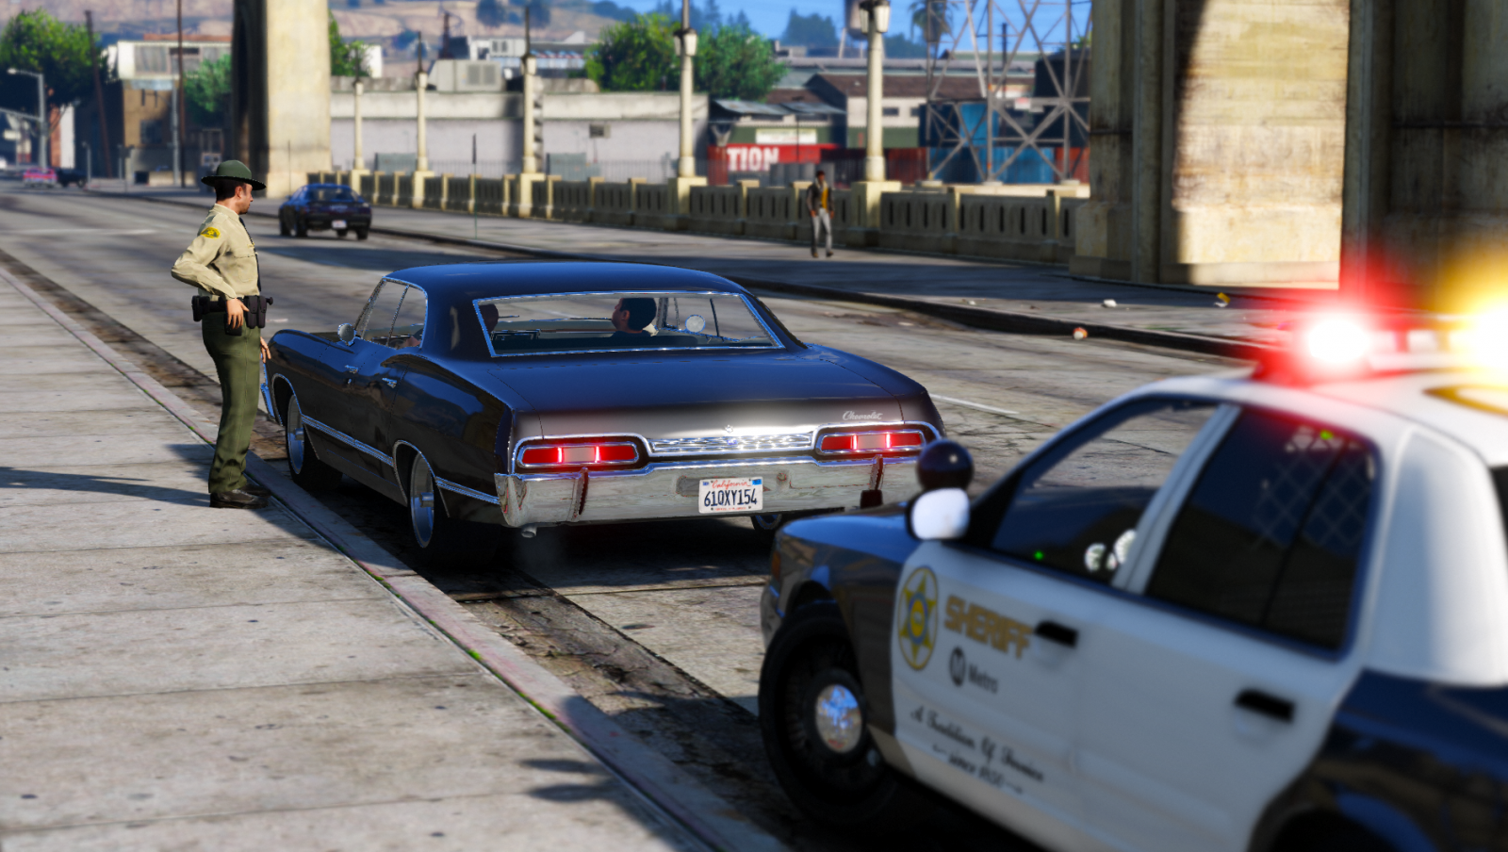
IS THERE RACIAL PROFILING IN CHARLOTTE?
Hunter Lamb, Wyatt Wilt, Anna Zechel

Slide 2
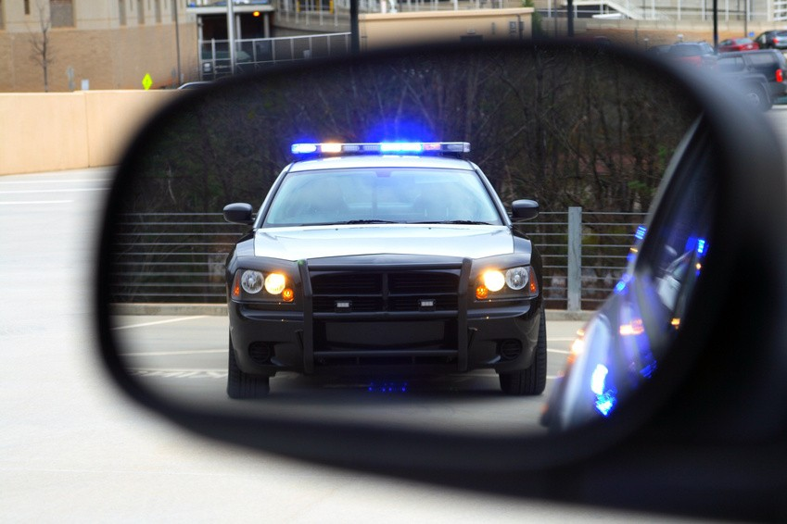
THE DATA
THE WHY
With everything going on, from race-motivated police brutality to Colin Kaepernick, we wanted to examine for ourselves how race is related to police traffic stops in our own area.
We used a dataset from data.gov (sorry RC we’re boring) that showed detailed information about every traffic stop.

Slide 3
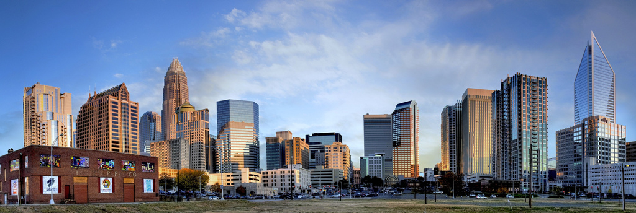
EXPLORATORY ANALYSIS
35%
55%
Of the population in Charlotte is black.
Of drivers stopped in Charlotte were black.
The proportions by race of drivers stopped don’t reflect the racial demographics of Charlotte. Our t-tests showed that the difference is significant.

Slide 4
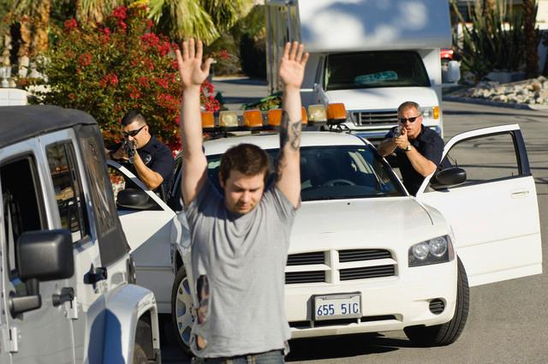
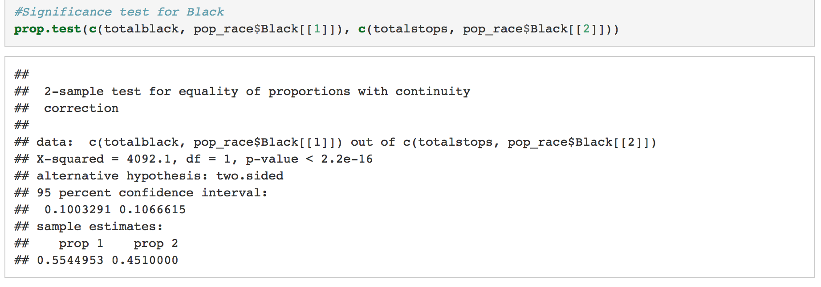
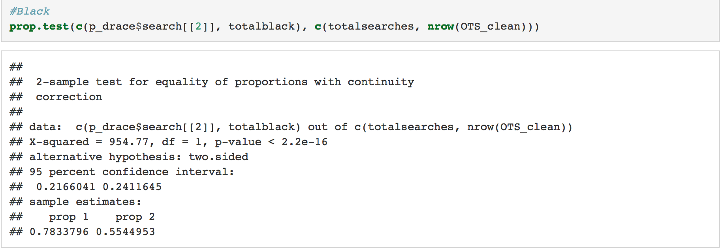
FINAL ANALYSIS

Slide 5
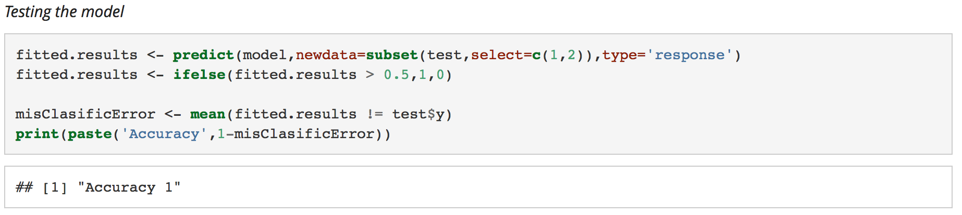
FINAL ANALYSIS

Slide 6
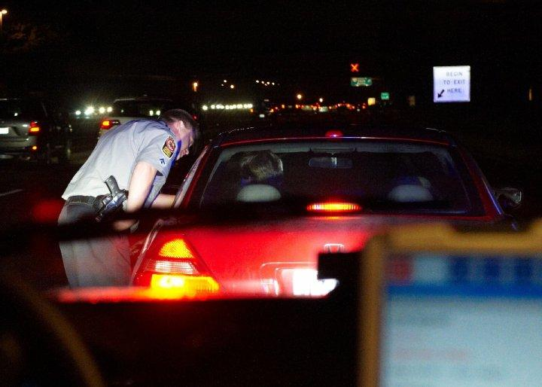
IMPLICATIONS
Our results confirm the conclusions of other research.
Race is disproportionately a factor in traffic stops.
This is especially true for segregated cities like Charlotte.

Slide 7
THANK YOU

