Slide 1
b
_
BLACKOUT
PROTOCOL
Your main account
is gone.
Can your team recover?
DEFENCE CHALLENGE / 2026
Notes:
0:00–0:20. BLACKOUT PROTOCOL helps small teams prepare for losing access to a shared account. Our question is simple: if the main account disappears, can the organisation still work? This presentation shows implemented features using illustrative Community Library data. Team names and member names are omitted at the user's request. Source: project README and docs/USER_GUIDE.md.

Slide 2
One account can stop essential work.
Small teams share access.
They need a way back.
Email unavailable
Shared files blocked
A recovery email that needs the lost
account is a dead end.
Website access blocked
Illustrative dependency chain
BLACKOUT PROTOCOL
2
Notes:
0:20–0:42. Think of a student club or volunteer organisation. Its files, website or channel may depend on the same email or person. Recovery can depend on that missing account too. BLACKOUT makes those declared connections visible before a real incident. This is a conditional problem, not a claim that every organisation has this setup. Source: agreed product purpose in docs/PROJECT_UPDATES.md and the Defence challenge brief. No market statistics or live provider discovery are claimed.

Slide 3
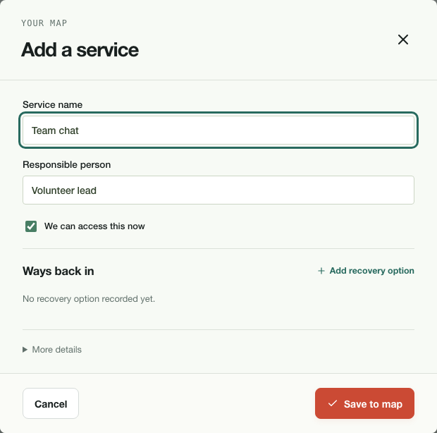
Start with the services your team uses.
One service
at a time.
Name the owner.
Record what access needs.
BLACKOUT PROTOCOL
3
Notes:
0:42–1:05. Add one service, its owner and any known recovery options. Details stay collapsed until needed. The app creates a map showing resources, accounts and essential work. Users supply their actual arrangements, or import a local Google Directory users.list export and review it. Unknown recovery methods remain unconfirmed. The screenshot shows the implemented direct editor using example data. Source: apps/web/planner/ServiceEditor.tsx and docs/USER_GUIDE.md. Screenshot: docs/screenshots/add-service.png.

Slide 4
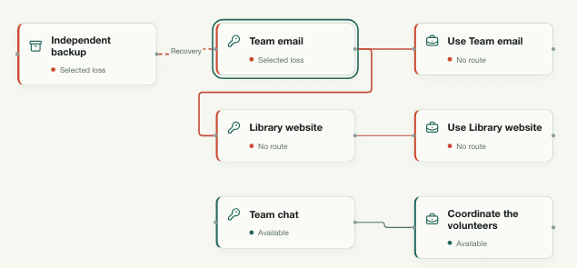
See what a loss would block.
1 / 3
activities still working
Example loss:
email + backup
Illustrative map • your accounts stay unchanged
BLACKOUT PROTOCOL
4
Notes:
1:05–1:30. Choose an unavailable account, phone, backup or person. The same map shows consequences for essential work, possible recovery routes and missing prerequisites. In this QA example, team email and its independent backup are both unavailable: one of three activities remains working, while two lack a confirmed route. No real account is locked or contacted. The engine uses declared dependencies and evidence; unknown methods do not count as working recovery routes. Source: docs/VALIDATION.md, packages/planner/analysis.ts and screenshot docs/screenshots/three-services.png.

Slide 5
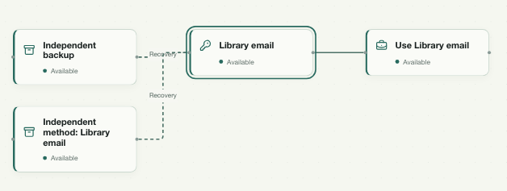
Prepare a route that survives the loss.
Keep the proposal
separate.
Assign the preparation.
Confirm the real method.
BLACKOUT PROTOCOL
5
Notes:
1:30–1:55. Evaluate an independent fallback against the same failure. Saving it creates a separate proposed plan, preserving the current arrangement. The proposal assumes the preparation has been implemented. The owner still has to configure and check it with the real provider. Record that preparation as an owned action in Next steps. Completing a task does not automatically verify a recovery method. The screenshot demonstrates a separately labelled proposal for the Library email. Source: docs/USER_GUIDE.md, packages/planner/analysis.ts, apps/web/planner/BlackoutCheck.tsx. Screenshot: docs/screenshots/dependency-map.png.

Slide 6
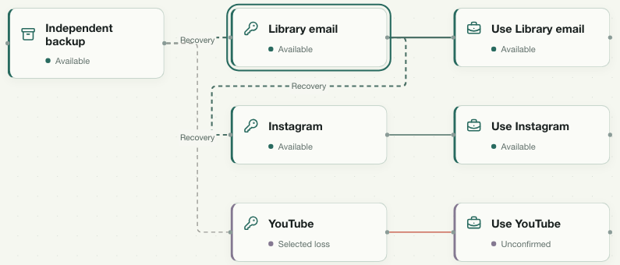
Check the recovery order together.
Owners act in order.
Approve people.
Assign accounts.
Record the check.
BLACKOUT PROTOCOL
6
Notes:
1:55–2:20. Create a team check from the same map after reviewing exactly which metadata is shared. Participants wait for approval, then receive account responsibilities. A missing prerequisite blocks a simulated step. The host can add responsibilities, finish the check and download a summary. Participants see accepted actions update the shared map. This does not execute provider recovery. Shared metadata is plaintext on the trusted local server, separate from the encrypted private workspace. Screenshot: docs/screenshots/own-team-running.png. Sources: apps/web/OrganisationRoom.tsx, docs/VALIDATION.md and docs/USER_GUIDE.md.

Slide 7
Leave with a usable recovery plan.
41
A readable reference
An encrypted backup
unit / integration tests
9
Actions with owners
browser journeys
Tested prototype • provider recovery and production security remain unverified
BLACKOUT PROTOCOL
7
Notes:
2:20–2:45. The useful outputs are a readable HTML recovery reference, an encrypted workspace backup and assigned preparation actions. Cached private planning is tested offline; team rooms need the local server. The current version passes 41 unit/integration tests and 9 browser journeys, including host plus three independent participant profiles. Those checks do not establish real provider recovery, production security or physical offline LAN use. The portable HTML builds, but direct file execution still needs validation. Sources: docs/VALIDATION.md, README.md and scripts/build-delivery.mjs. AI assistance was used for design, code, tests and documentation. The running app uses deterministic rules and needs no AI service.

Slide 8
BLACKOUT PROTOCOL
Find the dead end.
Prepare the way back.
A recovery plan your team can act on.
github.com/banany338/BLACKOUT-PROTOCOL
AI-assisted development • deterministic analysis • example data shown
Notes:
2:45–3:00. BLACKOUT connects account dependencies to a practical improvement: a route to prepare and a person responsible for it. Demonstrate one loss and one independent proposal, then show the exported plan. Repository: https://github.com/banany338/BLACKOUT-PROTOCOL . Built with React, TypeScript, React Flow, Fastify, Socket.IO, Zod, Node SQLite, Lucide and noble hashes. AI assistance was used for design, implementation, tests, documentation and these materials. It is disclosed here and in README.md. No competition outcome is guaranteed.

