Slide 1


Master Instagram Marketing: Unlock Your Brand's Potential

Slide 2

Why Instagram Matters: The Power of Visual Storytelling
Instagram has evolved beyond a simple photo-sharing app into a dynamic platform for brands to connect with their audience. With over a billion active users, it's a crucial channel for:
Building brand awareness
Showcasing products and services visually
Engaging with a diverse global community
Driving traffic and conversions
Visual content reigns supreme, allowing you to tell your brand's story in an immersive and captivating way.

Slide 3

Optimizing Your Profile: First Impressions Count
Profile Picture
Use a clear, recognizable logo or a professional headshot. This is your brand's face.
Compelling Bio
Clearly state who you are, what you offer, and why people should follow you. Use keywords and emojis.
Link in Bio
Direct users to your website, latest blog post, or product page. Use tools like Linktree for multiple links.
Story Highlights
Curate evergreen content from your Stories into themed highlights for easy access.

Slide 4

Crafting Compelling Content: Photos, Videos & Reels
High-Quality Photos
Engaging Videos
Dynamic Reels
Invest in good photography. Use natural light, clear focus, and appealing aesthetics to showcase your products or brand.
Share short tutorials, behind-the-scenes glimpses, or product demos. Videos capture attention and convey more.
Leverage Reels for short, entertaining content. Use trending audio and creative transitions to reach a wider audience.
Visual consistency and originality are key to standing out in a crowded feed.

Slide 5
Hashtag Strategy: Reach the Right Audience
Hashtags are your content's compass, guiding it to interested users. A strategic approach involves:
Relevance: Use hashtags directly related to your content, niche, and industry.
Variety: Mix broad, popular hashtags with more specific, niche ones.
Research: Explore what hashtags your competitors and target audience are using.
Branded Hashtags: Create unique hashtags for your brand campaigns or community.
Placement: Place hashtags in your caption or the first comment for cleaner aesthetics.
Using the right hashtags can significantly increase your content's discoverability and reach.

Slide 6

Engaging Your Community: Building Connections & Loyalty
Respond to Comments & DMs
Acknowledge and respond to every comment and direct message to foster a sense of community.
Interactive Stories
Use polls, Q&A stickers, and quizzes in your Stories to encourage direct interaction and feedback.
Run Contests & Giveaways
Boost engagement and reach by hosting fun contests with appealing prizes.
Collaborate with Influencers
Partner with micro- or macro-influencers whose audience aligns with your brand.

Slide 7

Instagram Ads: Targeted Growth and Conversions
Precise Targeting
Boosted Posts
Reach specific demographics, interests, and behaviors for highly effective campaigns.
Amplify your best-performing organic content to reach a wider audience quickly.
Shop Now Campaigns
Video Ads
Drive direct sales and conversions with clear calls-to-action that link to your products.
Utilize compelling video creatives to tell a richer story and capture more attention.
Instagram's robust advertising platform allows for detailed customization to meet various marketing objectives.

Slide 8
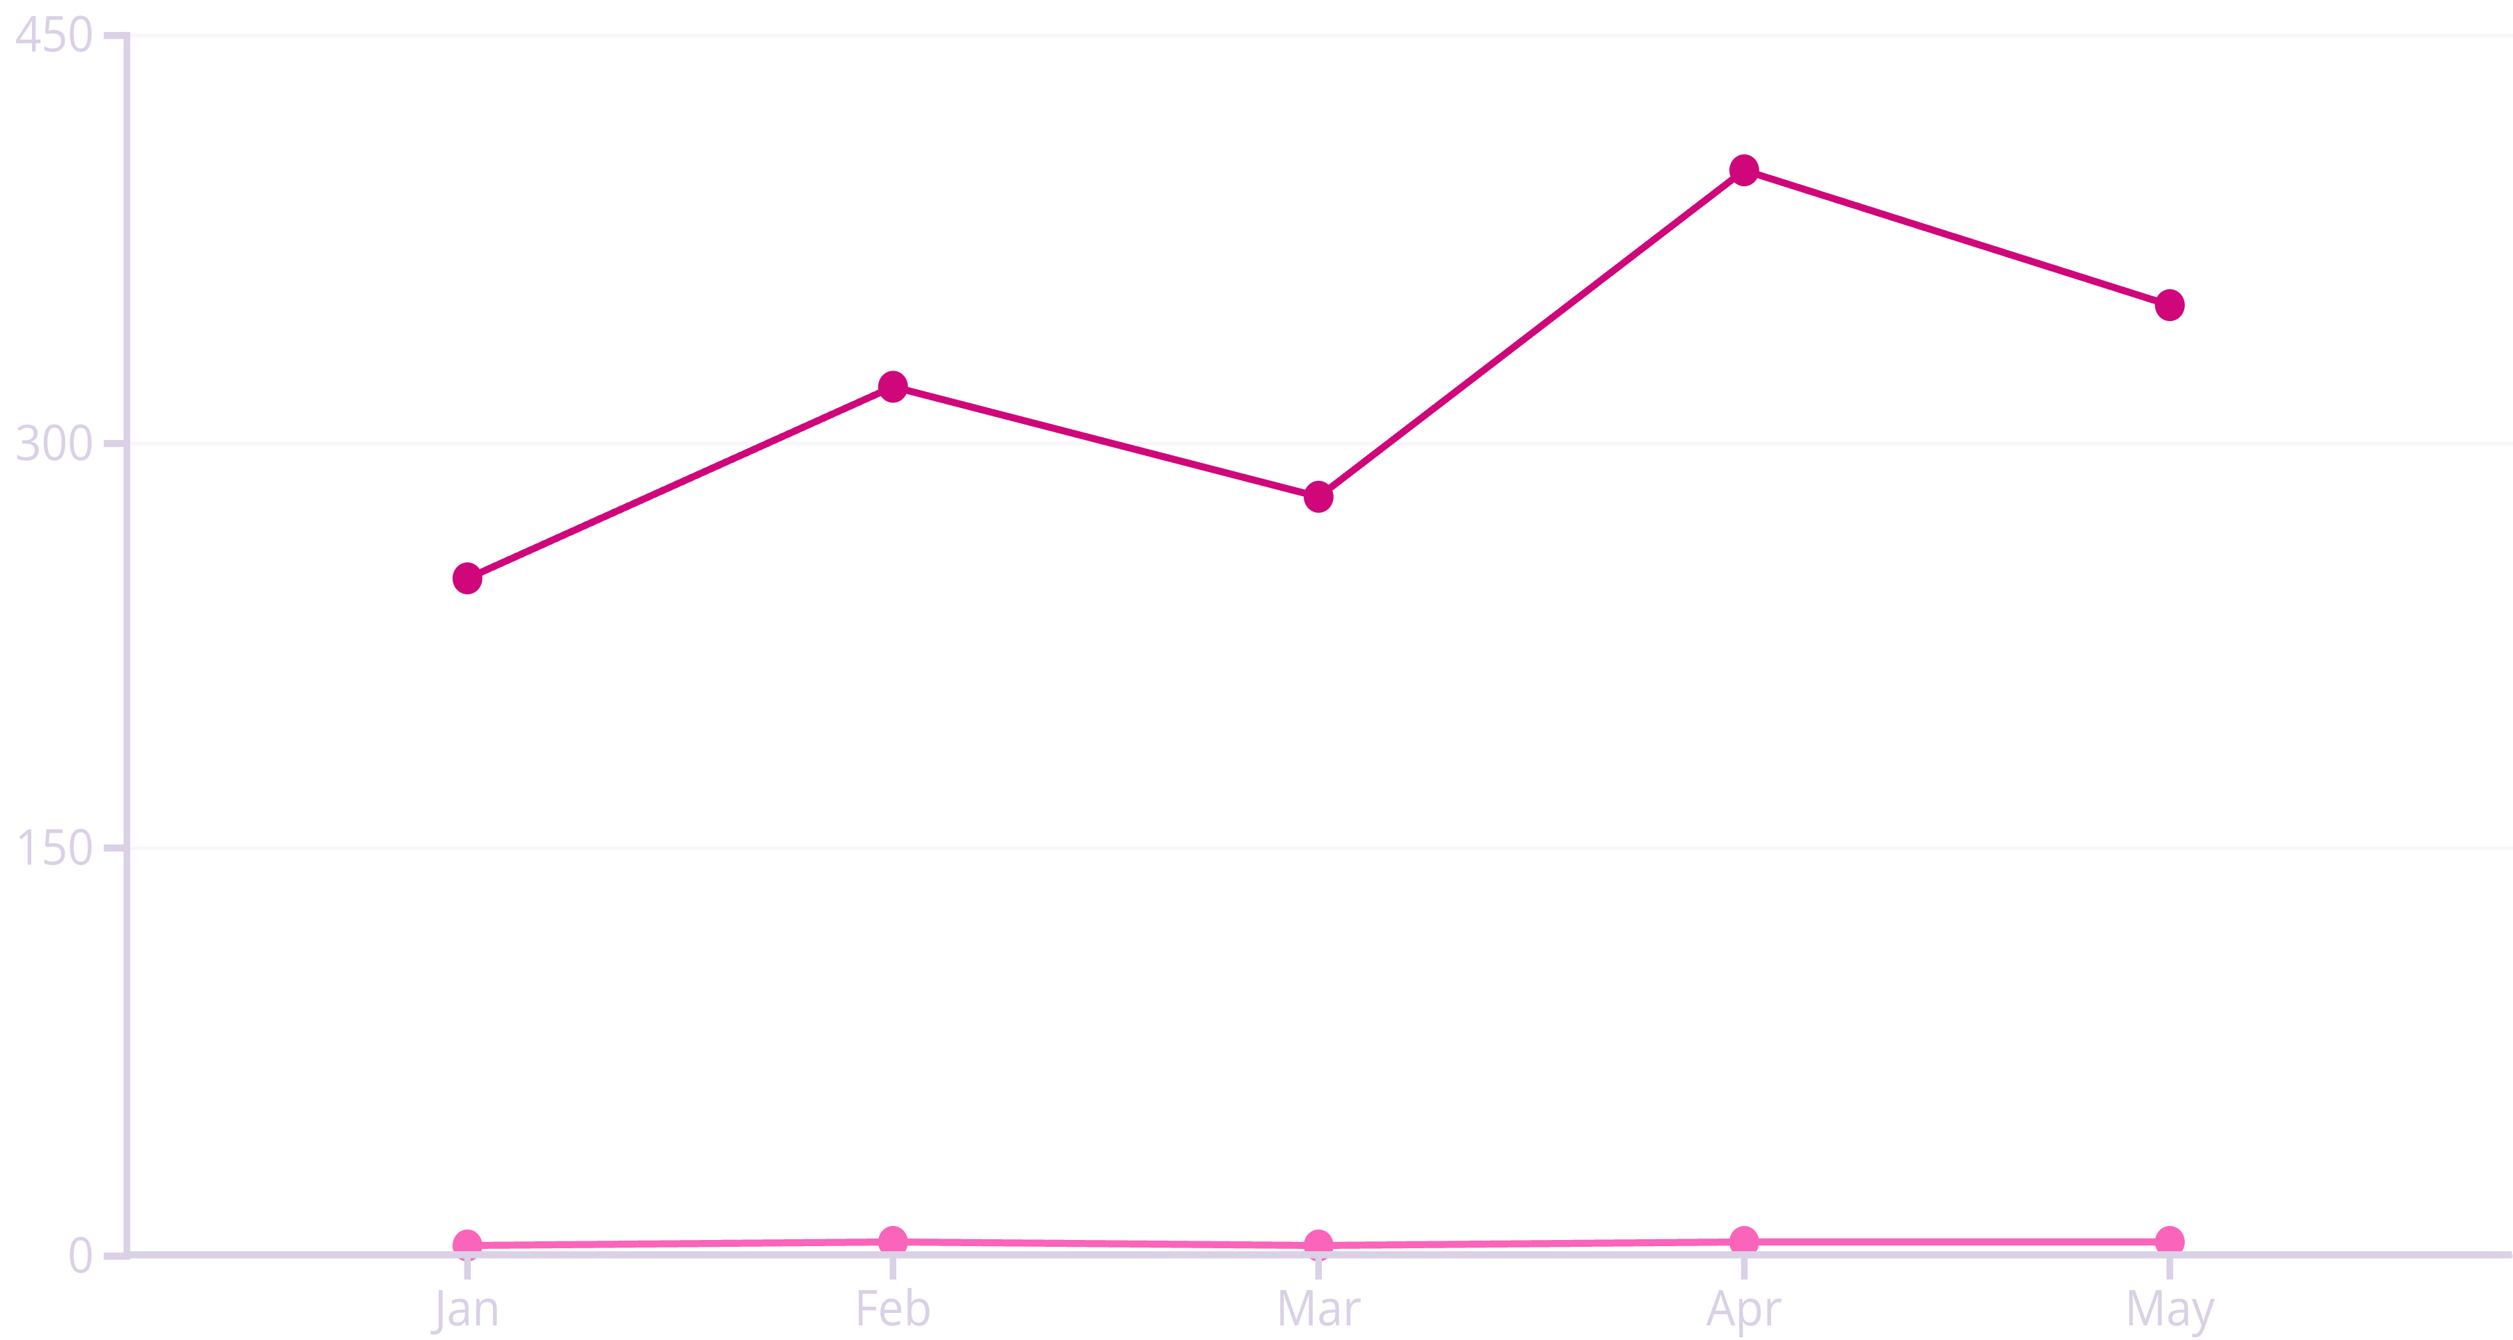
Analytics & Insights: Measuring Your Success
Followers Gained
Engagement Rate (%)
Understanding your Instagram analytics is vital for refining your strategy. Track key metrics such as:
Reach & Impressions: How many unique accounts saw your content.
Engagement Rate: The percentage of your audience that interacts with your content.
Follower Growth: Your net increase in followers over time.
Audience Demographics: Insights into your followers' age, gender, and location.
Best Performing Content: Identify what resonates most with your audience.

Slide 9
Staying Ahead: Trends and Future of Instagram Marketing
Short-Form Video Dominance
E-commerce Integration
Reels will continue to be a primary driver of discovery and engagement.
Seamless in-app shopping experiences will become even more sophisticated.
AI-Powered Personalization
Creator Economy Growth
Content algorithms will offer highly tailored experiences to users.
Authentic collaborations with creators will be increasingly important.
Adaptability and continuous learning are essential to thrive in the ever-evolving landscape of Instagram marketing.

Slide 10
Your Action Plan: Key Takeaways & Next Steps
Optimize Your Profile
Create Diverse Content
Master Hashtags
Ensure your bio, profile picture, and highlights are polished and informative.
Mix high-quality photos, engaging videos, and dynamic Reels.
Research and use a blend of relevant, popular, and niche hashtags.
Engage Actively
Measure & Adapt
Respond to your community and use interactive features.
Regularly review analytics to refine your strategy.
Start implementing these strategies today to elevate your brand's presence and impact on Instagram!

