Slide 1
Oh My SEARCH When content matters
Andrew Butenko
github.com/banban/OhMySearch

Slide 2

Who and Where
Elasticsearch:
Foursquare
Github
Amazon
NetSuite
Azure Search
Solr
Cnet
Netflix
digg.com
Sphinx
craigslist.org
Microsoft:
SQL FTS, Office Hybrid
Google:
Thunderstone.com (Google Search Appliance discontinued)
Notes:
Elasticsearch - simple like SQL Server.
Solr - like Oracle. You need PHD to configure Oracle :)
Google - Offering everything from image searches, map searches, news searches, etc. With impressive keyword relevancy and a continuously improving search algorithm, it's easy to see why Google is still the reigning champ.
Mahalo - Mahalo is a unique 'human-powered' search engine that employs a group of editors to manually sift and organize thousands of pieces of content. Poor guys.
Yahoo - While Yahoo has been suffering as of late, it's still a classic and a popular search engine.
Bing - The Microsoft powered search engine prides itself on being a "decision engine" by offering search suggestions on the side column and providing extra search options.
Ask - Clean layout and handy results grouping.
AOL Search - AOL continues to be used, primarily by people who still use AOL. They're out there somewhere.
Blekko - Blekko's clean, minimalist layout is easy to navigate, and /tags allow for grouping searches.
DogPile - the once alternative to Google is getting a comeback and is a great alternative to bigger search engines.
Duck Duck Go - Doesn't track your search history and avoids spammy sites.
The Internet Archive - This search engine lets users travel back in time to see how web pages looked in years gone by. A very fun search engine to play around with.
Wolfram alpha - It is not search engine, but computational knowledge engine

Slide 3
Just phrases
Sometimes the fastest way of searching is not to search at all. This particular cat may be skinned in myriad ways.
Full-text search is a battle between precision and recall.
The more frequently a term appears in a collection of documents, the less weight that term has
If you have to deal with only a single language, count yourself lucky. Finding the right strategy for handling documents written in several languages can be challenging.
All languages, except Esperanto, are irregular. While more-formal words tend to follow a regular pattern, the most commonly used words often have irregular rules.
Elasticsearch is a different kind of beast, especially if you come from the world of SQL. Out-of-the-box stemming solutions are never perfect.
Updating Elasticsearch objects ("documents") is interesting for two reasons, a good one and a weird one:
Good reason: documents are immutable. Updates involve marking the existing item as deleted and inserting a new document. This is exactly how SQL Server 2014 IMOLTP works. It's one secret of extreme efficiency and an excellent practice to follow.
Weird reason: you have to know the integer ID to update a document. It's highly efficient, which makes it, at worst, "weird"; not "bad".
Notes:
Search expectations changed and search engines have no recourse but to respond

Slide 4
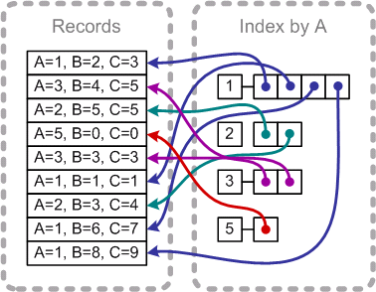
TERMINOLOGY (SEARCH vs RDBMS)
Cluster node = Instance
Index = Database
Type = Table
Document = Row
Field = Column
Mapping * = Schema
Alias ** = View + Synonym
Shard *** = Partition
Stemming = FORMOF, word breaker
More Like This = FTS Semantic Search similarity
Cardinality = Distinct values
Similarity = Rank != FTS Semantic Similarity
CURL(CRUD) = DDL
Query DSL = DML
Elasticsearch does not support ACID transactions, but uses version as optimistic concurrency control
Notes:
Elasticsearch is a near real time search platform. It does not support ACID transactions, but use optimistic concurrency control based on version.
* All types share space of index and need the same field types. You can’t use the same field name with different field types across the index
** Alias allows to merge, split, swap
*** Each Elasticsearch shard is a Lucene index. There is a maximum number of documents you can have in a single Lucene index. As of LUCENE-5843, the limit is 2,147,483,519(= Integer.MAX_VALUE - 128) documents. You can monitor shard sizes using the _cat/shards api.

Slide 5
Glossary
Aggregation - new replacement for facets, nested. Facet - not nested, is deprecated and not used anymore
Boosting - is used in parameters to increase the relative weight of a clause
Diacritics - symbols like ´, ^, and ¨. English uses diacritics only for imported words—like rôle, déjà, and däis. Other languages require diacritics in order to be correct.
Fielddata - aggregations work via a data structure known as fielddata. Fielddata is often the largest consumer of memory in an Elasticsearch cluster. Fielddata is not just used for aggregations. It is required for any operation that needs to look up the value contained in a specific document. Besides aggregations, this includes sorting, scripts that access field values, parent-child relationships
Filter - cashable request. See Query definition
Geohashes - are a way of encoding lat/lon points as strings. The original intention was to have a URL-friendly way of specifying geolocations, but geohashes have turned out to be a useful way of indexing geo-points and geo-shapes in database
Inflections - synonyms: "jumps,jumped,leap,leaps,leaped => jump", "cat,dog => pet", "little => small", ":)=>emoticon_happy", ":(=>emoticon_sad"
MLT - more like this. Recommendation engine
TF/IDF - term frequency / inverse document frequency. TF counts the number of times a term appears within the field we are querying in the current document. The more times it appears, the more relevant is this document. IDF takes into account how often a term appears as a percentage of all the documents in the index. The more frequently the term appears, the less weight it has.
Percolate Query - can be used to match queries stored in an index. The percolate query itself contains the document that will be used as query to match with the stored queries.
Precision - returning as few irrelevant documents as possible.
Pagination - results by page (from, size, skip, take )
Proximity query - a phrase query with slop.
Query - non cacheable request. See Filter definition
Recall - the number of relevant documents that a search returns.
Relevance aka Score - calculated weight or rank
Routing - shard placement controlled by using a hash of the document’s id value. Data can be saved to multiple directories, and if each directory is mounted on a different hard drive,
Similarity - (scoring / ranking model) defines how matching documents are scored. Similarity is per field, meaning that via the mapping one can define a different similarity per field. The default similarity that is based on the TF/IDF mode..
Shingles - these word pairs (or bigrams) : ["sue ate", "ate the", "the alligator"]. Shingles are not restricted to being pairs of words; you could index word triplets (trigrams) as well: ["sue ate the", "ate the alligator"]. Trigrams give you a higher degree of precision, but greatly increase the number of unique terms in the index.
Source - by default, the JSON document that you index will be stored in the _source field and will be returned by all get and search requests. This allows you access to the original object directly from search result
Stemming - reduce tokens to their root form: foxes → fox
Shard - is a single Lucene instance. It is a low-level “worker” unit which is managed automatically by Elasticsearch
Suggestions - Did you mean this/Autocomplete (Edge gramm - some*,Ngram - *ome*)
Typoes and Mispelings - Fuzzy matching allows for query-time matching of misspelled words, while phonetic token filters at index time can be used for sounds-like matching. Fuzzy matching treats two words that are “fuzzily” similar as if they were the same word.
Notes:
DSL – domain specific language

Slide 6
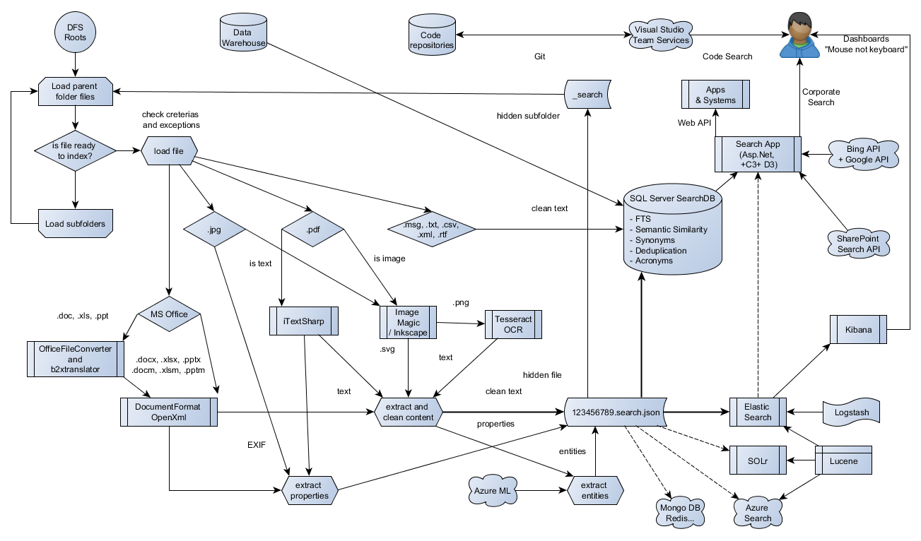
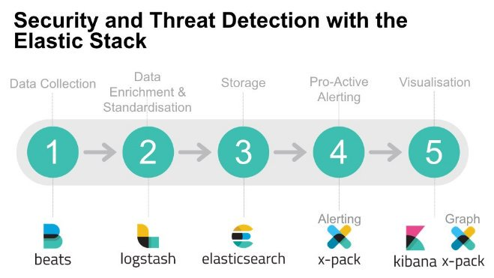
Search FLOWS
Notes:
Sketching time

Slide 7
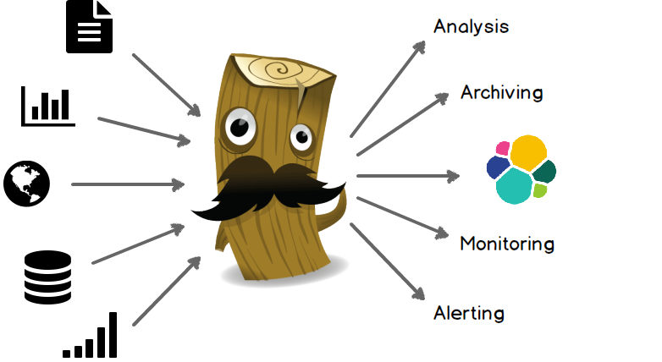
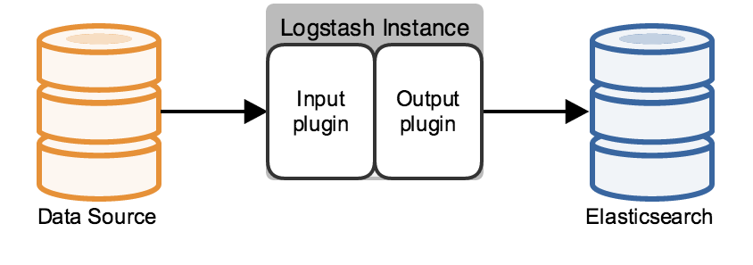
Collect Data
Shares, Downloads
SQL
Online Content
OS, Apps, IoT
Logs, Events, Queues
Files, Events
Queries, Events
Scrapping
Stashing
Extract
Data Set
Da ta
JSON
{"index": {"_type": "person", "_id": 1}
{"PersonType":"EM","MiddleName":"J","FirstName":"Ken", "ModifiedDate":"2003-02-08","LastName":"Sánchez"}
{"index": {"_type": "person", "_id": 2}
{"MiddleName":"Lee","FirstName":"Terri","LastName":"Duffy","EmailPromotion":1,"PersonType":"EM","ModifiedDate": "2002-02-24"}
{"index": {"_type": "person", "_id": 3}
{"PersonType":"EM","ModifiedDate":"2001-12-05","FirstName":"Roberto","LastName":"Tamburello"}
Index Bulk or Document
Azure Search
Mongo DB
Elastic Search
Solr
SQL FTS
Notes:
Deploying and Scaling Logstash https://www.elastic.co/guide/en/logstash/5.0/deploying-and-scaling.html

Slide 8
Search Files
Shared Files
doc
xls
ppt
dot
dotx
xlsb
zip
_search *
OFC
Convert
docx
xlsx
pptx
docm
xlsm
pptm
msg
rtf
txt
xml
pdf text
pdf image
jpg
Open XML SDK
text & properties
Text
Itext sharp
Tesseract OCR
ImageMagic
Inkscape
JSON file
(File Path, Name, Size, Last Modified, Content/Text, Properties, Entities)
"Entities": [
{
"Count": 22,
"Mention": "BOEING",
"Type": "ORG"
},
{
"Count": 20,
"Mention": "SEATTLE",
"Type": "LOC"
},
{
"Count": 3,
"Mention": “J. Bieber",
"Type": "PER"
}]
Azure ML
Index **
"Extension": ".pdf","Length": 1087273,"Name": "easa-tcds-a.120_(im)_volume_4_boeing_737--800-01-12122013","Content": "TCDSN No.: EASA.IM.A.120.4 Boeing 737 Page 1 of 236 Issue: 1 Date: 12 December 2013 TE.TC.00029-001 (c) European Aviation Safety Agency..... December 2013 Initial Issue -END-","LastModified": "\/Date(1430992210957)\/","Properties": { "NumberOfPages": 236, "Author": "keuppka", "PDFParser": "iTextSharp"}
Azure Search
Mongo DB
Elastic Search
Solr
SQL FTS
Notes:
* The content is stored in hidden folder and hidden Json files. You can rename, move parent folder or delete hidden one. It is stable
** Index could be done with different (logical) full path (DFS ). Json file does not have full path attribute!

Slide 9
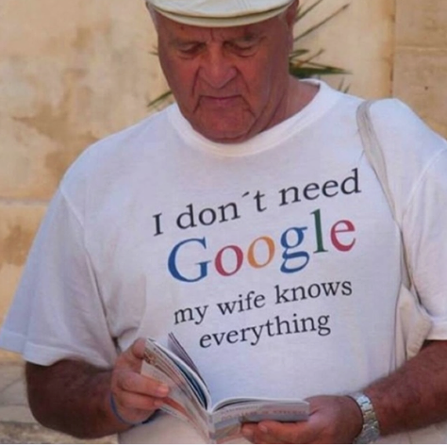
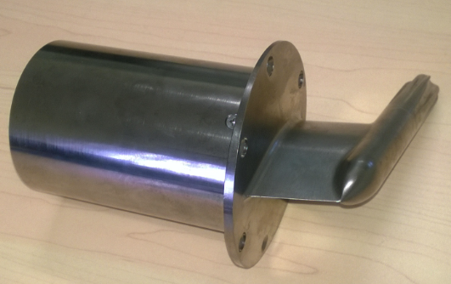
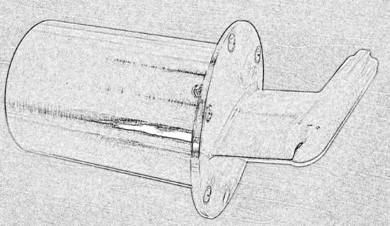
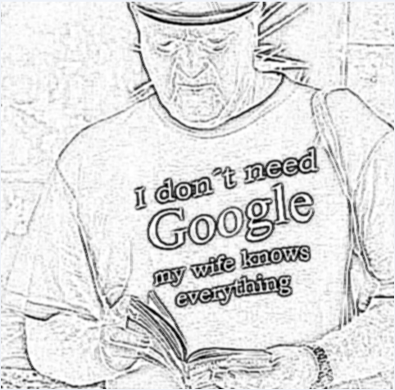
Search images
Shared Files
pdf image
Scanned image
Photo
Image Magic
PNG
Power Shell
EXIF
Image Magic / Inkscape
SVG
Tesseract OCR
TXT
"Manufacturer": "SAMSUNG","Contrast": "Normal","WhiteBalance": "Auto","Saturation": "Normal","Software": "I9300TDUUGNA4","ISO": 125,"Model": "GT-I9300T","Orientation": "0","FNumber": 2.6,"GPS": "34°56\u002714\"S 138°34\u002726\"E, 0M below Sea Level","CaptureMode": "Standard","Sharpness": "Normal","ExposureMode": "Auto","Comment": "\u0012ø\u000f;","MaxApperture": 2.76,"FocalLength": 3.7,"Exposuretime": "1/24","Height": 2448,"MeteringMode": "Centre","ExposureProgram": "Aperture Priority","LightSource": "Auto","Width": 3264,"ColorSpace": "sRGB","DateTaken": "\/Date(1439961584000)\/"
JSON file
(File Path, Name, Size, Last Modified, Content ,Vector, Properties, EXIF, GeoJson)
I don’t need Google my wife knows everything
Index
Azure Search
Mongo DB
Elastic Search
Solr
SQL FTS
Notes:
Cognitive services aka Project Oxford.
Scott Hanselman: RFC: Server-side Image and Graphics Processing with .NET Core and ASP.NET 5
Currently, as of the time of this blog post's writing, .NET Core has no good built-in option for image resizing or image generation/creation. There is no System.Drawing because there is no Win32 GDI. There are some options, that I'll point out later, but this clearly hasn't been a priority so it's not done yet. There has been some work on System.Drawing.Graphics, but it seems stalled.
http://www.hanselman.com/blog/RFCServersideImageAndGraphicsProcessingWithNETCoreAndASPNET5.aspx

Slide 10

Search API
In-house
Vendors / Clients API, AD, DFS, SQL, Web Services
Cloud
SharePoint, Power BI, Cortana Analytics, Visual Studio
ERP
Salesforce, NetSuite, OpenAir,
Microsoft AX
External
Government, Regulators, Travel providers
Social
Bing, Google, Foursquare, Twitter, Flickr
Authentication & Authorization
Session, Ticket, Claim, OWIN, Basic, Kerberos, NTLM, API Secrets and Keys
WCF
OData SOAP REST
Bulk
REST
Call
#find address, postal code…
#find trend, images…
#find coffee
$uri = "https://api.foursquare.com/v2/venues/search?client_id=$env:Foursquare_ClientId&client_secret=$env:Foursquare_ClientSecret&v=20140806&ll=-34.93727%2C138.57384&query=coffee"
#find sushi
$uri = "https://api.foursquare.com/v2/venues/search?client_id=$env:Foursquare_ClientId&client_secret=$env:Foursquare_ClientSecret&v=20140806&ll=40.7,-74&query=sushi"
Plugins (x-pack, timelion ...)
Kibana, Logstash, Bits
ES Node 1
NEST
Elasticsearch.Net
REST
Search Application Controllers
ES Node 2
Java, Ruby, Lucene, Node.js, Grok, Redis
Notes:
The main problem of high level app is strongly typed POCO model
We can bind some generic types (file, db records, photo to Nest objects mapping connection MapDefaultTypeIndicesmethid index to POCO) https://www.elastic.co/guide/en/elasticsearch/client/net-api/master/index-name-inference.html
So we assume that application is not aware of indexes, types and fields.
But in general – it must be <dynamic>

Slide 11
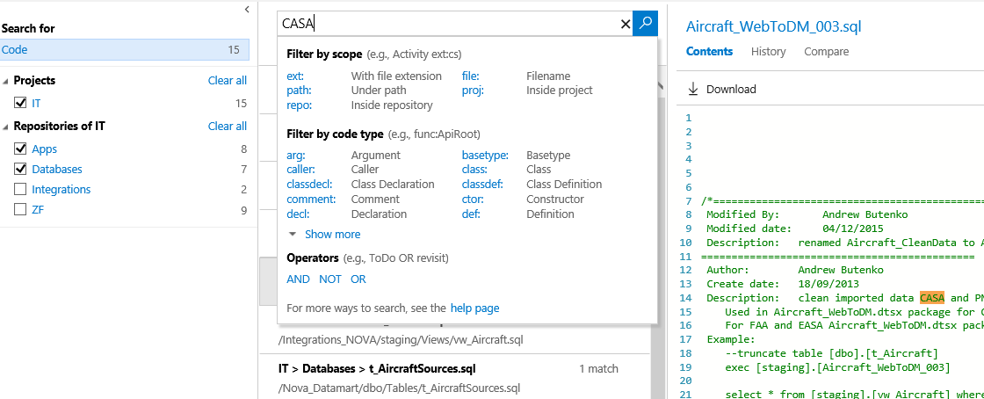
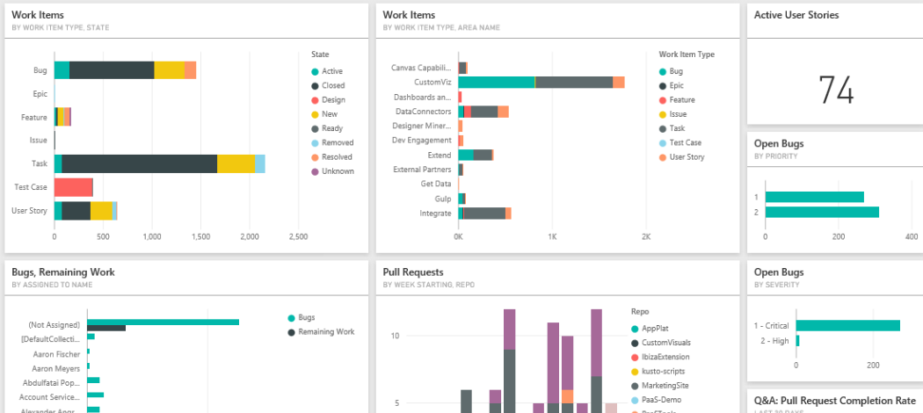
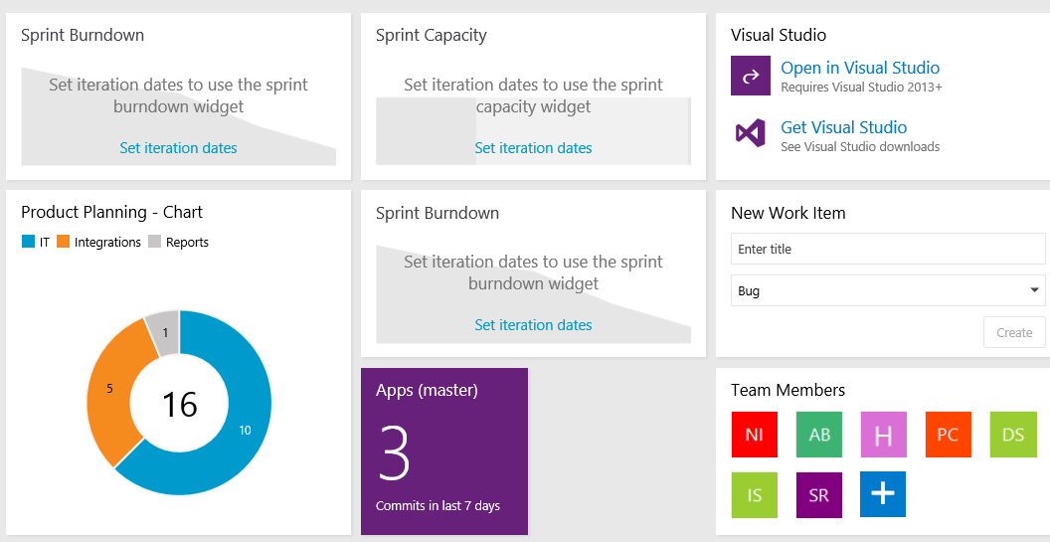

Search CODE
SVN
Git
Visual Studio Team Services
Central Repo
SVN to Git rebase
Local Repo
Sync
Master Repo
Index
Azure Search
Integrated Search
Power BI
Notes:
Connect Power BI to Team Services https://www.visualstudio.com/en-au/docs/report/powerbi/connect-vso-pbi-vs
Create Power BI dashboards and reports https://www.visualstudio.com/docs/report/powerbi/report-on-vso-with-power-bi-vs
Search code https://searchcode.com/
Search packages http://go-search.org/
Code galaxy http://anvaka.github.io/pm/#/?_k=fsi3be

Slide 12
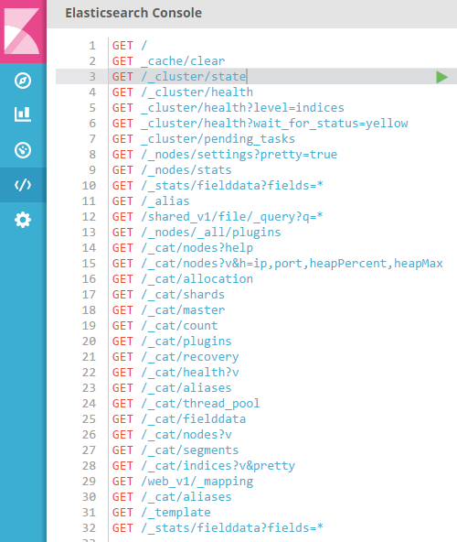

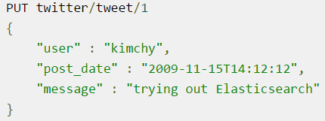
Search lexicon
Json: {a:1;b:2}
DSL: .a(1).b(2)
Object: obj.a = 1; obj.b = 2;
_alias – index name synonym used to merge, split or swap and hide from end user physical index names
_cat – group of commands
_cluster – collection of nodes
_explain - give useful feedback whether a document matches or didn’t match a specific query.
_mapping - Field-Type mapping
_type - type(table) inside index
_id unique ID (PK). Is auto generated 20 character hash (if not provided). The _id field is not indexed as its value can be derived automatically from the _uid field.
_uid => _type + _id
_nodes shows cluster node stats and settings
_query structured request with many options
_restore recover from back up
_search
_settings shows index settings (analysers, matchings, etc.)
_snapshot
_score = rank
_source - by default, the JSON document that you index will be stored in the _source field and will be returned by all get and search requests.
_stats – statistics from specific levels
?version - is deprecated. Instead, use a normal date field and set its value explicitly.
_template – predefined prototype of index or mapping
Notes:
Demo: Kibana
There are many syntax notations:
Json: {}
DSL: .().().(),
object
Some commands depend on others. Some of them could be reused on different levels
Intellisense is provided in Sense and Kibana

Slide 13
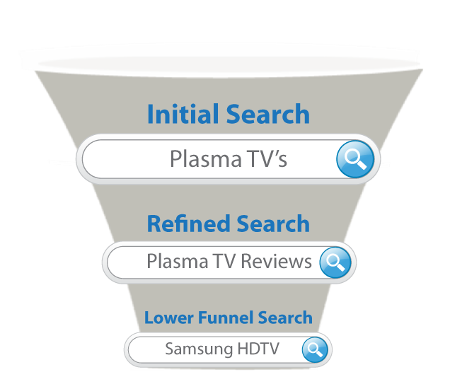
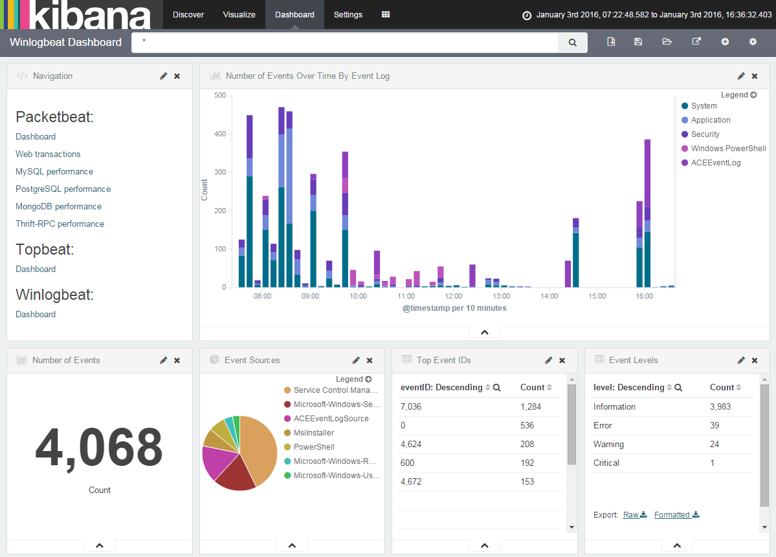
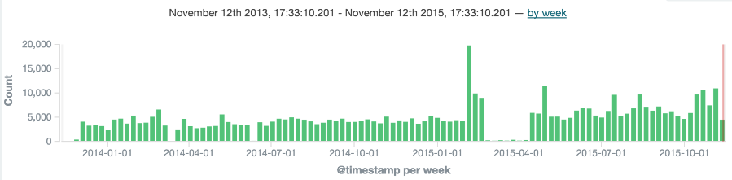
USER Experience
Cross platform, cross browser
Discover, iterate, navigate, pin, dashboard, map
Type less, take more *
Autocomplete, highlights, scope
Level of confidence
I know what I need
Not sure, help me
Cognitive services: gestures, speech, emotion, face recognitions
Filtering and aggregations (ex. facets)
Hierarchy (root -> root\folder -> root\folder\subfolder )
Date ranges (This Year, 2015, Last 7 Days, now+1h, now+1h+1m, now+1h/d, 2015-01-01||+1M/d) **
Attributes (Extension, Author, EXIF, custom attributes)
Geo shapes (distance, intersections)
Morphology operators (AND NOT OR NEAR)
Analysis and plugins
Fuzzy, MLT similarity, phonetic, stop words
Multy-language and Unicode support
Query history, percolating, boosting
Layouts and styles
SPA vs MPA, paging, scrolling, form factor, bootstrap, CSS options
Integrated search (SSRS, SharePoint, ERP, Social)
API controllers
Notes:
Demo: Application
* Sergey Brin (Google Co-founder) TED 2013 : My vision when we started Google 15 years ago was that eventually you wouldn't have to have a search query at all. You'd just have information come to you as you needed it. “
** now+1h = the current time plus one hour, with ms resolution.
now+1h+1m = The current time plus one hour plus one minute, with ms resolution.
now+1h/d = The current time plus one hour, rounded down to the nearest day.
2015-01-01||+1M/d = 2015-01-01 plus one month, rounded down to the nearest day.

Slide 14

Lessons learned
Scope file extensions for search *
Use scalable solutions (parallel processing, virtualisation, clustering, packaging)
Avoid Office 97(and below) requiring OpenXML conversion and not allowing to extract file properties
Exclude temporary or irrelevant files/folders (~temp.doc, /archive/, /old/)
Check if file/folder is locked or password protected
Avoid big files (PDF image based < 20MB, indexed document size <4MB)
Avoid special symbols in file/folder name: ()~^&*@/\!?[]`+ other languages.
Use UNC path but less then 255 symbols. Use DFS as workaround
Avoid dynamic type mapping where it is possible. Same name field must have the same data type across all types in index **
Add by batch, but replace the whole document - do not update each field
Activate geotags on your phone camera ☺
Notes:
* SQL FTS supports up to 170 extensions
** https://www.elastic.co/guide/en/elasticsearch/reference/current/mapping.html
Explicit mapping is preferable:
&$put "adworks_v1/_mapping/employee?update_all_types" '{"properties":{"BusinessEntityID":{"type":"integer"},"NationalIDNumber":{"type":"text"},"LoginID":{"type":"text"},"OrganizationNode":{"fields":{"tree":{"type":"string","analyzer":"hierarchy_analyzer"}},"type":"string","index":"not_analyzed"},"OrganizationLevel":{"type":"short"},"JobTitle":{"type":"text"},"BirthDate":{"type":"date","format":"YYYY-MM-DD"},"MaritalStatus":{"type":"text"},"Gender":{"type":"text"},"HireDate":{"type":"date","format":“yyyy-MM-DD"},"SalariedFlag":{"type":"text"},"VacationHours":{"type":"short"},"SickLeaveHours":{"type":"short"},"CurrentFlag":{"type":"text"},"rowguid":{"type":"keyword"},"ModifiedDate":{"type":"date","format":"YYYY-MM-DD"}},"dynamic":true,"date_detection":true}'

Slide 15
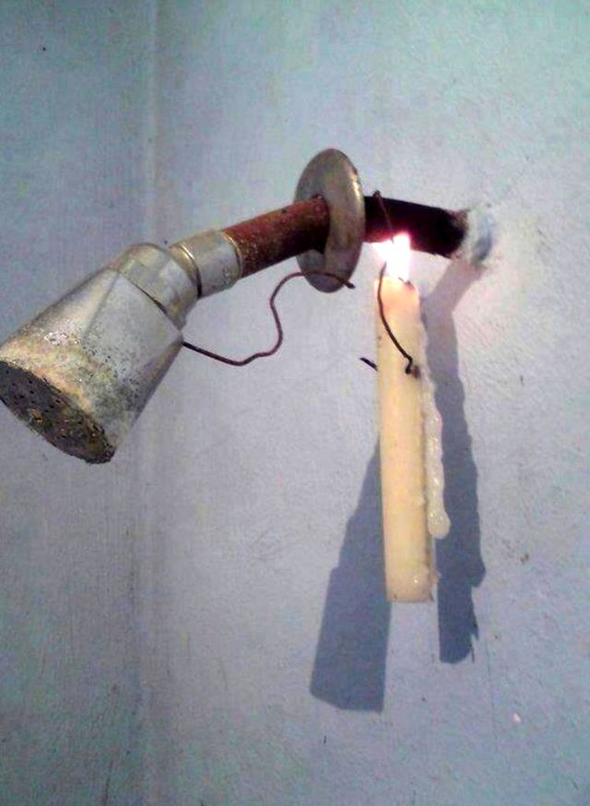
Search Services
Bring your query (BYQ)
Document id, query id and history for analysis *
Rank and aggregate search results
Subscribe for changes
Bring your content (BYC)
Notify about corrupted or changed content
Protect search results
Convert information to knowledge
Bring your service (BYS)
Integrate and decouple. Call search from one system, embed to another
Packaging and scaffolding: System Center, Docker, Chocolatey, Chef, Yeoman, NuGet, Bower, NPM Gulp, Node.js
Process tenants’ content and monetize
Notes:
* advisory profile

Slide 16
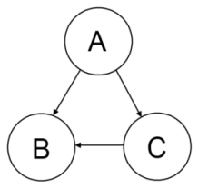
Dependencies
Back End
PowerShell in-house scripts + community modules (Image, etc.)
Text transformations
Microsoft Office Compatibility Pack for Word, Excel, and PowerPoint File Formats
Microsoft Office Compatibility Pack (SP3) , OfficeFileConverter, b2xtranslator
Microsoft Open XML SDK (v2.5+)
Itextsharp
Image transformations
Image Magick & GPL Ghostscript, Inkscape
Recognition
Tesseract OCR(v3.02) & Leptonica
Microsoft Cognitive services
Search
Elastic Search (v5.0), Kibana, Logstash, x-Pack, other plugins
Java 8 JDK or JRE 1.8.0_73+
SQL Server 2014+ & Full Text Search & Semantic Similarity & Microsoft Filter Pack (2.0)
Front End
Asp.Net Core, Bootstrap, Bootswatch, jQuery, D3, Chart.js, LESS and more…

Slide 17
Links
ES documentation, forum, cheat sheets
elastic.co/guide, discuss.elastic.co, cheat sheet, twitter.com/elastic
ES clients and plugins
.Net Client, Kibana, Timelion, Sense Google Chrome add in, PowerShell example
ES vs Others
Solr vs Elasticsearch
Elastic vs MongoDV vs Solr
Cloud solutions
Elastic Cloud *
Azure Quickstart Templates (find elastic templates), Cortana Intelligence Suite, Azure Search
Development:
ASP.Net Core RC2**, VisualStudio.com , GitHub.com
Other APIs and code engines
Foursquare.com, Flickr.com, Twitter.com, Search Code, Go Search packages, Code Galaxies
Packaging and scaffolding
System Center, Docker, Chocolatey, Chef, Yeoman, NuGet, NPM, Node.js, Bower
Notes:
* The Official Hosted Elasticsearch & Kibana Offering on AWS: $65/month 1GB 1 datacentre Sydney
** RTM will be released as v1 27th of June 2016

Slide 18
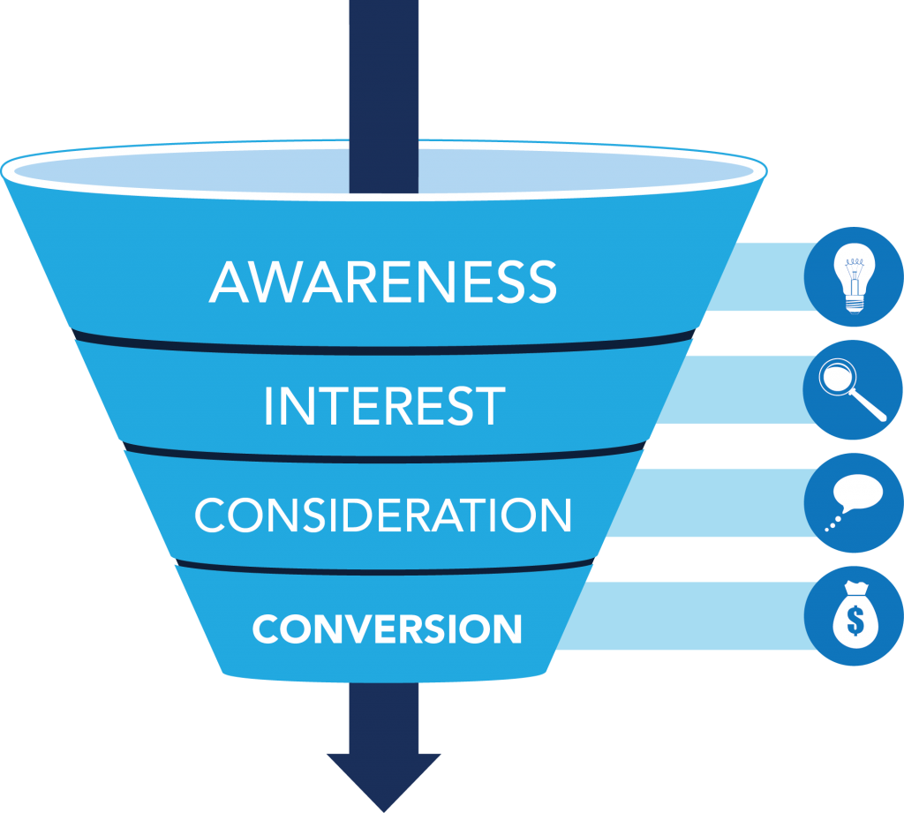
What is next
Ready
Grab some coffee and take a deep breath
Define scope for search and allocate resources
Evaluate and choose right tools
Set
Setup and configure backend
Index data at rest and in motion
Discover and map data
Go
Integrate and visualise
Measure and monitor
Improve and deliver
Ask: @andrew_butenko
Read: andrewbutenko.wordpress.com
Code: github.com/banban/OhMySearch
Notes:
Where to start from:
Install last version, build environments
Test files, web, sql, other search cases
Plan data at rest and data in motion indexing
Visualise
Integrate with other APIs
Build your cluster, virtual machines, templates
100 Data and Analytics Predictions Through 2020 https://www.gartner.com/doc/reprints?id=1-33SAA8U&ct=160418&st=sb

