Slide 1
Basics tools
Nan jiang
Wenge rong

Slide 2
Tools
Python: most prevelant
Library: Numpy, Scipy, Theano, Keras, lasagna,deepy
Matlab: most easy to use.
Library: DeepLearnToolbox.
C++: fastest speed.
Library: Caffe
https://github.com/Theano/Theano
http://keras.io/
https://github.com/rasmusbergpalm/DeepLearnToolbox
https://github.com/BVLC/caffe

Slide 3
Deeplearntoolbox
NN/ - A library for Feedforward Backpropagation Neural Networks
CNN/ - A library for Convolutional Neural Networks
DBN/ - A library for Deep Belief Networks
SAE/ - A library for Stacked Auto-Encoders
CAE/ - A library for Convolutional Auto-Encoders
util/ - Utility functions used by the libraries
data/ - Data used by the examples
tests/ - unit tests to verify toolbox is working

Slide 4
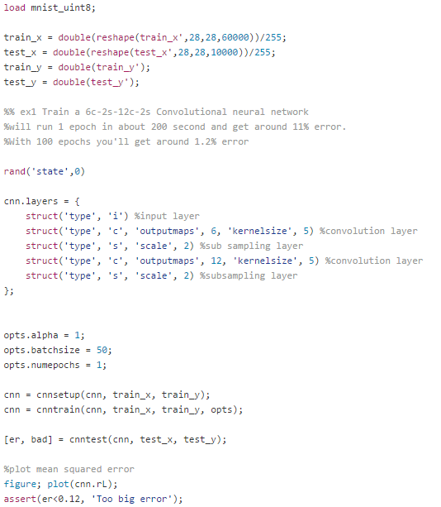
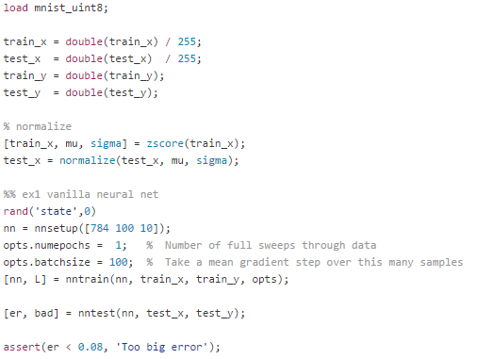
deeplearntoolbox

Slide 5
deeplearntoolbox
Conclusion:
Easy to use;
Easy to understand;
Traditional method have been implemented;
Modern model is hard to designed with it.

Slide 6
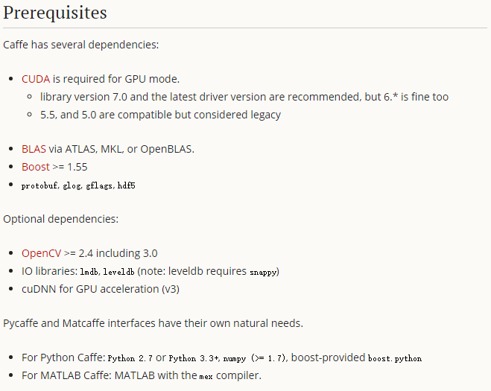
caffe
Hard to configure the dependency
Most used for Image & Computer Vision
Hard to build self-designed model.
官网：http://caffe.berkeleyvision.org/installation.html
配置教程：http://www.cnblogs.com/platero/p/3993877.html

Slide 7
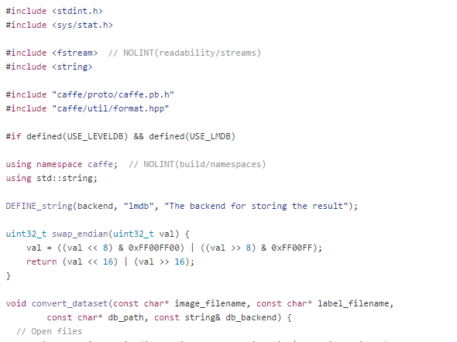
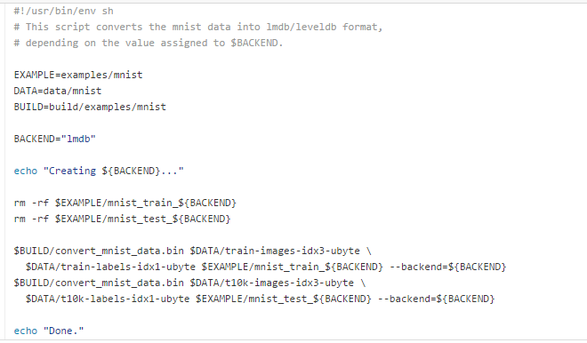
caffe
Shell Script
C++ object-oriented programming

Slide 8
caffe
Conclusion:
Suitable for mature model implement
Hard to design new model with it.
Hard to use.
Fast speed.
Prelevant platform.

Slide 9
Python - numpy
import numpy as np
# init
>>> a=array([1,2,3,4])
>>> a=array([(1.5, 2.3), (4.5, 6)])
>>> c=array([ [1, 2], [3, 4] ], dtype=complex) #在创建数组时，显示指定其类型
>>> c=zeros( (3, 4) ) # 创建全零的3x4的数组
>>> c=ones( (2, 3, 4), dtype=int16) # 初始化的时候，指定数据类型
注意：numpy.array和标准的Python库类array.array不相同

Slide 10
python - numpy
numpy的数组被称为ndarray。
ndarray.ndim: 数组轴的个数，轴的个数被称为秩
ndarray.shape: 数组的维度。这是只是数组在每个维度上大小的整数元组。
n*m 的矩阵，它的shape为(2, 3)， 这个元组的长度显然是秩，即维度或者dim值。
ndarray.size: 数组元素的总个数，等于shape中元素的乘积。
ndarray.dtype: 一个用来描述数组中元素类型的对象。dtype可以是python标准类型，或者numpy提供的数据类型。
ndarray.itemsize: 数组中每个元素的字节大小。
一个floatx64的itemsize属性值为8 (64/8=8)
一个元素类型为complex32的数组itemsize属性为4 (32/8=4)

Slide 11
Python - numpy
基本运算
数组的算术运算是elementwise的，对应元素做计算。
>>> a = array( [20,30,40,50] )
>>> b = arange( 4 )
>>> c = a-b
array([20, 29, 38, 47])
>>> b**2
array([0, 1, 4, 9])
>>> 10*sin(a)
array([ 9.12945251, -9.88031624, 7.4511316 , -2.62374854])
>>> a<35
array([True, True, False, False], dtype=bool)

Slide 12
Python - numpy
更改数组形状
>>> a= np.floor(10*np.random.random((3,4)))
>>> a.ravel() # 平坦化数组
array([ 7., 5., 9., 3., 7., 2., 7., 8., 6., 8., 3., 2.])
>>> a.shape= (6, 2)
>>> a.transpose() # 矩阵转置
array([[ 7., 9., 7., 7., 6., 3.],
[ 5., 3., 2., 8., 8., 2.]])
reshape 函数改变参数形状并返回它，而 resize 函数改变数组自身

Slide 13
Python - numpy
Too much function too remember !
Tricks to manipulate the compulation.
Basic library.

Slide 14
Python - theano
pip install theano
# windows is hard to install, linux is much better.
Prequisities:
numpy
Scipy
BLAS / LAPACK
G++
Python-dev
CUDA (not necessary)

Slide 15
Python - theano
Import theano
Import theano.tensor as T
Adding two Scalars
>>> from theano import function
>>> x = T.dscalar('x')
>>> y = T.dscalar('y')
>>> z = x + y
>>> f = function([x, y], z)

Slide 16
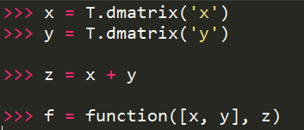
Python - theano
Adding matrics

Slide 17
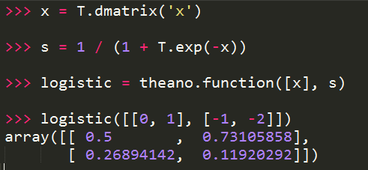
Python - theano
Logistic function

Slide 18
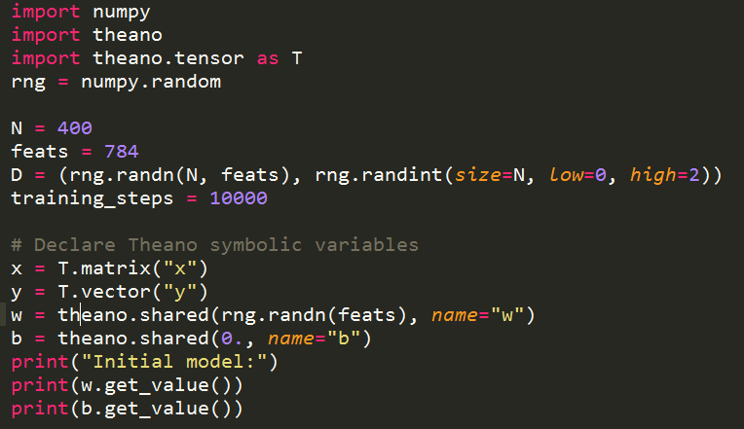
A Real Example: Logistic Regression
INIT

Slide 19
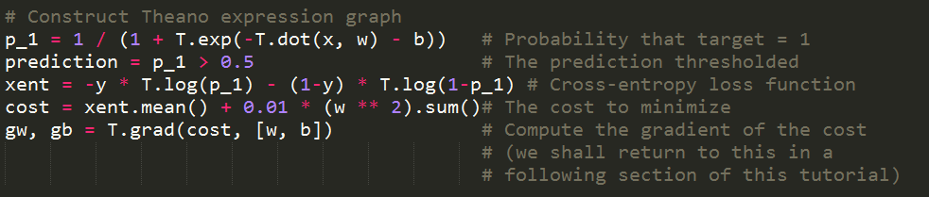
A Real Example: Logistic Regression
BUILD

Slide 20
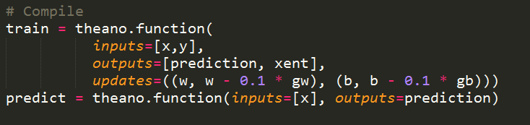
A Real Example: Logistic Regression
Compile

Slide 21
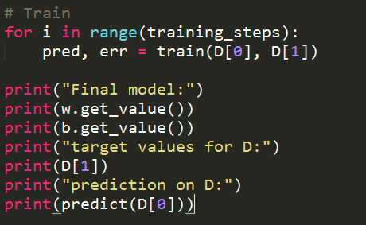
A Real Example: Logistic Regression
Train

Slide 22
keras
Deep Learning library for Theano and TensorFlow
Note:
pip install git+git://github.com/Theano/Theano.git
pip install keras

Slide 23
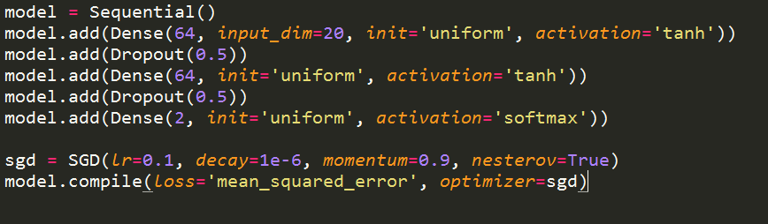
Keras - exaple
Muti-Layer Perceptron

Slide 24
keras
Conclusion:
Easy to use ?
Documentation ?
Example ?
Self-design capability ?

Slide 25
Resource - NLP
Deep Learning for Natural Language Processing [2015]
The University of Stanford
http://cs224d.stanford.edu/index.html
Deep Learning for NLP [2015-10]
The University of Darmstadt
Deep Learning [2014-2015]
The University of Oxford
http://www.cs.ox.ac.uk/people/nando.defreitas/machinelearning/
Advanced Natural Language Processing [2015]
The University of MIT
http://ocw.mit.edu/courses/electrical-engineering-and-computer-science/6-864-advanced-natural-language-processing-fall-2005/
Deep learning book [2015-12-3]
The University of Toronto
Yoshua Bengio

