Slide 1




Maxwell Metrics-based bug prediction model

Slide 2
Group member
Jiaqi Li（Victor） (Group leader)
Bing Su（Robin）
Dongge Tang（Henry）
Yunlu Weng（Gilles）

Slide 3
Outline
1. Introduction
Background
The problem to be solved
2. What’s metrics ?
3. The probable models
4. Conclusion
What we have already
What we will do next step
Our work scheduling
Task allocation
Chances

Slide 4
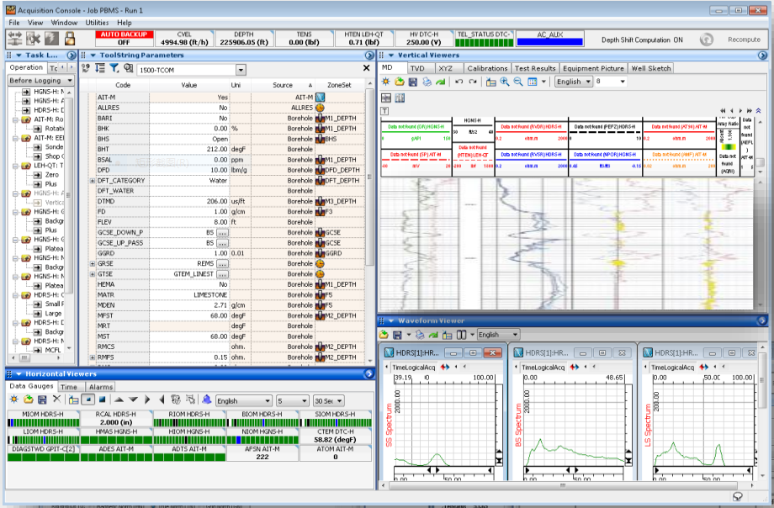
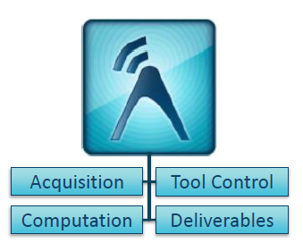
Background
The company and Maxwell
Schlumberger Software - BGC
What is Maxwell?
Notes:
First of all, I would like to introduce the company and the software which are important to our project. The company we worked with is schlumberger software, the Beijing geoscience center, it’s the schlumberger center of excellence for real-time software. Their mission is to provide integrated workflows and solutions that give their stakeholder competitive advantages to serve the clients. Among their brilliant softwares,one of the most important is called Maxwell, where our project is based on, and we get all the datasets from it. Maxwell is a real time acquisition software data from downhole sensors, it processes,computes and delivers the data to provide well site answer products to schlumberger’s clients.

Slide 5
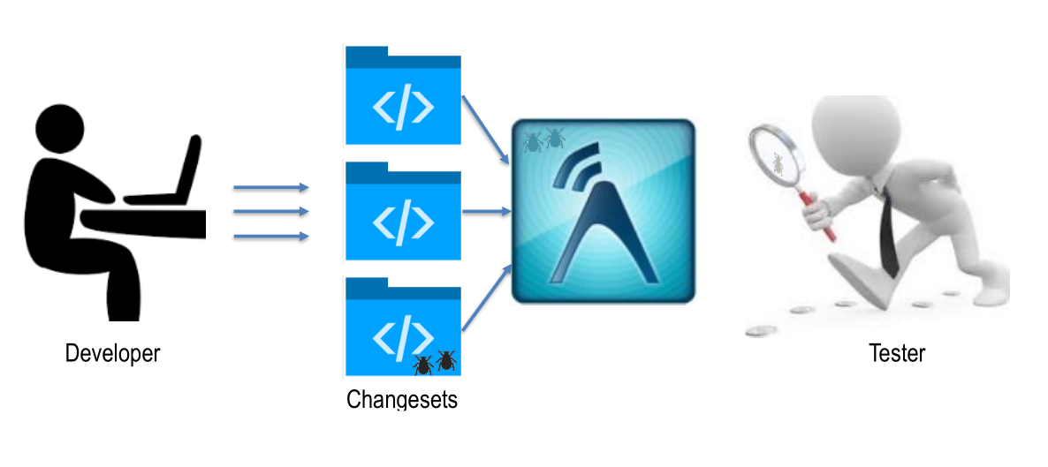
Problem definition

Slide 6

Problem definition
Taking advantage of the Maxwell software code metrics to determine the risk of a code change.
Our output:
a quantitative model to be used for test scope determination, including a variable importance plot for the various Maxwell code metrics.

Slide 7
Solution
Main idea: Machine learning
Metric selections
Model selection
Source code
Datasets
Outputs:
risk level

Slide 8

Metric
What is metric?
According to the dictionary: Metric is a system of related measures that facilitates the quantification of some particular characteristic
According to our project: we can understand it as the variables that we use to measure a change set.
So it comes a problem: which metrics should be used?

Slide 9
Metric
The metrics that we can get directly.
For example: Total LOC ( the number of lines of non-commented executable lines in the files comprising the new version of a binary)
The metrics that have been got according to the absolute metrics.
For example: M1(Churned LOC/Total LOC)
Relative
Absolute

Slide 10
Metric
The metrics we want to use:
The metrics that Schlumberger provides:
Total LOC : is the number of lines of non-commented executable lines in the files comprising the new version of a binary.
Churned LOC : is the sum of the added and changed lines of code between a baseline version and a new version of the files comprising a binary.
Deleted LOC : is the number of lines of code deleted between the baseline version and the new version of a binary.
File count : is the number of files compiled to create a binary.
Weeks of churn : is the cumulative time that a file was opened for editing from the version control system.
Churn count : is the number of changes made to the files comprising a binary between the two versions.
Files churned : is the number of files within the binary that churned.
...
Lines of change set
Statements of change set
Percent Branch statements
Percent Lines with Comments
Classes Defined
Methods Implemented per Class
Average Statements per Method
Line Number of Most Complex Function
Maximum Complexity
Line Number of Deepest Block
Maximum Block Depth
Line Number of Deepest Block
…
Chances

Slide 11
Our models
The
Method
To
do
prediction
Servces
metrics
severity
0
1
2
3
4
5

Slide 12
Our models
——Metrics Preprocessing
Why we make metrics preprocessing?
There are some metrics containing the same information.
Too many variable will make it difficult to find their relations.
The objective of metrics preprocessing
Reduce the dimension of the data.
Make the metrics independent.

Slide 13
Our models
——Metrics Preprocessing
Principal component analysis (PCA):
a statistical procedure.
uses an orthogonal transformation to convert a set of observations of possibly correlated variables into a set of values of linearly uncorrelated variables called principal components.
The number of principal components is less than or equal to the number of original variables.
Servces

Slide 14
Our models
——The method to do prediction
The traditional method of machine learning
SVM (Support vector machine)
The method of deep learning
MLP (Multilayer Perceptron)
LSTM (Long Short Term Memory )
Servces

Slide 15
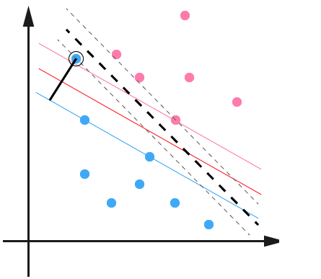
Our models
——The method to do prediction
SVM (Support vector machine)
constructs a hyper-plane or set of hyper-planes in a high- or infinite-dimensional space, which can be used for classification.
Servces

Slide 16
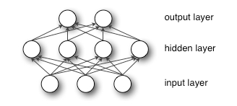
Our models
——The method to do prediction
MLP (Multilayer Perceptron)
a feed-forward artificial neural network model that maps sets of input data onto a set of appropriate outputs.
An MLP consists of multiple layers of nodes in a directed graph, with each layer fully connected to the next one.
Servces

Slide 17
Our models
——The method to do prediction
LSTM (Long Short Term Memory )
LSTM is a class of artificial neural network
LSTM can memorize the previous hiddent state, and deliver it to the next state.
The advantage of LSTM
RNN can build the realation between the data in diffrent days.

Slide 18
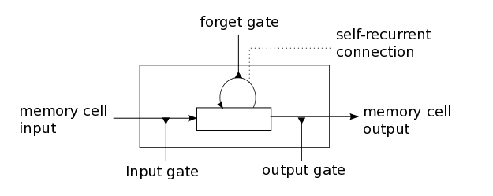
Our models
——The method to do prediction
LSTM introduces a structure called a memory cell .
The memory cell is composed of four main elements:
input gate, forget gate, output gate, self-recurrent connection.

Slide 19
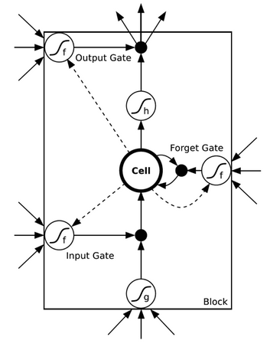
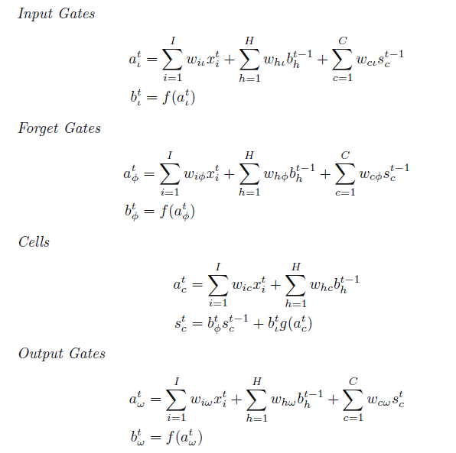
Our models
——The method to do prediction
The model LSTM

Slide 20
Conclusion
What we have:
Some preliminary metrics collected by Schlumberger:
Percent Comment Lines
Percent Documentation Lines
Classes, Interfaces, structs
Methods per Class
Calls per Method
Statements per Method
Line Number of Most Complex Method*
Maximum Complexity*
Line Number of Deepest Block
Maximum Block Depth
Average Block Depth
Average Complexity*

Slide 21
Conclusion (what we will do)
Some preliminary steps：
Further solutions：
Correlation analysis
Simple model between risk and metrics
- Partial least square regression
- Support vector regression
More metrics
More complex model
- temporal information (Time series analysis with LSTM)
- Risk caused by programmer
Risks
Chances

Slide 22
Conclusion (time line)
Nov. 4, 2016
Jan. 5 2017
Feb. 15~20 2017
Apr. 15, 2017
May 20, 2017
June 1, 2017
Dec. 9, 2016
Preliminary results
Evaluation
More metrics
Model optimization
The final adjustment
Discussion
Problem definition
Decision：
a preliminary expected result with the metrics we have already and simple model

Slide 23
Conclusion (division)
Gilles & Robin
Metric processing Data cleansing
Model construction
Victor &Henry

Slide 24
Thank you !

