Slide 1
Our models
The
Method
To
do
prediction
Servces
metrics
severity
0
1
2
3
4
5

Slide 2
Metrics Preprocessing
Why we make metrics preprocessing?
There are some metrics containing the same information.
Too many variable will make it difficult to find their relations.
The objective of metrics preprocessing
Reduce the dimension of the data.
Make the metrics independent.

Slide 3
Metrics Preprocessing
Principal component analysis (PCA):
a statistical procedure.
uses an orthogonal transformation to convert a set of observations of possibly correlated variables into a set of values of linearly uncorrelated variables called principal components.
The number of principal components is less than or equal to the number of original variables.
Servces

Slide 4
The method to do prediction
The traditional method of machine learning
SVM (Support vector machine)
The method of deep learning
MLP (Multilayer Perceptron)
LSTM (Long Short Term Memory )
Servces

Slide 5
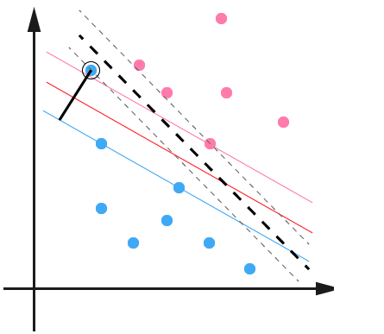
The method to do prediction
SVM (Support vector machine)
constructs a hyper-plane or set of hyper-planes in a high- or infinite-dimensional space, which can be used for classification.
Servces

Slide 6
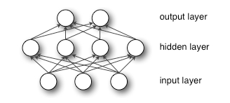
The method to do prediction
MLP (Multilayer Perceptron)
a feed-forward artificial neural network model that maps sets of input data onto a set of appropriate outputs.
An MLP consists of multiple layers of nodes in a directed graph, with each layer fully connected to the next one.
Servces

Slide 7
The method to do prediction
LSTM (Long Short Term Memory )
LSTM is a class of artificial neural network
LSTM can memorize the previous hiddent state, and deliver it to the next state.
The advantage of LSTM
RNN can build the realation between the data in diffrent days.

Slide 8
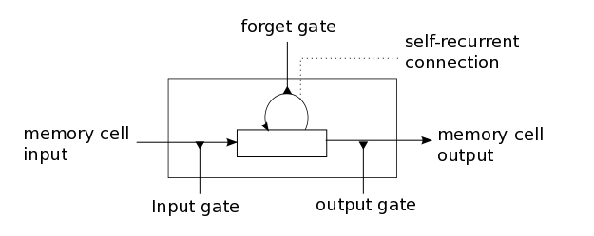
The method to do prediction
LSTM introduces a structure called a memory cell .
The memory cell is composed of four main elements:
input gate, forget gate, output gate, self-recurrent connection.

Slide 9
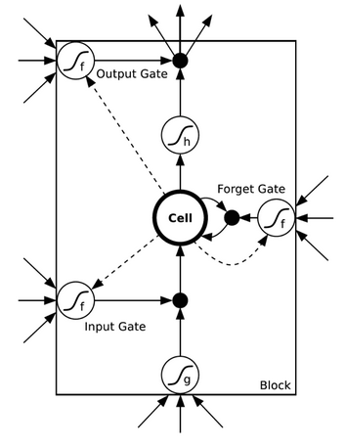
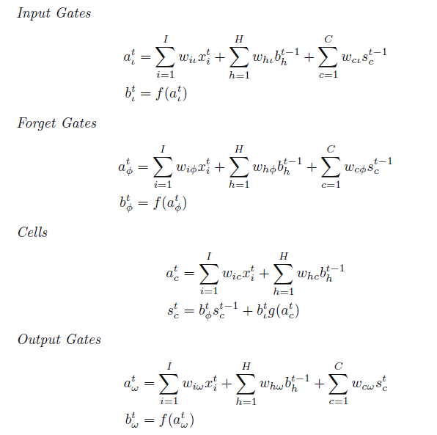
The method to do prediction
The model LSTM

