Slide 1
Maxwell Metrics-based bug prediction model

Slide 2
Precisely defined question
Maxwell: is a real time acquisition software.
Question: There are Changesets, and they will cause bug. Lines of Code are so big that they can’t be test one by one.
Our task: make a model →Predict which change sets are more likely to cause a bug so we can focus our testing efforts on these.
1

Slide 3
Features
Total LOC | The number of lines of non-commented executable lines in the files comprising the new version of a binary.
Churned LOC | The sum of the added and changed lines of code between a baseline version and a new version of the files comprising a binary.
Deleted LOC | The number of lines of code deleted between the baseline version and the new version of a binary.
File count | The number of files compiled to create a binary.
Weeks of churn | The cumulative time that a file was opened for editing from the version control system.
Churn count | The number of changes made to the files comprising a binary between the two versions
Files churned | The number of files within the binary that churned.
2

Slide 4
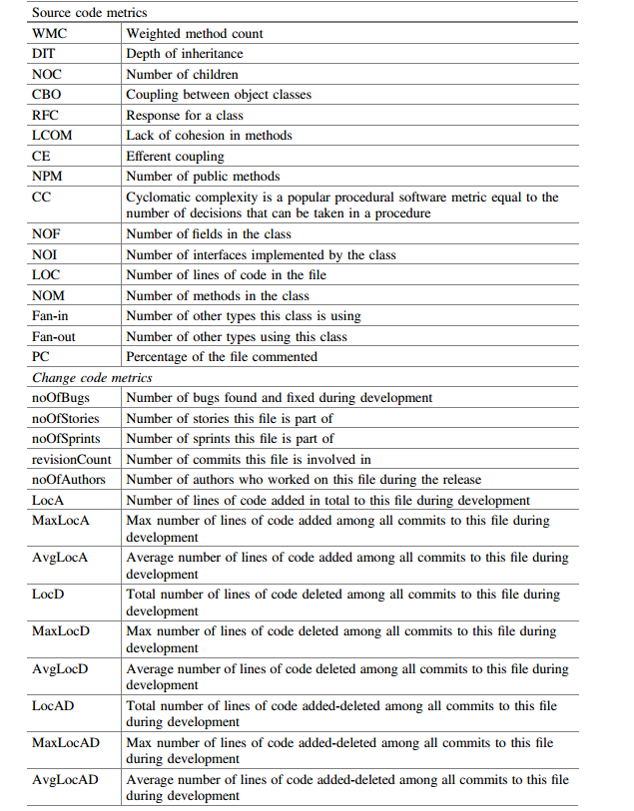
Features
参考word 和论文
2

Slide 5
Machine learning algorithms
MLP(Multilayer Perceptron)
SVM(Support Vector Machine)
CNN(Convolutional Neural Networks)
LSTM(Long Short Term Memory)
PCA(Principal Component Analysis)
DA(Denoising Autoencoders)
3

Slide 6

Overall workflow and concept
feature1
feature2
Machine
learning
algorithms
feature3
predict
Calculate
effort
feature4
······
feature
The predict index is file defect density.
effort is proportional to the number of test cases one has to perform manually
4

