Slide 1
Part 1
metrics considered valuable for risky change-set identification.

Slide 2
Code churun
Total added, modified and deleted LOC
Number of times that a binary was edited
Number of consecutive edits

Slide 3
Code complexity
Cyclomatic complexity
Fan-in\fan-out of function
Lines of code
Weighted methods per class
Depth of inheritance
Coupling between objects
Number of subclasses
Total global variables

Slide 4
Dependencies
Incoming\ outgoing direct\ indirect dependencies to a binary
Layer information: distance of a binary from the system kernel

Slide 5
Pre-release defects
Number of pre-release bugs found in a binary
Strong relationship between development defects per module and field defects per module

Slide 6
Edit frequency
Number of edits: The more edits to components the higher the instability and lower the quality

Slide 7
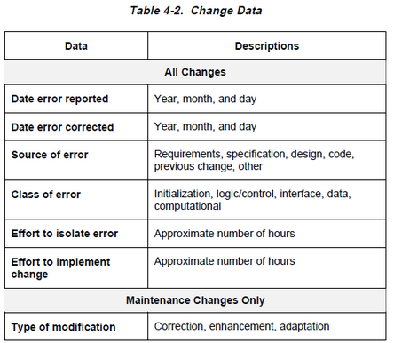
errors

Slide 8
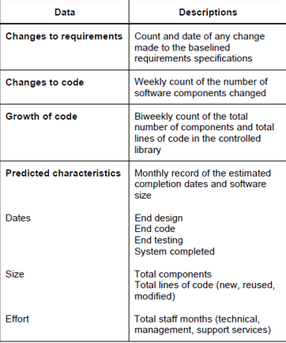
Project dynamics data

Slide 9
Part 2
mathematic algorisms considered to use in risk factors evaluation.

Slide 10
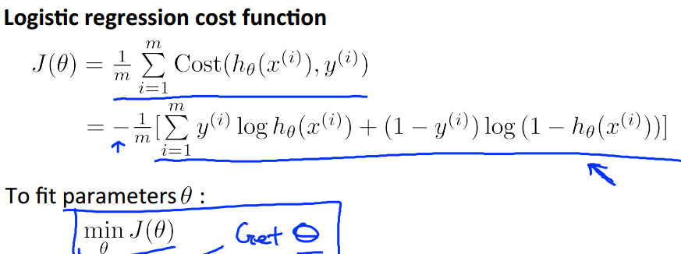
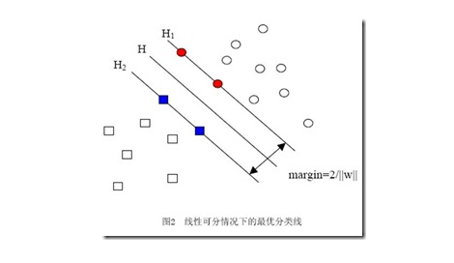
traditional machine learning
1.1 LR
1.2 SVM
Svm is to find a hyperplane to make the
dataset far away from the hyperplane.

Slide 11
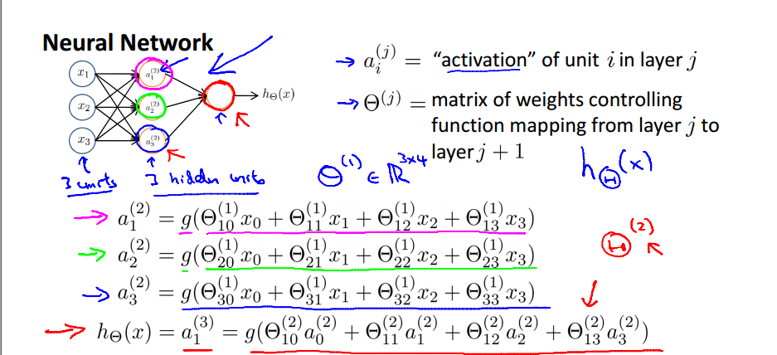
neural network

Slide 12
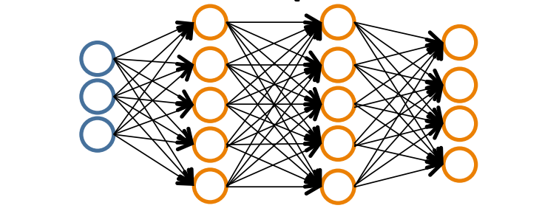
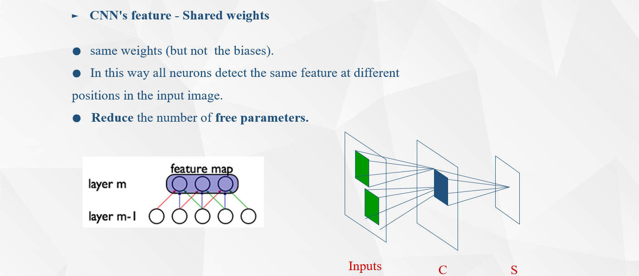
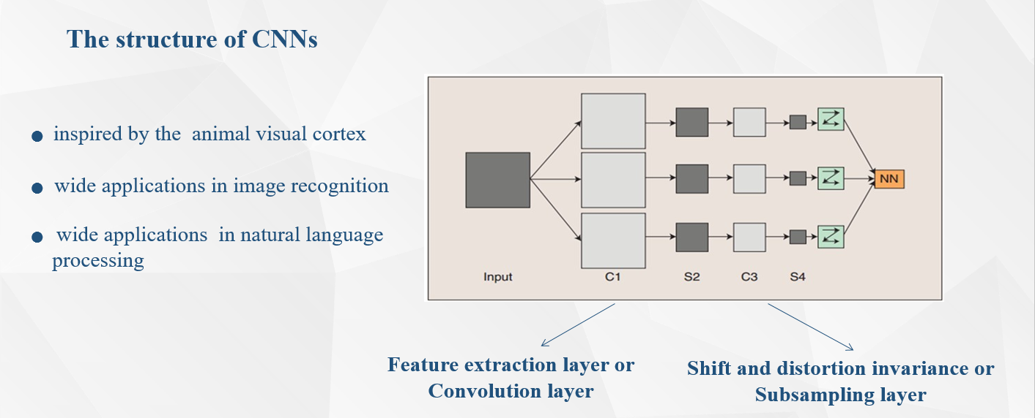
deep learning
3.1 MLP
3.2 CNN

Slide 13
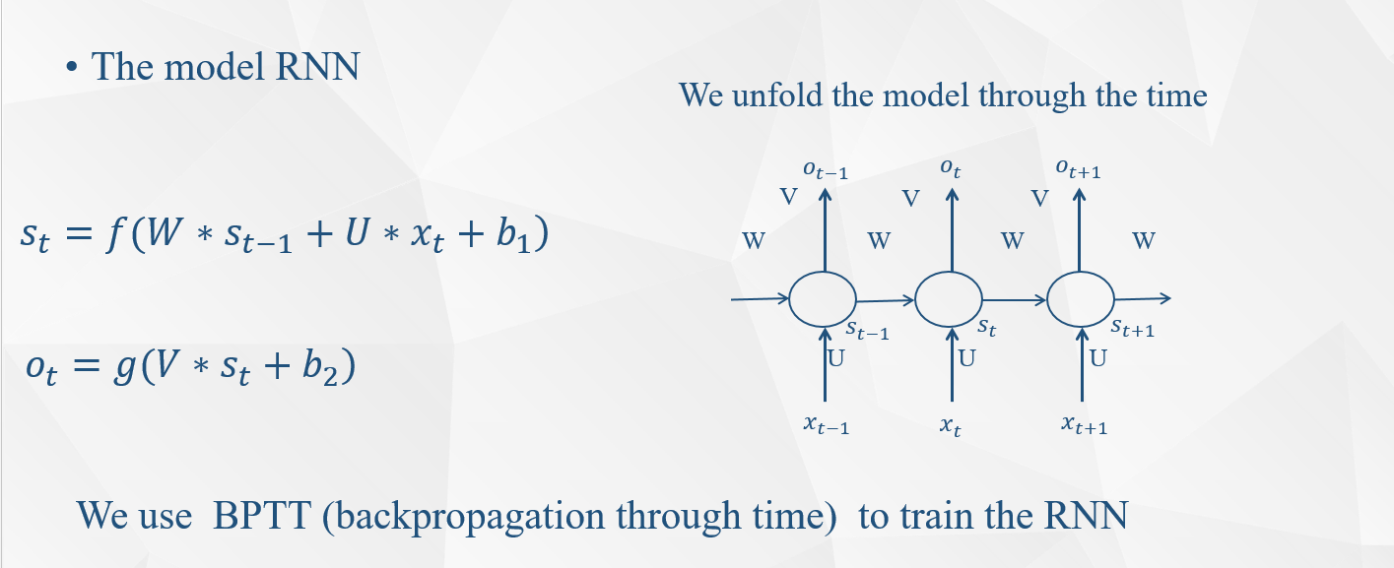
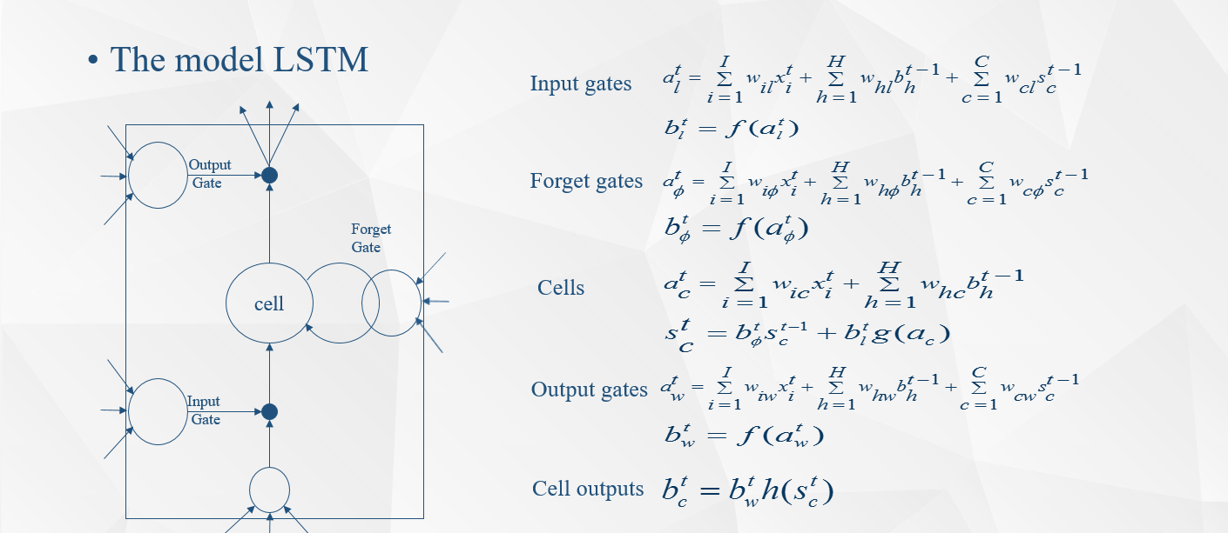
deep learning
3.3 LSTM

Slide 14
dimensionality reduction
4.1 PCA
Principal component analysis (PCA) is a statistical procedure that uses an orthogonal transformation to convert a set of observations of possibly correlated variables into a set of values of linearly uncorrelated variables called principal components. The number of principal components is less than or equal to the number of original variables. This transformation is defined in such a way that the first principal component has the largest possible variance (that is, accounts for as much of the variability in the data as possible), and each succeeding component in turn has the highest variance possible under the constraint that it is orthogonal to the preceding components. The resulting vectors are an uncorrelated orthogonal basis set. PCA is sensitive to the relative scaling of the original variables.

Slide 15

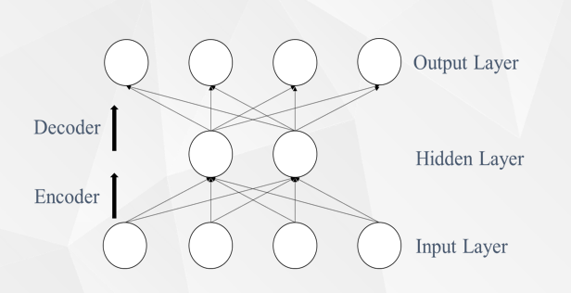
dimensionality reduction
4.2 DA

Slide 16
Step-wise regression
Forward selection, which involves starting with no variables in the model, testing the addition of each variable using a chosen model fit criterion, adding the variable (if any) whose inclusion gives the most statistically significant improvement of the fit, and repeating this process until none improves the model to a statistically significant extent.
Backward elimination, which involves starting with all candidate variables, testing the deletion of each variable using a chosen model fit criterion, deleting the variable (if any) whose loss gives the most statistically insignifiant deterioration of the model fit, and repeating this process until no further variables can be deleted without a statistically significant loss of fit.
Bidirectional elimination, a combination of the above, testing at each step for variables to be included or excluded.

