Slide 1
TS Spring
Day 3: Aspect-oriented programming

Slide 2
Introduction
https://github.com/banckaert/ts-spring-aop
Why this course?
AOP is a powerful tool
AOP is a fundamental part of the Spring Framework (and Java EE)
⬄
Seldom used to its full potential
Trainings and books on the subject are often academic and unpractical

Slide 3
Overview
Why Aspect-oriented Programming (AOP)?
How AOP helps to solve problems in enterprise applications
My First Aspect
First example of an aspect
Advices
What code can be used in aspects?
Pointcuts
How to define where aspects are added to your application

Slide 4
Overview
Aspects and Architecture
Expressing architecture using Pointcuts
Make architecture a part of your application
Spring AOP: under the hood
How Aspects are added to Objects
Deeper understanding about Spring’s AOP internals
Spring AOP: Spring Aspect Library
Out-of-the-box aspects for your application
Aspects, the real world
Some ideas for your own aspects

Slide 5
Why Aspect-oriented Programming (AOP)?
Why AOP?
Reducing Boiler Plate Code using AOP
How AOP Works
Cross-Cutting Concerns
Summary

Slide 6
Why AOP?
What is AOP?
Aspect Oriented Programming (AOP)
Complements Object Oriented Programming (OOP)
Unit of modularisation: OOP Class vs. AOP Aspect
Modularisation across types and objects (Cross Cutting Concerns)
What does AOP bring to the table?
AOP reduces Boiler Plate Code
AOP is used to add enterprise features to your application

Slide 7
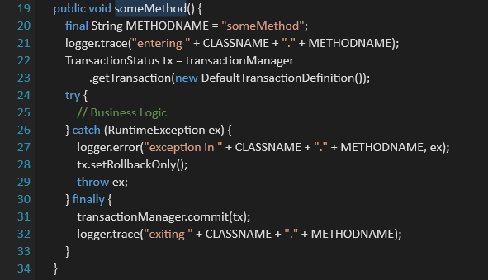
Reducing Boiler Plate Code using AOP (1/5)

Slide 8
Reducing Boiler Plate Code using AOP (2/5)
Logging
Transactions
Exception Handling

Slide 9

Reducing Boiler Plate Code using AOP (3/5)
Logging
Transactions
Exception Handling

Slide 10
Reducing Boiler Plate Code using AOP (4/5)
Logging
Transactions
Exception Handling

Slide 11
Reducing Boiler Plate Code using AOP (5/5)
Logging
Transactions
Exception Handling

Slide 12
How AOP Works
Package
Package
Package
Class
Class
Class
Class
Class
Class
Class
Class
Class

Slide 13
How AOP Works
Package
Package
Package
Class
Class
Class
Class
Class
Class
Class
Class
Class
Logging

Slide 14
How AOP Works
Package
Package
Package
Class
Class
Class
Class
Class
Class
Class
Class
Class
Logging
Transactions

Slide 15
How AOP Works
Package
Package
Package
Class
Class
Class
Class
Class
Class
Class
Class
Class
Logging
Transactions
Exception Handling

Slide 16
How AOP Works
Package
Package
Package
Class
Class
Class
Code Tangling
Class
Class
Class
Class
Class
Class
Logging
Transactions
Exception Handling

Slide 17
How AOP Works
Package
Package
Package
Class
Class
Class
Class
Class
Class
Class
Class
Class
Logging
Transactions
Exception Handling
Code Scattering

Slide 18
How AOP Works
Package
Package
Package
Class
Class
Class
Class
Class
Class
Class
Class
Class
Logging
Transactions
Exception Handling

Slide 19
How AOP Works
Package
Package
Package
Class
Class
Class
Class
Class
Class
Class
Class
Class
Transaction Aspect

Slide 20
How AOP Works
Package
Package
Package
Class
Class
Class
Class
Class
Class
Class
Class
Class
Logging Aspect
Transaction Aspect

Slide 21
How AOP Works
Package
Package
Package
Class
Class
Class
Class
Class
Class
Class
Class
Class
Logging Aspect
Transaction Aspect
Exception Handling Aspect

Slide 22
Cross-Cutting Concerns
Logging, Transactions and Exception Handling
OOP: Different classes contain same/similar code
⬄
AOP: centralized implementation
Notes:
▪ Tracing, Exception Handling and Transactions are cross-cutting concerns ▪ i.e. a lot of classes and methods must implement them
▪ Can’t be implemented in a single place ▪ …if you use object-oriented programming only
▪ Aspect-oriented programming allows centralized implementation of cross-cutting concerns

Slide 23
Summary
Without AOP cross-cutting concerns are introduced across the code
Mostly of a technical nature
Logging
Exception handling
Transactions
Security
…
Result
Code tangling: Multiple concerns in each piece of code
Code scattering: Aspects are not implemented in one place
Aspect-oriented programming resolves these issues
Exercise - aop01

Slide 24
My First Aspect
What is an Aspect?
JoinPoint
My First Aspect
Weaving
Spring configuration
Summary

Slide 25
What is an Aspect?
Aspect implements cross cutting concern
‘that scattered code’
Boiler Plate Code
Aspect
=
Pointcut
Where the Aspect is applied
(Set van Joinpoints)
+
Advice
What Aspect code is executed

Slide 26
JoinPoint
Point in the control flow of a program
Advices are provided with information about the join point
Class name
Method name

Slide 27
My First Aspect
Logging

Slide 28
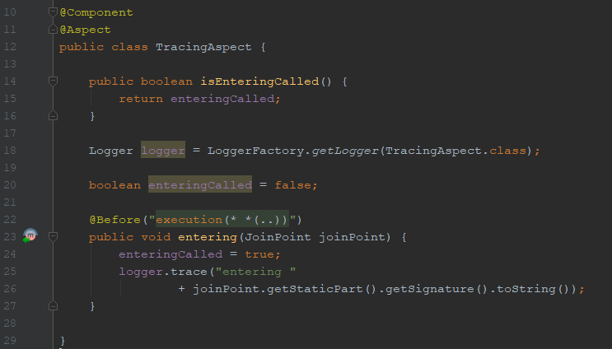
My First Aspect

Slide 29
Weaving
The process of adding Advices to the main program code at the configured JoinPoints

Slide 30
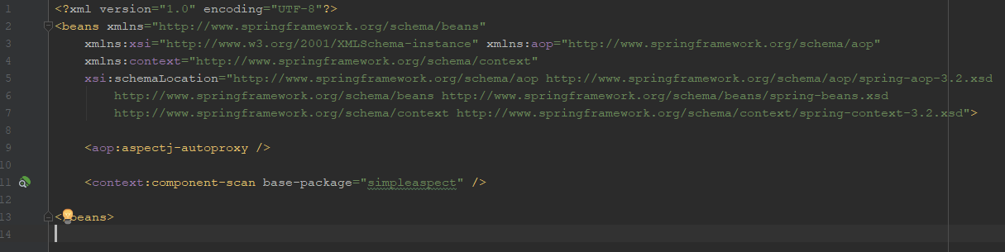
Spring configuration - XML

Slide 31
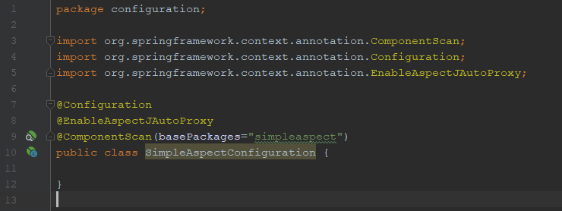
Spring configuration - Java

Slide 32
Summary
Aspect =
Advice – what code is executed +
Pointcut – where the code is executed
Aspects are Spring Beans
@Aspect
Advices are methods
@Before annotation
With pointcut expression
Activate AOP
XML or
Java Config
Exercise - aop02

Slide 33
Advices
So far: “Before” Advices
There’s more

Slide 34
Advices – Types of Advices
Method

Slide 35
Advices – Types Advices
Before
Methode

Slide 36
Advices – Types Advices
Before
Methode
After

Slide 37
Advices – Types Advices
Before
Methode
After
After Throwing

Slide 38
Advices – Types Advices
Before
Methode
After
After Throwing
After Returning

Slide 39
Advices – Types Advices
Before
Around
Methode
After
After Throwing
After Returning

Slide 40
Advices – Before
Before
Around
Methode
After
After Throwing
After Returning

Slide 41
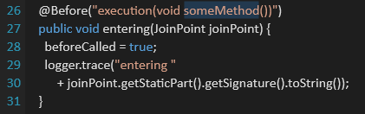
Advices - Before
Execution BEFORE the method
Exception
=> prevents method execution
=> propagated to caller

Slide 42
Advices – After
Before
Around
Methode
After
After Throwing
After Returning

Slide 43
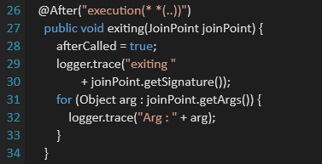
Advices – After
Execution AFTER the method
Exception
=> could have been thrown
=> or method could have been executed successfully

Slide 44
Advices – After Throwing
Before
Around
Methode
After
After Throwing
After Returning

Slide 45
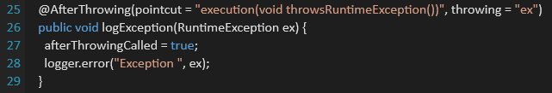
Advices – After Throwing
Execution AFTER the method THREW an exception
Exception
=> propagated to caller
=> can be accessed from code
=> Type Safe: e.g. only executed if a RuntimeExceptionis thrown

Slide 46
Advices – After Returning
Before
Around
Methode
After
After Throwing
After Returning

Slide 47
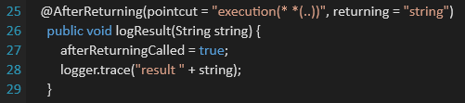
Advices – After Returning
Execution AFTER the method RETURNED successfully
Result can be accessed from code
Type Safe: e.g. only called if a String is returned

Slide 48
Advices – Around
Before
Around
Methode
After
After Throwing
After Returning

Slide 49
Advices – Around
Wraps AROUND the method
Prevent method execution
… even without throwing an exception (<> Before Advice)
=> only advice that can catch exceptions
=> only advice that can modify return value
Current method call is passed to the Advice
ProceedingJoinPoint
Can be executed or skipped

Slide 50
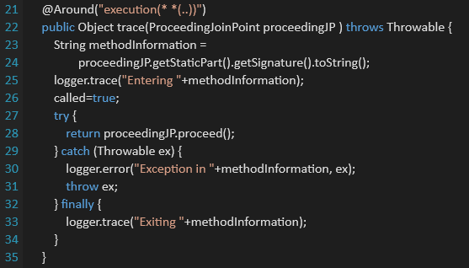
Advices – Around
Notes:
Current method call is passed to the Advice
ProceedingJoinPoint
Can be executed or skipped

Slide 51
Advices – Around
Most powerful advice
=> can be used instead of Before and After
=> powerful but complex
With great power comes great responsibility

Slide 52
Advices
Exercise - aop3

Slide 53
Pointcuts
So far: aspects on specific methods or all methods
There’s more

Slide 54
Pointcuts
Pointcut Expressions
On Packages and Classes
On Annotations
On Spring Beans
Combining Pointcuts
Pointcut Reuse
Summary

Slide 55
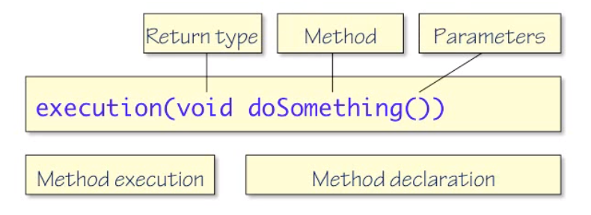
Pointcut Expressions
@PointCut
Defines where an aspect is added to the program flow
Pointcut expression language = SQL for code
Wildcards, wildcards, wildcards…

Slide 56
Pointcut Expressions
execution(* hello())
Method: hello
Parameters: none
Return type: any
execution(* hello(int, int))
Method: hello
Parameters: 2 x int
Return type: any

Slide 57
Pointcut Expressions
execution(* hello(*))
Method: hello
Parameters: 1 parameter of any type
Return type: any
execution(* hello(..))
Method: hello
Parameters: any number of parameters of any type
Return type: any

Slide 58
On Packages and Classes
execution(int com.axxes.services.Service.hello(int))
Method: hello
Class: Service
Package: com.axxes.services
Parameters: 1 parameter of type int
Return type: int
execution(* com.axxes..*Service.*(..))
Method: any
Class: with class name ending with Service
Package: com.axxes or sub package
Parameters: any number of parameters of any type
Return type: any

Slide 59
On Packages and Classes
execution(* *.*(..))
Method: any
Class: any
Package: default
Parameters: any number of parameters of any type
Return type: any
execution(* *..*.*(..))
Method: any
Class: any
Package: any package or sub package
Parameters: any number of parameters of any type
Return type: any

Slide 60
On Annotations
execution(@com.axxes.annotations.Annotation * *(..))
Annotated method
execution(* (@ com.axxes.annotations.Annotation *).*(..))
Annotated class
Notes:
fully qualified class name of the Annotation

Slide 61
On Spring Beans
bean(*Service)
Bean name default: class name
Beans definition
Java Config: @Bean method name
Annotation: parameter to @Component, @Service, @Repository
XML: name / id attribute of bean element

Slide 62
Combining Pointcuts
Boolean operators: &&, ||, !, …
execution(* service.*.*(..)) || execution(* repository.*.*(..))

Slide 63
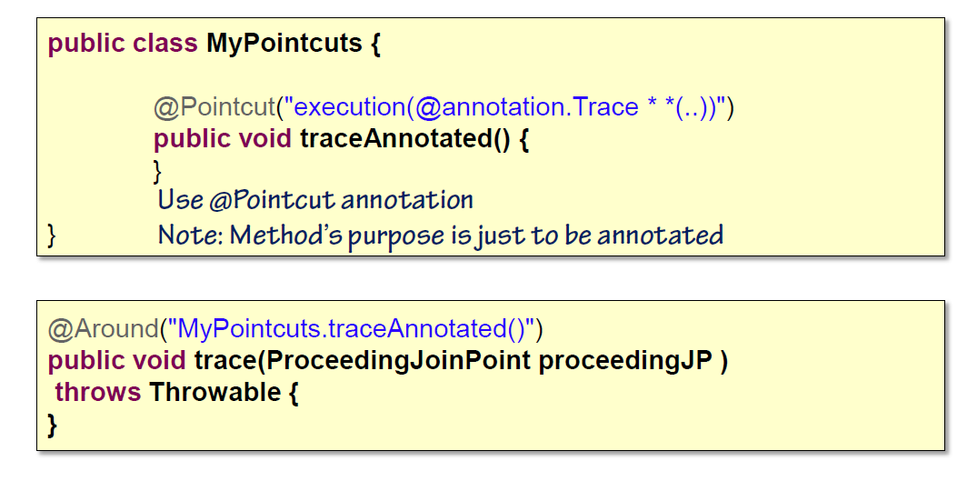
Pointcut Reuse
Problem: Pointcut expression repeated every time a pointcut is used => Solution: Around Advice on annotated stub

Slide 64
Summary
Pointcuts: Where should an advice be added?
Pointcut Expressions, use of wildcards
Pointcuts through:
Methods (within class on classpath)
Annotations
Bean names
Combine and reuse Pointcuts
Exercise – aop04

Slide 65
AOP and Architecture
Problems with Architecture
Criticism on AOP
Architecture in terms of Aspects, a plan
Summary

Slide 66
Problems with Architecture
Architecture in documents
Not read
Not followed
Lots of boilerplate code
< = >
Architecture in code => AOP to the rescue!

Slide 67
Problems with Architecture
For each call to a service
Call must be traced
Exceptions must be logged
For each call to a repository
Call must be traced
Performance must be traced
Exceptions must be logged
=>
Specific behavior should be added
Tracing, exception handling, …
… to specific parts of the the architecture
Repositories, services etc

Slide 68
Criticism on AOP
Control flow is obscured
Pointcut may depend on runtime condition
=>
AOP adds random code to random parts of the system
It is hard to reason about the system
What happens when?
<=>
Not true when AOP is used properly

Slide 69
Architecture in terms of Aspects, a plan
Aim: Add behavior to parts of the architecture using AOP
Methodology:
Step 1 : Define architecture as Pointcuts
Step 2 : Define behavior using Advices
Step 3 : Add Advices to correct Pointcuts
Result: No more technical boiler plate

Slide 70
Summary
AOP adds behavior to specific parts of the system
Pointcuts can express architecture
Should be added to the project early
No Exercise -> LAB at the end of the session!

Slide 71
AOP in Spring (How It Works)
Proxies
Local Method Calls
Pitfalls of proxies
How proxies are implemented
Limits of proxies
Summary

Slide 72
Proxies
Proxy
Other Spring Beans
Spring Bean
Advice
Proxy looks like original object
Proxy is injected in other Spring Beans
Interfaces -> Dynamic Proxies
Otherwise -> CGLIB generated sub classes

Slide 73
Local Method Calls
Proxy
Other Spring Beans
Spring Bean
Advice
Call never reaches proxy
=> No call to Advice

Slide 74
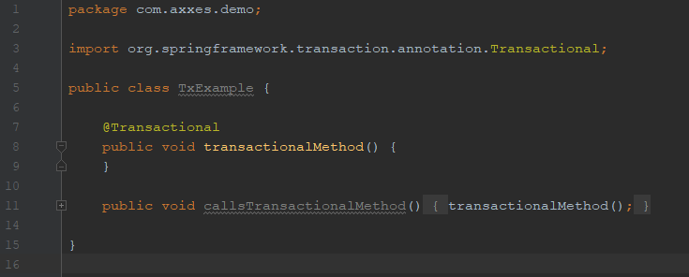
Pitfalls of proxies
@Transactional is implemented using Spring AOP
@Transactional will not be evaluated when called via callsTransactionalMethod()

Slide 75
How proxies are implemented
Dynamic Proxies
Feature of the JDK
Allow dynamic method dispatch
For interfaces only
CGLIB is used
Byte code instrumentation library
Subclass dynamically create subclass
Subclass implements the proxy
When no interface is implemented
Or if proxy-target-class is set to true

Slide 76
Limits of proxies
Work only on public methods
-> No protected, private
Works only on methods calls from outside
Spring Dependency Injection makes it transparent

Slide 77
Summary
Spring AOP uses proxy based AOP
CGLIB (subclasses)
or Dynamic Proxies (interfaces)
DI makes proxies transparent
Beware: Call on the local object will not go through the proxy
Can write code to create proxies
Exercise – aop05
Notes:
@EnableAspectJAutoProxy(proxyTargetClass = true)

Slide 78
AOP in Spring (Spring Aspect Library)
Spring offers some Aspects OTB
Apply to most common usage of Aspects
Caching
Exception handling
Logging
Transactions
…
High Quality Code (Open Source)
Save time & effort

Slide 79
AOP in Spring (Spring Aspect Library)
Logging

Slide 80
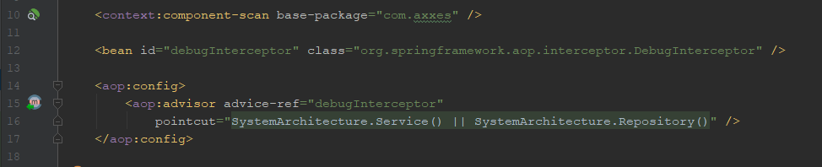
The Spring Context

Slide 81
Other Tracing Aspects
Package org.springframework.aop.interceptor
CustomizableTraceInterceptor: Can customize the trace output
SimpleTraceInterceptor: Basic information
DebugInterceptor: Full information
…
PerformanceMonitorInterceptor: Performance measurement in ms
=>
There’s plenty available OTB
Notes:
https://docs.spring.io/spring/docs/current/javadoc-api/org/springframework/aop/interceptor/package-summary.html

Slide 82
Other Aspects
Caching, Exception handling, Logging, Transactions,… and Security
AsyncExecutionInterceptor to process method calls asynchronously
ConcurrencyThrottleInterceptor to limit the number of threads in an object
…

Slide 83
AOP in Spring (Spring Aspect Library)
Transactions
Notes:
Can add @Transactional annotation To method or class
Could we use pointcuts?

Slide 84
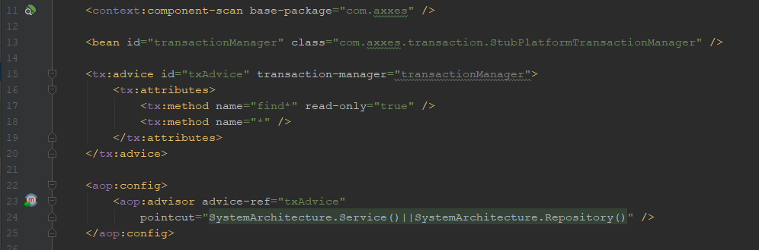
The Spring Context

Slide 85
Summary
Spring provides a library of aspects
Include tracing, transactions…
Using pointcuts enterprise services can be transparently added to the business logic
Exercise – aop06a (tracing) and aop06b (transactions)

Slide 86
Aspects, the real world
Spring’s aspect library contains some interesting aspect
But can we do more?
Which challenges you suppose can be solved with AOP?

Slide 87
Example 1:Retry
Retry a method call if it fails
Can help to resolve transient failures
Exercise – aop07a

Slide 88
Retry
Don’t use
If a service is not accessible:
Calls are buffered
Calls pile up
The service comes up again
immediately swamped with requests
go down again
Not very smart
Especially when calling external systems

Slide 89
Example 2: Circuit Breaker
If an error occurs the circuit breaker breaks the circuit
service is not called anymore
exception is immediately forwarded to the caller
After a while the service is called again
retry after some time
or retry after number of calls
If the call succeeds the circuit breaker is closed again
Exercise – aop07b

Slide 90
Circuit Breaker
Usable, but room for improvement
After a failure slowly ramp up
Incorporate a STRATEGY
isAvailable() : boolean
reportSuccess()
reportFailure()
…
Use a fallback
Default value
Simplified service
Cache

Slide 91
Example 3: JPA / JDBC
Problem: JPA contains a cache
Changes are not immediately propagated to the database
JDBC calls might see incorrect data
=>
Solution: Flush EntityManager every time a JDBC call happens
Exercise – aop07c

Slide 92
Example 4: Context Security
Customer may only see his Account
Account is a domain object – no Spring Bean
Exercise – aop07d

Slide 93
Summary
Manipulate how a method is called
Exception Handling
Record calls
Filter
Adjust return values
…

Slide 94
Aspects - LAB
Free exercise based on the project from the first 2 days

