Slide 1
Econ Meeting Notes
2022-02-15

Slide 2
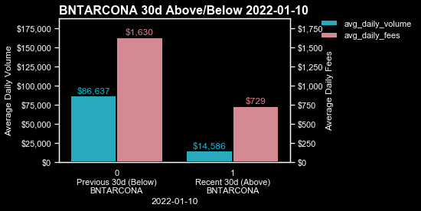
BNTARCONA

