Slide 1
Sales & Financial Dashboard Summary
Automated PPT Summary

Slide 2
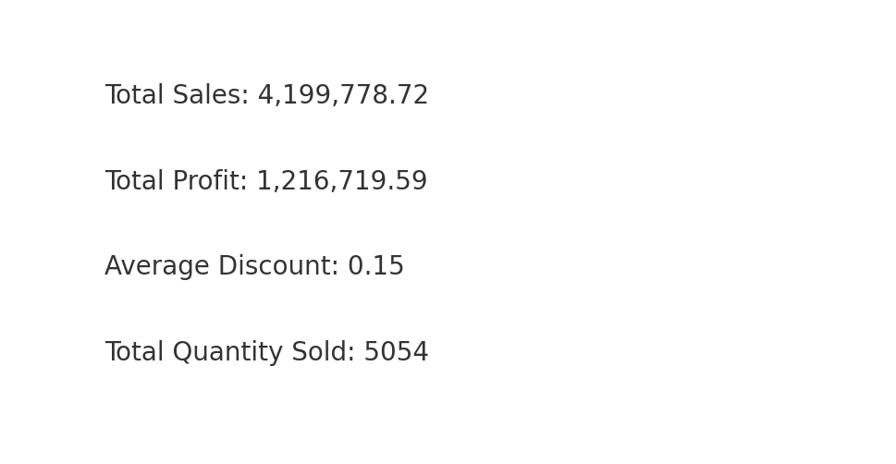
Key Performance Indicators

Slide 3
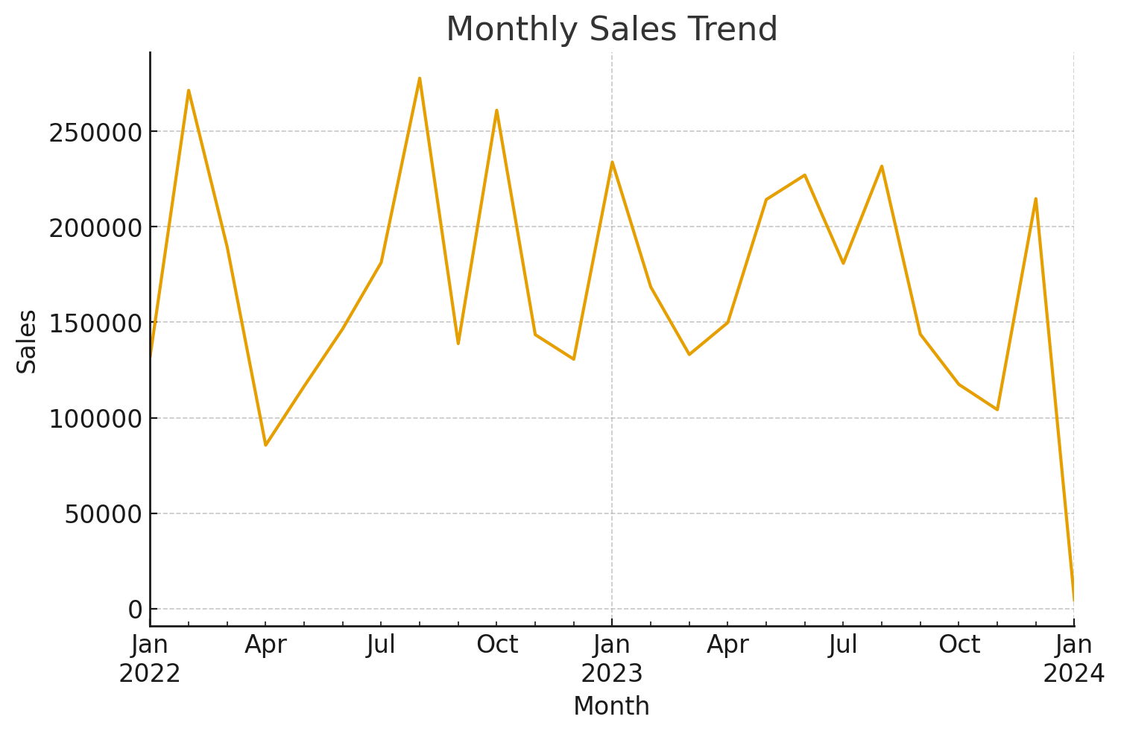
Sales Trend Over Time

Slide 4
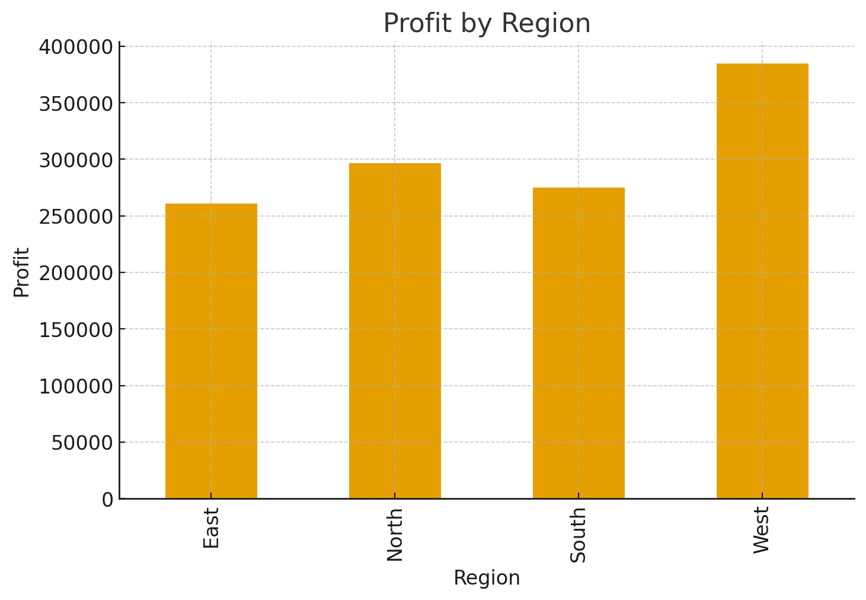
Profit by Region

