Slide 1
Title- Gene Expression analysis of lung adenocarcinoma and matched adjacent non- tumor lung tissue.
Organism- Homo sapiens
GSE Accession no.- GSE32863
Platforms- GPL6884
Illumina HumanWG-6 v3.0 expression beadchip
No. of samples- 116
Samples- GSM813411 to GSM813526

Slide 2
https://www.ncbi.nlm.nih.gov/geo/query/acc.cgi?acc=GSE32863
Before Filtration: 48804 genes
After Filtration: 18610 genes
P Value: 0.05
Upregulated Genes: 162
Downregulated genes: 413

Slide 3
Upregulated

Slide 6
Downregulated

Slide 9
Visualization Of Upregulated and Downregulated Genes
X axis-> Fold Change
1.5 -> Upregulated
-1.5 -> Downregulated
Y axis->P value

Slide 10
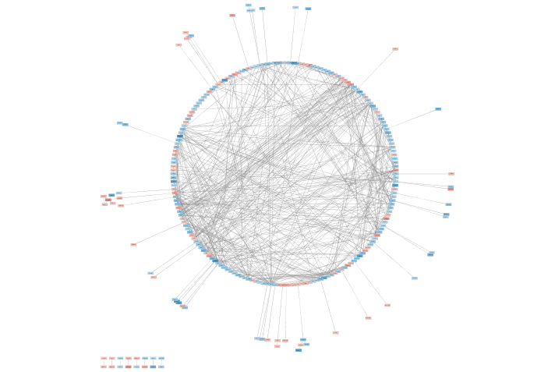
Molecular Interaction Network Using Cytoscape

Slide 11
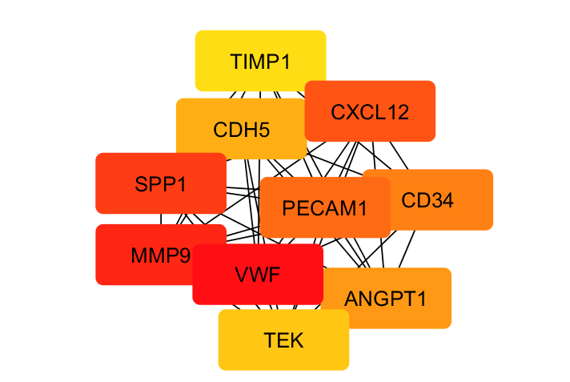
Top10 Highest Interaction Of Genes Using Cytohubba By MCC

